Slide 1




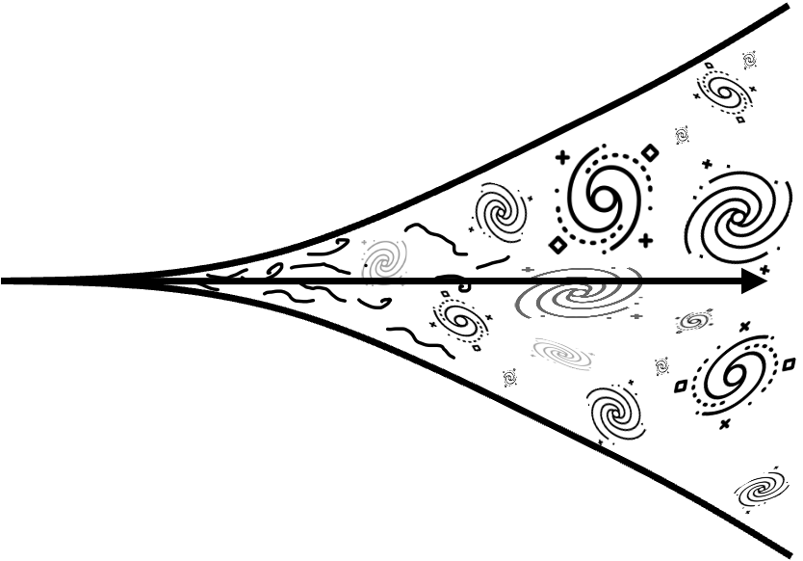


Shape of m₁ function
mass ratio
q
Effective spin
$$χeff$$
$\text{q}−χeff$
relation
z evolution
Channel
peak at
34
prefer equal
skewed positive
small slope/
narrow
with SFR
flat/rise
drop
P-PISN
I) Standard
?
?
?
?
II) Shoulder
?
?
?
?
III) CCSN-transition
?
?
?
?
~
Chemically Homogeneous
?
I) pure
~
II) quasi
?
?
Hierarchical
2g + 1g
?
?
~
?
?
2g + 2g
Globular clusters
~
?
Pop III
~
You shouldn’t go much smaller than this
Notes:
Why does the stable mass transfer channel drop below a certain mass?
Well in essence this is caused by the mass ratio dependence of mass transfer stability. Mass transfer is more stable for equal masses, and gets less stable at extreme mass ratios.
The stable MT channel is pretty fun because we can basically reduce it to a cartoonish representation of the key evolutionary steps.
This is possible because, compared to e.g. common envelopes, the stable channel is well constrained!
It turns out that the reverse mass transfer being stable, is a very crucial constraint in this channel and imposes a minimum on the BH mass.
I won’t bore you with the derivation

