Slide 1



Cosmology with Redshift Evolving Masses of Binary Neutron Stars
Soumendra Kishore Roy
Stony Brook University
Center for Computational Astrophysics, Flatiron Institute
With Lieke van Son (CCA), Anarya Ray (UWM), Will Farr (SBU/CCA)
April 6, 2024
APS April Meeting, Sacramento CA
https://github.com/SoumendraRoy/Seminars/tree/main/APS_2024
Caption
Caption
Caption

Slide 2
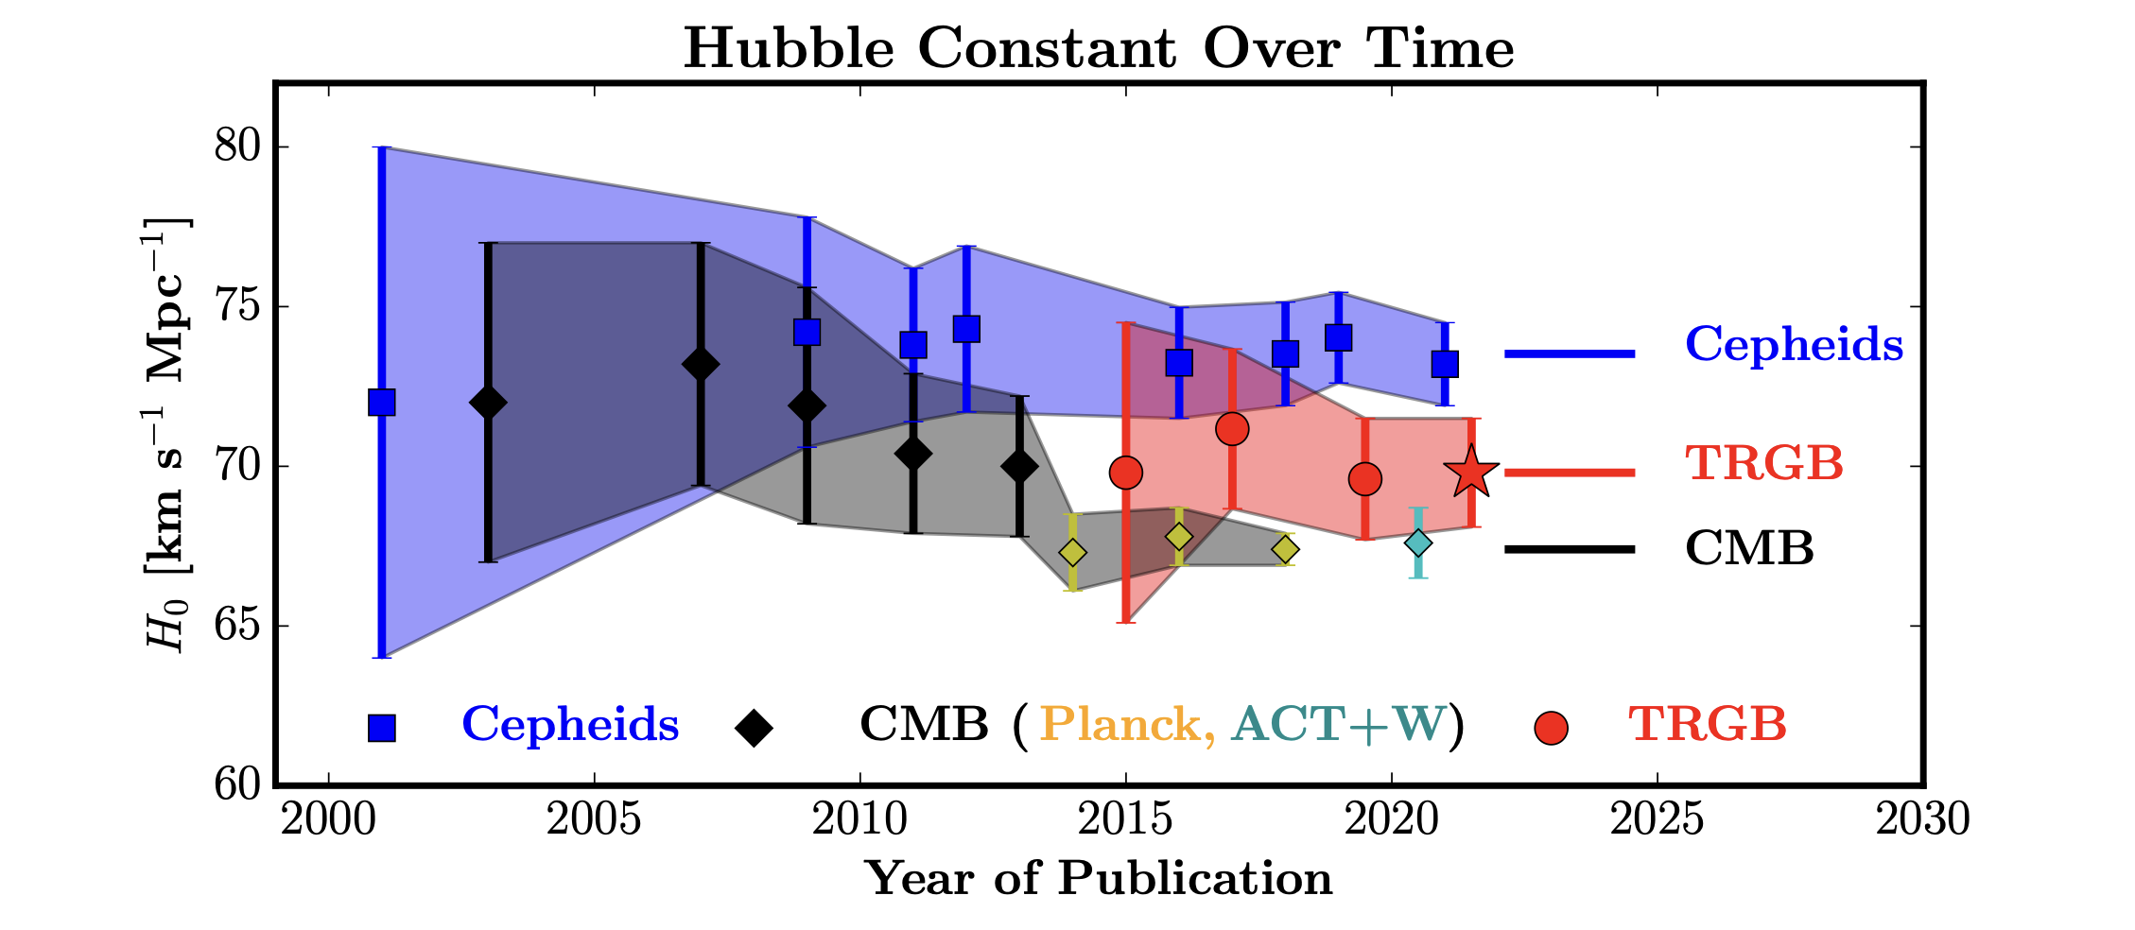
Measurement of Hubble Constant
T
Tension between Early and Late Universe Measurements
Freedman et al. 2021
SNe IA calibrated with Cepheids: Riess et al. 2021
Planck 2018: Planck Collaboration 2018
SNe IA calibrated with TRGB: Freedman et al. 2021

Slide 3
Distance vs Redshift
Standard Siren:
No Need to Use Distance Ladder
Well Modeled Selection Effect
Distance ✅
Redshift is Hard!
Electromagnetic Counterparts/ Galaxy Catalogs

Slide 4
Distance vs Redshift
Redshift Only with GWs:
$$m_{det}=m(1+z)$$
Measured
If We Know
We Can Infer

Slide 5
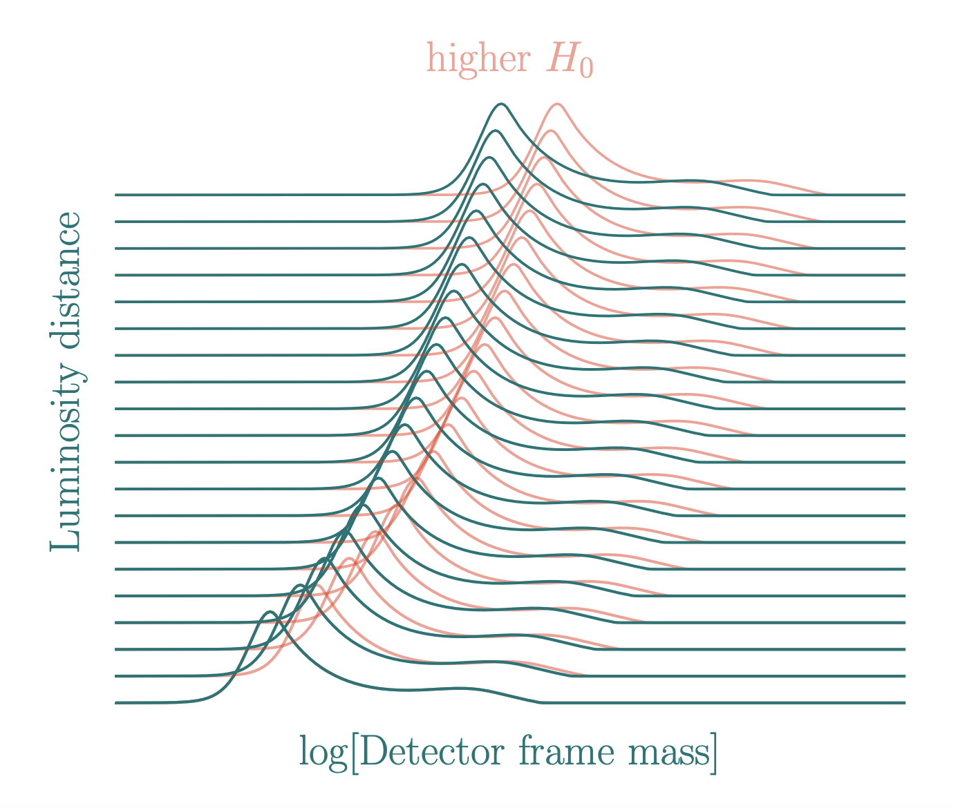
Distance vs Redshift
Spectral Siren:
First Done in Taylor et al. 2011
Chen et al. 2024
Redshift ✅

Slide 6
But…
$$m_{det}=m(1+z)$$
m needs to be ind. of z
Our Work: How Much Bias will We Get, if We don’t Assume z Evolving Mass Model in the Inference for a Pop of BNS with z Evolution

Slide 7

Method
Generate the Astrophysical Pop of $m_{1},m_{2},z$ with
Caption
Add PE Errors on $m_{1}^{det},m_{2}^{det},D_{L}$ at CE Sensitivity
Find Hierarchical Pos of Cosmo Params with Pop($m_{1},m_{2},z$) = Pop($m_{1},m_{2}$) Pop(z)

Slide 8
$$M_{c}=M_{c}(z)$$

Slide 9
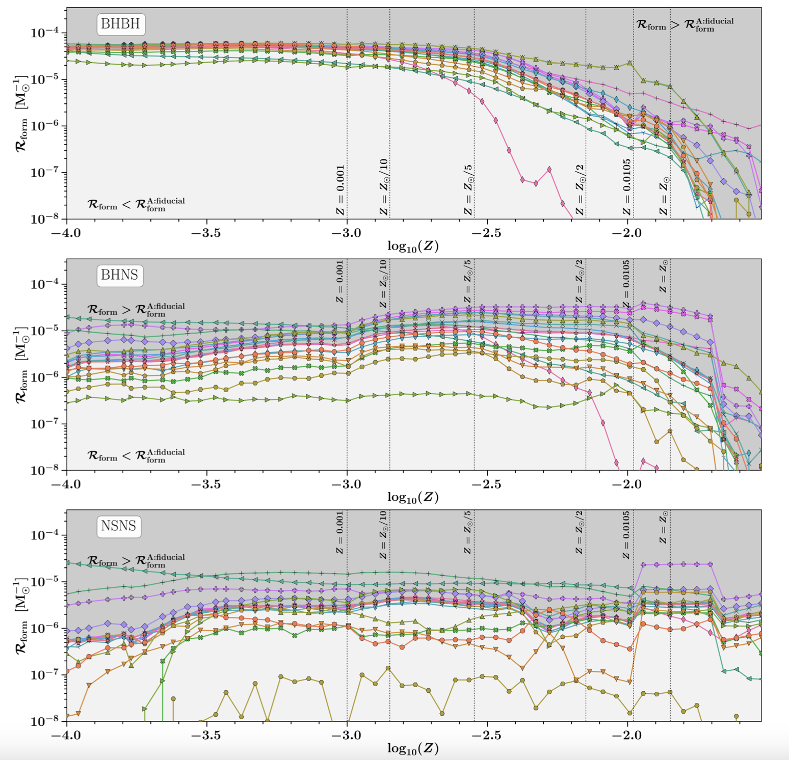
Is It Always the Case?
Broekgaarden et al. 2021
Consistent in All Different Pop Synth Simulations
Giacobbo & Mapelli 2018, Giacobbo et al. 2018, Klencki et al. 2018, Neijssel et al. 2019, Santoliquido et al. 2021, Iorio et al. 2023, and Fishbach & van Son 2023
Caption

Slide 10
Result

Slide 11
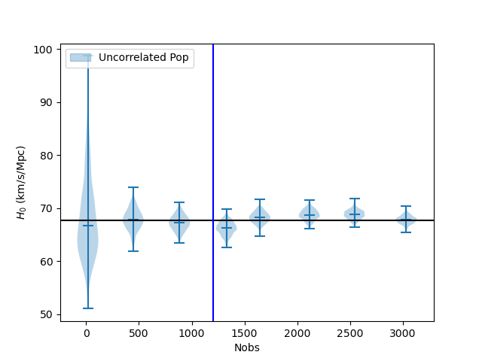
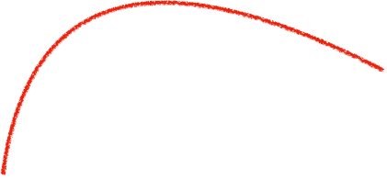
Hubble Constant
O(10 days)
% Level
O(23 days)
Planck18
Caption

Slide 12
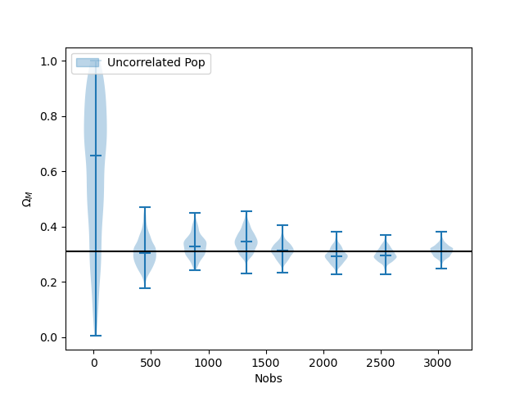
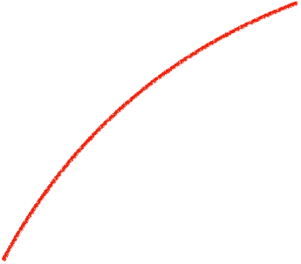
$$Ω_{M}$$
O(5%)
Planck18
Caption

Slide 13
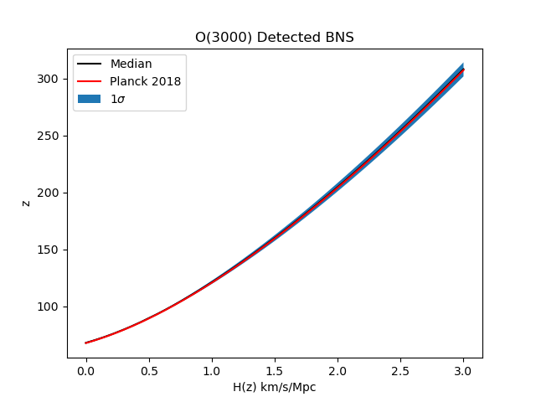
Hubble Parameter
Hz Best Constrained at z=0.34
Caption

Slide 14
Summary
We Don’t Need to Assume z Evolving BNS Mass Model to Get a Percent Level Constraint on $H_{0}$
We Get a Percent Level Spectral Siren Measurement of $H_{0}$ with O(10 days) observation in CE

