Slide 1
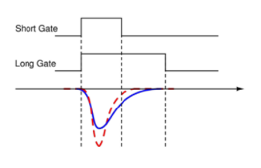
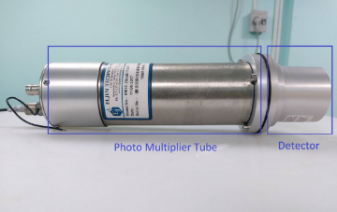
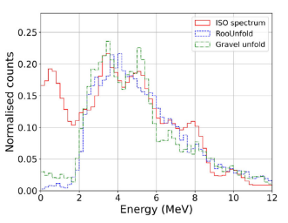
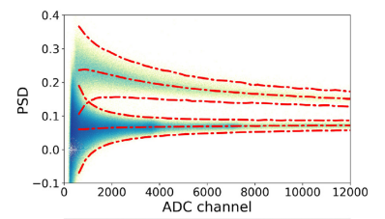

DIFFERENTIATION OF NEUTRON AND GAMMA RESPONSE FOR EJ-301 DETECTOR AT LOW ENERGIES
IDEA
Next, we perform unfolding, wherein we reconstruct the energy spectrum by using the detector response that is measured experimentally.
To take additional experimental data and assemble a template of pulse shapes for different ADC Channels.
Learning and implementing an appropriate ML algorithm (tSNE).
Short gate and long gate for two chosen pulses^{[2]}
Unfolding the energy spectrum and validating our findings against the ISO spectrum.
EJ-301 liquid scintillation detector and photo-multiplier tube^{[1]}
Pulse shape discrimination is a measure of the charge accumulated in the tail of the pulse over the total charge in the pulse.
In direct dark matter search experiments, fast neutrons are prevalent in the background and can mimic WIMP signals.
We plan on covering the first two baselines by the mid-semester examination.
$PSD=\frac{Qlong−−Qshort}{Qlong}$
Unfolded Am-Be spectrum^{[1]}
Both teammates will contribute towards all baselines since all of them are inter-dependent.
We use an Am-Be source which gives both neutron and gamma spectra. It is essential to differentiate between them.
Goal: Unfolding the Am-Be spectrum and validating it against the ISO spectrum, specifically below the 740 ADC Channel cut.
We have access to the dataset used for PSD and unfolding used to plot the previous figures, for both neutron and gamma signals.
The EJ-301 is a liquid scintillation detector. It shows excellent pulse shape discrimination and allows differentiation of neutron and gamma spectra.
BASELINES
To gain a thorough understanding of the physical phenomenon that govern our project.
Pulse shape discrimination achieved for Am-Be source. The upper band corresponds to neutron, the lower to gamma^{[1]}

Slide 2
DIFFERENTIATION OF NEUTRON AND GAMMA RESPONSE FOR EJ-301 DETECTOR AT LOW ENERGIES
RELEVANT PAPERS
S. Das, V.K.S. Kashyap, B. Mohanty, Energy calibration of EJ-301 scintillation detector using unfolding methods for fast neutron measurement, Nuclear Instruments and Methods in Physics Research Section A: Accelerators, Spectrometers, Detectors and Associated Equipment, Volume 1042, 2022, 167405
Chen, Y., Chen, X., Lei, J. et al. Unfolding the fast neutron spectra of a BC501A liquid scintillation detector using GRAVEL method. Sci. China Phys. Mech. Astron. 57, 2014, 1885–1890
Laurens van der Maaten and Geoffrey Hinton. “Visualizing Data using t-SNE”. In: Journal of Machine Learning Research 9 (2008), pp. 2579–2605.
[1] source: S. Das, V.K.S. Kashyap, B. Mohanty, Energy calibration of EJ-301 scintillation detector using unfolding methods for fast neutron measurement, Nuclear Instruments and Methods in Physics Research Section A: Accelerators, Spectrometers, Detectors and Associated Equipment, Volume 1042, 2022, 167405
[2] source: S. Das, Simulating the response of a liquid scintillation detector to gamma and neutrons, National Institute of Science Education and Research, Bhubaneswar, 2021

