Slide 1
System Design
Text to Speech Name Pronunciation Services

Slide 2

Architecture
Azure Private Cloud
React UI Components
Azure Public Cloud
Azure Text-Speech Services
Users
Authenticate
Authenticate
API Services
DB

Slide 3
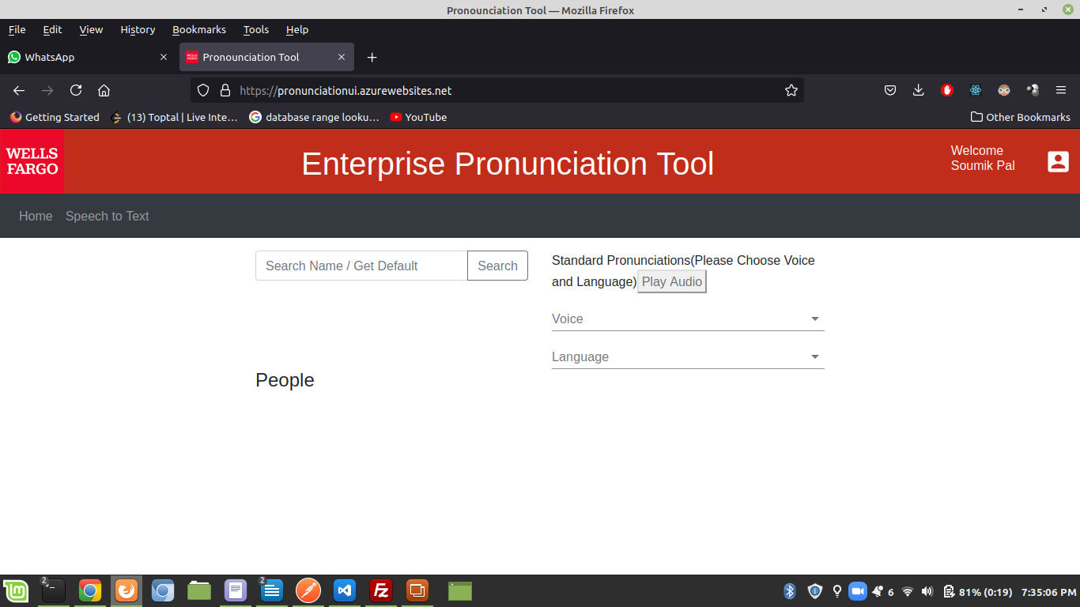
UI Mockups

Slide 4
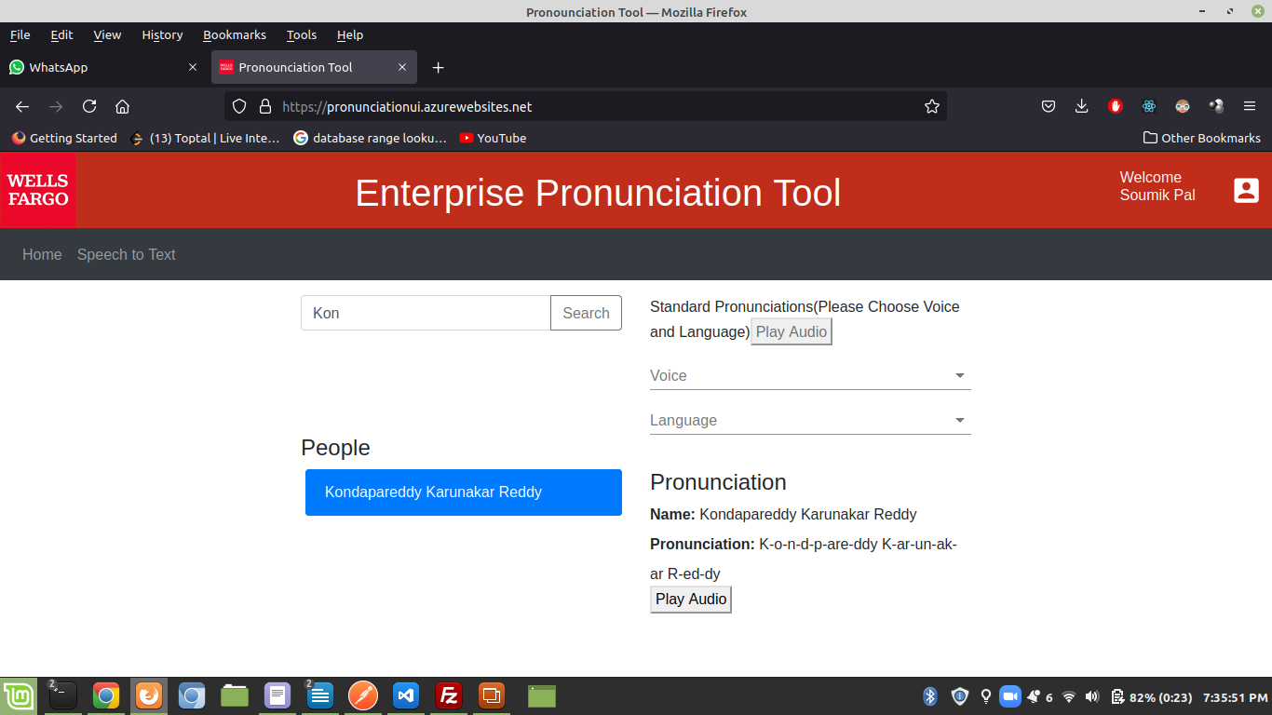
UI Mockups

Slide 5
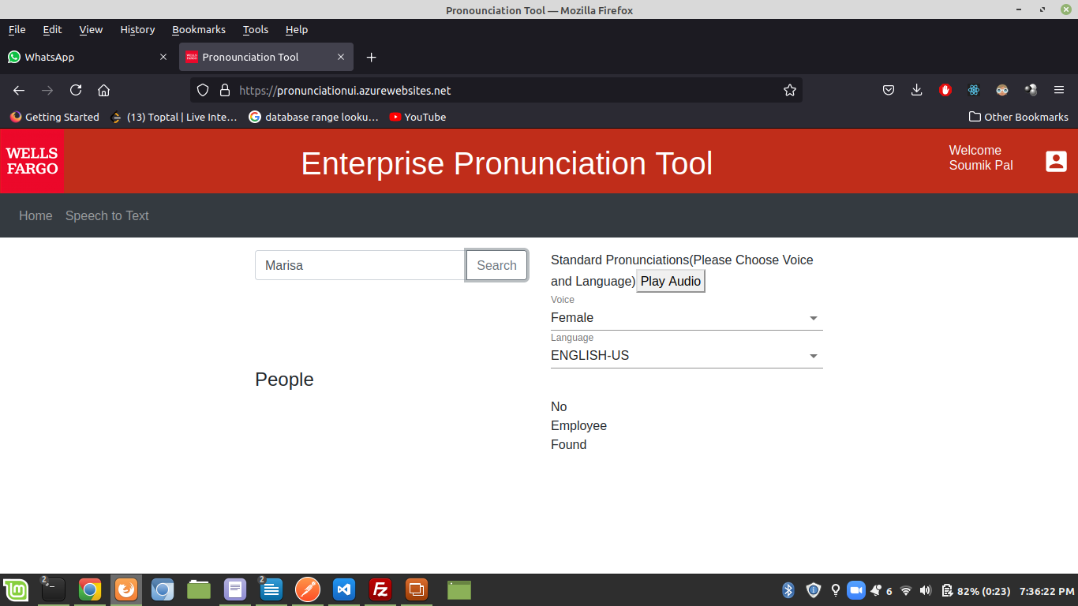
UI Mockups

Slide 6
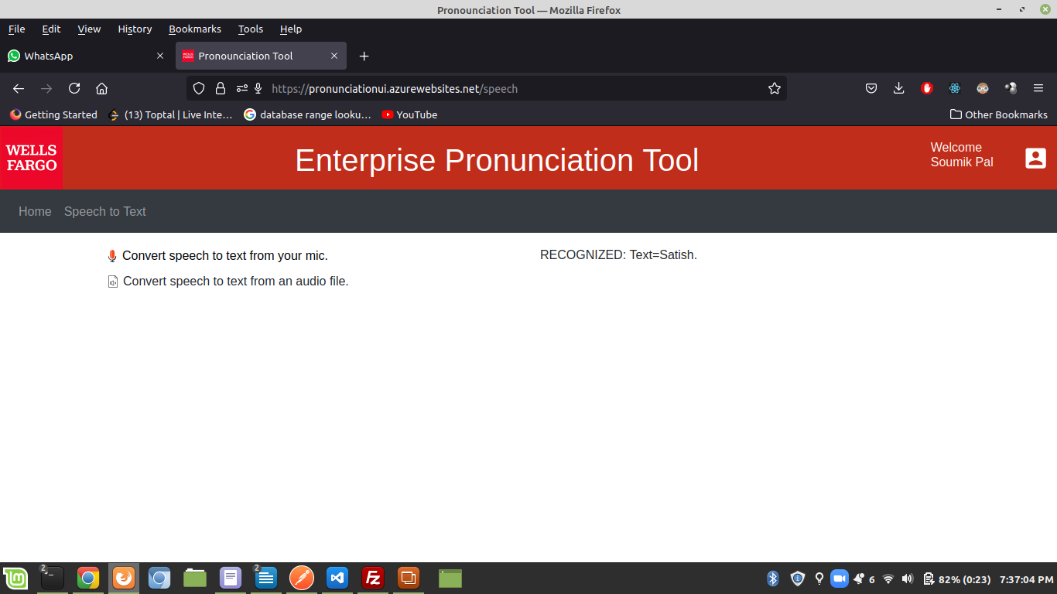
UI MOCKUPS

Slide 7
API Contract (Text to Speech)
Step 1:
Get Access Token
Use below endpoint and POST request through postman to get access token and in the response access token will be received.
End Point : https://eastus.api.cognitive.microsoft.com/sts/v1.0/issuetoken
Request Headers:
Ocp-Apim-Subscription-Key: c70c20199fb0429992ac543f60f5fc3e
Content-type: application/x-www-form-urlencoded
Content-Length: 0

Slide 8
API Contract (Text to Speech)
Step 2:
Usage of Access Token :The access token that is received in step 1 should be sent to the service as the Authorization: Bearer <TOKEN> header.
Authorization: Bearer [Base64 access_token]
Request headers :This table lists required and optional headers for text-to-speech requests:
Header | Description | Required or optional
Authorization | An authorization token preceded by the word Bearer. For more information, see Authentication. | Required
Content-Type | Specifies the content type for the provided text. Accepted value: application/ssml+xml. | Required
X-Microsoft-OutputFormat | Specifies the audio output format. For a complete list of accepted values, see Audio outputs. | Required
User-Agent | The application name. The provided value must be fewer than 255 characters. | Required

Slide 9
API Contract (Text to Speech)
Endpoint : https://eastus.tts.speech.microsoft.com/cognitiveservices/v1?User-Agent=speakit
Request headers:
POST https://eastus.tts.speech.microsoft.com/cognitiveservices/v1?User-Agent=speakit
Ocp-Apim-Subscription-Key : c70c20199fb0429992ac543f60f5fc3e
X-Microsoft-OutputFormat : riff-24khz-16bit-mono-pcm
User-Agent : speakit
Content-type : application/ssml+xml
Body :
<speak version='1.0' xml:lang='en-US'><voice xml:lang='en-US' xml:gender='Male'
name='en-US-ChristopherNeural'>
Alexander
</voice></speak>

Slide 10
API Contract (Text to Speech)
Response Codes:
The HTTP status code for each response indicates success or common errors
HTTP status code | Description | Possible reason
200 | OK | The request was successful. The response body is an audio file.
400 | Bad request | A required parameter is missing, empty, or null. Or, the value passed to either a required or optional parameter is invalid. A common reason is a header that's too long.
401 | Unauthorized | The request is not authorized. Make sure your subscription key or token is valid and in the correct region.
415 | Unsupported media type | It's possible that the wrong Content-Type value was provided. Content-Type should be set to application/ssml+xml.

Slide 11
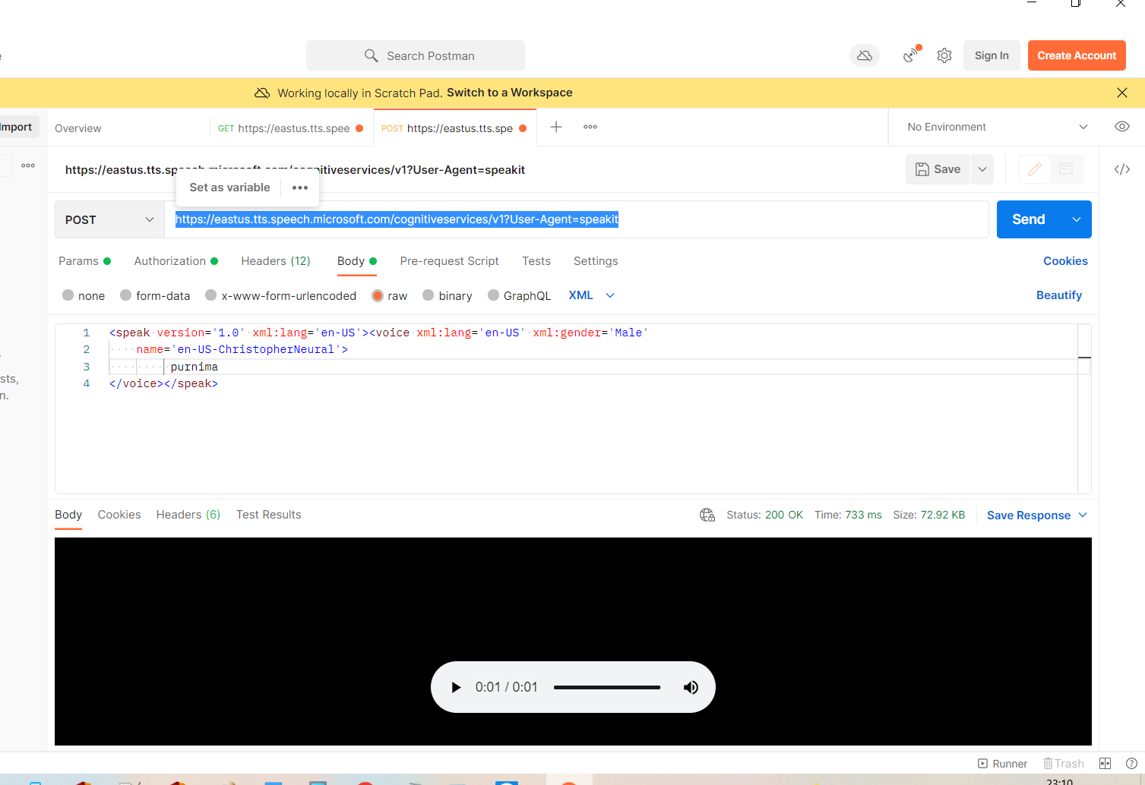
Text To Speech – Sample Request

Slide 12
Features
Current Scope
Future Scope
Ability to convert text to speech via Azure Cognitive Services (Text to Speech)
Choose Male or Female voice
Choose Specific Regional voice
Ability to check custom pronunciations of Colleagues
Ability to upload a custom audio for name pronunciation(Currently via Backend only)
Ability to convert speech to text via
mic or audio file
Authentication via API tokens that expire every 10 mins
Authentication between UI and API services
Ability for an admin to approve custom name pronunciation
Ability to upload custom audio for name pronunciation via UI

Slide 13
Github Repository
1. UI Repo
Host: https://pronunciationui.azurewebsites.net/
https://github.com/SoumikPal/namePronunciation
2. Service Repo(Backend)
https://github.com/SoumikPal/namePronunciationServiceMvn
Services API
Host: https://namepronunciationserviceptmvn.azurewebsites.net
Endpoints:
1.Token Generation for Cognitive Services: POST /api/token
2.Get Standard Pronunciation of any word via azure cognitive service: POST /api/pronounce
Request Body : {
"name": "Bala",
"gender": "Male",
"voiceregion": "en-US"
}

Slide 14
Services API
3.Create a Custom Pronunction for an Employee: POST api/v1/employeeNames
Request Body:
"name": "Soumik Pal",
"customAudio": ENCODED AUDIO DATA
“customPronunciation”:”S-o-u-m-e-e-k P-a-l”
4.Update Details of an existing Employee: POST api/v1/employeeNames/{employeeid}
Request Body
“id” employeeid
"customAudio": ENCODED AUDIO DATA
“customPronunciation”:”S-o-u-m-e-e-k P-a-l”
5.Get an Employee Detail with their Preferred Pronunciations : GET api/v1/employeeNames/{id}
6.Get all Employee Details with their Preferred Pronunciations:GET api/v1/employeeNames

Slide 15
Thank you

