Slide 1


COVID Paper Exploration:
The Workshop
Your Name Here
Microsoft Learn Student Ambassador
@microsoft
https://github.com/microsoft/workshop-library/blob/main/covid-paper-exploration-workshop/README.md
Notes:
Let’s say HI and introduce each other:
Francesca starts saying hi and introducing Dmitry.
- Short Bio of Dmitry (Francesca introduces Dmitry) – Dmitry joined Microsoft 15 years ago, as technical evangelist. He then worked for some years as AI/ML software engineer, doing pilot projects with large companies in Europe. Now he combines his work as Cloud Developer Advocate with being an Associate Professor at Moscow Institute for Physics and Technology. He lives in Moscow, Russia, and in addition to technology loves his daughter Vickie and does experiments in using AI in Science Art.
Short Bio of Francesca (Dmitry introduces Francesca) – Francesca is an Italian scientist based in Boston, Massachusetts. She loves data, machine learning and long walks with her 6-month-old daughter. Francesca is Adjunct Professor of AI and machine learning at Columbia University and Principal Cloud Advocate Manager at Microsoft. Before joining Microsoft, she was a research fellow at Harvard University in the Technology and Operations Management Unit.

Slide 2

Problem
Around 30,000 scientific papers related to COVID appear monthly
Notes:
Francesca
One of the major challenges of the COVID-19 pandemic has been finding effective treatments for the virus.
The rapid spread of coronavirus generated an urgent need for comprehensive therapies.
As consequence, the medical research community experienced an acceleration in new coronavirus literature, making it difficult for scientists to keep up.
Just to give you an idea: Around 30,000 scientific papers related to COVID appear monthly

Slide 3
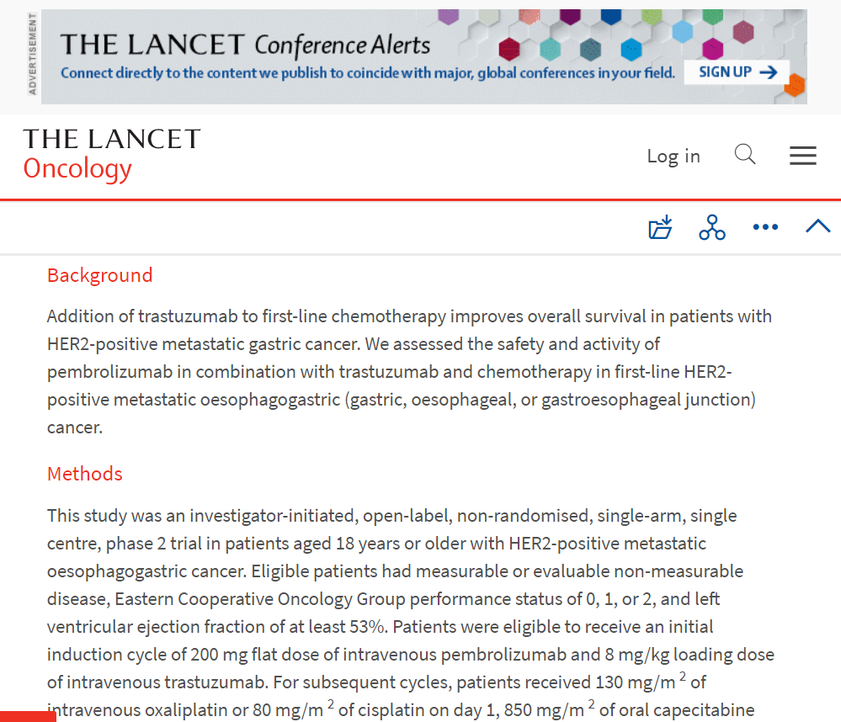
CORD Papers Dataset
CORD-19 Dataset
Contains over 800,000 scholarly articles about COVID-19 and the coronavirus family of viruses for use by the global research community
400,000+ articles with full text
Data Source
https://allenai.org/data/cord-19
https://www.kaggle.com/allen-institute-for-ai/CORD-19-research-challenge
Notes:
Francesca
In this session, we show how to leverage CORD dataset, containing more than 400,000 scientific papers on COVID, and recent advances in natural language processing and other artificial intelligence techniques to generate new insights in support of the ongoing fight against COVID.
The CORD-19 dataset represents the most extensive machine-readable coronavirus literature collection available for data mining. In that same dataset, there are about 200,000 articles with full text
Data source links.
This allows the worldwide AI research community the opportunity to apply text and data mining approaches to connect insights across this content.

Slide 4

Natural Language Processing
Common tasks for NLP:
Intent Classification
Named Entity Recognition (NER)
Keyword Extraction
Text Summarization
Question Answering
Open Domain Question Answering
Language Models:
Recurrent Neural Network (LSTM, GRU)
Transformers
GPT-2
BERT
Microsoft Turing-NLG
GPT-3
Microsoft Learn Module:
Introduction to NLP with PyTorch
aka.ms/pytorch_nlp
docs.microsoft.com/en-us/learn/paths/pytorch-fundamentals/
Notes:
Francesca
NLP is focused on the interactions between computers and human language, how to program computers to process and analyze large amounts of natural language data.
NLP is behind the following common applications:
Intent Classification
Named Entity Recognition (NER)
Keyword Extraction
Text Summarization
Question Answering
Open Domain Question Answering
Statistical models include the development of probabilistic models that can predict the next word in the sequence, given the words that precede it. A number of statistical language models are in use already, such as
Recurrent Neural Network (LSTM, GRU)
Transformers
BERT
Microsoft Turing-NLG
If you want to learn more about NLP with Pytorch, check out our Microsoft Learn Module:
Introduction to NLP with PyTorch – (GitHub Repo)
https://aka.ms/pytorch_nlp

Slide 5
How BERT Works (Simplified)
Masked Language Model + Next Sentence Prediction
During holidays, I like to ______ with my dog. It is so cute.
0.85 Play
0.05 Sleep
0.09 Fight
0.80 YES
0.20 NO
BERT contains 345 million parameters => very difficult to train from scratch! In most of the cases it makes sense to use pre-trained language model.
Notes:
Francesca
BERT makes use of Transformer, an attention mechanism that learns contextual relations between words (or sub-words) in a text. In its vanilla form, Transformer includes two separate mechanisms — an encoder that reads the text input and a decoder that produces a prediction for the task.
As opposed to directional models, which read the text input sequentially (left-to-right or right-to-left), the Transformer encoder reads the entire sequence of words at once. This characteristic allows the model to learn the context of a word based on all its surroundings (left and right of the word).
Before feeding word sequences into BERT, a part of the words in each sequence are replaced with a [MASK] token. The model then attempts to predict the original value of the masked words, based on the context provided by the other, non-masked, words in the sequence.
BERT contains 345 million parameters => so it is very difficult to train from scratch! In most of the cases it makes sense to use pre-trained language model.

Slide 6
Main Idea
Use NLP tools to extract semi-structured data from papers, to enable semantically rich queries over the paper corpus.
Power BI Dashboard
CORD Corpus
Extracted JSON
Cosmos DB Database
NER
Relations
SQL Queries
Text Analytics for Health
Azure Semantic Search
Notes:
Francesca
The main idea is to extract as much semi-structured information from text as possible, and then store it into some NoSQL database for further processing. Storing information in the database would allow us to make some very specific queries to answer some of the questions, as well as to provide visual exploration tool for medical expert for structured search and insight generation. The overall architecture of the proposed system is shown in this slide.
We will use different Azure technologies to gain insights into the paper corpus, such as Text Analytics for Health, CosmosDB and PowerBI.

Slide 7
How to take part
Go to https://github.com/microsoft/workshop-library/blob/main/covid-paper-exploration-workshop/README.md
Run http://eazify.net/nbrun (how to)
CLONE / Download
Run in Codespaces
Run in Jupyter / VS Code
COVIDPaperExploration.ipynb
(solution is in solution folder, but try not to look there)

Slide 8

Milestone 1: Get CORD Corpus
Register on Kaggle.com
Download metadata.csv
Place into data directory (replace existing)
Unzip if needed
This workshop is heavily based on Pandas, a very frequently used Python library to manipulate tabular data. You can read more about using Pandas for data processing in our Data Science for Beginners Curriculum.

Slide 9
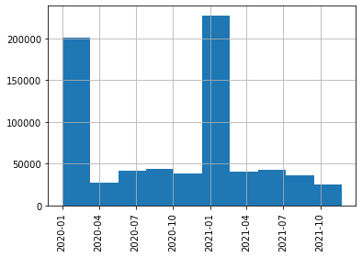
Milestone 2: Start Exploring the Data
Clean the data: convert data types, filter inappropriate dates
Publication frequency per month.
Can you figure out why there are two peaks?

Slide 10
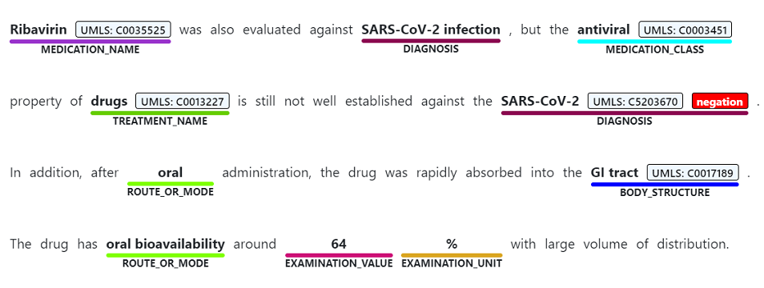
Text Analytics for Health: Entity Extraction
+ Entity Linking, Negation Detection
Notes:
Francesca
Named Entity Extraction detects words and phrases mentioned in unstructured text that can be associated with one or more semantic types, such as diagnosis, medication name, symptom/sign, or age.

Slide 11
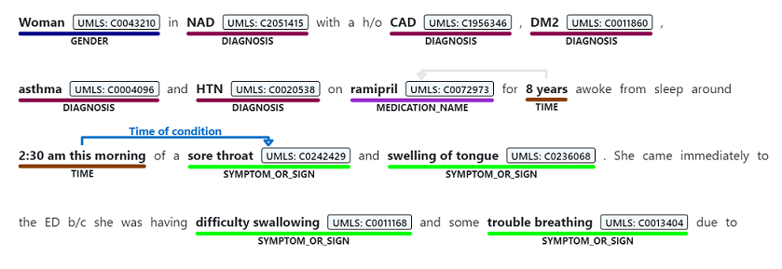
Relation Extraction
Notes:
Francesca
Relation extraction identifies meaningful connections between concepts mentioned in text. For example, a "time of condition" relation is found by associating a condition name with a time or between an abbreviation and the full description.

Slide 12
Using Text Analytics for Health
Pip Install the Azure TextAnalytics SDK:
pip install azure.ai.textanalytics
Create the client:
from azure.core.credentials import AzureKeyCredential
from azure.ai.textanalytics import TextAnalyticsClient
client = TextAnalyticsClient(endpoint=endpoint,
credential=AzureKeyCredential(key))
Do the call:
documents = ["I have not been administered any aspirin, just 300 mg or favipiravir daily."]
poller = client.begin_analyze_healthcare_entities(documents)
result = poller.result()
Notes:
Dmitry

Slide 13
Recognition Result
C0004057
I have not been administered any aspirin,
just 300 mg or favipiravir daily.
Medication
Dosage
Frequency
C1138226
DosageOfMedication
FrequencyOfMedication
aspirin (C0004057) [MedicationName]
300 mg [Dosage] --DosageOfMedication--> favipiravir (C1138226) [MedicationName] favipiravir (C1138226) [MedicationName]
daily [Frequency] --FrequencyOfMedication--> favipiravir (C1138226) [MedicationName]
Notes:
Dmitry

Slide 14
Milestone 3: Use Text Analytics for Health
Get your Azure Account
Create “Text Analytics” cloud resource
  Use S1 tier, not free!
Copy endpoint / key to notebook
Call the service to see if it works

Slide 15
Milestone 4: Process Abstracts
Randomly select ~300-1000 abstracts
  You may want to limit the dates to ~6-9 months, and then do random selection
Think how to store entites/relations
  Inside Pandas DF, or separately as Python list/dict
Batch them into groups of 10 and call the service
We have also provided the result of processing 1500 papers in data\processed.pkl.bz2 file. It will save you ~20 minutes of processing time.

Slide 16
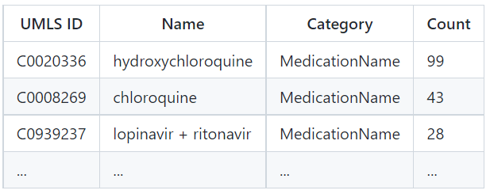
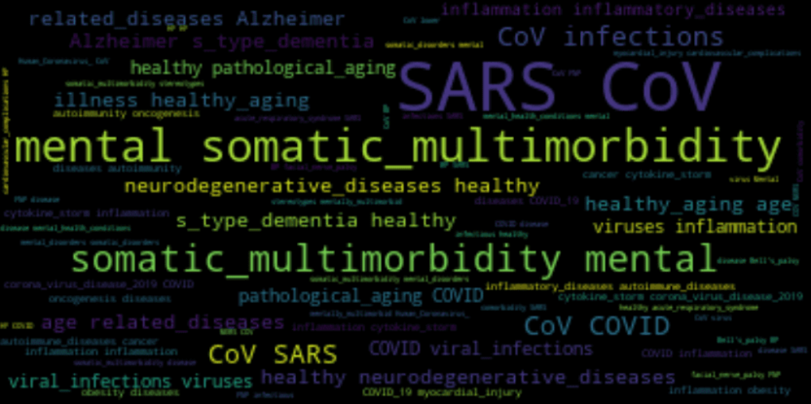
Milestone 5: Get Top Entities (Medication, Diagnoses, ..)

Slide 17
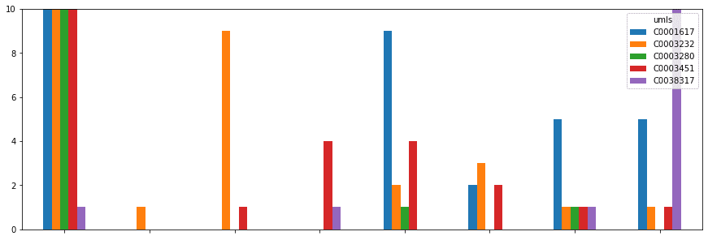
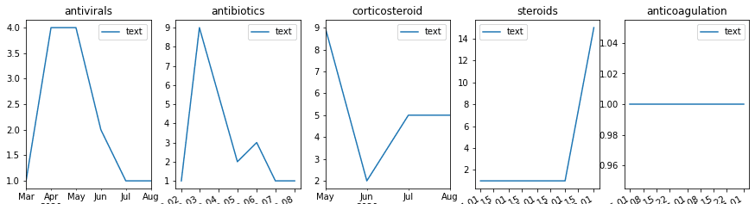
Milestone 6: Visualize Change in Treatment Strategies

Slide 18
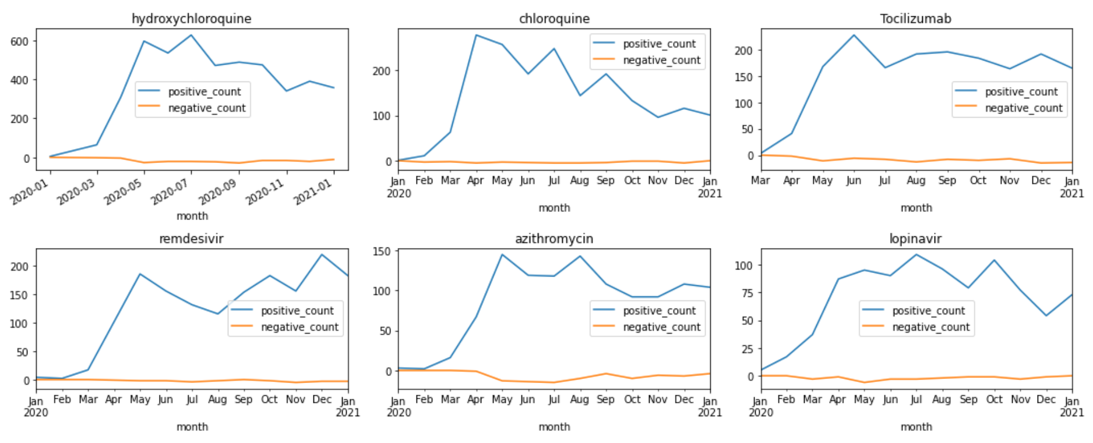
How Medication Strategies Change
Notes:
Dmitry

Slide 19
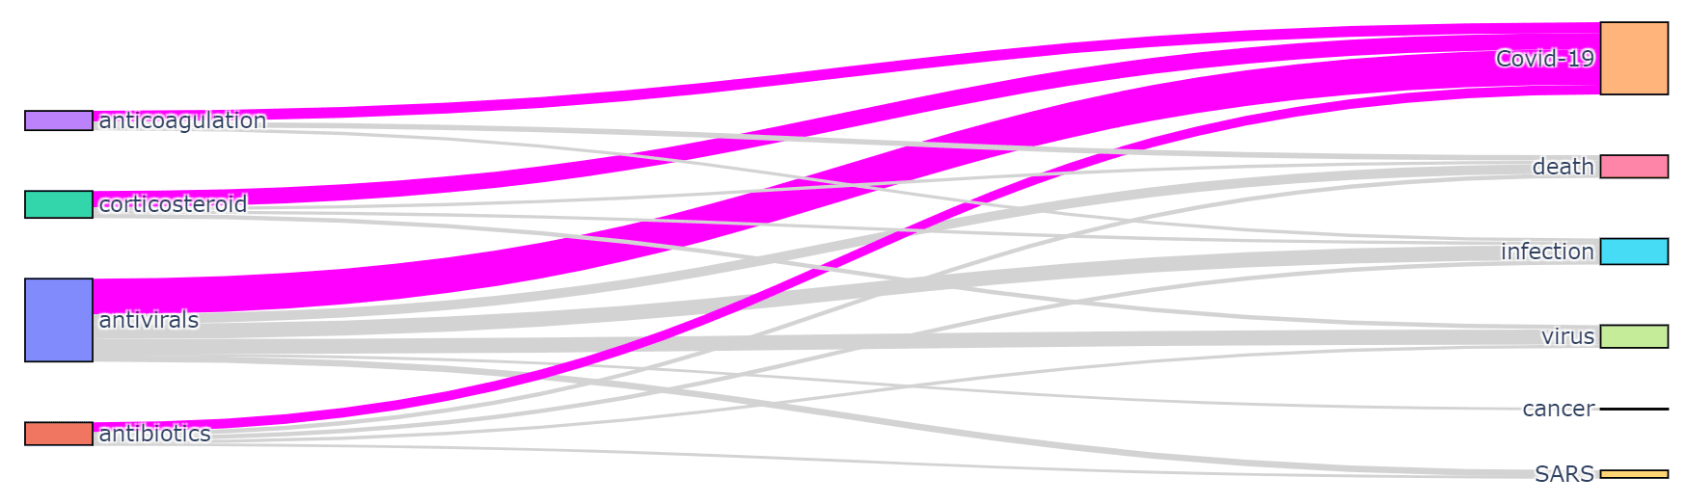
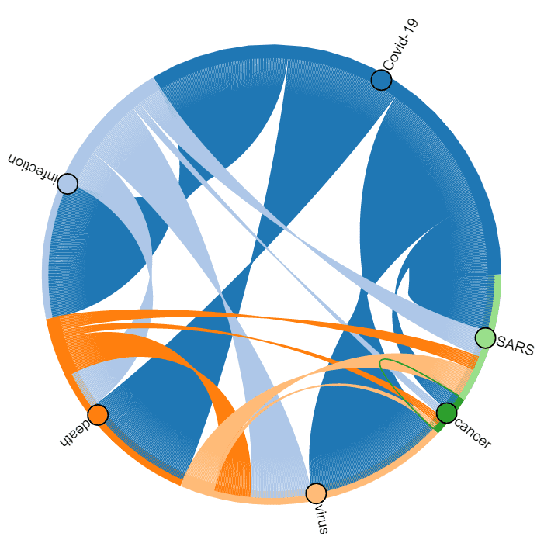
Milestone 7: Visualize Co-occurence of Terms
Holoviews
+Bokeh
Plotly

Slide 20
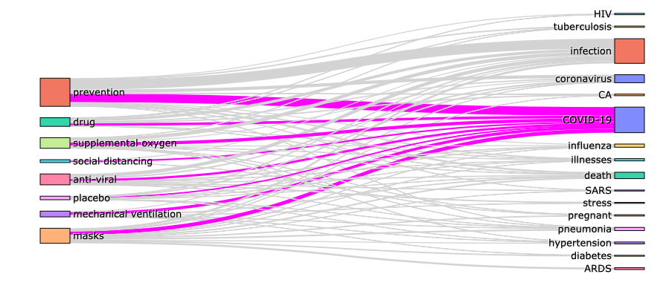
Term relations
Notes:
Dmitry

Slide 21
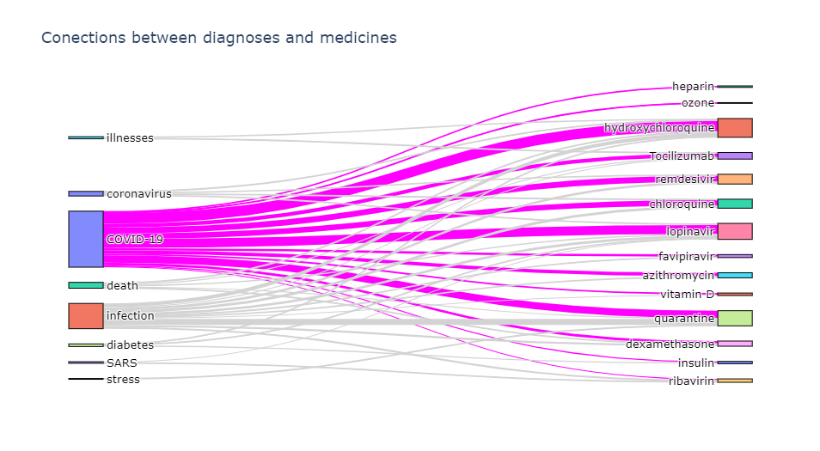
Term Relations
Notes:
Dmitry

Slide 22
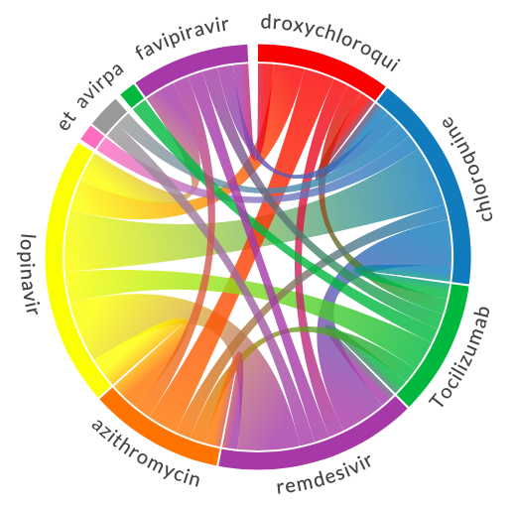
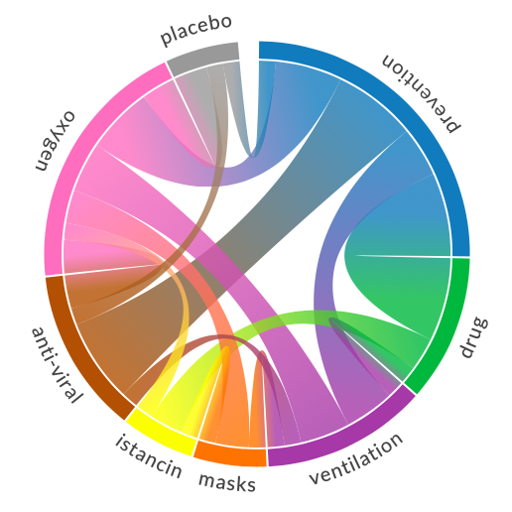
Terms Co-occurence
Medicine
Treatment
Notes:
Dmitry

Slide 23
Conclusions
❶
Text Mining for Medical Texts can be very valuable resource for gaining insights into large text corpus.
Text Analytics for Health does NER/Ontology Mapping for medical texts. For other domains we might need to use Custom NER.
❷
Python and Pandas are very effective means of data manipulation. We can use Codespaces or VS Code with Jupyter extension to start working on Jupyter document in a convenient environment.
❸
Notes:
Dmitry

Slide 24
Further Reading
❶
MS Learn: Microsoft Azure AI Fundamentals: Explore natural language processing
More on NER-based paper analysis in this blog post – including Cosmos DB, Power BI and more. Scientific Paper available at arXiv:2110.15453
❷
❸
To Learn NLP in-depth and how NER is implemented at neural network level:
Introduction to NLP with PyTorch
Introduction to NLP with Tensorflow
Notes:
Dmitry

Slide 25
Further Activities
For different knowledge domains, you would need to train your own NER neural network model, and for that you will also need a dataset. Custom Named Entity Recognition service can help you do that. However, Text Analytics Service that has some pre-built entity extraction mechanism, as well as keyword extraction.
❶
Analyze a blog or social network posts and get the idea of different topics that author is writing about. See how interests change over time, as well as the mood. You can use the blog of Scott Hanselman, it goes back to 2002.
❷
Analyze COVID 19 twitter feed to see if you can extract changes in major topics on twitter.
❸
Analyze your e-mail archive to see how the topics you discuss and your mood change over time. Most e-mail clients allow you to export your e-mails to plain text or CSV format (here is an example for Outlook).
Notes:
Dmitry

Slide 26
Thank You!

