Slide 1
EEE 414- Electrical Service Design
Final Project Demonstration
Title: 2-unit, 9 storied Apartment
design modelling in Auto-cad
Presented by-
1806099--- Mahin Shariar
1806101--- Niaz Mahmud
1806102--- Soumik Shanto
1806105--- Ihzaz Abrar Sadik
1806107--- Priya Acharjee
1806125--- Arnab Nath
Group---01
Level---4, Term---02

Slide 2
Outline
Nutshell
Introduction
Floor Plan & Layout
Fittings & Conduits Layout
Distribution Systems
Emergency Distribution Systems
Analysis and Evaluation
References

Slide 3
1. Nutshell
Our project is about the distribution of environments in 2-unit apartment 9-storied building floor plan designs (3400 sq ft) that have been generated in 2D for better visualization in Auto-cad Software. This is a replica model that can be implemented with some advanced modifications to build a home in real life.

Slide 4
2. Introduction
We were instructed to model a 9 storied building having 2 units. Each unit covers not less then 3400 sq feet. Also, an instruction was to implement a parking & a basement having enough space for 18 cars. An elevator is also installed to ensure the ease of going any apartment without any time delay. Necessary safety managements have also been taken to ensure public safety.

Slide 5

2.1 Complexity Analysis
Our plan is having an area of $67.5′$ $×{50}^{′}−3′′$. So, we had gone through some difficulties about putting the essential components along with the lift & enough free space in this limited area. This was the only complexity we have had.

Slide 6
3.1 Design---First floor plan
We have 2 units i.e. 2 apartments in each floor.
Every apartment consists of –
a. 1 Master Bedrooms (100 sq. feet to 135 sq. feet)
b. 2 Bedroom (100 sq. feet)
c. 1 Living Room (182 sq. feet)
d. 1 Dinning Space
e. 1 Kitchen
f. 3 Toilets
g. Free space as in Veranda
Also, a lift is installed in every floor.

Slide 7
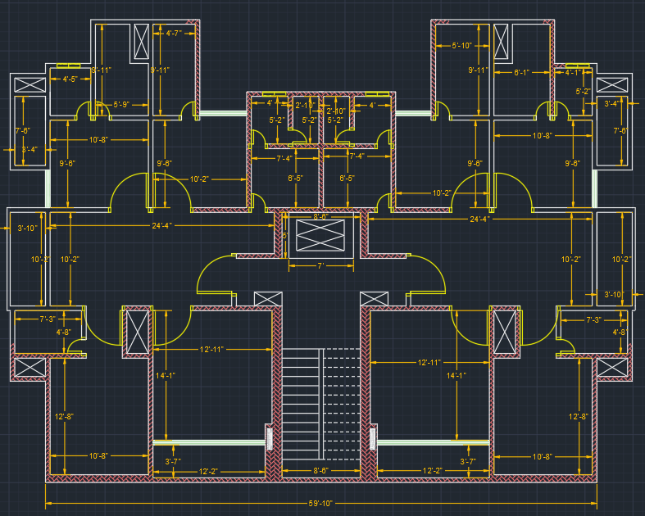
First floor layout
Veranda
Toilet
Toilet
Veranda
Bedroom
Veranda
Store
Bedroom
Kitchen
Veranda
Dinning Space
LIFT
Toilet
Staircase
M. Bedroom
Living Room

Slide 8
3.2 Design---Ground Floor Plan
Our ground floor contains –
a. 1 Guard Room (38 sq. feet)
b. 1 Meter Room (45 sq. feet)
c. 1 Toilet (23 sq. feet)
d. Parking area
e. Ramp
Also, a lift is installed in Ground floor.

Slide 9
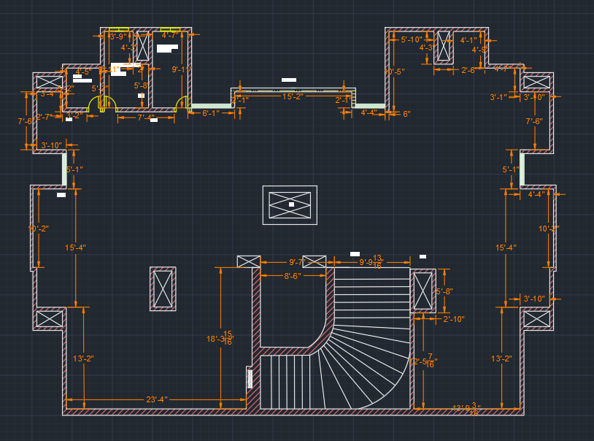
Ground floor layout
Guard’s Room
Meter Room
Toilet
Parking area
LIFT
Staircase
Ramp

Slide 10
3.3 Design---Basement Plan
Our basement contains –
a. Parking area
b. Ramp
c. Lift

Slide 11
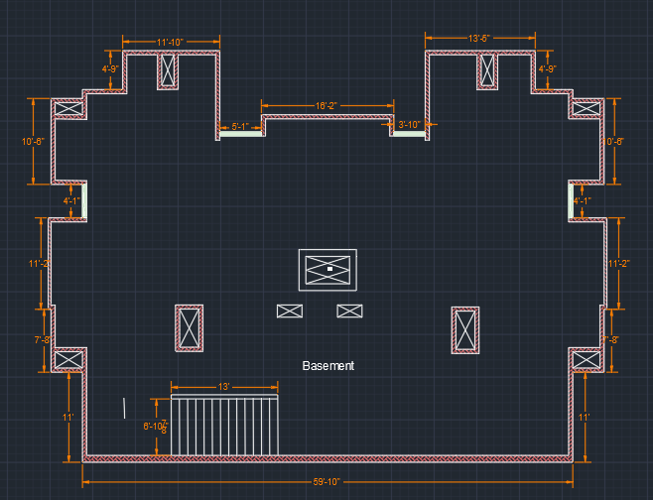
Basement Plan
LIFT
Ramp

Slide 12
3.4 Design---Roof Plan
Our Roof contains –
a. Lightning arrester (4 in 4 corners)
b. Staircase & Lift
c. Air spikes

Slide 13
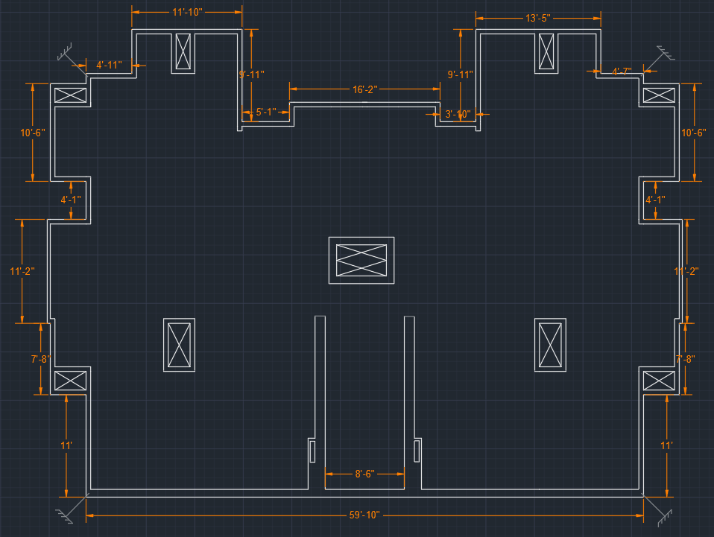
Roof Layout
Lightning Arrester
LIFT
Stair-case

Slide 14
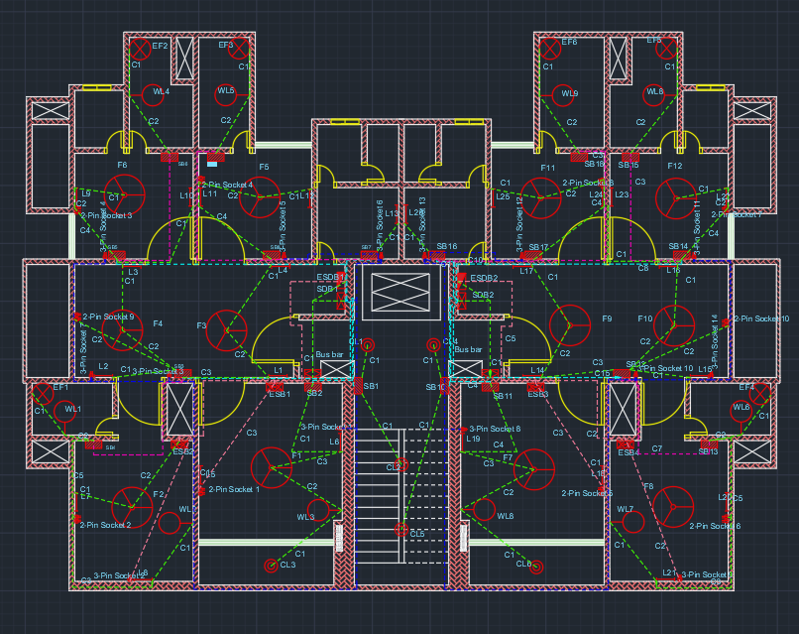
4.1 First Floor with Fittings & Conduits

Slide 15
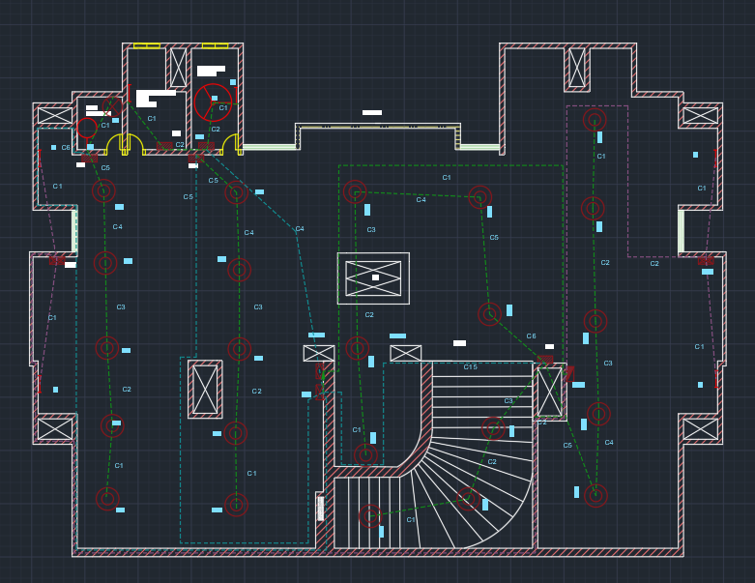
4.2 Ground Floor with Fittings & Conduits

Slide 16
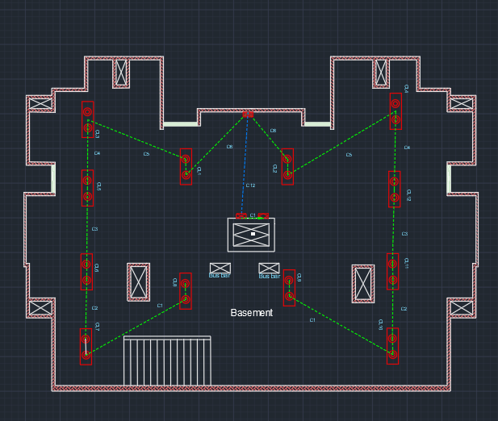
4.3 Basement with Fittings & Conduits

Slide 17
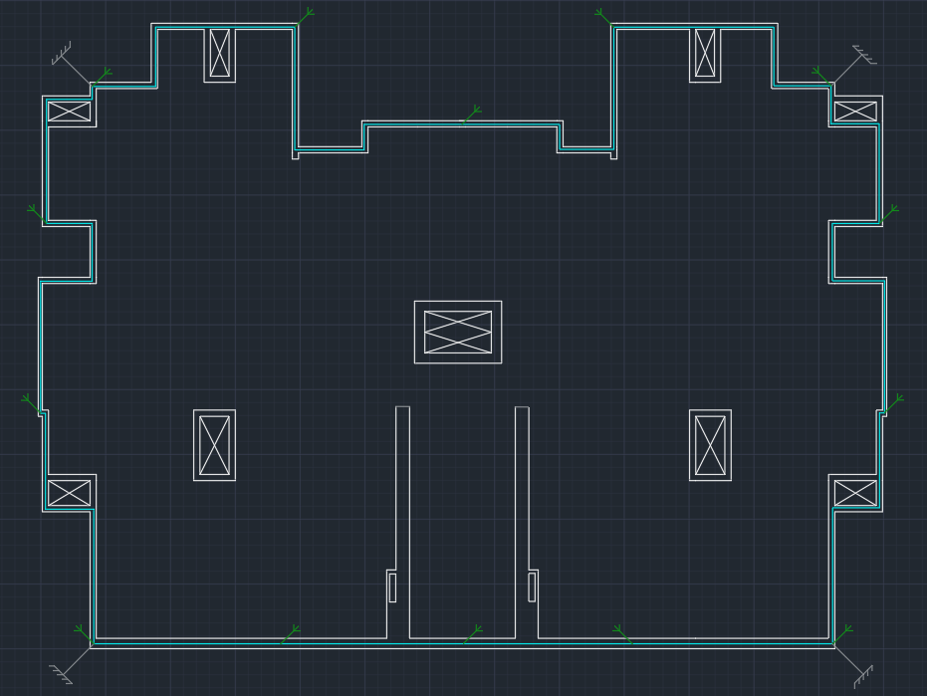
4.4 Roof with Fittings & Conduits

Slide 18
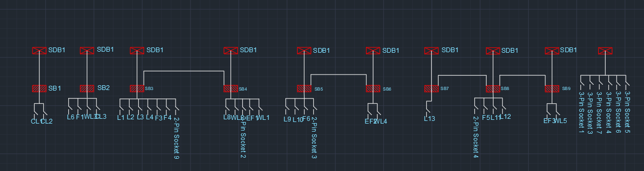
5.1 Distribution Systems
First Floor

Slide 19
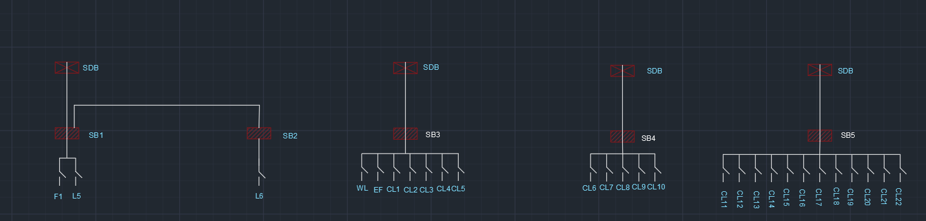
5.2 Distribution Systems
Ground Floor

Slide 20
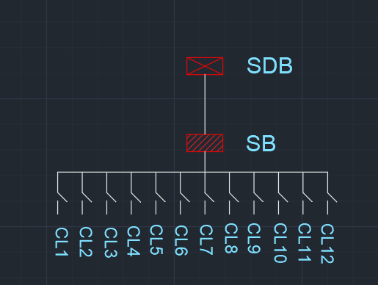
5.3 Distribution Systems
Basement

Slide 21
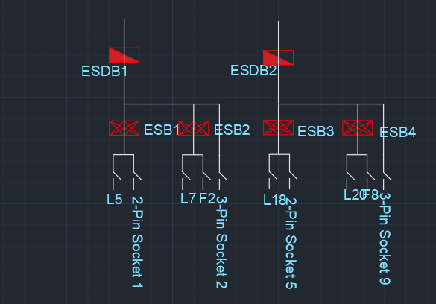
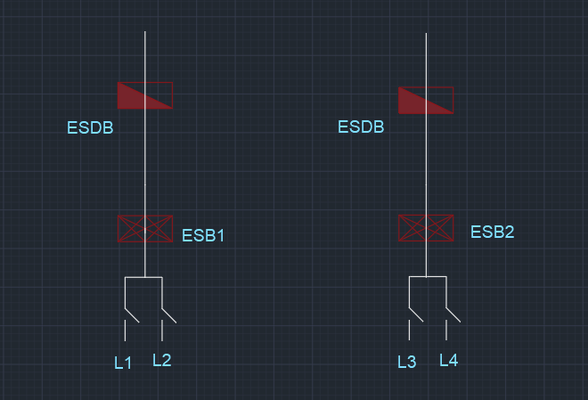
6. Emergency distribution Systems
First Floor
Ground Floor

Slide 22
Distribution Systems
First Floor

Slide 23
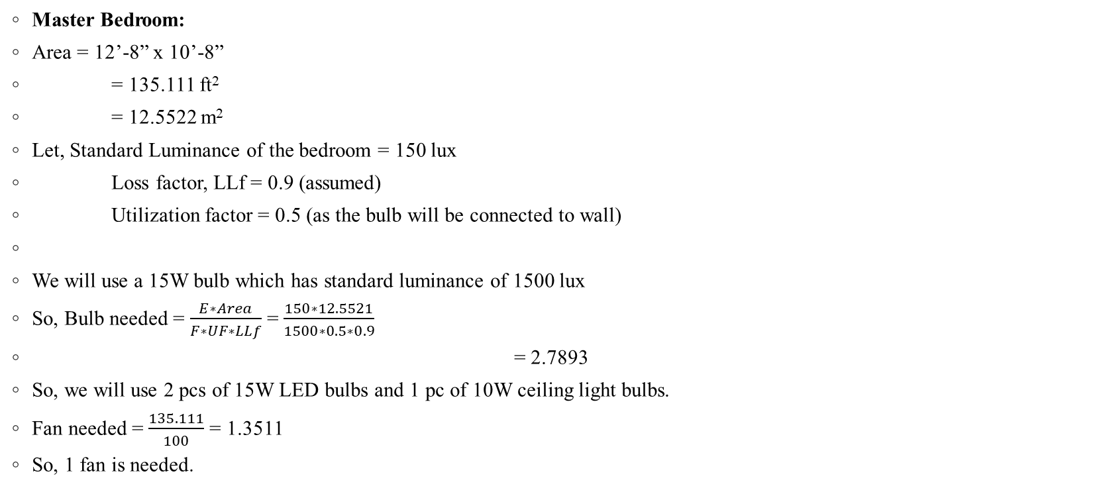
Sample Calculations
Master Bedroom:
Area = 12’-8” x 10’-8”
= 135.111 ft²
= 12.5522 m²
Let, Standard Luminance of the bedroom = 150 lux
Loss factor, LLf = 0.9 (assumed)
Utilization factor = 0.5 (as the bulb will be connected to wall)
We will use a 15W bulb which has standard luminance of 1500 lux
So, Bulb needed = $\frac{E∗Area}{F∗UF∗LLf}$ = $\frac{150∗12.5521}{1500∗0.5∗0.9}$
= 2.7893
So, we will use 2 pcs of 15W LED bulbs and 1 pc of 10W ceiling light bulbs.
Fan needed = $\frac{135.111}{100}$ = 1.3511
So, 1 fan is needed.

Slide 24

For ESB1
As L₁ ,L₂ are fluorescent LED
P = (15+15) = 30W
I = $\frac{30}{220∗0.7}$ = 0.1948 A
So, 2x1.5 rm BYM + 1.5 BYA ECC are used
For ESB2
As L₃ ,L₄ are fluorescent LED
P = (15+15) = 30W
I = $\frac{30}{220∗0.7}$ = 0.1948 A
So, 2x1.5 rm BYM + 1.5 BYA ECC are used

Slide 25

1st Floor (SDB Calc.)
SDB1
Total Load = SB2+ SB3+ SB5+ SB7
= (235+535+280+295) W
= 1345 W
SDB Load = 1345$×0.7+6×3000×0.2$ = 4541.5 W
SDB Current =$\frac{4541.5}{220∗0.7}$A = 29.49 A
So, 40A MCCB is needed from SDB to MDB.

Slide 26
6.1 Individual Contribution of Each Member
1806099: Ground Floor, Basement, Roof layout
1806101: Dimension labelling, Calculations
1806102: Ground Floor & First Floor electrical works & First Floor’s calculations
1806105: First Floor layout + All floor’s electrical work + Project report
1806107: SDB & ESDB Calculations, PPT design, Conduit calculations, Ground Floor Layout
1806125: Roof layout & Dimension labeling

Slide 27
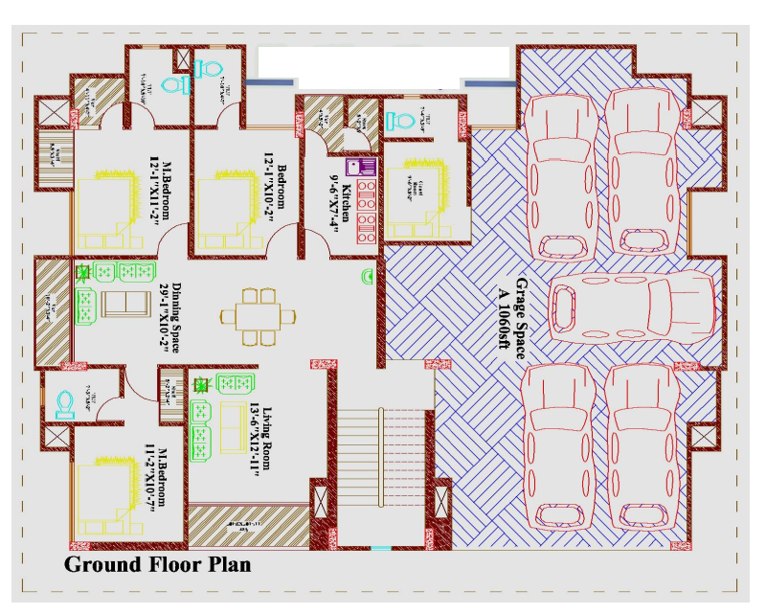
7. References

Slide 28
