Slide 1
An Intelligent Door Access System: Addressing Emergency Response and Enhancing Accessibility for Physically Challenged Individuals
Course title: eee 404
Course name: Robotics and automation laboratory

Slide 2
Group 2:
Group member:
Sifat alam
Md. Ashik Ahmed
Soumik Shanto
Arnab musabbir
Sadman Sadik Rian
Indrojit sarkar

Slide 4

FEATURES
OTP and RFID
Data Encryption and Security Measures
Emergency Response
Remote Accessibility
Abnormal Activity Detection

Slide 5


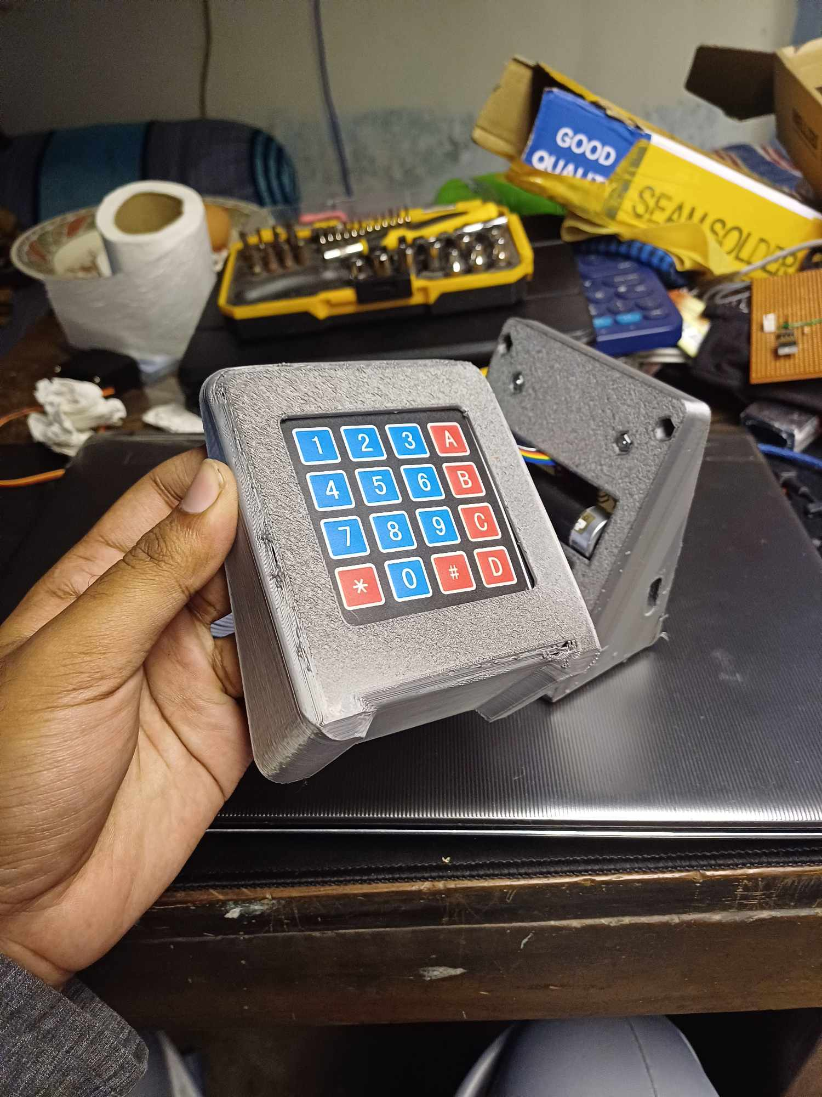

Case 1:
Access for Residents
Door Open for correct code
Entering from outside
Input
Pass-code
Sent to the Microcontroller
Authentication
Access denied for incorrect code

Slide 6


Case 2: Guest Entry with One-Time Password (OTP)
Request a passcode from the resident.
Resident requests the server to generate OTP
Server generate OTP and forwards to the resident
Resident send the OTP to guest
Door Open for correct OTP generated within 15 minutes
Guest
Sent to the Microcontroller
Input
OTP
Authentication
Access denied otherwise

Slide 7
Seamless Internal Entry
Press the door button from inside
door automatically opens
No code
No OTP
Only press
Very easy

Slide 8
Emergency Response System
Continuous environmental monitoring by sensors
Detect emergencies like fire or earthquake
The controller is promptly notified upon detection.
Ensuring swift egress.
The actuator opens the door automatically

Slide 9
Data encryption
5 9 3 1 7
12 13 fb
23 b4 d5
15 68
The password
Hexa decimal value in ASCII
Mapping the values into matrix
Substituting the values using S-box
Shifting the rows
Mixing up the colums
Adding round key
7 more round
The encrypted password
35 39 33 31 37
35 39 33
31 37 85
bc e4 1c
e1 13 e2
a1 da 11
3f 20 5f
b7 b6 5e
86 11 70
b0 bc 34
e1 13 e2
11 a1 da
20 5f 3f
16 2e 22 db 67 8a 93 98 20

Slide 10
Decryption process
12 13 fb
23 b4 d5
15 68 91
e1 13 e2
11 a1 da
20 5f 3f
b7 b6 5e
86 11 70
b0 bc 34

