Slide 1
Team management
 | Soumil | Sunny | Noah | James
Phase 1 | Use cases | Overall planning | UML | Mockups
Phase 2 | Entities & Utils | Game engines | Maps | UI
Phase 3 | Testing | Report | Testing | Additional Features
Phase 4 | Report | Read me | Artifacts | Demo

Slide 2
Team management
 | Soumil | Sunny | Noah | James
Phase 1 | Use cases | Overall planning | UML | Mockups
Phase 2 | Entities & Utils | Game engines | Maps | UI
Phase 3 | Testing | Report | Testing | Additional Features
Phase 4 | Report | Read me | Artifacts | Demo

Slide 3
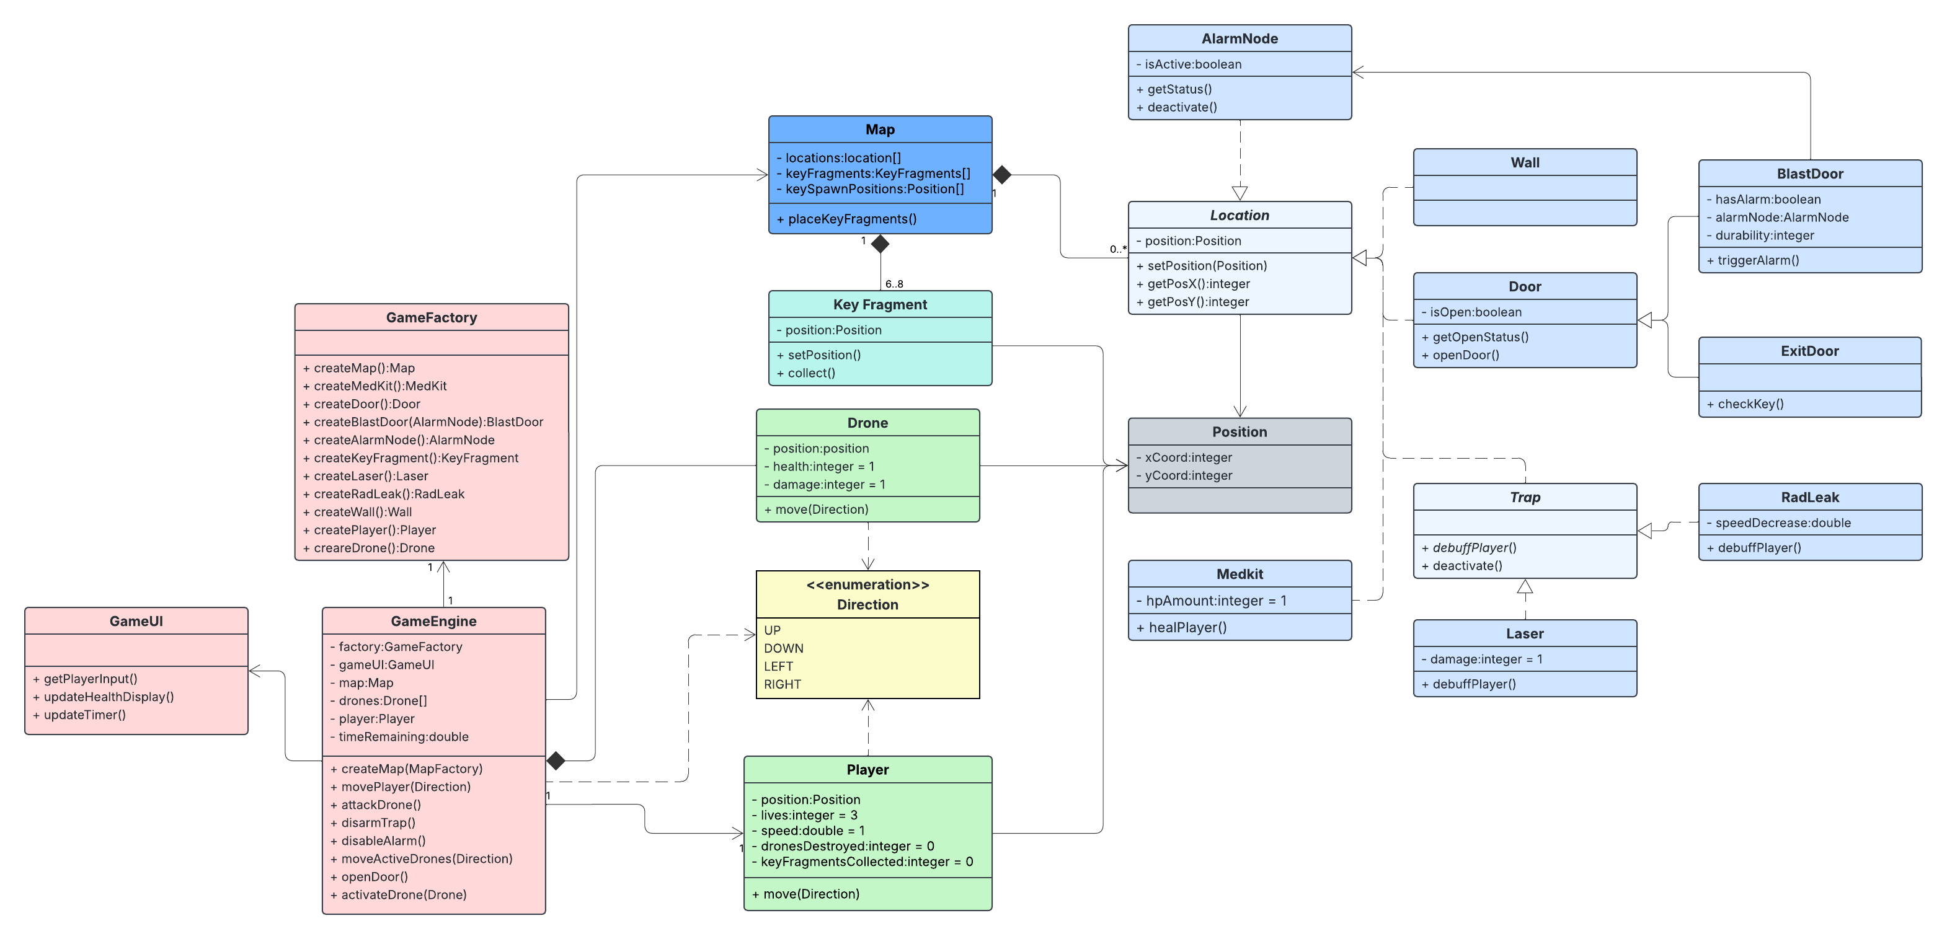
UML Diagram

