Slide 1

IIT ROORKEE × FUTURENSE
PG Certificate in AI/GenAI Powered Cybersecurity — Capstone, Cohort 1
AlertMind
An AI-Assisted Mini Security Operations Centre
Wazuh SIEM • MITRE ATT&CK-Mapped Detections • LangChain + Llama 3.1 (Groq) Tier-1 Analyst Assistant
Soumil | Karnamughilhan R
Capstone Project Submission
Notes:
Good [morning/afternoon] everyone. My capstone project is AlertMind — an AI-assisted mini Security Operations Centre that combines a real SIEM deployment with a generative AI analyst assistant. Over the next 10 minutes I'll walk through the problem, the architecture, what I built, and what the results showed.

Slide 2




THE PROBLEM
SOC analysts are drowning in alerts
Modern SIEMs (Wazuh, Sentinel, Splunk, QRadar) correlate huge volumes of security logs — but every alert still needs a human to read it, map it to an attacker technique, and decide what to do next.
The Opportunity
Alert fatigue
LLMs can't replace analyst judgement — but they can absorb the repetitive first pass: summarizing, mapping to ATT&CK, and drafting next steps.
Thousands of daily alerts; most are low-priority or false positives.
Slow triage
Every alert needs manual context-building before investigation even starts.
AlertMind tests exactly this idea — with guardrails, and a human always in the loop.
Inconsistent analysis
Different analysts interpret the same alert differently.
02
Notes:
Security teams today are overwhelmed by alert volume. SIEMs are good at detecting events, but a human still has to read every alert, figure out the attacker technique, and decide what to do — and that doesn't scale, and different analysts read the same alert differently. That's the gap AlertMind targets: use an LLM as a tier-1 assistant that does the first pass, while the analyst keeps final say.

Slide 3


PROJECT OVERVIEW
Three layers, one integrated SOC
AlertMind combines detection, engineering, and generative AI into a single working pipeline.
01
02
03
Security Monitoring
Detection Engineering
AI-Assisted Analysis
Wazuh SIEM on Ubuntu Server ingests Windows (Sysmon), Linux audit logs, and AWS CloudTrail.
12 custom rules covering common attacker techniques, each mapped to MITRE ATT&CK.
LangChain + Groq-hosted Llama 3.1 8B Instant triages exported alerts as a tier-1 assistant.
03
Notes:
The project has three integrated layers. First, security monitoring — Wazuh collects logs from Windows, Linux and AWS CloudTrail. Second, detection engineering — twelve custom rules mapped to MITRE ATT&CK. And third, AI-assisted analysis — a LangChain application using Groq's Llama 3.1 8B model that acts as a tier-1 analyst on top of the alerts Wazuh generates.

Slide 4



OBJECTIVES
What the project set out to prove
Deploy a functional Wazuh SIEM with live log collection
Build 10+ custom detection rules mapped to MITRE ATT&CK
Design real-time SOC monitoring dashboards
Write IR playbooks aligned to NIST SP 800-61 Rev. 2
Build an AI tier-1 assistant with LangChain + an LLM
Enforce responsible-AI guardrails and human approval
Guided by two evaluation metrics: MTTD (Mean Time to Detect) and MTTR (Mean Time to Respond).
04
Notes:
These were the core objectives — deploying the SIEM, building at least ten detection rules mapped to ATT&CK, dashboards, IR playbooks aligned to NIST 800-61, the AI assistant, and responsible AI guardrails. The whole thing was measured against two standard SOC metrics: mean time to detect and mean time to respond.

Slide 5
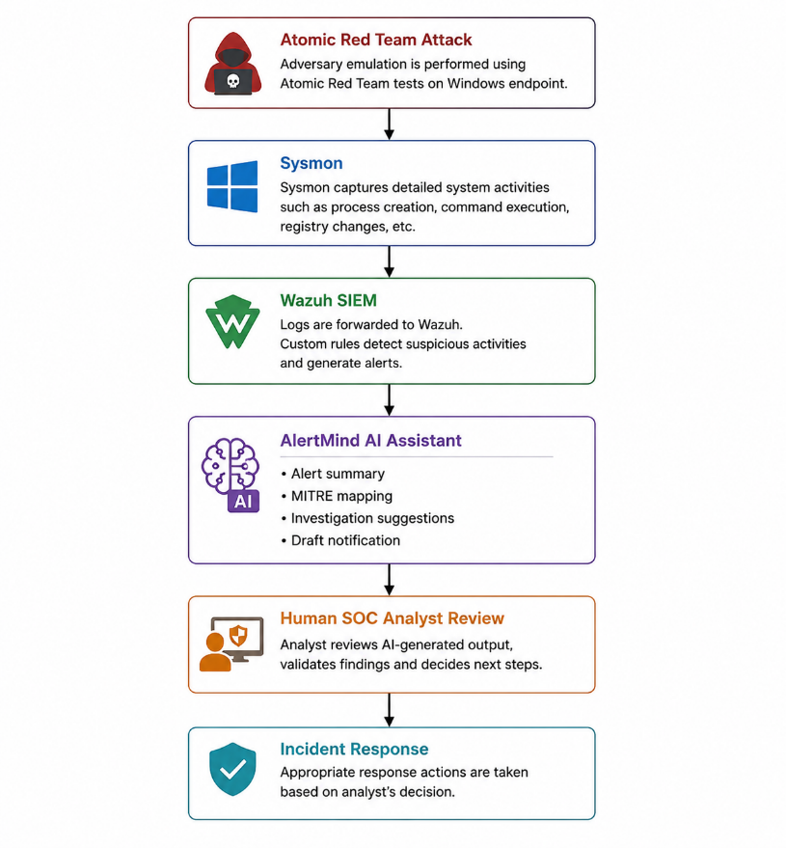


SYSTEM ARCHITECTURE
Five components, one pipeline
Endpoint Layer
Windows Server 2019 (Sysmon) + Ubuntu (auditd)
SIEM Layer
Wazuh Manager, OpenSearch Indexer, Dashboard
Threat Simulation
Atomic Red Team on the Windows endpoint
AI Analysis Layer
LangChain + Groq Llama 3.1 8B Instant
Governance Layer
Sanitization, logging, mandatory human review
05
Notes:
Here's the full architecture. On the left is the actual diagram from the report. Endpoints — Windows and Linux — forward telemetry to the Wazuh SIEM layer. Atomic Red Team simulates real attacker techniques against the Windows endpoint. Alerts that Wazuh generates are exported to the AI analysis layer — a LangChain app calling Groq's Llama 3.1 8B model — and everything is wrapped in a governance layer: sanitization, logging, and mandatory human review before any action.

Slide 6
DETECTION ENGINEERING
12 custom rules, mapped to MITRE ATT&CK
100100
Suspicious Windows Command Shell
T1059.003
12
100101/102
Encoded / Download-Cradle PowerShell
T1059.001
100103
Multiple Failed Login Attempts
T1110
custom detection
rules built & validated
100104
New Windows User Account Creation
T1136
100105
New Windows Service Installation
T1543.003
100106/111
Registry Run Key / Startup Persistence
T1547.001
Behaviour-based — focused on attacker technique, not malware signatures.
100107
Scheduled Task Creation
T1053.005
100108
Successful Remote Logon
T1021.001
100110
Suspicious PowerShell Network Connection
T1105
100112
Process Execution from Temp Folder
T1204.002
06
Notes:
Twelve custom detection rules were built and validated — one was retired during validation for being redundant, so eleven distinct techniques made it into the final set. Each rule targets a specific attacker behaviour — command shell abuse, encoded PowerShell, persistence via registry or scheduled tasks, brute force logins, and more — and every rule is mapped to its MITRE ATT&CK technique ID, so the SOC has a standard vocabulary for what happened.

Slide 7
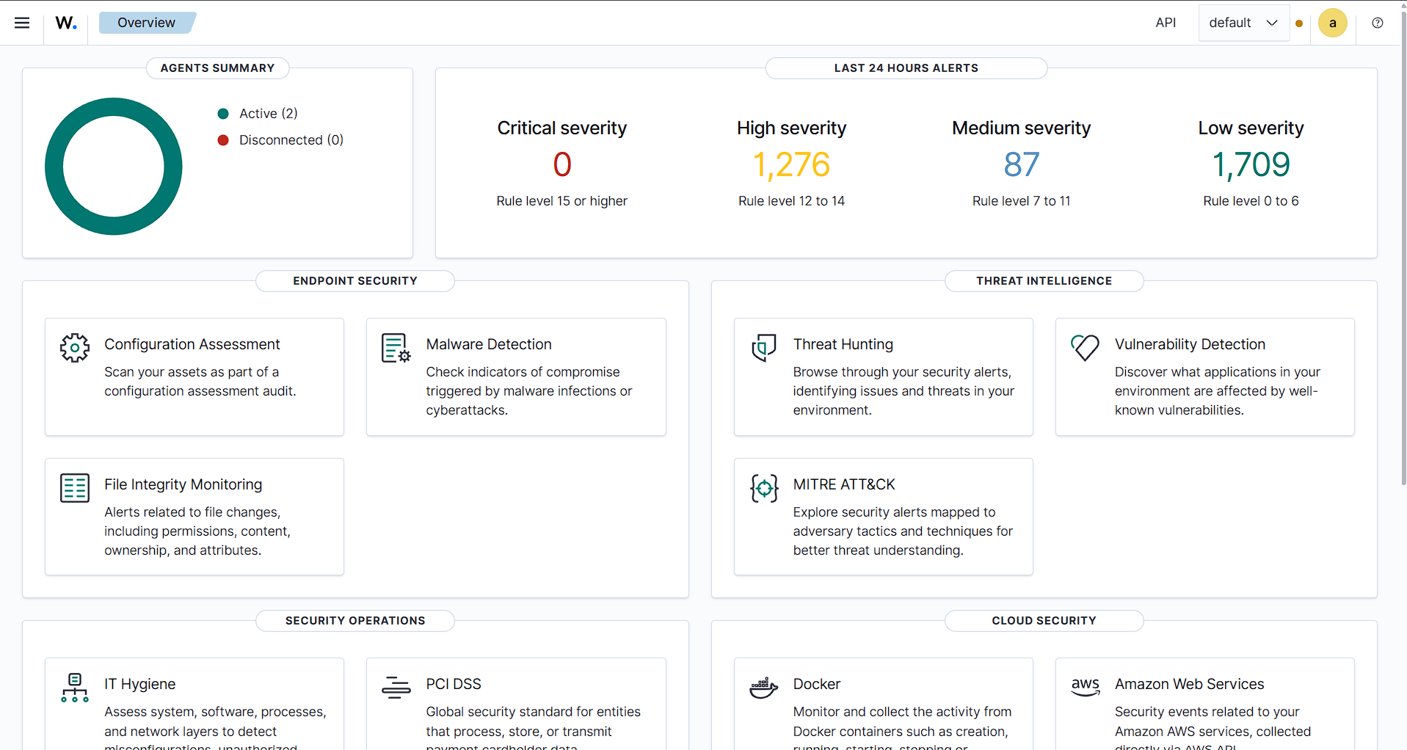
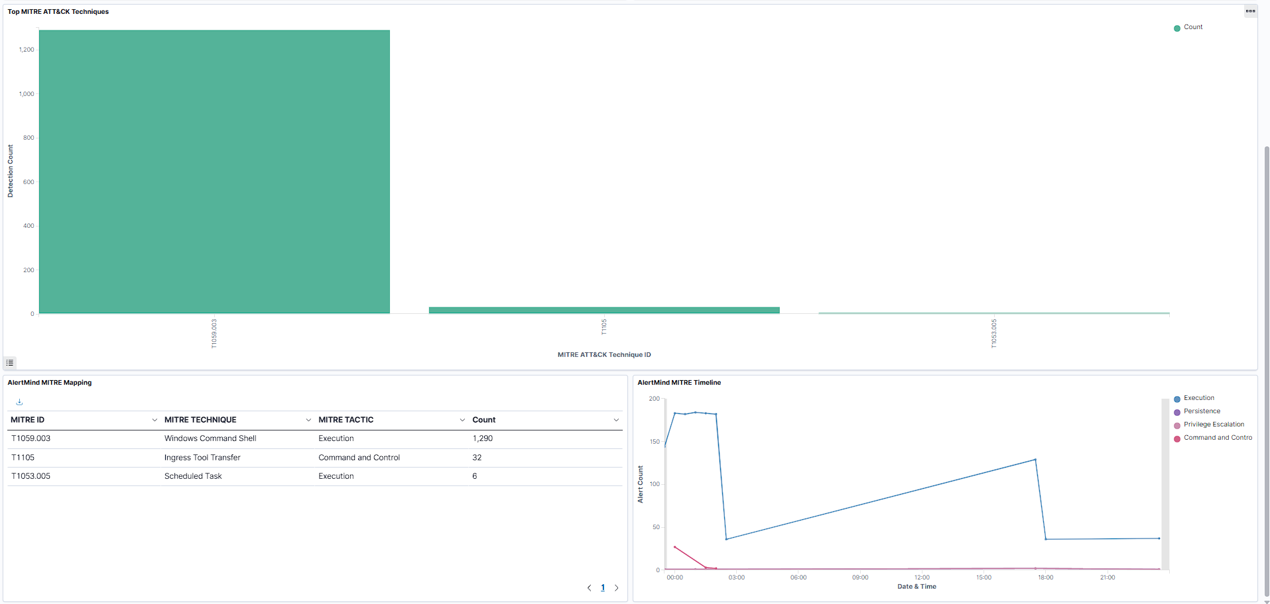
VISUALIZATION
Two dashboards, built for analyst speed
SOC Overview Dashboard
MITRE ATT&CK Dashboard
Total alerts, severity, active agents & recent events | Alerts mapped to attacker tactics & techniques
07
Notes:
Two custom dashboards were built inside Wazuh. The SOC Overview dashboard gives total alerts, severity split, active agents and recent events at a glance. The MITRE ATT&CK dashboard maps every triggered rule to its tactic and technique, so an analyst instantly sees what stage of an attack they're looking at.

Slide 8

THE AI LAYER
AlertMind: a tier-1 assistant, not an autopilot
Wazuh Alert
→
AlertMind
→
Analyst Review
JSON export
LangChain + Llama 3.1 8B (Groq)
Human approves every action
For every alert, AlertMind generates:
Concise alert summary
MITRE ATT&CK technique mapping
Why this shape works
Suggested investigation queries
The assistant never touches raw logs directly — it only reasons over an already-detected, structured alert. Detection stays with Wazuh; AlertMind only interprets. That keeps the AI layer swappable and the SOC's ground truth trustworthy.
Recommended analyst actions
Draft stakeholder notification
08
Notes:
This is the core AI layer. Wazuh generates the alert as JSON, AlertMind — built with LangChain calling Groq's Llama 3.1 8B Instant model — processes it, and the analyst reviews the output before anything happens. For every alert it produces five things: a summary, an ATT&CK mapping, investigation queries, recommended actions, and a draft notification. Importantly, the AI never touches raw logs or performs detection itself — it only interprets what Wazuh already found, which keeps detection trustworthy and the AI layer replaceable.

Slide 9
RESPONSIBLE AI
Guardrails that keep a human in charge
Prompt Sanitization
Full Audit Logging
Mandatory Human Review
No Automated Response
Inputs are cleaned before reaching the model, reducing prompt-injection risk.
Every prompt and AI response is logged for traceability and review.
No recommendation is acted on without analyst sign-off.
The assistant advises only — it cannot trigger containment or remediation.
09
Notes:
Because this is a security context, responsible AI wasn't optional. Every prompt is sanitized, every prompt and response is logged for audit, every recommendation needs a human sign-off, and the assistant is never allowed to trigger an automated response — it only advises.

Slide 10

TESTING & VALIDATION
Validated with Atomic Red Team, end to end
1
2
3
4
Simulate
→
Collect
→
Detect
→
Analyze
Atomic Red Team executes real attacker techniques on the Windows endpoint.
Sysmon + Wazuh Agent capture the resulting telemetry.
Custom rules evaluate events and fire the mapped alert.
AlertMind processes the alert and returns structured guidance.
Result: every tested technique was detected end-to-end, and for every generated alert, AlertMind consistently returned all five structured outputs — without ever modifying Wazuh's original detection.
10
Notes:
Validation followed four stages: Atomic Red Team simulated real attacker techniques, Sysmon and the Wazuh Agent captured the telemetry, the custom rules fired the correct alert, and AlertMind then analyzed that alert. Across all tested techniques, detection worked end-to-end, and the AI assistant consistently returned all five outputs — summary, mapping, investigation steps, recommended action, and draft notification — without ever touching Wazuh's own detection result.

Slide 11
RESULTS & DISCUSSION
What worked — and what's next
Key Results
Known Limitations
Centralized log collection across Windows, Linux & AWS CloudTrail
Tested in a controlled VM lab, not a production-scale network
All custom rules fired correctly against simulated attacks
AI gives recommendations only — no automated response
AI assistant produced structured, consistent output every time
Small model (Llama 3.1 8B) — larger models may reason better
Detection logic and AI reasoning stayed fully decoupled
Evaluation was scenario-based, not a large-scale attack corpus
11
Notes:
On results: centralized monitoring worked across all three log sources, every custom rule fired correctly during testing, and the AI consistently produced structured output while never interfering with Wazuh's own detection. On limitations — this was a controlled lab, not production scale; the AI only recommends, never acts automatically; and it's a small 8-billion-parameter model, so a larger model could reason even better. These are honest, expected boundaries of a capstone-scale prototype.

Slide 12
CONCLUSION
AI as a decision-support tool —
not a replacement
Wazuh stays responsible for detection — the ground truth never changes.
AlertMind cuts the time to understand an alert, not the rigor of the analysis.
Every recommendation is reviewed by a human before anything happens.
Thank you — Questions?
12
Notes:
To conclude: AlertMind shows that AI works best in a SOC as a decision-support tool, not a replacement. Wazuh remains the source of truth for detection; AlertMind simply reduces the time and effort it takes an analyst to understand and act on an alert, with a human always making the final call. Thank you — happy to take any questions.

