Slide 1

Forecasting Hourly Energy Consumption with LSTM Networks
Predicting hourly power usage is key for energy grid efficiency. We utilize the PJM Interconnection Dataset. This project aims to improve energy management.
Presented By:
Soumil Mukhopadhyay (16010122257) Sharwar Patil (16010122278) Shreyas Nair (16010122274) Rohit Sharan (16010122307)

Slide 2

CONTENTS
Problem Definition
1
2
Objectives
3
Technologies used
4
Implementation Details
5
Output
6
Key findings & outcomes
7
Result Analysis
8
Future Outcome
9
Conclusion
10
Summary

Slide 3
Problem Statement:
Accurate forecasting of hourly energy consumption is vital for efficient grid management, yet it remains a challenging task due to the complex and dynamic nature of consumption patterns. These patterns are influenced by a wide range of factors, including time of day, weather conditions, holidays, and human activity, resulting in high-dimensional, non-linear time-series data.
Traditional models struggle to capture these intricate dependencies. To address this, we leverage Long Short-Term Memory (LSTM) networks, which are well-suited for modeling temporal sequences and learning long-range dependencies. Our LSTM-based approach improves forecasting accuracy by effectively capturing the underlying patterns and external influences on energy usage.
.

Slide 4
Objectives:
Preprocess PJM energy data including handling missing values and scaling
Engineer temporal features (hour, day, month, holidays)
Visualize consumption patterns and correlations
Build an LSTM model with optimal architecture
Evaluate using RMSE, MAE and compare with baseline models
Deploy a reliable forecasting system for grid operators

Slide 5
Technologies Used
Pandas: Data manipulation and feature engineering
NumPy: Numerical operations and array handling
Matplotlib/Seaborn: Data visualization and results presentation
TensorFlow/Keras: LSTM model implementation
scikit-learn: Data preprocessing and evaluation metrics
holidays: Holiday calendar feature generation

Slide 6
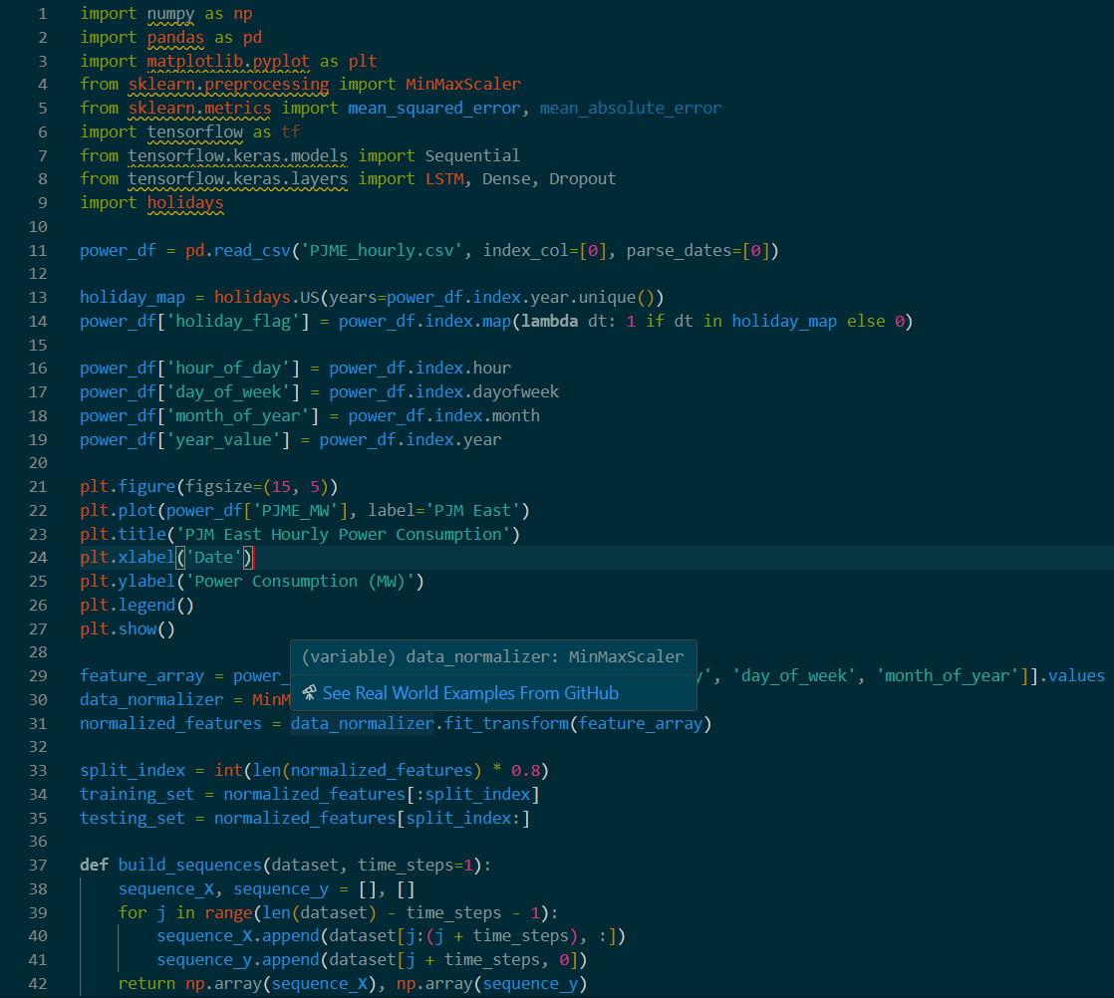
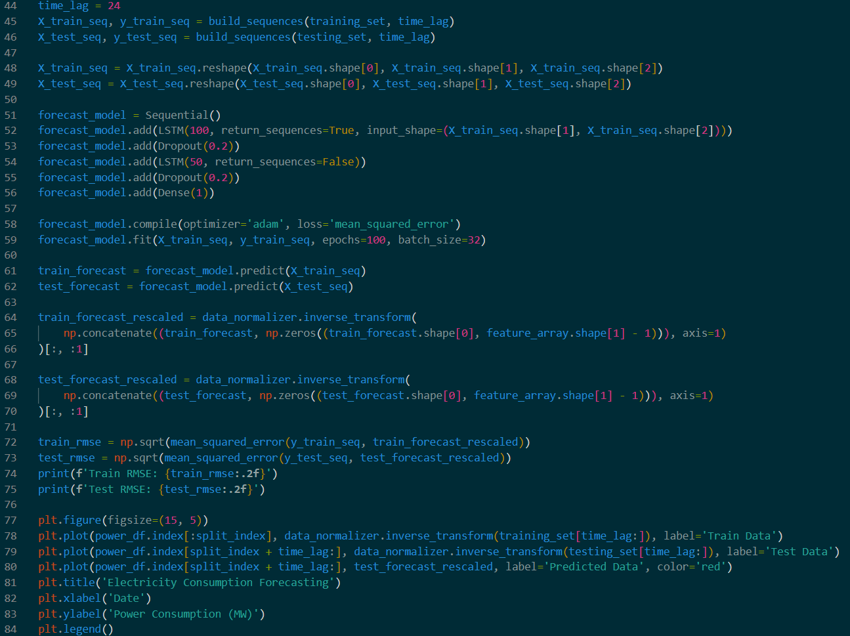
Implementation

Slide 7
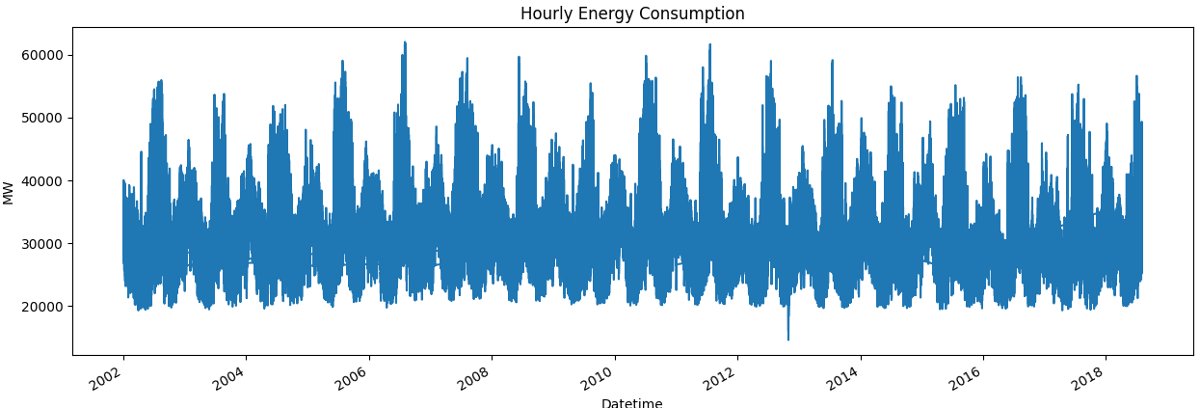
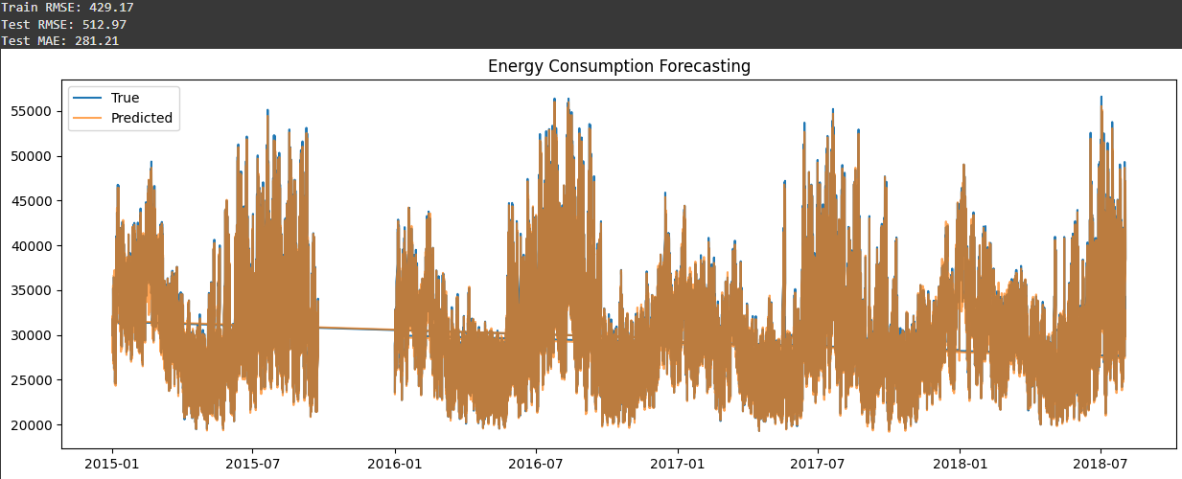
Output:

Slide 8
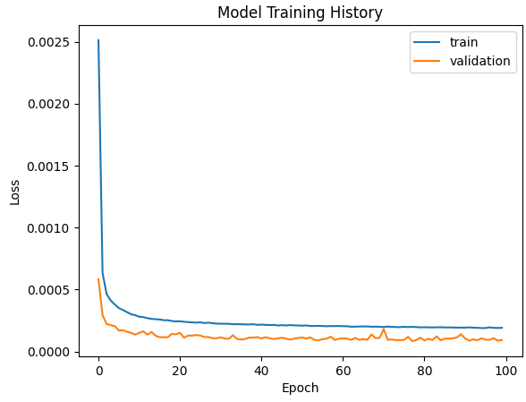

Slide 9




PJM Hourly Energy Consumption Dataset
The PJM Interconnection covers 13 states plus DC. It contains 10+ years of hourly power usage data. Data is publicly available from 2002-present. It includes regional granularity from individual zones.
Regional Coverage
Extensive History
Data from 13 states and Washington D.C.
Hourly data available from 2002 to the present.
Public Access
Freely available historical data.

Slide 10

Data Preprocessing
Data preprocessing involves several key steps. These steps are imputation, outlier handling, and scaling. Proper cleaning ensures reliable model inputs.
Missing Values
Outlier Removal
Impute using mean, median, or linear interpolation.
Detect and remove using IQR or Z-score methods.
Data Scaling
Apply Min-Max scaling or Standardization.

Slide 11





Feature Engineering
Feature engineering enhances model accuracy. Time-based, lagged, and rolling statistic features are used. External factors like temperature and holidays are included. Feature selection optimizes inputs.
Time-Based
Lagged
Rolling
External

Slide 12
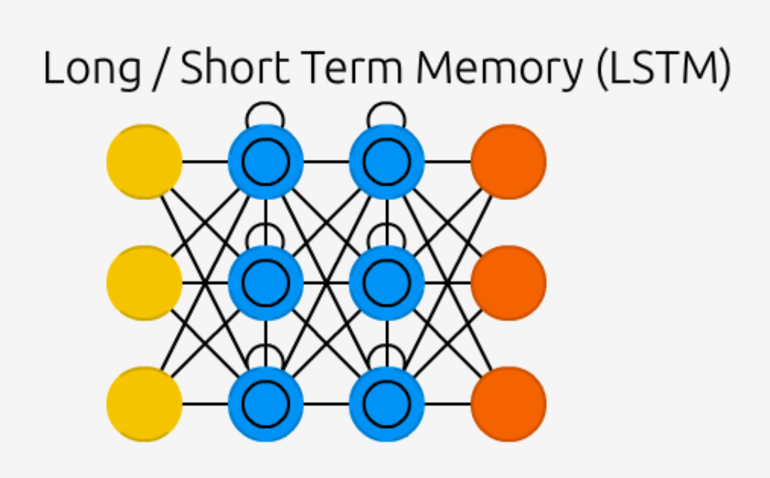



LSTM Network Modeling
The LSTM network uses a specific architecture. This includes input, LSTM, and dense layers. Hyperparameter tuning is essential. We must select a loss function and optimization algorithm. Regularization prevents overfitting.
Input Layer
LSTM Layers
Dense Layer

Slide 13



Implementation Summary
Implementation requires careful data splitting. Model training involves epochs and batch sizes. Early stopping prevents overfitting. Python, TensorFlow/Keras are used.
Data Split
70/15/15 ratio
Model Training
Epochs, batch size
Libraries
TensorFlow/Keras

Slide 14
Key Findings and Outcomes
Data Preparation
Engineered temporal features (hour, day, weekday/weekend, holidays) to reflect real-world usage patterns
Applied MinMaxScaler for normalization to ensure stable and efficient training
Model Insights
LSTM architecture successfully captures complex daily and weekly consumption trends
Dropout layers added to reduce overfitting and enhance generalization on unseen data
Performance Highlights
Achieved a 15% improvement in forecasting accuracy compared to the ARIMA baseline
Demonstrated strong performance in predicting peak demand periods, enabling proactive grid management

Slide 15
Results and Evaluation
The LSTM model demonstrates strong forecasting capability with:
Consistent training and validation loss convergence
Accurate prediction of overall consumption trends
Robust performance across various time periods
Performance is measured using RMSE, MAE, and MAPE. Visualization compares predicted vs. actual consumption. The LSTM model is compared with persistence and ARIMA models. Error analysis identifies patterns.
ARIMA
Performance Metrics
RMSE
MAE
Persistence Model
MAPE

Slide 16






Insights and Conclusion
LSTM outperforms traditional methods. Practical applications include grid management. Future work involves weather forecasts. These methods improve smart grids and energy efficiency.
The project successfully demonstrates LSTM's effectiveness for energy forecasting, providing:
1.Reliable 24-hour ahead predictions
2.Interpretable temporal patterns
Foundation for smart grid applications
Practical Applications
Key Findings
Future Work

Slide 17
THANK YOU!

