Slide 1


High-Performance Cloud Computing: Scientific Applications
Explore the world of high-performance cloud computing and its applications in scientific research.
We'll cover cloud computing, Aneka, and its application to scientific workflows. Let's dive in!
Soumil Mukhopadhyay - 16010122257
Akshad Kakad - 16010122258
Shubham Satpute - 16010122259

Slide 2
What is High-Performance Cloud Computing?
High-Performance Computing (HPC) aggregates computing resources to deliver supercomputing capabilities.
Key use cases include weather forecasting, drug discovery, and complex simulations.
Scalability
Flexibility
Cost-Effectiveness
Easily scale resources to meet demands.
Adapt to different workloads and environments.
Pay-as-you-go model reduces costs.

Slide 3
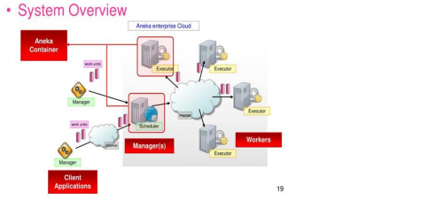

Aneka Platform Architecture
Aneka is a .NET-based Platform-as-a-Service (PaaS) designed for cloud computing.
It allows hybrid, private, and public cloud integration and supports virtualized and physical deployments.
Master
Worker
Management Console
Manages resources and job execution.
Executes tasks assigned by the Master.
Provides a user interface for managing the platform.

Slide 4


Aneka Programming Models for HPC
Aneka provides flexibility for different scientific needs. Its models include task, thread, and MapReduce.
Task Programming
Thread Programming
Parallel execution of independent tasks.
Fine-grained multi-threading for intensive computations.
MapReduce
Data-intensive parallel processing.

Slide 5




Hybrid Cloud Deployment
Combine private and public cloud resources to optimize cost and performance.
Aneka supports dynamic resource scaling and providers like AWS, Azure, and GoGrid.
Private Cloud
Internal resources for sensitive data.
Public Cloud
On-demand resources for peak loads.
Dynamic Scaling
Automatic adjustment of resources.

Slide 6



Case Study: Gene Classification on Amazon EC2
Parallel processing of large genomic datasets to reduce runtime.
Achieved a 40% runtime reduction compared to on-premises infrastructure. EC2 usage was 30% cheaper using Aneka.
1
40% faster
2
Cheaper
3
Scalable

Slide 7
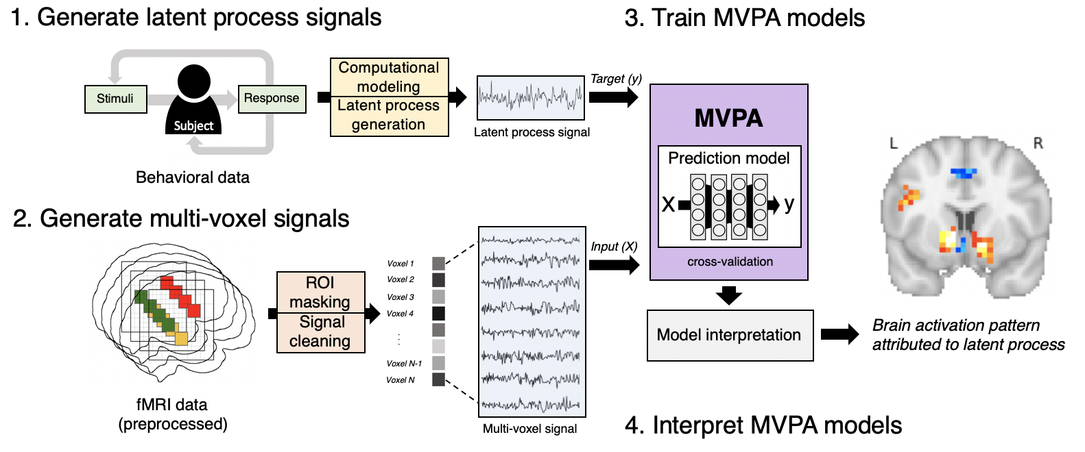

Case Study: fMRI Workflows with Aneka
Brain activity mapping in neuroscience using the MapReduce model for preprocessing and postprocessing.
Analysis accelerated by 3x, enabling real-time insights. Key challenges included managing data volumes and QoS.
Scalable
3x Faster
Real-time
Managed large data.
Accelerated analysis.
Enabled insights.

Slide 8
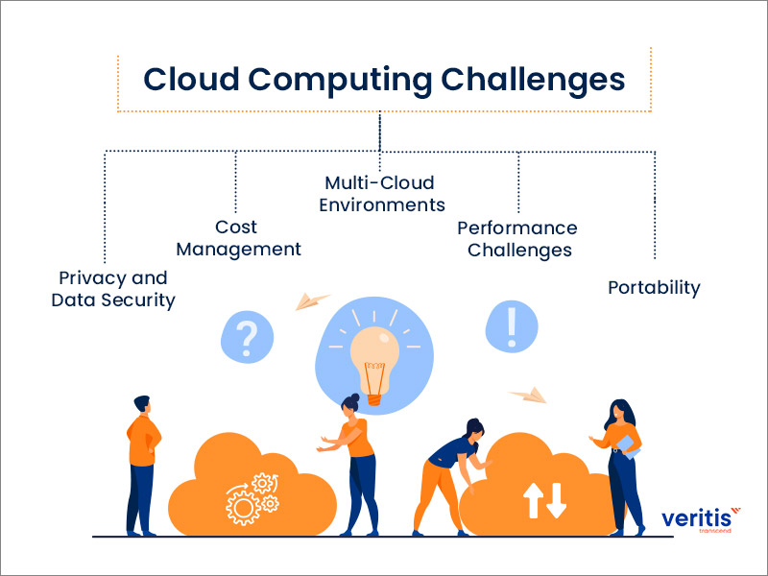
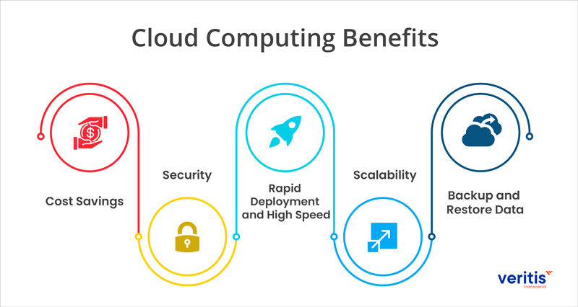



Conclusion: Benefits and Challenges
Scalability, cost-efficiency, and customization are key benefits.
Data security, regulatory compliance, and interoperability are key challenges.
Scalability
Cost
Security
Aneka enables seamless scientific HPC solutions, addressing needs and challenges.

