Slide 1
Team Name :- CodeOfDuty
Topic:- Legal Ally
Dhruv Mehta [TL]
Hyder Presswala
Soumil Mukhopadhyay
Rushikesh Shembade

Slide 2
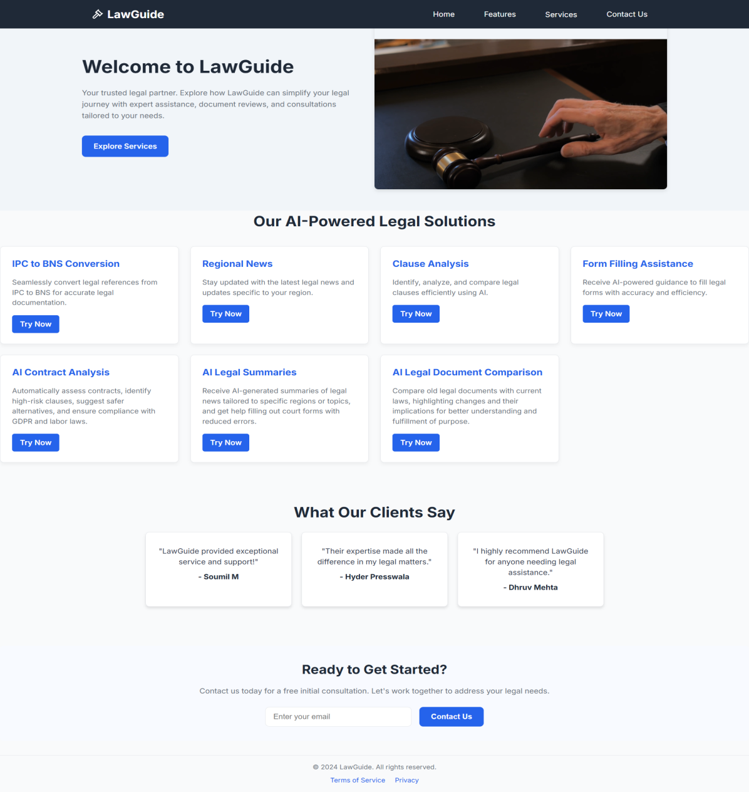
LawGuide:-Your Legal Assistant’s

Slide 3
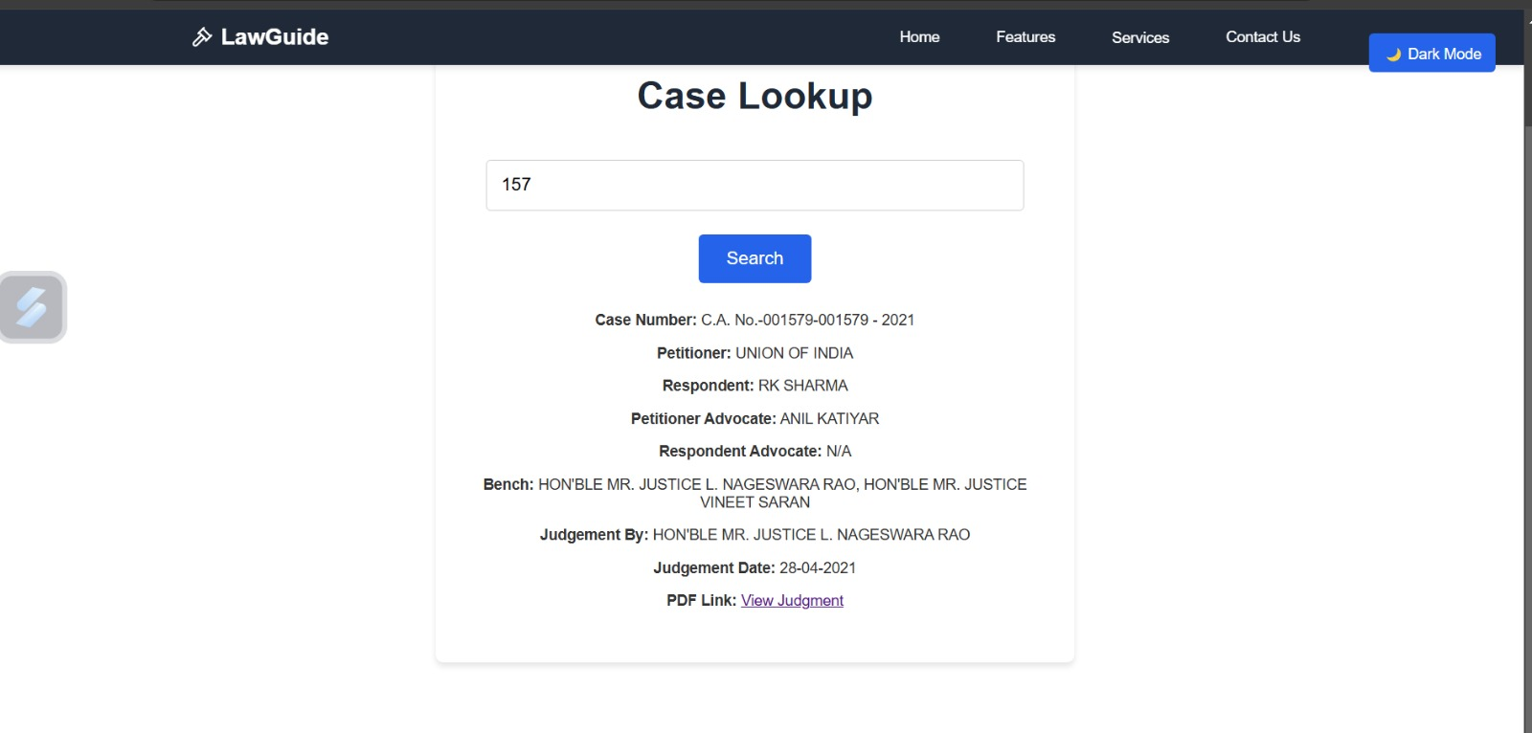
Case Lookup Using Case Number

Slide 4
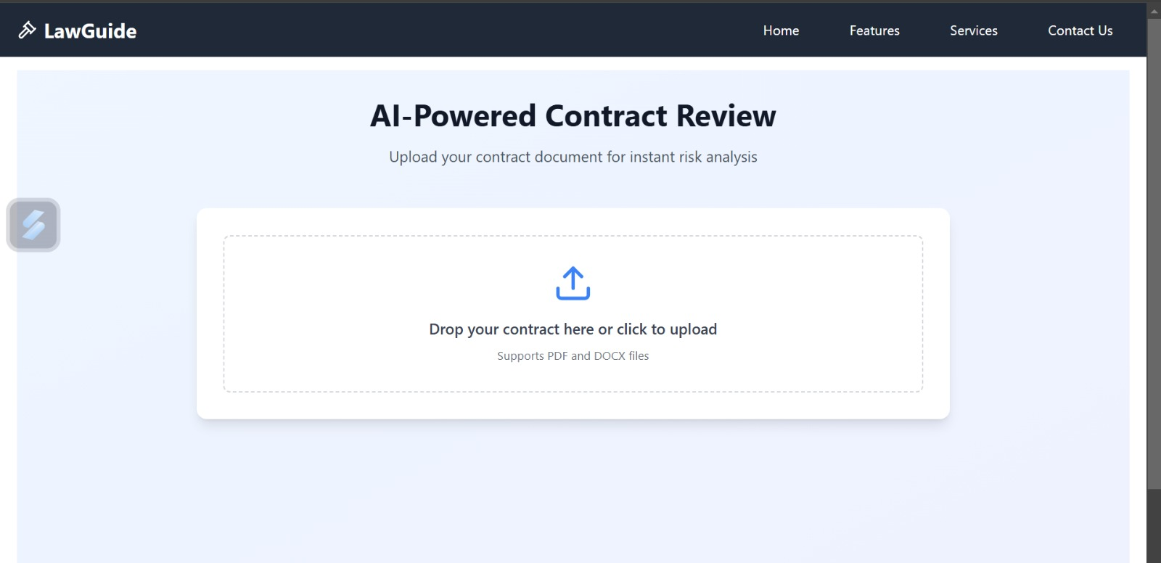
Contract Review

Slide 5
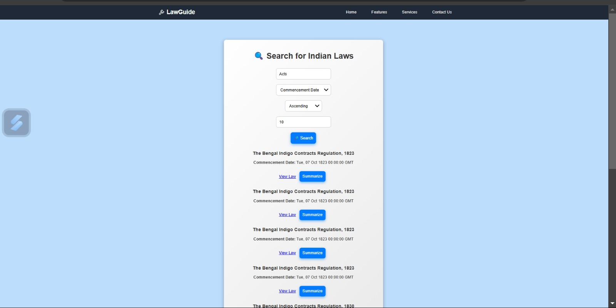
Searching for Indian Law Cases

Slide 6
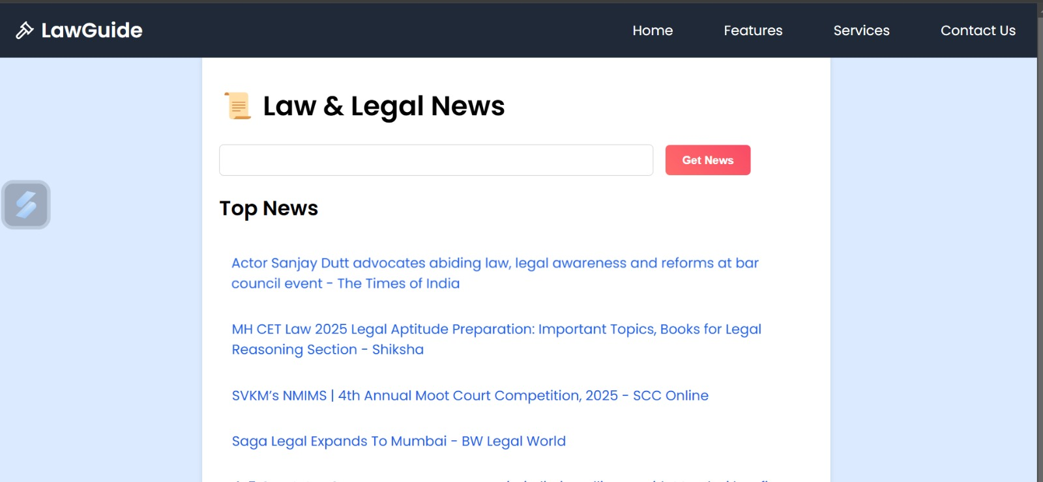
Regional News

Slide 7
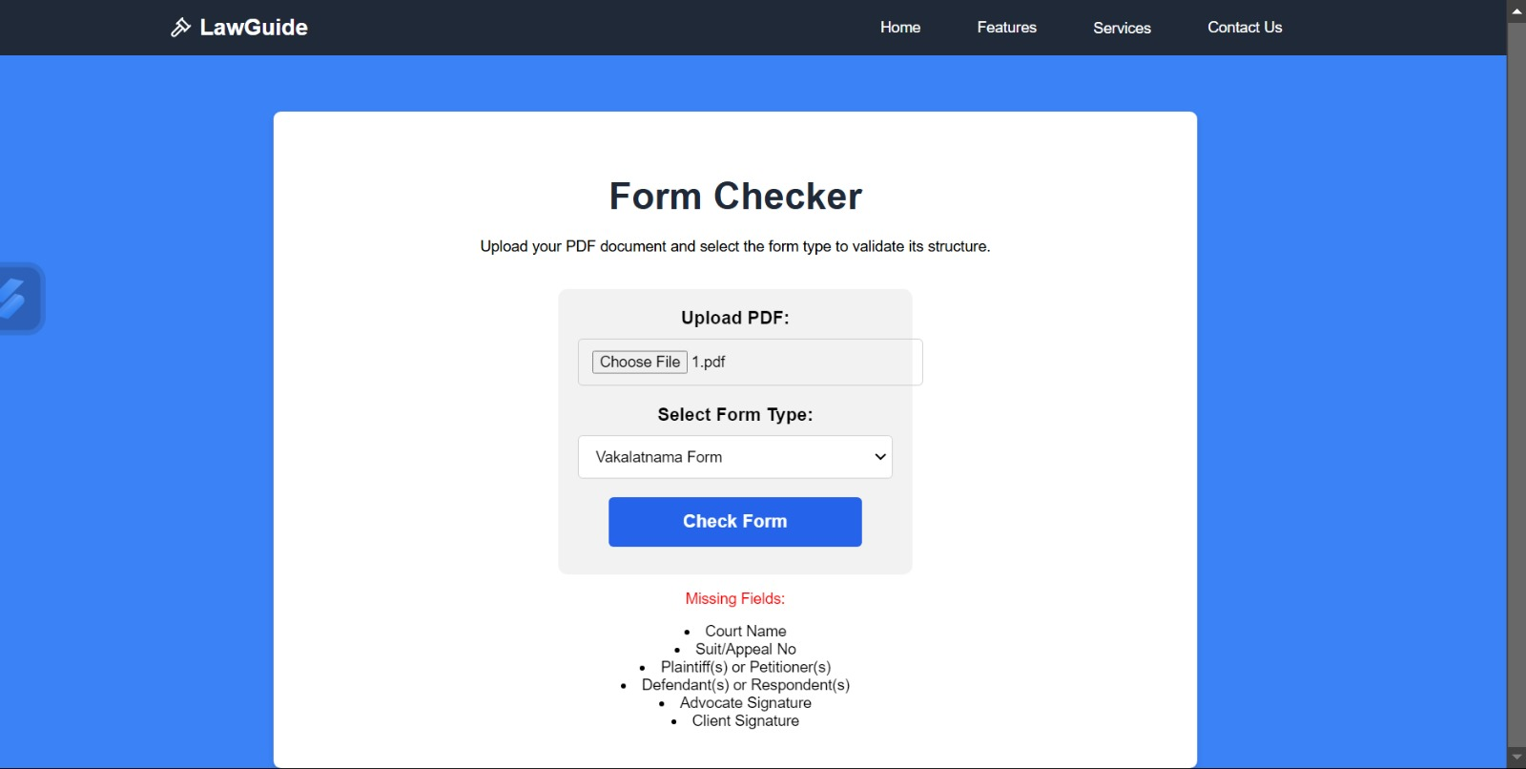
Legal Form Validator

Slide 8
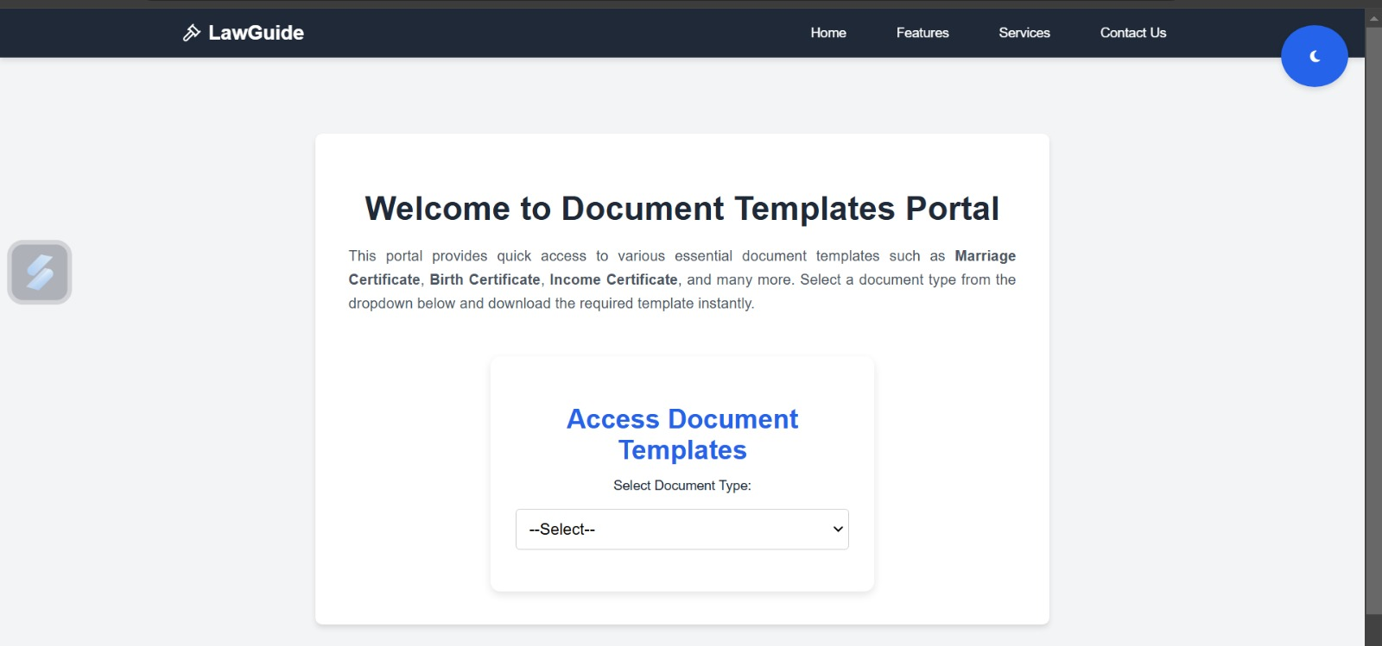
Document Templates

Slide 9
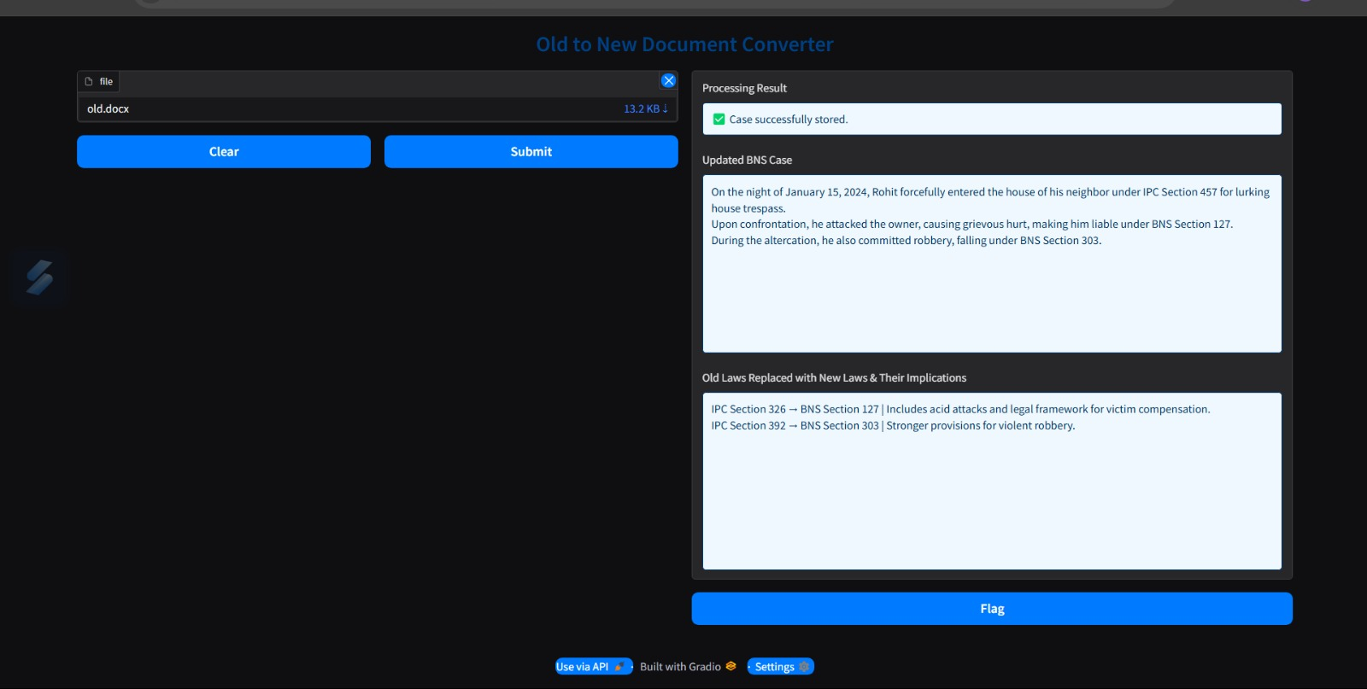
Old document Comparison with New One

Slide 10
THANK YOU!

