Slide 1
Comment System Application
Name-Soumili Bera
College - IIEST Shibpur

Slide 2
TOPICS:
INTRODUCTION
FUNCTIONALITIES
TECHNOLOGY
CONCLUSION

Slide 3
INTRODUCTION
The comment system application has been designed to help different users to collaborate their ideas together by commenting. In this system multiple users can sign in and they can write their thoughts/ideas which the other users can also see and can comment in reply, thus creating a collaborative environment for multiple users.
So, this system is responsible for the field of Collaboration where a team can discuss their ideas and can develop something easily. The comment system can also be added to any other application where the different users can use this system to design their ideas while working in a team.

Slide 4
FUNCTIONALITIES:
The various functionalities of the System is-
Sign up for the user
Sign in
Forgot Password
Comment Box
Filter function
Log out

Slide 5
Sign Up
The sign up page will help the user to sign up into the system .Once the user has signed up then he/she can use the system.
The various fields required for sign up is
Email Id - Every user needs to have a unique email address
Password - To secure their profile
Secret Code - Which will help the user to reset password at later part

Slide 6
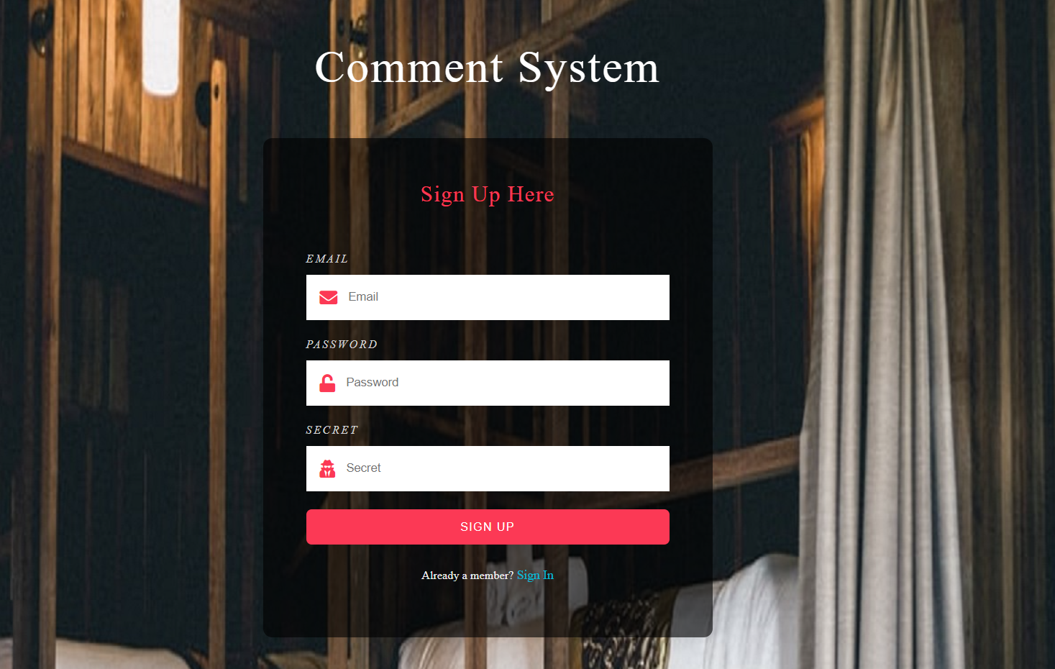

Slide 7
Sign In
The user can sign in using the registered email id and password. Check has been kept so that the user gets access only if entered correct password and email id. Otherwise access will be denied displaying the required message.

Slide 8
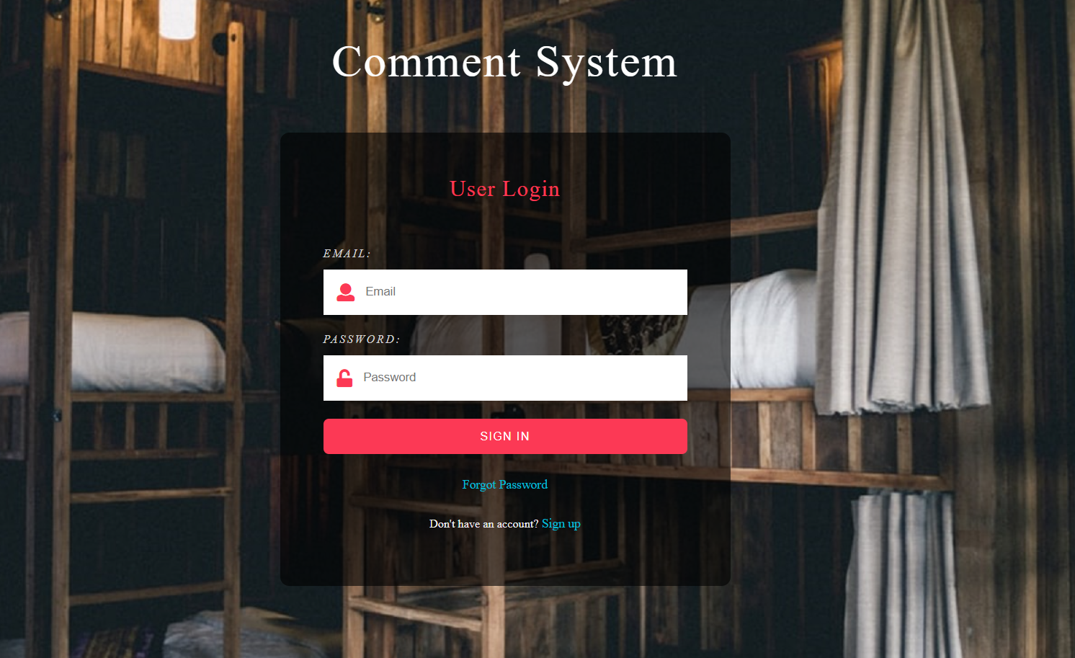

Slide 9
Forgot password
The forgot password option helps the user in getting access to the older password only if the secret code is entered properly. Once the secret code entered matches, the old password would be displayed to the user and the user can copy it and store it somewhere for further purpose.

Slide 10
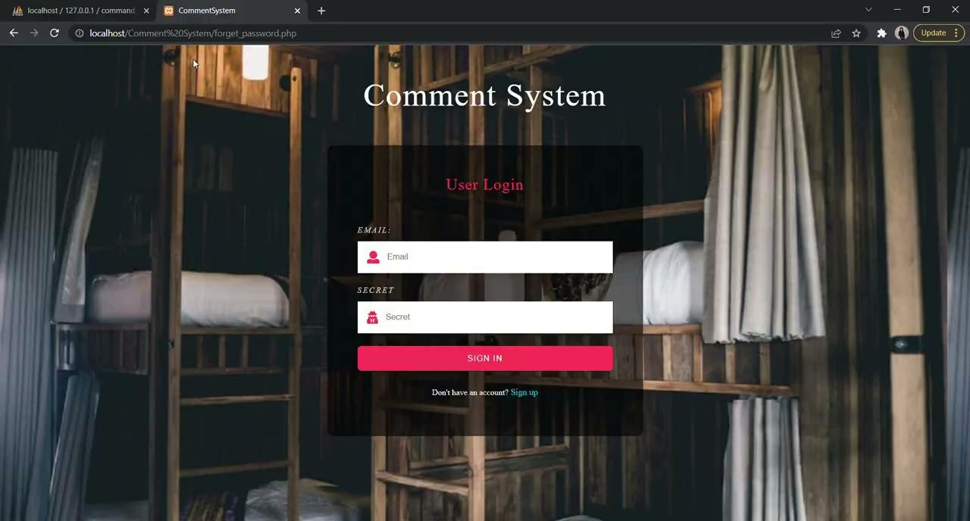

Slide 11
Comment Box
Once the user signs in, he/she can see a comment box where the user can type anything. Also the user can see the comments of other user.

Slide 12
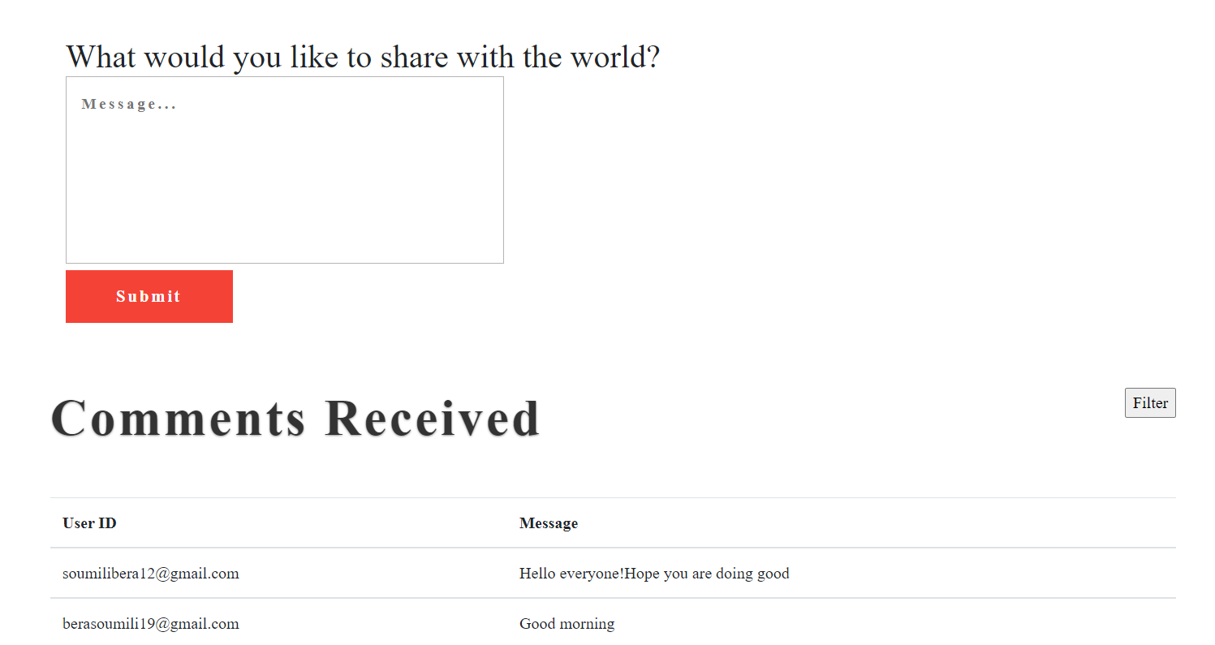

Slide 13
Filter function
The filter function in the comments received section helps us to filter out the comments the logged in user. Thus the logged in user can see what all comments did they post in the system.

Slide 14
TECHNOLOGY
The technology used in this project besides HTML, CSS, Javascript and Bootstrap is PhP along with mysqli for database queries.
Xampp has been used along with phpmyadmin for running this system.

Slide 15
CONCLUSION
Due to the ongoing pandemic where the virtual environment has become more important for maintaining the standards of works and meetings via video call have become the most common thing, the aim of this Comment System is to enable users to stay connected with limited resources and also keeping in mind the different time horizons. It is a system that will help users to collaborate easily with their ideas when video calls cannot be done.

Slide 16
THANK YOU

