Slide 1

Advanced Electric Load Demand Forecasting Using AI
MAJOR PROJECT • 2026 – 2027
Under The Supervision Of
Dr. Mamtarani Das
Department of Computer Science and Engineering | Major Project — 7th Semester
Soumit Mal (Data Science) - 2301020365
Subhasish Kumar Sahu (Data Science) - 2301020857
Roshan Singh (Data Science) - 2301020380
Raja Ram Kumar (Computer Science & Core) - 2301020406
GITHUB REPO: github.com/Soumit2k05/MP-1-7th-Sem-Soumit-Subhasish-Roshan-Rajaram

Slide 2
Outline
1
Problem Statement & Objectives
5
Exploratory Data Analysis & Feature Engineering
2
Literature Review & Research Gap
6
Model Training, Bayesian Optimization & SHAP Explainability
3
Dataset Overview
7
Results, Performance Comparison & Regional Case Study
4
Proposed Methodology — End-to-End Pipeline
8
Conclusion & Future Work
2

Slide 3
Problem Statement
1
Increasing Electricity Demand
2
Limitations of Traditional Methods
Consumption shifts continuously with daily usage, weather conditions and seasonal variation, making accurate forecasting difficult.
Classical approaches such as ARIMA, SVM and ANN struggle with noise, outliers and changing demand patterns, reducing reliability.
3
Impact of Imprecise Forecasting
4
Need for an Intelligent Solution
Poor predictions raise operational cost and energy wastage, and weaken the efficiency of power-system planning.
An AI-based model that handles noisy data effectively improves accuracy and supports better power-system decisions.
3

Slide 4
Research Objectives
1
2
3
Leakage-Free Evaluation
Bayesian Hyperparameter Optimization
Game-Theoretic Explainability
Strict chronological train-test split so no training observation follows a test observation.
Replace manual or exhaustive grid search with Optuna TPE across 60 trials.
Apply SHAP TreeExplainer to compute exact marginal feature contributions.
4
5
6
Comparative Benchmarking
Feature Engineering
Reproducible Pipeline
Head-to-head evaluation of Linear Regression, Random Forest, XGBoost and LSTM.
Construct lag and rolling-mean features that encode recent load history.
Deliver a documented, end-to-end pipeline from raw CSV to a deployable model.
4

Slide 5
Literature Review & Research Gap
Study | Merit | Demerit
Bayesian Optimization of GBTs — P. Duan et al., 2023 | TPE substantially reduces error vs. grid search. | No SHAP-based feature explainability.
Sequence-Aware LSTM Forecasting — S. Hochreiter et al., 2021 | Captures long-range dependencies without manual lags. | High compute cost; weak interpretability.
Explainable AI via SHAP — A. Lundberg et al., 2022 | Rigorous, mathematically grounded feature scores. | Single-model evaluation only.
Hybrid LSTM-XGBoost — O. M. Neda, e-Prime 2026 | Combines boosting and recurrent strengths. | Doesn't isolate features vs. architecture effects.
RESEARCH GAP
1
2
3
4
Data Leakage
Low Interpretability
Manual Tuning
Limited Benchmarking
Random splits let future data leak into training, inflating scores.
High-accuracy models treated as black boxes, without SHAP validation.
Heavy reliance on manual/grid search rather than Bayesian Optimization.
Rare head-to-head test of XGBoost against sequence deep learning.
5

Slide 6
Dataset Overview
Three datasets were used to train and evaluate the forecasting models, spanning grid-level, national and building-level electricity demand.
PJME Hourly
Mediterranean_Electric_Load_2025
Building Energy
PJM Interconnection, USA
Synthetic building-level series
RECORDS
69,000+ daily records
RANGE
Jan 2020 – Mar 2025
CONTENT
Demand, draw & shortage
RECORDS
RECORDS
145,366 hourly readings
5,000+ hourly records
RANGE
RANGE
Jan 2002 – Aug 2018
Single-building span
CONTENT
CONTENT
Grid-level demand (MW)
Weather, occupancy, HVAC & PV
Dataset | Records | Frequency
PJME Hourly | 145K+ | Hourly
Mediterranean_Electric_Load_2025 | 69K+ | Daily
Building Energy | 5K+ | Hourly
Three datasets were considered: PJME Hourly (primary), Mediterranean (regional study), and Building Energy (alternative).
6

Slide 7
Methodology — End-to-End Pipeline
Data Ingestion &
Chronological Split
→
Feature
Engineering
→
Parallel Model
Training
→
Optuna Bayesian
Tuning (XGBoost)
→
SHAP
Explainability
→
Evaluation
(MAE / RMSE / R²)
Best Model Saved (.pkl) → Deployment / Dashboard Integration
1
2
3
4
5
Data Preparation
Feature Selection
Model Training
Model Evaluation
Deployment
Cleaned the dataset and applied an 80:20 chronological train-test split, preserving time order.
Selected temporal, lag and rolling-statistic inputs relevant to electricity consumption.
Trained Linear Regression, Random Forest and XGBoost (default and Optuna-tuned) models.
Compared models using MAE, RMSE and R² to select the best performer.
Saved the best model as a .pkl file for dashboard integration.
7

Slide 8
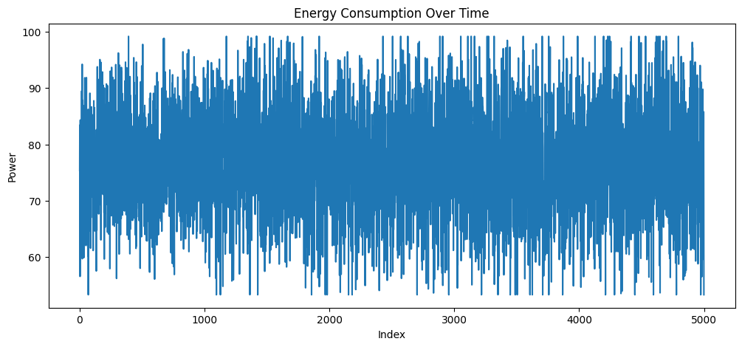
Exploratory Data Analysis (EDA)
The dataset was analyzed to identify daily and seasonal electricity consumption patterns before feature engineering began.
Time Features
Extracted Hour, Day, Month, Weekday and Weekend to capture time-based trends.
Lag Features
Created Lag-1, Lag-24 and Lag-168 from prior hour, day and week consumption.
Rolling Statistics
24-hour and 168-hour rolling averages reduce noise and highlight longer-term trends.
Outcome
Demand is lowest 03:00–05:00, rises sharply in the 06:00–09:00 morning ramp, plateaus by day, and peaks 17:00–20:00. Weekend demand runs 8–12% below equivalent weekday hours.
Figure — hourly load-variation pattern used to validate temporal feature choices
8

Slide 9
Feature Engineering Pipeline
Time, lag and rolling-window signals are combined into a single feature matrix used identically across every model.
Raw Datetime-
Indexed Series
→
→
Combined
Feature
Matrix
Time-Based Features
Hour • Day • Month • Weekday • Weekend • Quarter • Year
Captures intra-day, weekly and seasonal demand cycles
Lag Features
Lag_1 (t-1) • Lag_24 (t-24) • Lag_168 (t-168)
Strongest short-term predictors: previous hour, same hour yesterday, same hour last week
Rolling Statistics
Rolling_Mean_24 • Rolling_Mean_168
Smooths short-term noise and encodes recent demand level
9

Slide 10
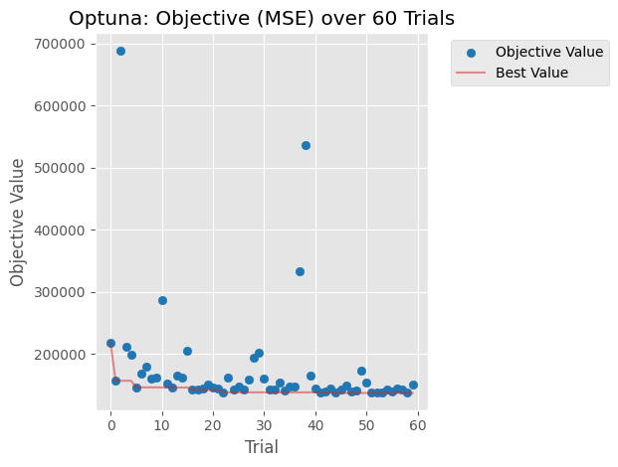
AI/ML Models & Bayesian Optimization
MODELS TRAINED
BAYESIAN HYPERPARAMETER SEARCH — OPTUNA (XGBOOST)
Linear Regression
n_estimators
100 – 800 (int)
Statistical baseline
learning_rate
0.01 – 0.3 (log)
max_depth
3 – 10 (int)
Random Forest
subsample
0.5 – 1.0
n_estimators=200, depth=15
colsample_bytree
0.5 – 1.0
reg_alpha / reg_lambda
1e-8 – 10.0 (log)
XGBoost (Default)
Sklearn-compatible defaults
21.1% RMSE Reduction
XGBoost (Optuna Tuned)
vs. default XGBoost
Best of 60-trial TPE search
RMSE: 469.9 → 370.9 MW
60 trials • TPE method
Figure — Optuna TPE optimization history across 60 trials (objective = validation MSE)
LSTM (2-Layer)
168-hour sliding window
LSTM topology: LSTM(128) → Dropout(0.2) → BatchNorm → LSTM(64) → Dropout(0.2) → BatchNorm → Dense(32) → Dense(1), with EarlyStopping and ReduceLROnPlateau.
10

Slide 11
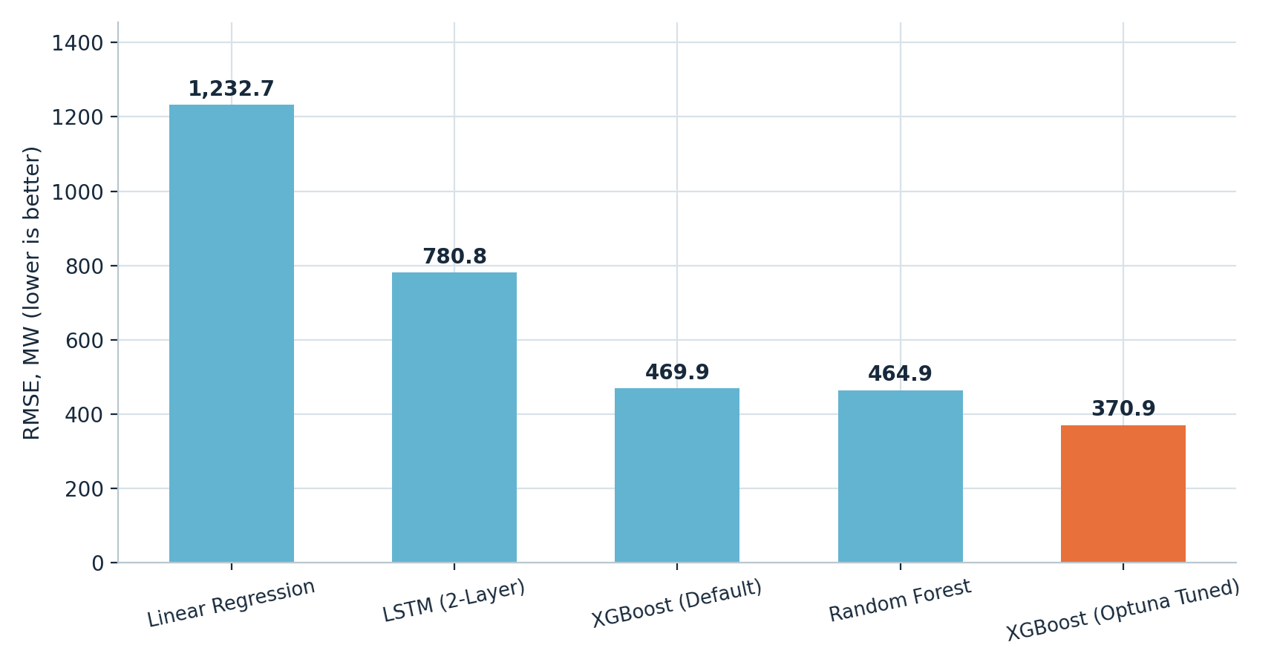
Results — PJME Hourly Load Forecasting
Model | MAE (MW) | RMSE (MW) | R²
Linear Regression (Baseline) | 965.0 | 1,232.7 | 0.9635
Random Forest | 334.9 | 464.9 | 0.9948
XGBoost (Default) | 354.8 | 469.9 | 0.9947
XGBoost (Optuna Tuned) | 269.4 | 370.9 | 0.9967
LSTM (2-Layer) | 611.0 | 780.8 | 0.9853
Best Model
Lowest Error
Highest Accuracy
Tuning Impact
XGBoost (Optuna Tuned) delivered the strongest performance across all three metrics.
Achieved MAE 269.4 MW and RMSE 370.9 MW on the chronologically held-out test set.
Recorded the highest R² score of 0.9967 among all five models.
Optuna tuning cut XGBoost's RMSE by 21.1% versus its default configuration.
Random Forest performed well as an ensemble baseline, while plain Linear Regression recorded the highest error; disciplined feature engineering combined with Bayesian tuning outperformed the sequence-based LSTM.
11

Slide 12
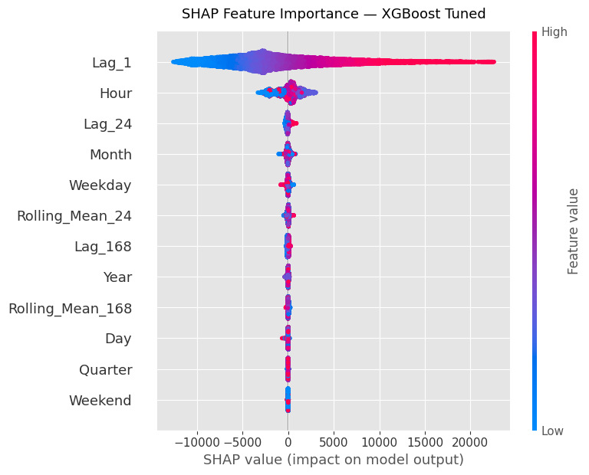
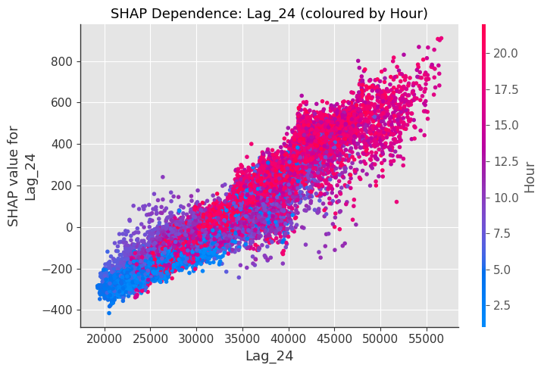
Explainability Using SHAP
SHAP TreeExplainer provides game-theoretic, mathematically rigorous transparency for the XGBoost (Optuna Tuned) model.
Figure — SHAP beeswarm summary: global feature importance
Figure — SHAP dependence plot for Lag_24, coloured by Hour of day
Lag_1 is the dominant predictor by a wide margin; Lag_24 and Hour follow as the next-strongest signals. The Lag_24 dependence plot reveals a non-linear interaction that strengthens at evening peak hours (17–21).
12

Slide 13








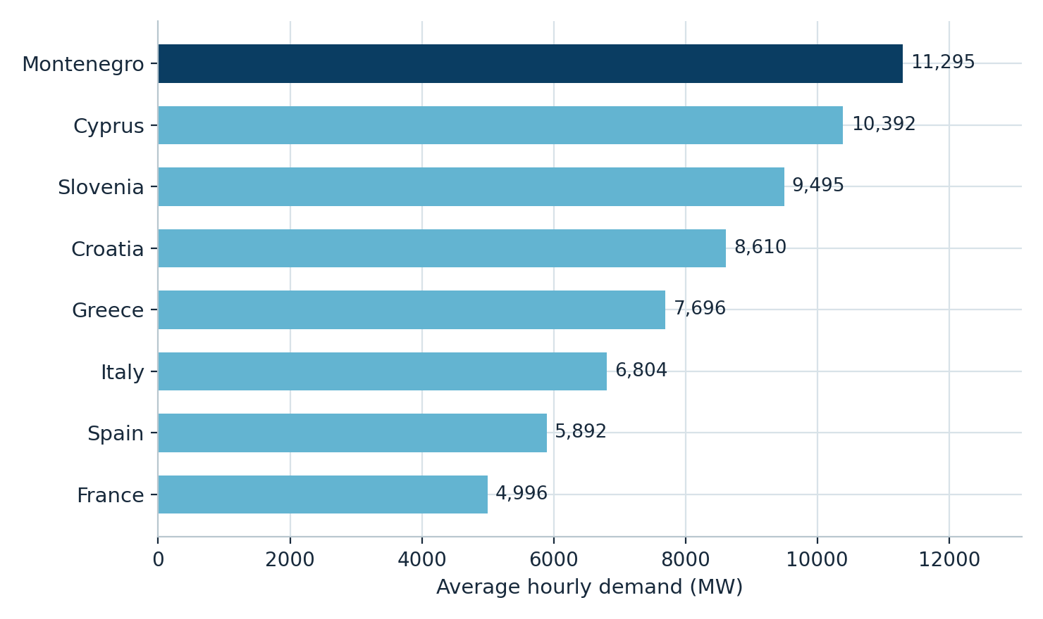
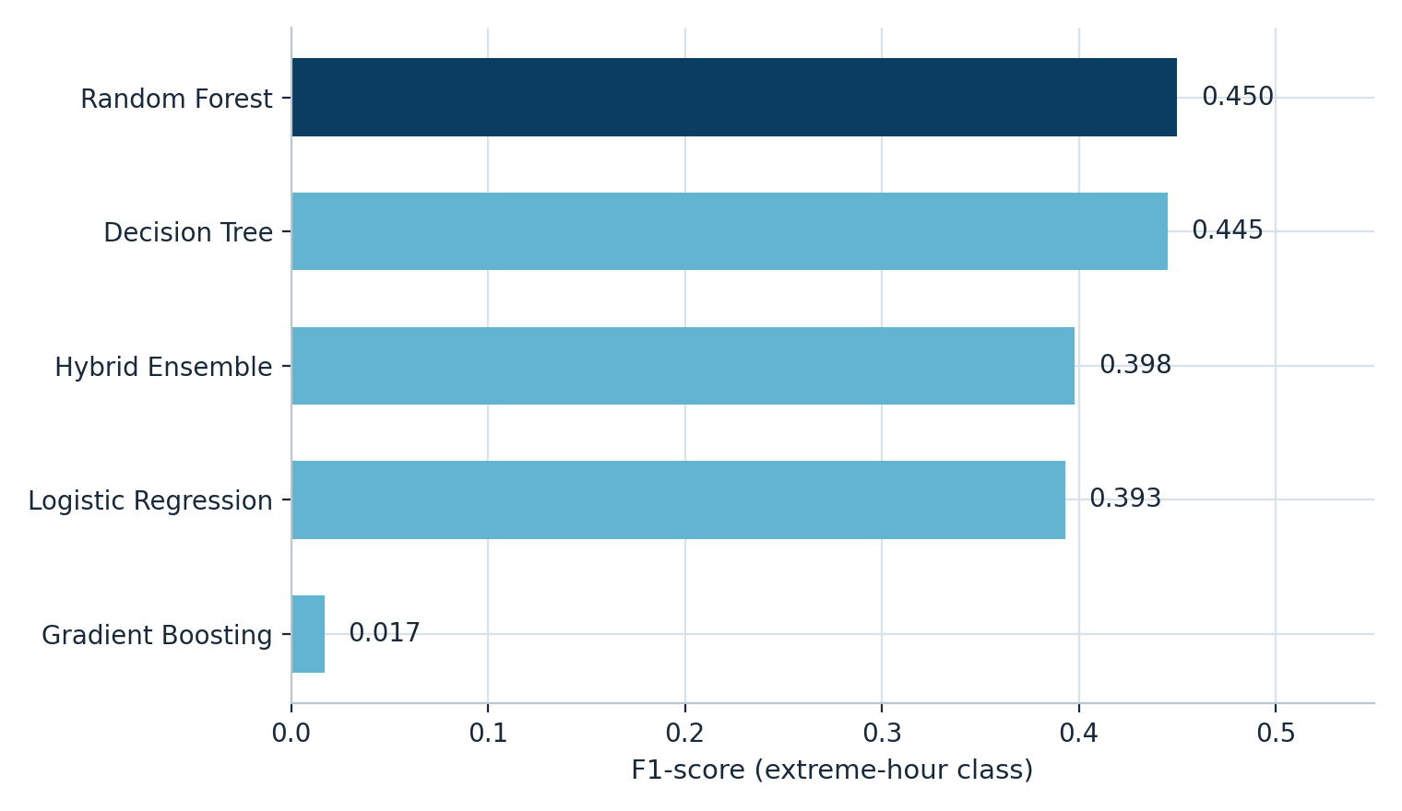
Mediterranean Analysis — Countries & Classification
11,520 hourly records
• 8 countries • 1 Jan – 1 Mar 2025
France
Spain
Italy
Greece
Croatia
Slovenia
Cyprus
Montenegro
Best classifier F1
Model | Accuracy | Precision | Recall | F1
Random Forest | 0.795 | 0.306 | 0.854 | 0.450
Decision Tree | 0.784 | 0.298 | 0.881 | 0.445
Hybrid Ensemble | 0.724 | 0.253 | 0.929 | 0.398
Logistic Regression | 0.750 | 0.258 | 0.823 | 0.393
Gradient Boosting | 0.902 | 0.500 | 0.009 | 0.017
Goal: Predict next-hour extreme demand using time, demand, ramp, and country features.
Key Finding: Montenegro has the highest average demand (11,295 MW), while France has the lowest (4,996 MW); 10% of hours are extreme.
Best Model: Random Forest performs best, achieving F1 = 0.450 and Recall = 0.854.
13

Slide 14
Conclusion & Future Work
CONCLUSION
FUTURE WORK
1
Complete Forecasting Pipeline
1
Advanced Architectures
Built an end-to-end pipeline spanning preprocessing, feature engineering, model training, tuning and explainability.
Explore Attention and Transformer models (e.g. TFT, PatchTST) for longer multi-horizon forecasts.
2
Uncertainty Quantification
2
Superior, Leakage-Free Accuracy
Add probabilistic interval forecasting to communicate prediction confidence to operators.
XGBoost with Optuna tuning outperformed Linear Regression, Random Forest and LSTM on MAE, RMSE and R², under a strict chronological split.
3
Edge Deployment
Transparent, Real-World Relevant
Optimize lightweight models for real-time inference on resource-constrained hardware.
3
SHAP confirmed Lag_1, Hour and Lag_24 as the dominant drivers; the pipeline supports smart-grid planning decisions.
4
Multimodal Data Integration
Fuse live weather feeds, dynamic electricity pricing and generation data into the model.
4
Regional Generalization
The Mediterranean case study showed the approach extends to multi-country demand and extreme-event risk.
5
Expanded Regional Coverage
Extend the Mediterranean synchronization analysis to more countries and longer time spans.
14

Slide 15
SOURCES
References
[1] P. Duan et al., “Bayesian Optimization of Gradient Boosted Trees for Short-Term Load Forecasting,” Energies, 2023.
[2] S. Hochreiter et al., “Deep Learning for Sequence-Aware Load Forecasting Using LSTM Networks,” IEEE Access, 2021.
[3] A. Lundberg et al., “Explainable AI for Power System Load Demand Prediction Using SHAP,” Applied Energy, 2022.
[4] O. M. Neda, “Hybrid LSTM-XGBoost Model for Multi-Horizon Short-Term Load Forecasting,” e-Prime, vol. 17, p. 201211, 2026.
[5] S. M. Lundberg and S.-I. Lee, “A Unified Approach to Interpreting Model Predictions,” NeurIPS, 2017.
[6] T. Akiba et al., “Optuna: A Next-generation Hyperparameter Optimization Framework,” Proc. ACM KDD, 2019.
[7] T. Chen and C. Guestrin, “XGBoost: A Scalable Tree Boosting System,” Proc. ACM KDD, 2016.
[8] S. R. Rallapalli and S. Ghosh, “Forecasting Monthly Peak Demand of Electricity in India,” Energy Policy, vol. 45, pp. 516–520, 2012.
[9] J. Bergstra and Y. Bengio, “Random Search for Hyper-Parameter Optimization,” JMLR, vol. 13, pp. 281–305, 2012.
[10] ENTSO-E, “ENTSO-E Transparency Platform — Actual Total Load per Country,” ENTSO-E Power Statistics, 2025.
15

