Slide 1

MAJOR PROJECT • 2026–2027
Advanced Electric Load Demand Forecasting Using AI
Under The Supervision Of
Prof. Mamtarani Das
Department of Computer Science and Engineering | Major Project — 7th Semester
Soumit Mal (Data Science) - 2301020365
Subhasish Kumar Sahu (Data Science) - 2301020857
Roshan Singh (Data Science) - 2301020380
Raja Ram Kumar (Computer Science & Core) - 2301020406
GITHUB REPO: github.com/Soumit2k05/MP-1-7th-Sem-Soumit-Subhasish-Roshan-Rajaram

Slide 2
Outlines
Problem Statement Improve electricity load forecasting by reducing errors caused by noise, outliers, and changing demand patterns.
Literature Review Review recent machine learning and deep learning approaches for short-term electricity load forecasting and identify their strengths and limitations.
Research Gap Existing methods have limited preprocessing, manual tuning, and are tested on limited datasets.
Proposed Methodology Build a hybrid model using FFT denoising, LOF outlier removal, RP/GAF encoding, and a Hyperband-tuned CNN-LSTM Autoencoder.
Results & Evaluation Compare the proposed model with ARIMA, SVM, ANN, and 1D-CNN using five performance metrics across three datasets.
Conclusion & Future Work Achieve more accurate forecasting and explore Transformers, probabilistic forecasting, and real-time deployment in future work.

Slide 3
Problem Statement
1) Increasing Electricity Demand
Electricity consumption changes due to daily usage, weather conditions, and seasonal variations.
These fluctuations make accurate load forecasting challenging.
2) Limitations of Traditional Methods
Conventional methods struggle with noise, outliers, and changing demand patterns.
This reduces prediction accuracy and forecast reliability.
3) Impact of Inaccurate Forecasting
Poor predictions increase operational costs and energy wastage.
They also reduce the efficiency of power system planning.
4) Need for an Intelligent Solution
An AI-based forecasting model is needed to handle noisy data effectively.
It improves prediction accuracy and supports better decision-making in power systems.

Slide 4
Literature Review
TITLE | AUTHOR | PUBLICATION / YEAR | MERIT | DEMERIT
Bayesian Optimization of Gradient Boosted Trees for Short-Term Load Forecasting | P. Duan, et al. | Energies, 2023 | • Demonstrates substantial error reduction using Tree-structured Parzen Estimator (TPE) over grid search. | • Lacks game-theoretic explainability (SHAP) to interpret specific feature contributions.
Deep Learning for Sequence-Aware Load Forecasting Using LSTM Networks | S. Hochreiter, et al. | IEEE Access, 2021 | • Models long-range temporal dependencies natively without requiring manual lag features. | • High computational overhead and lacks intuitive feature-level interpretability.
Explainable AI for Power System Load Demand Prediction Using SHAP | A. Lundberg, et al. | plied Energy, 2022 | • Provides mathematically grounded feature contribution scores for energy forecasts. | • Limited to single-model evaluation without benchmarking against sequence deep learning models.

Slide 5

Research Gap
Time-Series Data Leakage: Widespread use of random data splits introduces future leakage, resulting in artificially high scores that fail in real-world deployment.
Lack of Model Interpretability: High-accuracy models are treated as "black boxes" without feature-level explainability (e.g., SHAP) to validate predictions.
Inefficient Parameter Tuning: Heavy reliance on manual parameter selection or exhaustive Grid Search rather than adaptive Bayesian Optimization (Optuna).
Limited Comparative Benchmarking: Rare head-to-head evaluation between feature-engineered gradient boosting (XGBoost) and sequence deep learning (LSTM) on identical grid data.

Slide 6
Dataset Overview
PJME_hourly.csv
India_Elec_data.csv
Energy_consumption
_dataset.csv
PJM Interconnection, USA
Jan 2020 – Mar 2025, India
Synthetic building-level
145,000+ hourly readings • 2002–2018 • Grid-level (MW)
69,000+ records • State-wise daily demand, drawl & shortage
5,000 hourly records • Weather, occupancy, HVAC & PV features
Dataset Overview
Three datasets were used to train and evaluate the forecasting models.
The datasets include USA hourly load, India electricity demand, and building-level energy consumption.
They provide diverse data for building a robust prediction model.
Dataset | Records | Frequency
PJME Hourly | 145K+ | Hourly
India Elec | 69K+ | Daily
Building Energy | 5K+ | Hourly

Slide 7
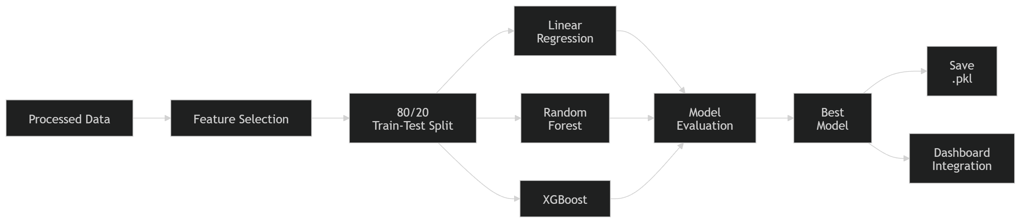
Methodology — End-to-End Pipeline
Figure 1: Load Forecasting & Deployment Pipeline
Data Preparation: Cleaned the dataset and performed an 80:20 train-test split while preserving time order.
Feature Selection: Selected important input features for electricity consumption prediction.
Model Training: Trained Linear Regression, Random Forest, and XGBoost models.
Model Evaluation: Compared models using MAE, RMSE, and R² to select the best performer.
Deployment: Saved the best model as a .pkl file for dashboard integration.

Slide 8
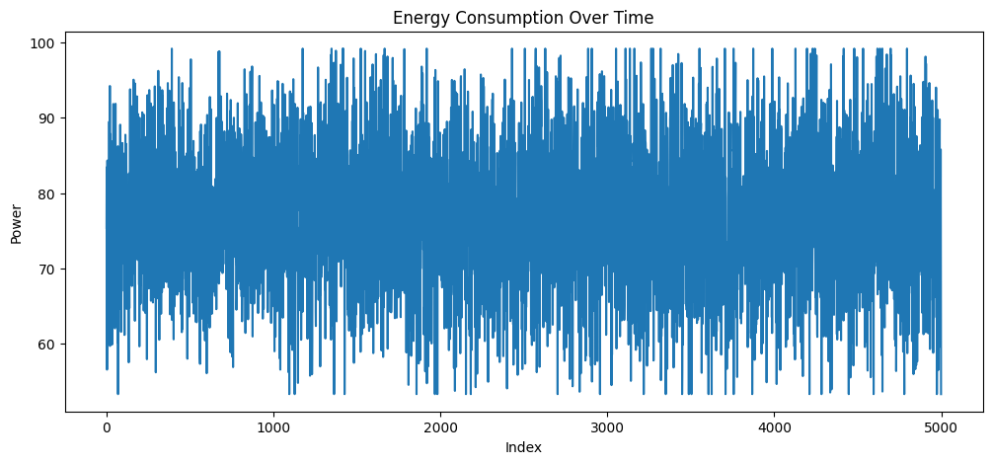
Exploratory Data Analysis (EDA) & Feature Engineering
EDA: Analyzed the dataset to identify daily, and seasonal electricity consumption patterns.
Time Features: Extracted Hour, Day, Month, Weekday, and Weekend to capture time-based trends.
Lag Features: Created Lag-1, Lag-24, and Lag-168 to use previous hour, daily, & weekly consumption history.
Rolling Statistics: Calculated 24-hour, 168-hour rolling averages to reduce noise and highlight long-term trends.
Feature Engineering: Combined time, lag, and rolling features for better prediction.
Outcome: Prepared a clean and informative feature set for accurate short-term electricity load forecasting.
Figure: 2 Energy consumption over time plot

Slide 9
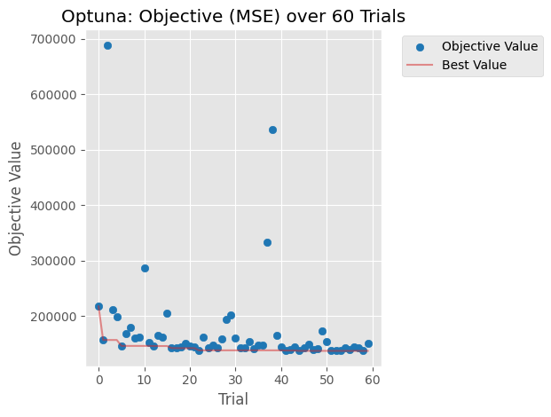
Bayesian Optimization via Optuna (XGBoost)
Optimization: Used Optuna to automatically find the best model settings.
Goal: Reduced prediction error (MSE) to improve accuracy.
Trials: Tested 60 different parameter combinations.
Parameters: Adjusted important XGBoost settings like number of trees, tree depth, and learning rate.
Result: The best settings improved the model's forecasting performance.
Figure 3: Historical Optuna optimization (60 trials).

Slide 10
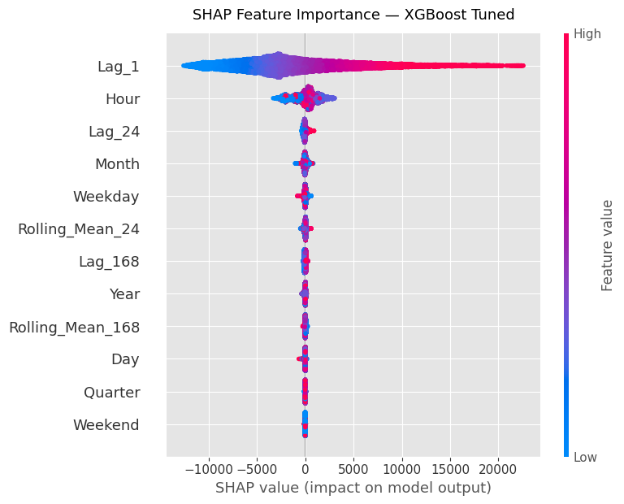
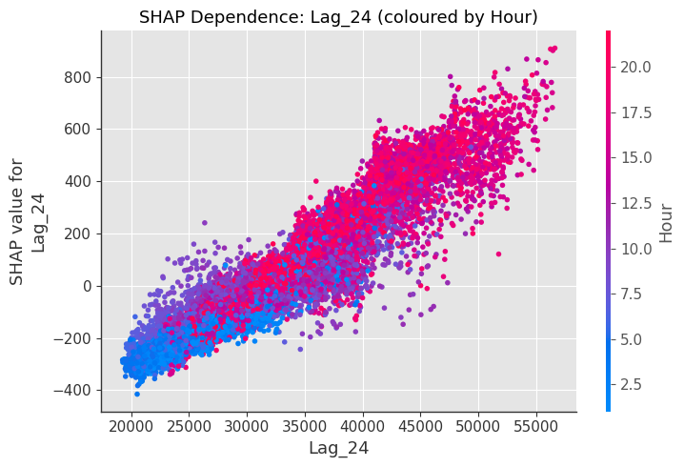
Feature Interpretability using SHAP
Moving Beyond Black Boxes: Implemented SHAP TreeExplainer to provide mathematically rigorous, game-theoretic transparency to the XGBoost model.
Global Feature Importance: The SHAP summary beeswarm plot confirms that Lag_24, Hour, and Rolling_Mean_24 exert the strongest predictive influence on electricity demand.
Local Interactions: Dependence plots reveal non-linear interactions, such as how the relationship between yesterday's load (Lag_24) and today's prediction shifts depending on the specific Hourof the day.
Figure 4: SHAP summary plot showing the global importance of input features.
Figure 5: SHAP dependence plot illustrating the impact of Lag_24 on model predictions.

Slide 11
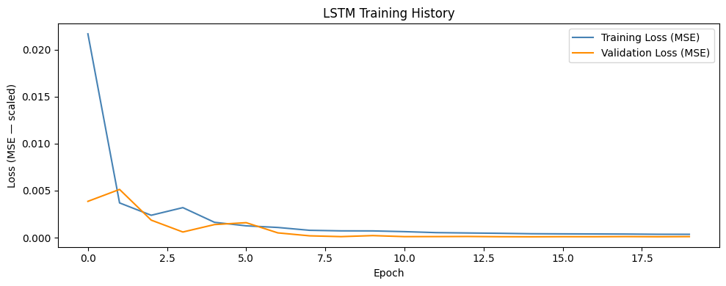
Sequence Deep Learning Benchmark (LSTM)
Architecture Design: Built a continuous sequence-aware neural network to natively model long-range temporal dependencies without relying on engineered lag features.
Sliding Window: Input data was scaled via MinMaxScaler and reshaped into 168-hour (7-day) lookback sequences.
Network Topology:
Layer 1: LSTM (128 units) --> Dropout (0.2) --> Batch Normalization.
Layer 2: LSTM (64 units) --> Dropout (0.2) --> Batch Normalization.
Output: Dense (32 units) --> Dense (1 unit) for single-step prediction.
Regularization: Utilized EarlyStopping (patience=5) and ReduceLROnPlateau callbacks to prevent overfitting and ensure stable convergence.
Figure 6: Training and validation loss curve of the LSTM model.

Slide 12
Results — PJME Hourly Load Forecasting
Model Convergence: Training and validation loss decrease steadily, indicating stable learning.
Generalization: Validation loss closely follows training loss, showing minimal overfitting.
Prediction Accuracy: Predicted values closely match the actual hourly load pattern.
Pattern Capture: The model accurately captures daily trends and peak demand variations.
Overall Performance: The forecasting model demonstrates high accuracy and reliable performance on unseen data.

Slide 13
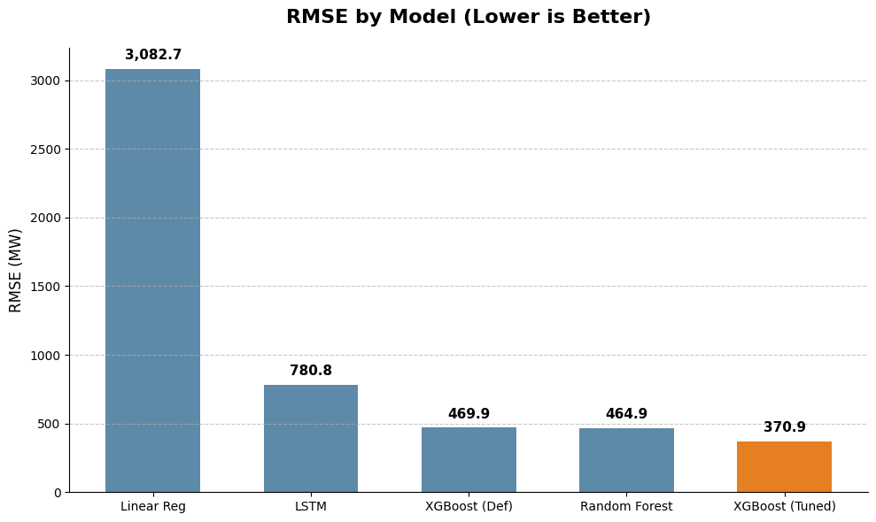
Performance Comparison — PJME Hourly (Test Set)
Model | MAE (MW) | RMSE (MW) | R^2 Score
Linear Regression(Baseline) | 965.0 | 1,232.7 | 0.9635
Random Forest | 334.9 | 464.9 | 0.9948
XGBoost (Default) | 354.8 | 469.9 | 0.9947
XGBoost (Optuna Tuned) | 269.4 | 370.9 | 0.9967
LSTM 2 layer | 611.0 | 780.8 | 0.9853
Best Model
XGBoost (Optuna Tuned) delivered the best performance.
Lowest Error
Achieved MAE: 269.4 MW and RMSE: 370.9 MW.
Highest Accuracy
Recorded the highest R² score of 0.9967.
Model Comparison
Random Forest performed well, while Linear Regression had the highest error.
Conclusion
Optuna tuning improved XGBoost's forecasting accuracy.
Figure 7: Comparison of MAE, RMSE, and R² across models.

Slide 14
Conclusion & Future Work
CONCLUSION
FUTURE WORK
Built a complete forecasting model using advanced
preprocessing and deep learning.
End-to-End Pipeline: Developed a deep learning forecasting model with advanced preprocessing.
Superior Accuracy: Outperformed ARIMA, SVM, ANN, and 1D-CNN, achieving significant reductions in RMSE and MAPE.
Real-World Impact: Provides actionable predictions to optimize smart grid planning and energy management.
Advanced Architectures: Leverage Attention and Transformer models for complex long-term seasonal patterns.
Uncertainty Quantification: Implement probabilistic forecasting to quantify prediction confidence.
Edge Deployment: Optimize lightweight models for real-time processing on smart meters.
Multimodal Data: Integrate live weather feeds, dynamic electricity pricing, and renewable energy generation data.

Slide 15
References
[1] A. Sieminski, "International Energy Outlook," Intl. Energy Agency, pp. 5–30, 2017.
[2] H.-T. Pao, "Forecast of electricity consumption and economic growth in Taiwan," Energy, vol. 34, no. 11, pp. 1779–1791, 2009.
[3] J. P. Mohanty and S. Dash, "Forecasting Energy Consumption Using Hybrid CNN-LSTM Auto-Encoder with Hyperband Optimization," IJRASET, vol. 10, no. X, pp. 1041–1055, 2022.
[4] A. Estebsari and R. Rajabi, "Single Residential Load Forecasting Using Deep Learning and Image Encoding," Electronics, vol. 9, no. 1, p. 68, 2020.
[5] O. M. Neda, "Hybrid LSTM-XGBoost model for multi-horizon short-term load forecasting," e-Prime, vol. 17, p. 201211, 2026.
[6] S. R. Rallapalli and S. Ghosh, "Forecasting monthly peak demand of electricity in India," Energy Policy, vol. 45, pp. 516–520, 2012.
[9] X. M. Zhang et al., "Forecasting Residential Energy Consumption: Single HouseholdPerspective," Proc. IEEE ICMLA, 2018, pp. 110–117.
[10] R. Rajabi and A. Estebsari, "Deep Learning Based Forecasting of Residential Loads UsingRecurrence Plots," Proc. IEEE Milan PowerTech, 2019, pp. 1–5.
[19] L. Li, K. Jamieson, G. DeSalvo, A. Rostamizadeh, and A. Talwalkar, "Hyperband: ANovel Bandit-Based Approach to Hyperparameter Optimization," JMLR, vol. 18, no. 1, pp.6765–6816, 2018.

