Slide 1
Evaluating the privacy of Android mobile applications under forensic analysis
Author :
Christoforos Ntantogian
Dimitris Apostolopoulos
Giannis Marinakis
Christos Xenakis
Presented by :
Soumit Kumar Kundu
Roll : 1407059

Slide 2
Overview
In this paper, the possibility of recovering authentication credentials of mobile applications from the volatile memory of Android mobile devices are analyzed.
Also here the authors explore the patterns and expressions that indicate the exact position of authentication credentials in a memory dump.

Slide 3
The Honey Stick Project
In this project, 50 smart phones were intentionally lost in cities around the U.S. and Canada. The phones were loaded with logging software, so that Symantec could keep track of all activities.
The study came to the result that in the 96 percent of the cases, the finders had accessed the personal data (e.g., email, photos, etc.) that was stored in the lost devices.
Moreover, on nearly half of them (43 percent), the finders had attempted to access the owners’ online banking applications

Slide 4
Volatile memory acquisition procedure
To dump the volatile memory of a rooted Android mobile device, we used an opensource forensics tool named, Linux memory extractor (LiME)
a loadable kernel module, named lime.ko, which is an object file that contains code to extend the running kernel functionality of an OS(i.e: Android) is used in this case
Next a sound image of the device’s SD memory card is acquired, using an open source imaging tool called dd .

Slide 5
Volatile memory acquisition procedure(cont’d)
Using command insmod the lime.ko module is inserted into the Android kernel .
Now memory dump is downloaded from the Android device to the computer through the Android Debug Bridge (adb)
The time, required to end the dumping process, depends on the size of the volatile memory of the examined mobile device

Slide 6
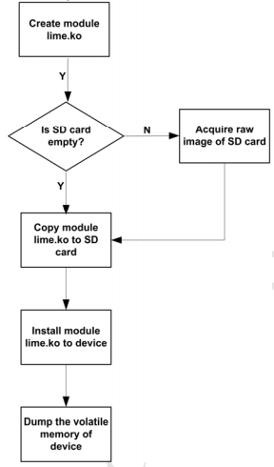
Fig 01 : Obtaining data from memory dump

Slide 7
Observations
Time is with security. The more time passes from the moment a user submitted his/her authentication credentials, the more likely is the authentication credential to be deleted
Setting up a running application into the background does not delete the authentications credentials from the volatile memory .
Even using a task killer application to end a running application does not wipe out the related authentication credentials from the volatile memory

Slide 8
Observations (cont’d)
using a mobile device as a smart phone (i.e., activating various Android applications), it is more likely to erase the authentication credentials that reside in the device's volatile memory, than using it as mobile phone (i.e., make/receive calls and send/receive SMS)
m-banking applications, have been proved to be more vulnerable to the discovery of authentication credential
password managers that aim to enhance the privacy of users. But if some malicious script can acquire the master password all other credentials can be easily achieved.

Slide 9
Conclusion
Taking into account that users tend to reuse password across various websites and applications developers should use correct and secure programing techniques and guidelines (i.e., delete the authentication credentials when they are not used from the applications), in order to minimize the threat.

Slide 10
Thank You

