Slide 1
A CLUSTERING ALGORITHM FOR WSN TO OPTIMIZE THE NETWORK LIFE TIME USING TYPE-2 FUZZY LOGIC MODEL
Author :
D V Pushpalatha Padmalaya Nayak
Presented by :
Soumit Kumar Kundu
Roll : 1407059

Slide 2
Outline
Overview
Clustering Protocols
Proposed Model
Results and discussion
Conclusion

Slide 3
Overview
This paper describes the use of Fuzzy Logic Model and how to optimize the network life time of Wireless Sensors using Type-2 Fuzzy Logic Model.
Wireless sensors are used for surveillance , border protection etc. But as it is not practically feasible for human to attend the sensors nodes, these cannot be reached or replaced easily.
So, in order to maintain their life time we can use Type-2 fuzzy logic to increase battery life time, or minimize the energy consumption.

Slide 4
CLUSTERING PROTOCOLS
Clustering protocols determines cluster head (CH) in order to send data to Base Station (BS).
LEACH, LEACH-C, CHEF, are most common clustering protocols that determines the CH using energy, distance from BS etc.
This paper uses Type-2 Fuzzy Logic which handles uncertainty of real time.

Slide 5
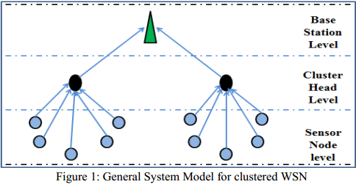
CLUSTERING PROTOCOLS (cont’d)
Fig 01: General System Model for clustered WSN

Slide 6
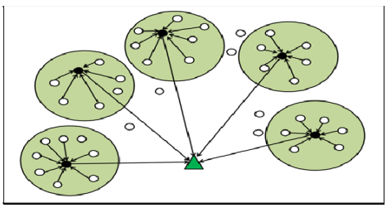
CLUSTERING PROTOCOLS (cont’d)
Fig 02: Proposed Model using Type-2 Fuzzy Logic Model

Slide 7
PROPOSED MODEL
Type-2 Fuzzy Model chooses CH’s using 3 parameters :-Remaining Battery Life, Distance from BS and Concentration.
Let us assume N nodes distributed randomly over MxM region and there are k clusters. So, there are N/k nodes in each cluster including the CH.
If any incident occur in the environment the sensors collect data and sends to CH and from CH the data goes to BS.
To reduce the energy consumption and data duplication the three parameters are given three membership functions. For Battery life the functions are Less(0), Medium(1), High(2).The others are implemented in the same process.

Slide 8
PROPOSED MODEL (cont’d)
The membership functions are inputs for the Fuzzy Inference System. The Fuzzy System generated using 4 components. They are :- Fuzzifier, Inference System, Type defuzzifier/Reducer, Knowledge Base.
The Fuzzy Inference system gives an output that shows the chance of a certain node to be CH.
This output is composed of 7 membership functions. These functions are :- Very Poor (-1), Poor(0), Below Average (1), Average (2), Above Average(3), Strong(4), Very strong(5).

Slide 9
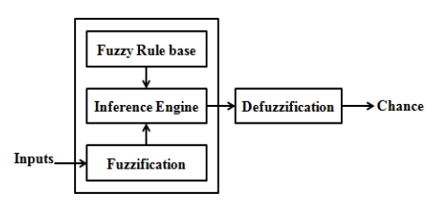
PROPOSED MODEL (cont’d)
Fig 03 : Block diagram of Type-1 Fuzzy Inference System

Slide 10
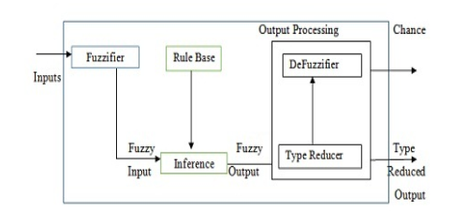
PROPOSED MODEL (cont’d)
Fig 04 : Block diagram of Type-2 Fuzzy Inference System

Slide 11
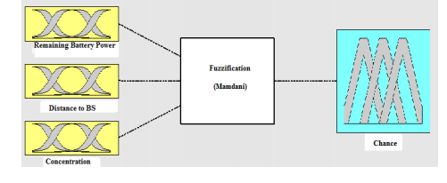
PROPOSED MODEL (cont’d)
Fig 05 : Fuzzy System for the proposed model

Slide 12
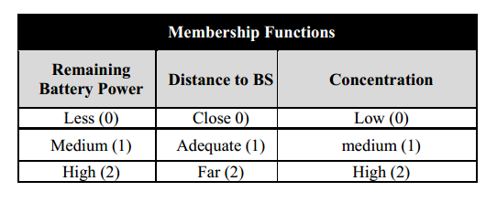
PROPOSED MODEL (cont’d)
Table 01 : Membership function for input variables

Slide 13
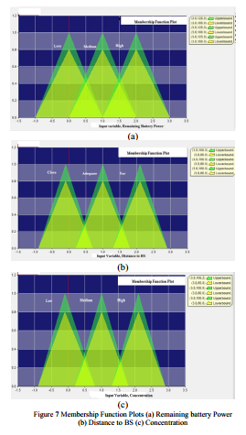
RESULTS & DISCUSSION
These figures shows the results or chance of a certain node to be CH.
The proposed protocol can be verified using MATLAB and the results are shown using MATLAB and NS-2.
Fig 06 : Membership Function Plots (a) Remaining battery Power (b) Distance to BS (c) Concentration

Slide 14
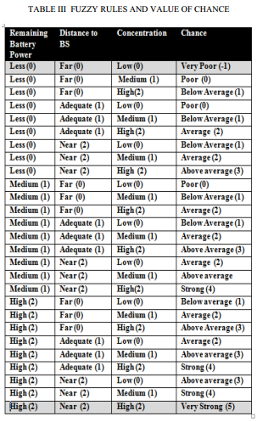
RESULTS & DISCUSSION (cont’d)
Table 02 : Fuzzy rules and value of chance

Slide 15
Conclusion
The main idea is to use Fuzzy Logic Type-2 Model to elect the CH as it handles the uncertainty more accurately than Type-1 fuzzy logic model. Many research results are available based on Type-1 Fuzzy Logic Model not with Type-2 Fuzzy Logic Model. The validity of the proposed protocol has been verified through MATLAB Fuzzy Inference System tools (Mamdani’s rule).

Slide 16
Thank You

