Slide 1
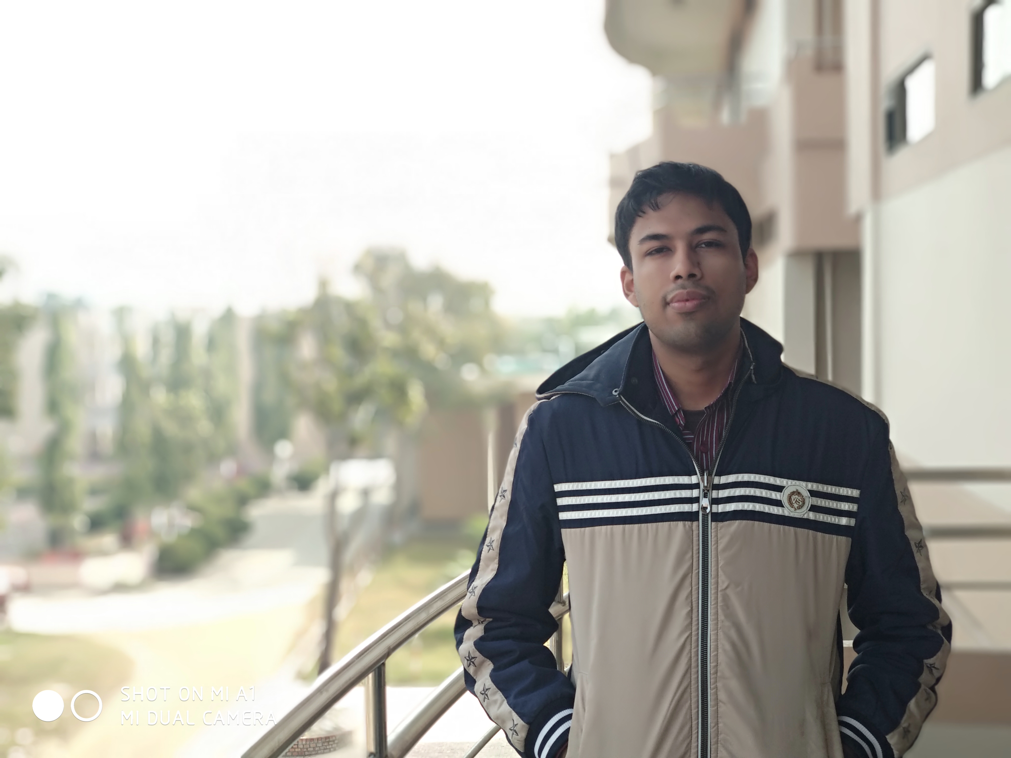
Curriculum vitae
Soumit Kumar Kundu
ACADEMIC QUALIFICATION :
Programming Languages:
Java, Swift
C/C+, python, assembly
Php, javascript
PASSING YEAR | INSTITUTION | GRADES (G.P.A.) | EXAM
2019 | KUET | 3.30 | BSc. (CSE)
2014 | Dinajpur Govt. College | 5.00 | H.S.C
2012 | Dinajpur Zilla School | 5.00 | S.S.C

Slide 2
Projects and Development experience :
  Android based online doctor appointment application
  Web application with Php (An e-commerce platform)
  An iOS app of game character parsing with Swift3
  Hardware project : Smart irrigation system with soil moisture display
Research Interest:
  Wireless Sensor Network
  Machine Learning
Social Profiles:
  Github : github.com/Soumit38
  Linked-in : linkedin.com/Soumit
  Stackoverflow: stackoverflow.com/Soumit
  Email : Soumitkumar4@gmail.com

