Slide 1
Applying Fault Tolerance in the Internet of Things(IoT)
Supervisor: Dr. Muhammad Sheikh Sadi
Presented by
Sunanda das
Roll : 1207026
MD. Ahsanul Haque Roll: 1307027

Slide 2
Outlines
Introduction
Fault tolerance
Internet of things(IoT)
Methodology
Experimental Analysis
Results
Future Work
Conclusions
References
Page 1/15

Slide 3
Introduction
Domestic appliances are transitioning into the third internet wave, the Internet of Things.
So, it is important to use fault tolerance mechanism to IoT.
Sometimes, End users can not identify the poor performance.
Our system is able to analyze the collected data and can detect fault.
Page 2/15

Slide 4
Fault Tolerance
Fault tolerance is the ability of a system to continue performing its intended functions in spite faults.
Fault tolerance is achieved by different techniques.
In this work fault tolerance is achieved using fault detection and analysis in IoT device.
Page 3/15

Slide 5

Internet of Things(IoT)
Increasing number of IoT devices in our everyday life.
Fault tolerance is an important issue in IoT devices.
Fig 1 : Internet of Things
Page 4/15

Slide 6
Methodology (1/5)
The System has three stages:
Sending signal from mobile device to raspberry pi.
Fault Detection and taking corresponding action in pi.
Applying fault tolerant mechanism so that IoT devices can not be damaged.
Page 5/15

Slide 7
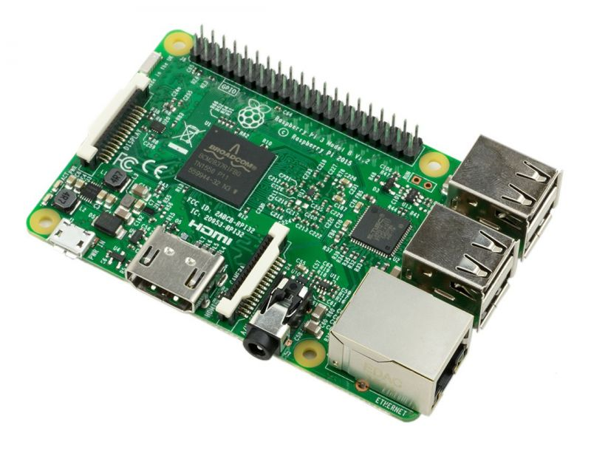
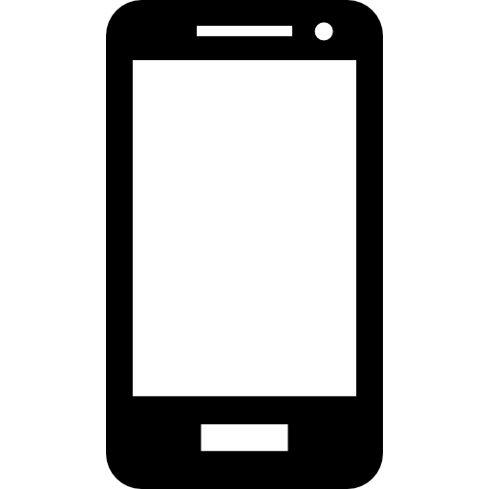
Methodology (2/5)
Send signal
Fig 2 : sending signal from mobile to raspberry pi
Page 6/15

Slide 8
Methodology (3/5)
M
M
voter
output
M
Fig 3: Fault tolerance using Triple Modular Redundancy
Page 7/15

Slide 9
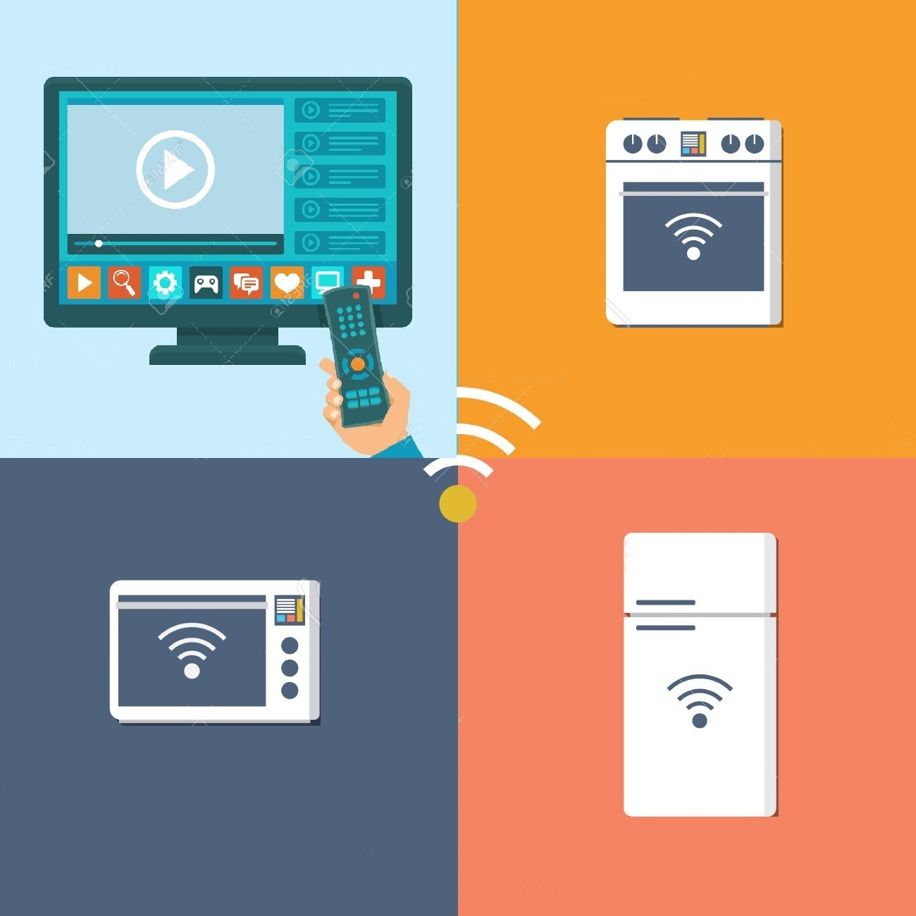

Methodology (4/5)
Domestic Devices
DCRT
(Data Collection in Real Time)
Save data
In file
Preprocessing
FDD
(Fault Detection and Diagnosis)
U.I.
Module
Fig 4: Flow Graph of the proposed system
Page 8/15

Slide 10
Methodology (5/5)
Reference Data
Real Time Data
Threshold Data
Fig 5: Fault Detection using Threshold (an example)
Page 9/15

Slide 11
Experimental Analysis
We use the following tools:
Raspberry pi
Android phone
Led Lights
Relay and Relay module
Bread Board
Connecting wires
Page 10/15

Slide 12
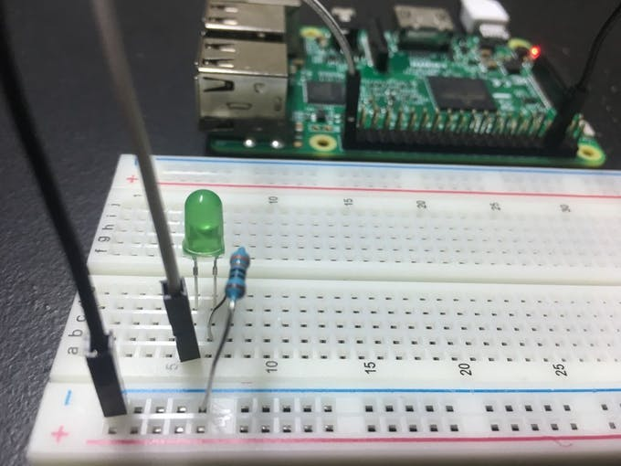
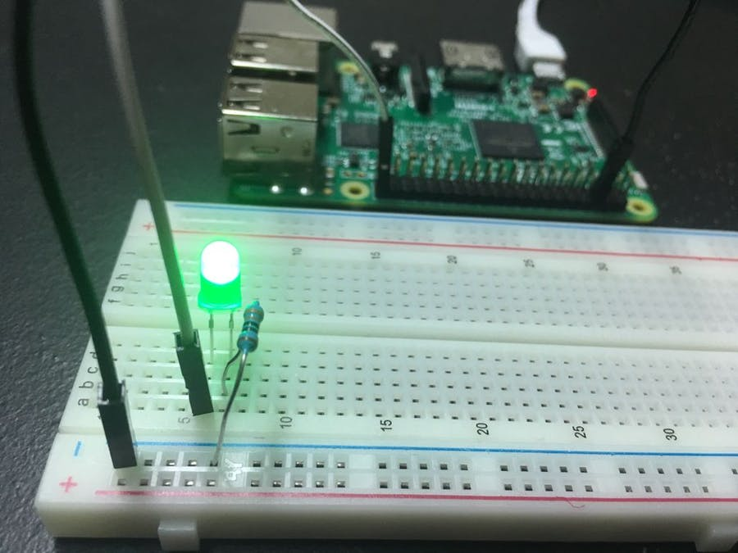
Results(1/2)
Making an IoT controlled System
Using raspberry pi to control signal transfer
Fig 6: Sample Experiment using Led
Page 11/15

Slide 13
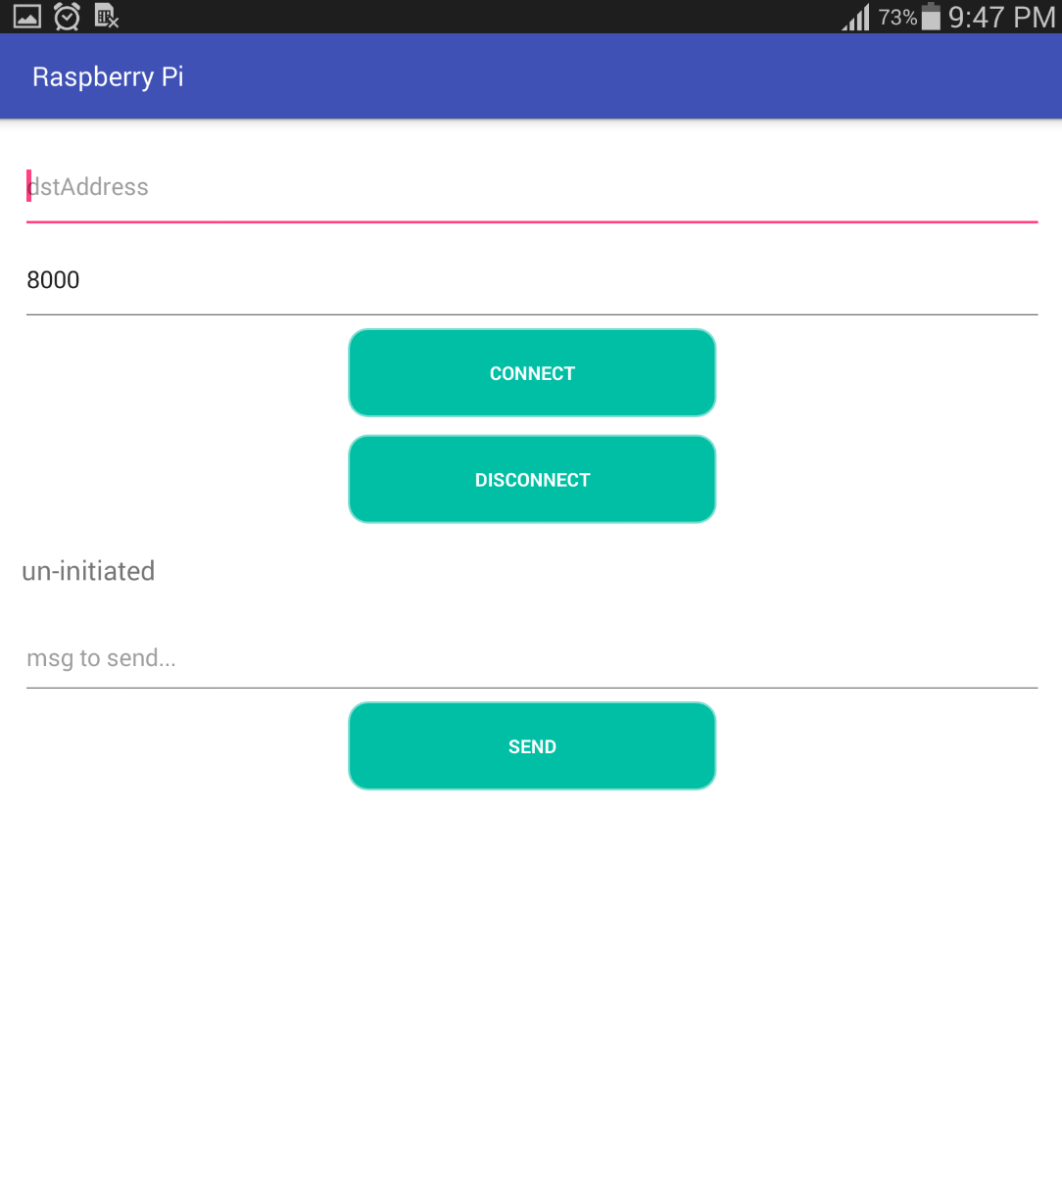
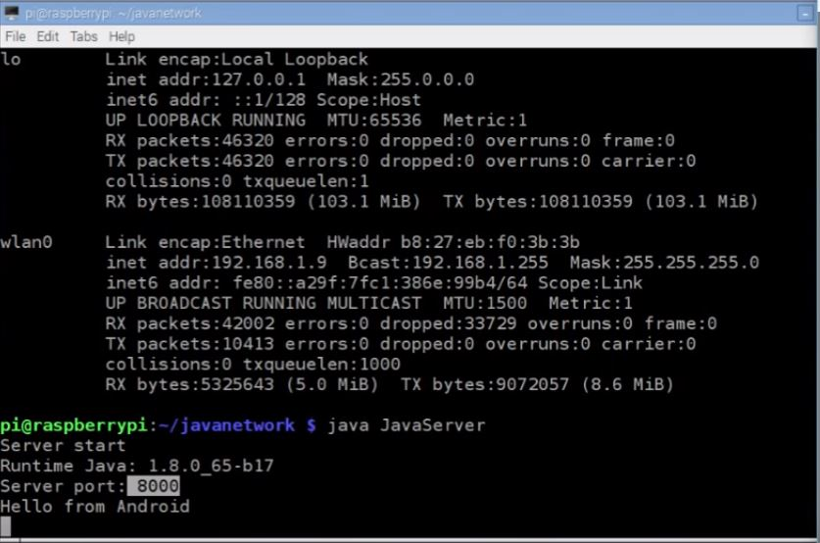
Results(2/2)
Making an android application to initiate connection
Connecting to port 8000 of raspberry pi
Send message from android application to raspberry pi remotely.
Page 12/15

Slide 14
Future Work
wifi connection is used to transfer signals, In future we have plan of using LAN connection.
Led is used as sample device, we work with real IoT device like Air conditioner, modern fridge later.
As future work, we intend to integrate the system in a smart home environment.
Page 13/15

Slide 15
Conclusions
The System can get noisy signal.
Triple modular redundancy is used to get rid of this issue.
Fault is detected and certain action is taken so that the IoT device can properly function for a long period of time.
Page 14/15

Slide 16
References
[1] Jorge C. Seabra, Mario A. Costa Jr., and Mateus M. Lucena "IoT based Intelligent System for Fault Detection and Diagnosis in Domestic Appliances", IEEE 2016. [2]Sen Zhou, Kwei-Jay Lin, Jun Na, Ching-Chi Chuang and Chi-Sheng Shih "Supporting Service Adaptation in Fault Tolerant Internet of Things", 2015 IEEE 8th International Conference on Service-Oriented Computing and Applications [3] D.J. Cook et al., "MavHome: An agent-based smart home", IEEE Int. Conf. on Pervasive Computing and Communications (PerCom). 2013, Vol. 1, pp. 521-524.
[4] Ma Hongzhong. Machine condition monitoring and fault diagnosis. Mechanical industry press,2008.
[5] Jiang Yuanyuan,Wang Youren. power electronic circuit fault Based on the LS -SVM prediction method. Electric Machines And Control, 2011, 15(8).
[6] J. J. Li, T. Y. Chai. Applications of Identification and Fault Detection Techniques to Aluminum Electrolysis Process. Acta Automatica Sinica. 1998(24): 275-277.
[7] G.E.Hinton, R.R.Salakhutdinov. Supporting Online Material for Reducing the Dimensionality of Data with Neural Networks [J]. Science, 2006, (28) 313- 504.
Page 15/15

Slide 17


