Slide 1
Window Functions

Slide 2
Students Table
CREATE TABLE students (
id INT PRIMARY KEY,
name VARCHAR(50),
class VARCHAR(10),
marks INT
);
INSERT INTO students VALUES
(1, 'Alice', 'A', 85),
(2, 'Bob', 'A', 78),
(3, 'Charlie','A', 92),
(4, 'David', 'B', 88),
(5, 'Eva', 'B', 91),
(6, 'Frank', 'B', 76),
(7, 'Grace', 'C', 83),
(8, 'Hank', 'C', 89),
(9, 'Ivy', 'C', 95);

Slide 3
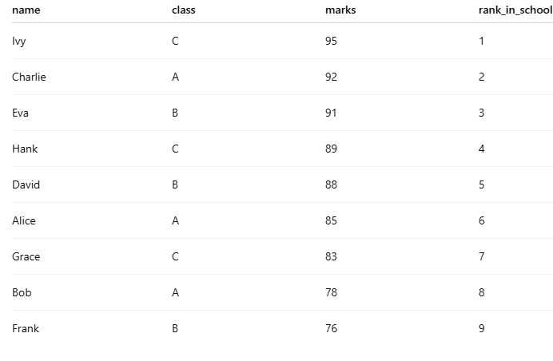
1. Rank students by marks across the whole school.

Slide 4
Rank students by marks across the whole school.
SELECT
name, class, marks,
RANK() OVER (ORDER BY marks DESC) AS rank_in_school
FROM students;

Slide 5
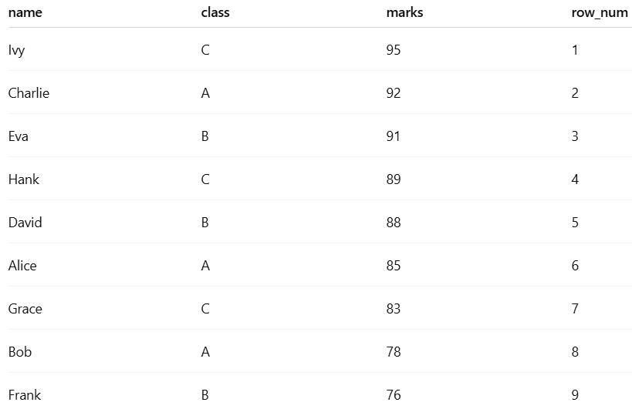
2. Assign a unique row number to each student ordered by marks.

Slide 6
2. Assign a unique row number to each student ordered by marks.
SELECT
name, class, marks,
ROW_NUMBER() OVER (ORDER BY marks DESC) AS row_num
FROM students;

Slide 7
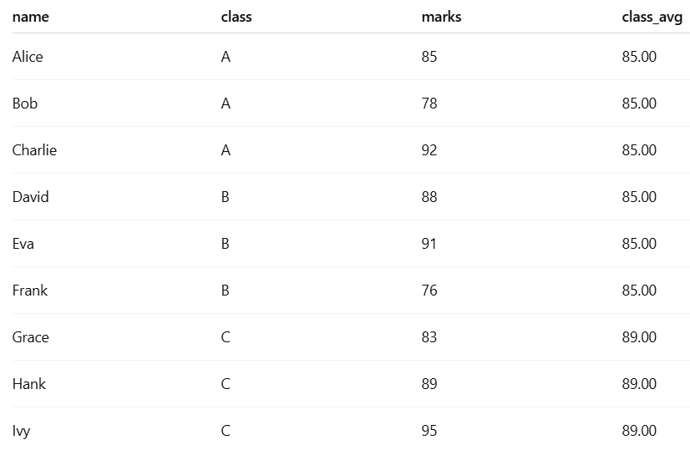
3. Show each student’s marks and the average marks of their class..

Slide 8
3. Show each student’s marks and the average marks of their class..
SELECT
name, class, marks,
AVG(marks) OVER (PARTITION BY class) AS class_avg
FROM students;

Slide 9
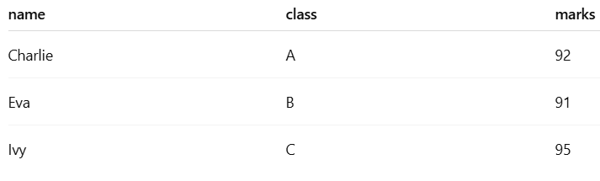
4. Find the highest scorer(s) in each class.

Slide 10
4. Find the highest scorer(s) in each class.
SELECT *
FROM (
SELECT
name, class, marks,
RANK() OVER (PARTITION BY class ORDER BY marks DESC) AS rank_in_class
FROM students
) x
WHERE rank_in_class = 1;

Slide 11
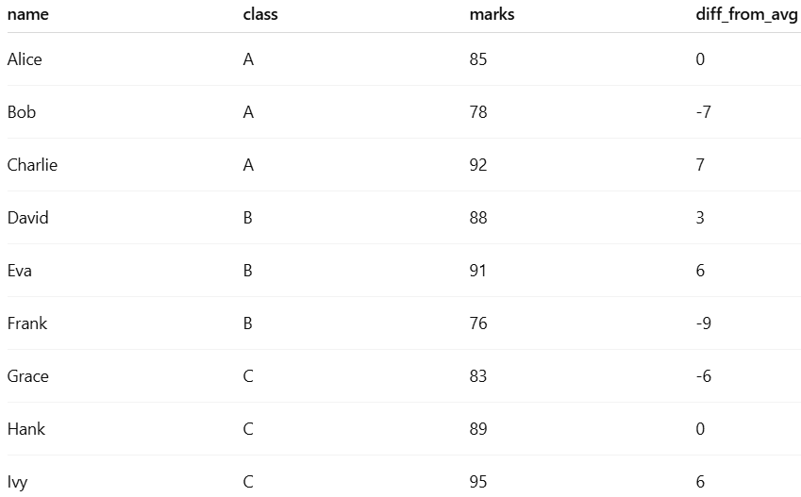
5. Show each student’s marks and how far they are from their class average.

Slide 12
5. Show each student’s marks and how far they are from their class average.
SELECT
name, class, marks,
marks - AVG(marks) OVER (PARTITION BY class) AS diff_from_avg
FROM students;

