Slide 1

August 2022
Customer Segmentation and Targeting
Online Retail Dataset
A presentation by Group 4:
Soumya Agrawal, Olivia Lee, Aniket Patel, Soumith Reddy

Slide 2




MEET THE TEAM
Aniket Patel
Soumya Agrawal
Soumith Reddy
Olivia Lee

Slide 3
ON THE AGENDA:
Problem Statement​
Dataset Description​
Exploratory Data Analysis​
Cohort Analysis
Recency Frequency Monetary (RFM) Analysis
Customer Lifetime Value (CLTV) Modeling

Slide 4

PROBLEM STATEMENT
Identify the high value customers of an online retail platform and delineate customer persona to inform advertising budget decision-making
It is the time that you have wasted on your rose that makes your rose so important
- Antoine de Saint-Exupéry
Source: Kaggle dataset: https://www.kaggle.com/datasets/mashlyn/online-retail-ii-uci/code

Slide 5
DATASET DESCRIPTION
The data set contains all the transactions occurring for a UK-based and registered, non-store online retail.
Data for duration between December 2009 and December 2011.
Approximately 1M transaction records in the data set.
Dataset has eight nominal and numerical variables.
Level of data: Invoice, StockCode and CustomerID.

Slide 6



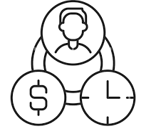
EXPLORATORY DATA ANALYSIS SUMMARY
Data Cleaning
Seasonality
Removed records with negative values in “quantity” and “Price” columns
Removed records with missing ”Customer ID” and cancelled orders
Handled the data outliers by selecting values within 1.5 times the inter-quartile range from the 1st and 3rd quartile
Nov, Oct and Dec record the highest sales while its lowest in Feb – Q’4 records the maximum sales
Sales are highest on Thursday and the least on Saturday
Afternoons record the highest sales and evenings are the lowest
Cohort Analysis
RFM Analysis
Not even half (50%) of the customers came back after their first purchase
Also, the top 25 % of the customers in the 2010 December cohort did not purchase during June 2011, September 2011, and October 2011.
RFM stands for Recency, Frequency, Monetary – this is a commonly used analysis in the retail industry for customer segmentation
We would like to triangulate these results with our model’s output to see the overlap and strengthen the analysis
The above information is supplemented with the relevant plots in the Appendix section

Slide 7
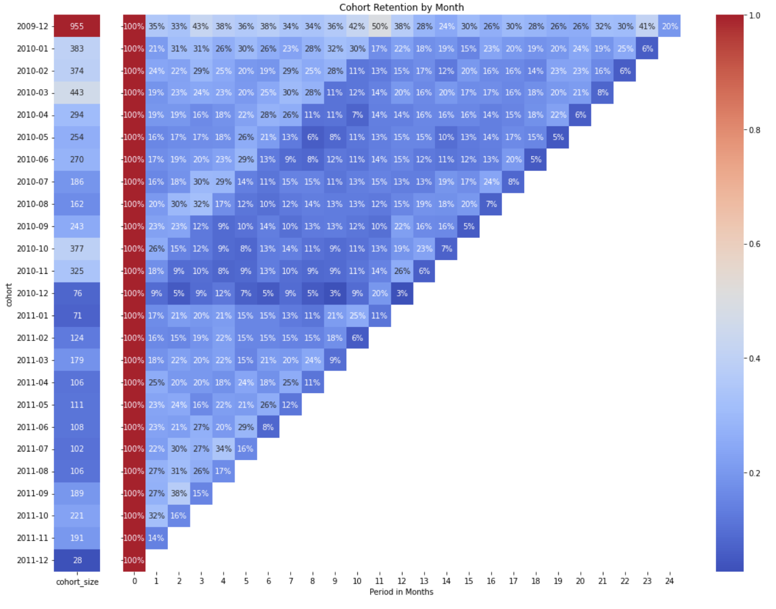
COHORT ANALYSIS
Heat map for TOP 25 percent of the customers
91% of Jan 2011 customers returned after 10 months
Heat map for ENTIRE of the customers
25% of Jan 2011 customers returned after 10 months

Slide 8
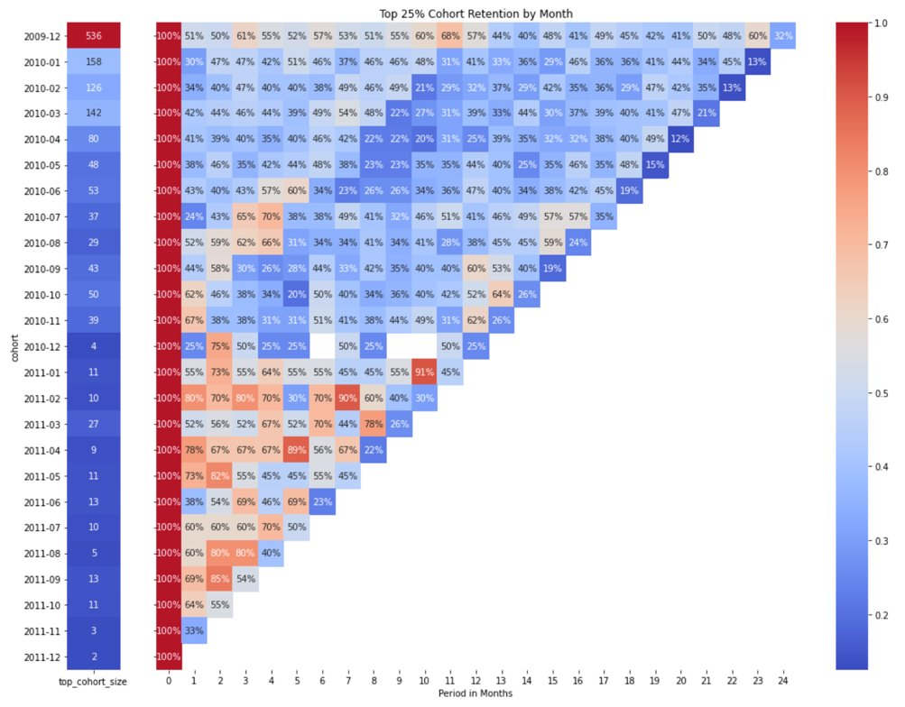
COHORT ANALYSIS
Heat map for ENTIRE of the customers
Heat map for TOP 25 percent of the customers
Customer retention has increased after 2011 for top customers (the shades get warmer in the cohort analysis on the right)

Slide 9
RFM ANALYSIS OUTCOMES
Segment | # of Customers | Description | Suggested Marketing Campaigns
Loyal | 1100 | Customers who buy most often from the store | Loyalty Programs, Free Shipping
Whales | 370 | Customers who generate high revenue (Highest Monetary Value) | Premium offers, Subscription tiers, Luxury Products
Promising - Faithful | 199 | Customers who visit often but don’t spend a lot | Incentives tied to spending thresholds and product recommendations
Based on the Recency, Frequency and Monetary Analysis, the customers are divided into the above segments as per their individual RFM scores. These RFM scores help in bucketing the customers target them accordingly
The rest of the customers could be explored for any other marketing campaigns

Slide 10
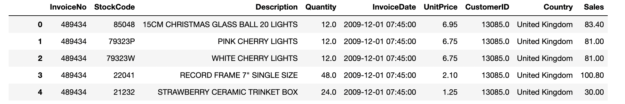
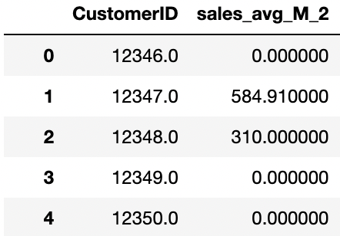
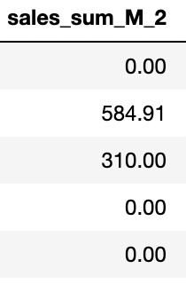
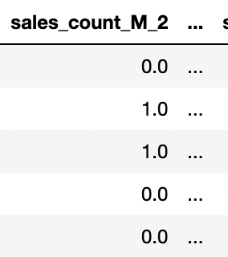
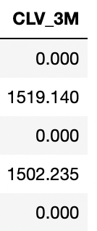
FEATURE ENGINEERING FOR CUSTOMER LIFETIME VALUE PREDICTION

Slide 11
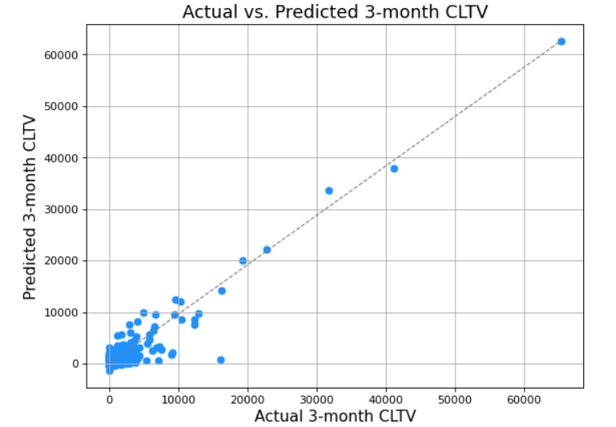
BASELINE 3-MONTH CLTV MODEL: MULTI-LINEAR REGRESSION
Baseline Train set MedAE: $137.13
Baseline Test set MedAE: $141.01
Range of target: $0 to $65,000
The Baseline model considered all the features, many of them may be statistically insignificant – to eliminate these unnecessary features we can run a Lasso Regression

Slide 12
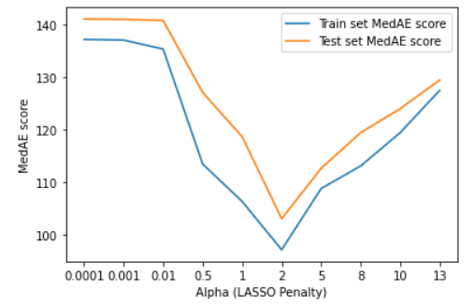
IMPROVED 3-MONTH CLTV MODEL: LASSO REGRESSION
​
​
Train set MedAE for alpha=2 is 116.65
Test set MedAE for alpha=2 is 128.87
Range of target: $0 to $65,000
Median Absolute Error is minimum for alpha=2. Overfitting is ruled out since train and test set errors are similar.

Slide 13
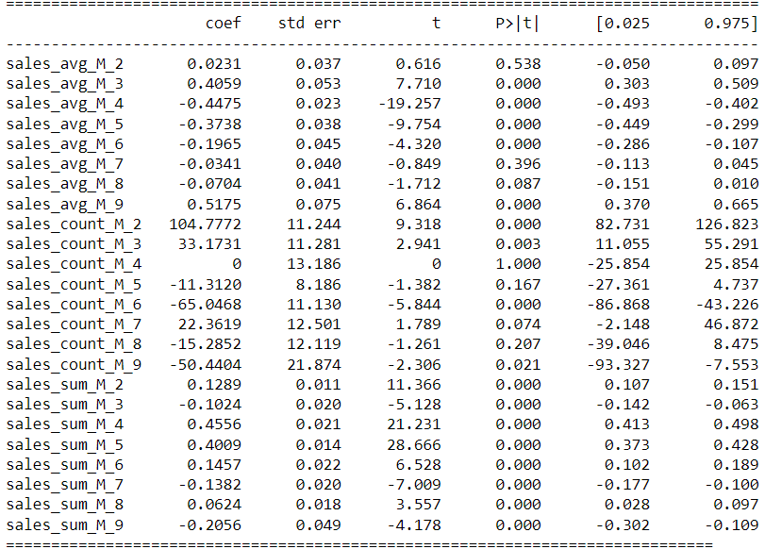
IMPROVED CLTV MODEL: LASSO REGRESSION
Sales count for last 4th quarter is zeroed by the LASSO regression and some features are statistically insignificant
(t-value < 2)
Lasso set the unnecessary feature coefficients to 0 and improves the model performance by 8.6% over baseline.
3-month CLTV coupled with the RFM segments enables targeting potential high-value customers

Slide 14
QUESTIONS?

Slide 15
THANK YOU :)

Slide 16
REFERENCES
Dataset: https://www.kaggle.com/datasets/mashlyn/online-retail-ii-uci
Cohort Analysis: https://www.kaggle.com/code/ahmtcnbs/cohort-analysis
RFM Analysis: https://www.barilliance.com/rfm-analysis/

Slide 17
APPENDIX

Slide 18
DATA DESCRIPTION | summary of the eight variables in online retail dataset
Invoice- Represents the invoice number. A 6-digit integral number uniquely assigned to each transaction. Nominal.
StockCode: Represents product (item) code. Nominal. A 5-digit integral number uniquely assigned to each distinct product.
Description: Represents product (item) name. Nominal.
Quantity: Represents the quantities of each product (item) per transaction. Numeric.
InvoiceDate: Represents the invoice date and time. Numeric. The day and time when a transaction was generated.
UnitPrice: Represents the unit price. Numeric. Product price per unit in sterling (Â£).
CustomerID: Represents the customer number. Nominal. A 5-digit integral number uniquely assigned to each customer.
Country: Represents the name of the country where a customer resides. Nominal.

Slide 19
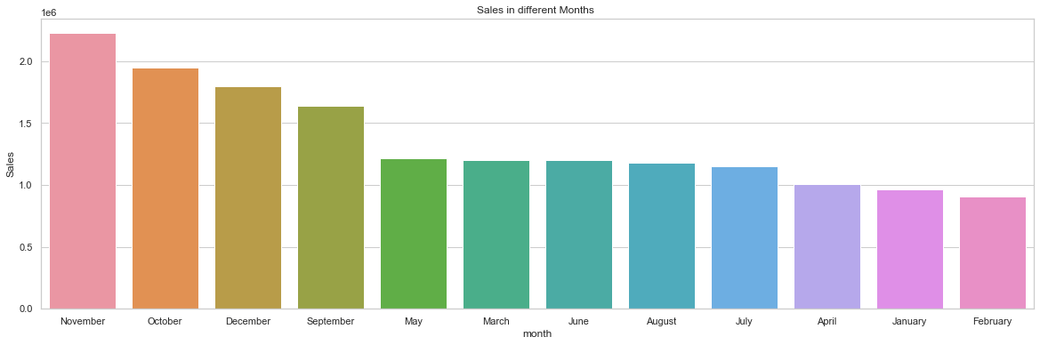
Exploratory Data Analysis – Seasonality by Month

Slide 20
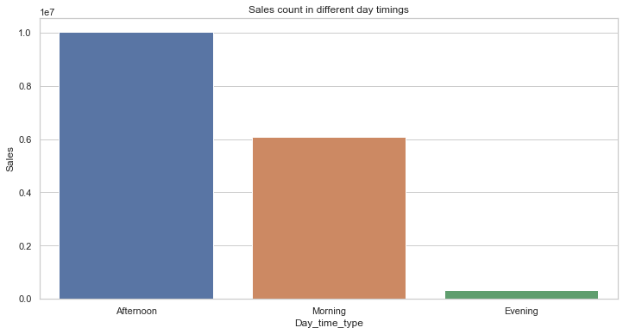
Exploratory Data Analysis – Seasonality by Time
Sales

Slide 21
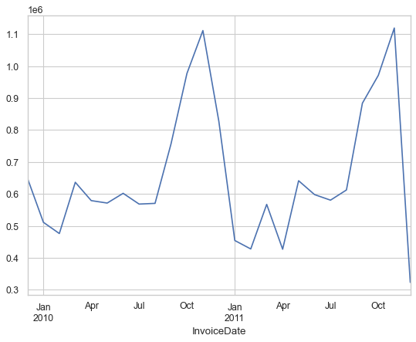
Exploratory Data Analysis – Seasonality – Time Series
Sales

Slide 22
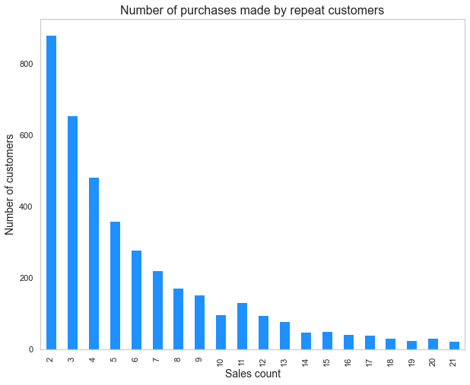
Exploratory Data Analysis – Purchases by Repeat Customers

Slide 23
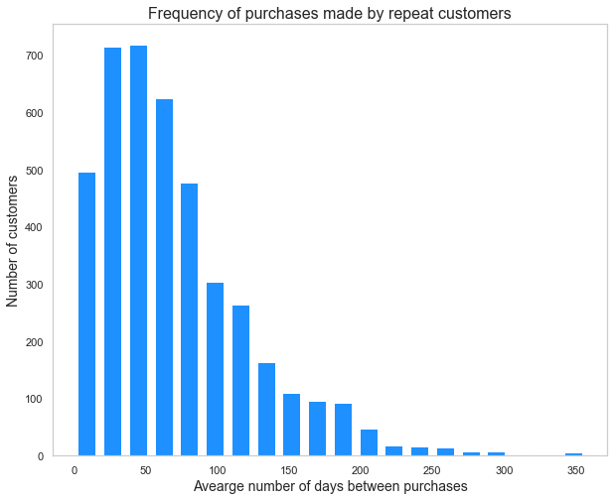
Exploratory Data Analysis – Frequency of Purchases by Repeat Customers

