Slide 1
Nearest Neighbor Queries
Chris Buzzerd, Dave Boerner, and Kevin Stewart

Slide 2
Introduction
Nearest Neighbor queries are used to
  Find the nearest object to a given point
    ex. Given a star, find the 5 closest stars
  Find the closest object given a range
    ex. Find all stars between 5 and 20 light years of a given star
  Spatial joins
    ex. Find the three closest restaurants for each of two different movie theaters

Slide 3
Why we need NN Queries
There are many methods of querying spatial data
Few of these methods can be used in nearest neighbor queries

Slide 4
The Quad Tree
Proposed method for NN queries
Top-down recursive search
Start by going down tree until the query point is found (this gives first estimate of NN location)
Back-track back up through tree and explore remaining sub trees until no more sub trees need to be visited.

Slide 5
R-Trees
Extension of the B-trees for storing objects higher than 1 dimension
Used to find spatial overlap
Before authors of paper no NN algorithms existed for R-Trees
Following metrics introduced are applicable to other spatial data structures

Slide 6
R-Trees continued
Remain balanced and flexible
Dynamically adjust grouping to counter dead space and/or dense areas

Slide 7
Definitions

Slide 8
Metrics
MINDIST – minimum distance from an object O to a query point P
MINMAXDIST – minimum of the maximum possible distances from query point P to a face of vertex of the MBR containing the object

Slide 9
Metrics continued
MINDIST provides lower bound
MINMAXDIST provides upper bound
Boundaries allow NN algorithm to “prune” paths (sub-trees) from search space in R-Tree

Slide 10
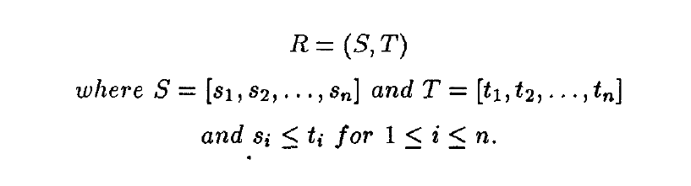
Definition
Rectangle in space - two endpoints of its major diagonal

Slide 11
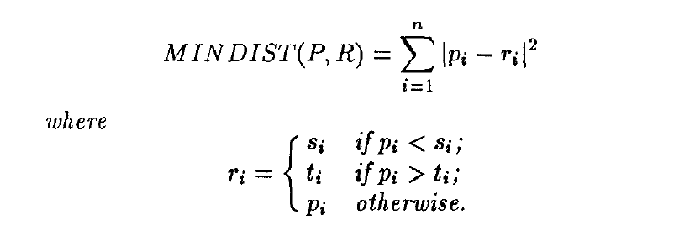
Definition
Distance from point P to rectangle R is denoted as MINDIST(P,R)

Slide 12
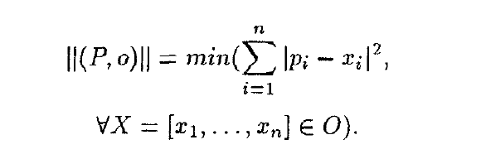
Definition
Distance from point P to a spatial object o is denoted as ||(P, o)||

Slide 13

MINDIST Theorem
MINDIST used to determine closest object to point P from all objects enclosed by Rectangle R
MINDIST offers first approximation of the NN distance to every MBR of the node and used to direct the search

Slide 14
MBR Face Property
Every edge of any MBR contains at least one point of some spatial object in the DB
As you travel along the perimeter your guaranteed to hit the object

Slide 15
MINMAXDIST
Handles queries involving range
  Ex. give me all bus stations within 20 miles of an apartment building
Removes all MBR’s where the MINDIST of a given query is greater than the MINMAXDIST of an MBR
  Avoids false-drops; aka. Visits to unnecessary nodes

Slide 16
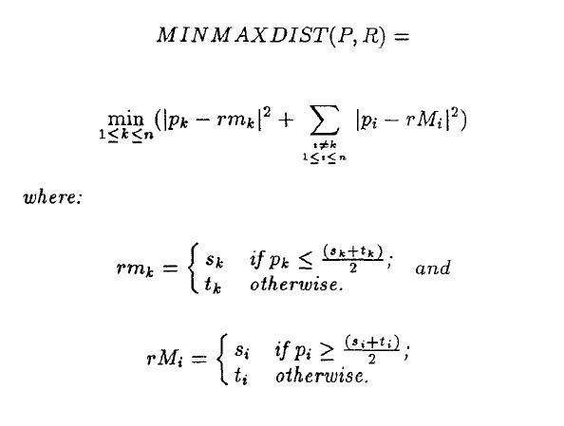
Definition

Slide 17
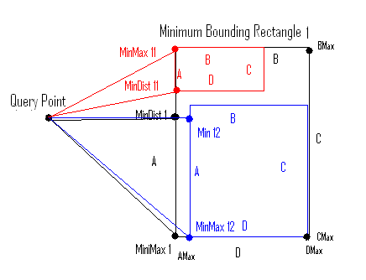
MINDIST/MINMAXDIST

Slide 18
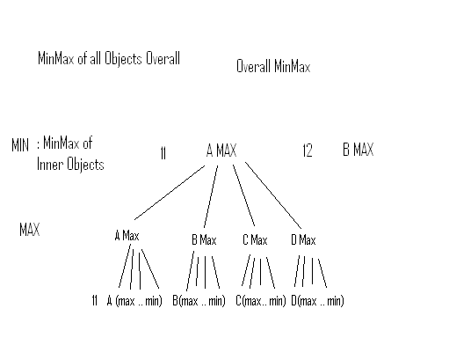
MINMAXDIST

Slide 19
NN Theorem
Determines furthest object in P from those in Rectangle R
Used to direct search either as starting or limiting point

Slide 20
Nearest Neighbor Algorithm

Slide 21
Search Ordering
MINDIST Ordering is optimistic choice
MINMAXDIST Ordering is pessimistic choice
Optimal MBR visit ordering depends on
  distance to each MBR
  Size and layout of MBR’s within each MBR
Using the MINDIST metric is not always the most efficient search method

Slide 22
Downward Pruning
Given an MBR M with a MINDIST greater than the MINMAXDIST of another MBR, MBR M is discarded
If actual distance from P to object O is greater than the MINMAXDIST of an MBR, the object O is discarded

Slide 23
Upward Pruning
Every MBR, M, with MINDIST greater than the actual distance from point P to Object O is discarded
The Object O cannot enclose an object closer than O

Slide 24
The Actual Algorithm
Ordered depth first traversal starting at root and traversing down tree
At non-leaf nodes
  Compute metric bounds of each MBR
  Sort MBR’s into Active Branch List
  Apply downward pruning strategies
At leaf nodes call specific distance function and update Nearest value if necessary

Slide 25
K Nearest Neighbors
Sorted buffer of k nearest neighbors is needed instead of Nearest variable
MBR pruning done according to the distance of the furthest nearest neighbor in this buffer

Slide 26
Experiments

Slide 27
Real World Data Sets
Segment based data from Long Beach, CA
latitude and longitude pairs
55,000 Street Segments

Slide 28
Synthetic Data Sets
Varying data sets of size 2^0 to 2^8 K
Generated data sets using unique random seeds
Stored as grid of rectangles 8K X 8K
Each 8X8 grid contained 100 equally spaced points

Slide 29
Results
Three uniform sets of queries of 100 points each
Used several spatial distributions:
  Sparse – few or no street segments
  Dense – large number of streets
  Uniform – even distributed data

Slide 30
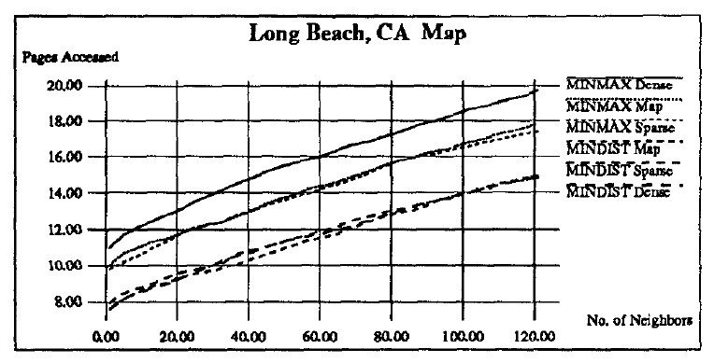
Avg. of 100 queries

