Slide 1
Searching on Multi-Dimensional Data
COL 106
Slide Courtesy: Dan Tromer, Piotyr Indyk, George Bebis

Slide 2

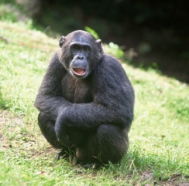
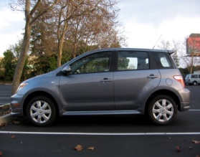
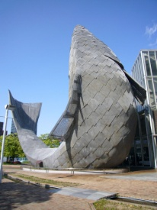
Large Scale Image Search in Database
Find similar images in a large database
Kristen Grauman et al

Slide 3
Nearest Neighbor Search
Problem definition
Given: a set P of n points in R^{d}
Over some metric
find the nearest neighbor p of q in P
Q?
Distance metric
Notes:
The solution strategy is:
Select Features → feature space R^{d}
Select distance metric → for example l₁ or l₂
Build data-structure for fast near-neighbor queries
Scale-ability with n & with d is important

Slide 4
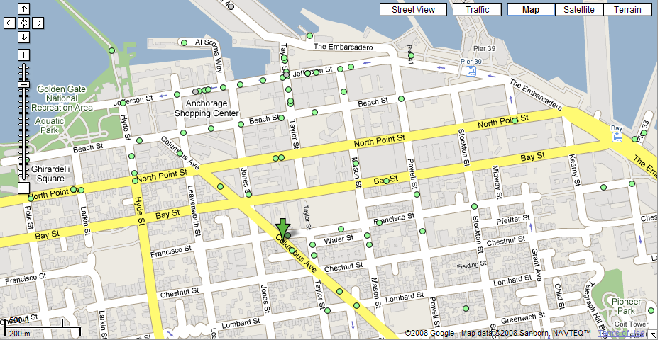
Nearest Neighbor(s) Query
  What is the closest restaurant to my hotel?

Slide 5


Other Applications
Classification
Clustering
Indexing
Copyright violation detection
Weight
q ?
color

Slide 6
We will see three solutions
(or as many as time permits)…
Quad Trees
K-D Trees
Locality Sensitive Hashing

Slide 7
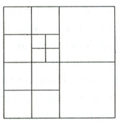
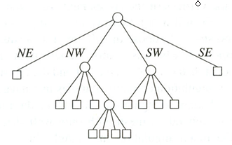
Quad Trees
N
A tree in which each internal node has up to four children.
Every node in the quadtree corresponds to a square.
The children of a node v correspond to the four quadrants of the square of v.
The children of a node are labelled NE, NW, SW, and SE to indicate to which quadrant they correspond.
W
E
S
Notes:
Extension to the K-dimensional case

Slide 8
Quadtree Construction
(data stored at leaves)
400
a
Input: point set P
while Some cell C contains more than “k” points do
Split cell C
end
b
c
d
e
Y
g
f
h
l
j
i
k
X 50, Y 200
0
X
100
SW
SE
NW
NE
i h
X 75, Y 100
c e
X 25, Y 300
j k
f
g l
d
a b

Slide 9
Quadtree – Exact Match Query
Partitioning of the plane
The quad tree
D(35,85)
A(50,50)
•
•
B(75,80)
P
SE
NE
•
NW
C(90,65)
SW
B(75,80)
•
NE
A(50,50)
E
D
SE
SW
NW
•
C
E(25,25)
To search for P(55, 75):
Since X_{A}< X_{P} and Y_{A} < Y_{P} → go to NE (i.e., B).
Since X_{B} > X_{P} and Y_{B} > Y_{P} → go to SW, which in this case is null.
Notes:
Multimedia Technologies
7/17/97
Kien A. Hua
9

Slide 10
Quadtree – Nearest Neighbor Query
X₁,Y₁
SW
SE
NE
NW
X₂,Y₂
Y
X
Notes:
Extension to the K-dimensional case

Slide 11
Quadtree – Nearest Neighbor Query
X₁,Y₁
SW
NE
NW
SE
X₂,Y₂
Y
NW
X
Notes:
Extension to the K-dimensional case

Slide 12
Quadtree– Nearest Neighbor Query
X₁,Y₁
SW
NE
NW
SE
X₂,Y₂
SW
Y
NW
SE
NE
X
Notes:
Extension to the K-dimensional case

Slide 13
Quadtree– Nearest Neighbor Search
Algorithm
Initialize range search with large r
Put the root on a stack
Repeat
  Pop the next node T from the stack
  For each child C of T
    if C intersects with a circle (ball) of radius r around q, add C to the stack
    if C is a leaf, examine point(s) in C and
    update r
q
Whenever a point is found, update r (i.e., current minimum)
Only investigate nodes with respect to current r.

Slide 14
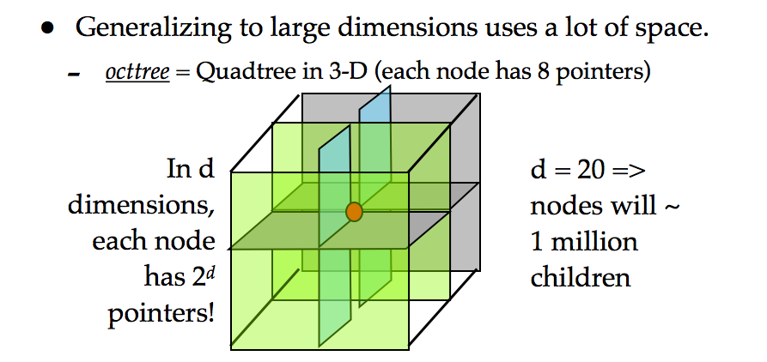
Quadtree (cont’d)
Simple data structure.
Easy to implement.
But, it might not be efficient: two close points may require a lot of levels in the tree to split them

Slide 15
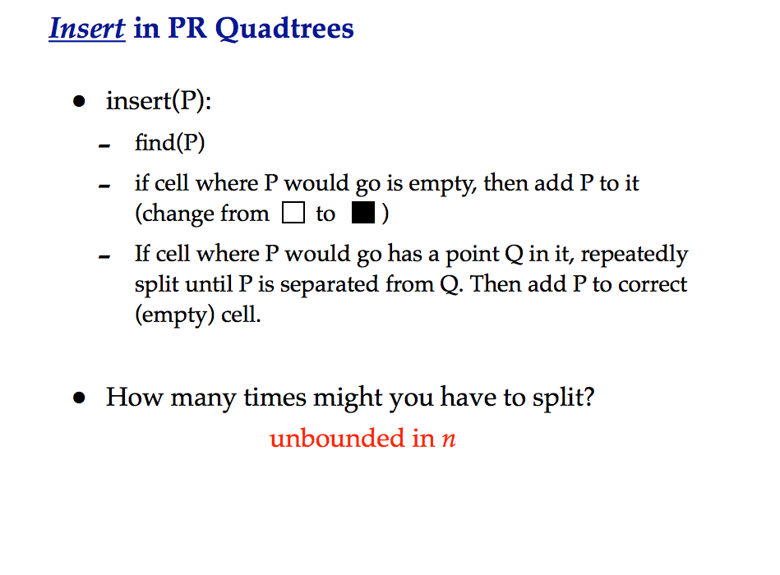

Slide 16
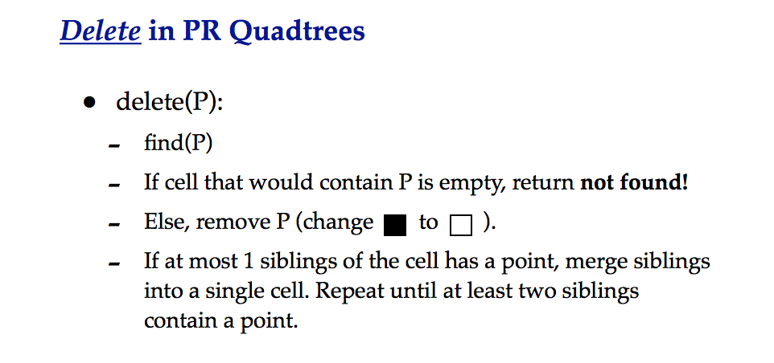

Slide 17
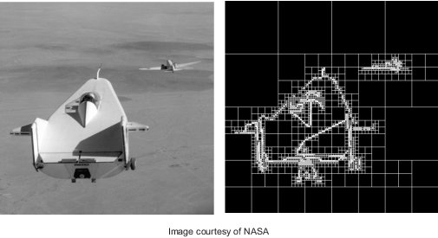
The following image shows original image and its PR quad tree decomposition.

Slide 18
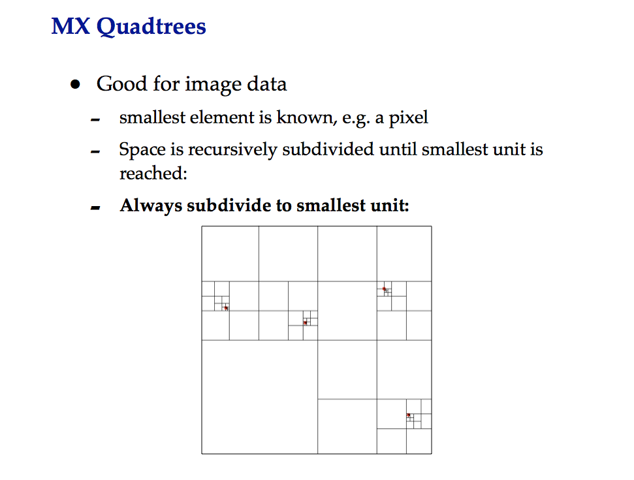

Slide 19
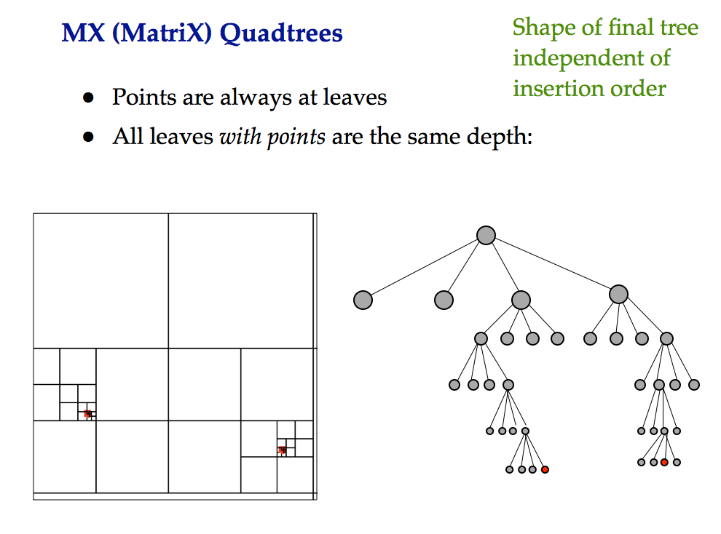

Slide 20
KD Tree
A binary search tree where every node is a
k-dimensional point.
Example: k=2
53, 14
27, 28
65, 51
30, 11
31, 85
70, 3
99, 90
29, 16
40, 26
7, 39
32, 29
82, 64
38, 23
55,62
73, 75
15, 61

Slide 21
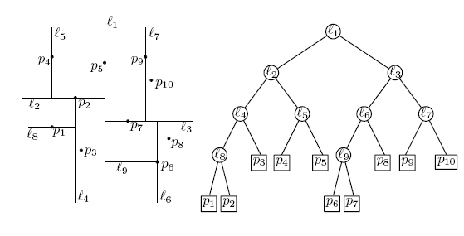
KD Tree (cont’d)
Example: data stored at the leaves

Slide 22
KD Tree (cont’d)
Every node (except leaves) represents a hyperplane that divides the space into two parts.
Points to the left (right) of this hyperplane represent the left (right) sub-tree of that node.
P_{left}
P_{right}

Slide 23
KD Tree (cont’d)
As we move down the tree, we divide the space along alternating (but not always) axis-aligned hyperplanes:
Split by x-coordinate: split by a vertical line that has (ideally) half the points left or on, and half right.
Split by y-coordinate: split by a horizontal line that has (ideally) half the points below or on and half above.

Slide 24
KD Tree - Example
Split by x-coordinate: split by a vertical line that has approximately half the points left or on, and half right.
x

Slide 25
KD Tree - Example
Split by y-coordinate: split by a horizontal line that has half the points below or on and half above.
x
y
y

Slide 26
KD Tree - Example
Split by x-coordinate: split by a vertical line that has half the points left or on, and half right.
x
y
y
x
x
x
x

Slide 27
KD Tree - Example
Split by y-coordinate: split by a horizontal line that has half the points below or on and half above.
x
y
y
x
x
x
x
y
y

Slide 28
Node Structure
A KD-tree node has 5 fields
  Splitting axis
  Splitting value
  Data
  Left pointer
  Right pointer

Slide 29
Splitting Strategies
Divide based on order of point insertion
  Assumes that points are given one at a time.
Divide by finding median
  Assumes all the points are available ahead of time.
Divide perpendicular to the axis with widest spread
  Split axes might not alternate
… and more!

Slide 30
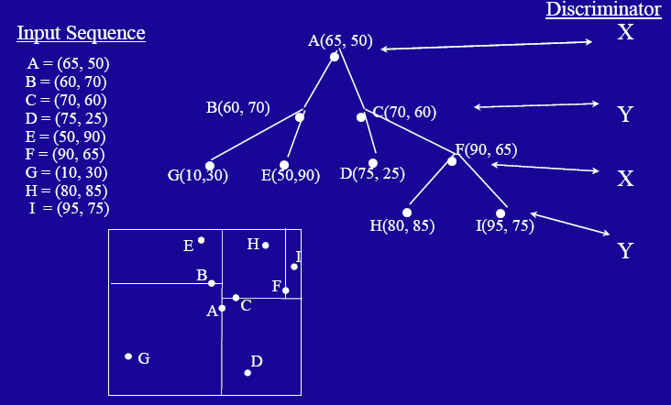
Example – using order of point insertion
(data stored at nodes)

Slide 31
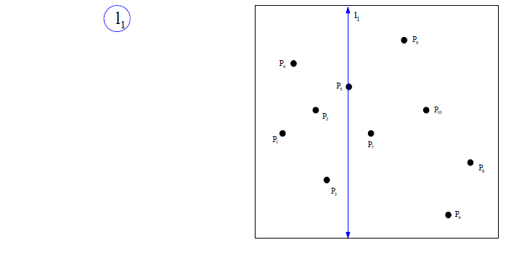
Example – using median
(data stored at the leaves)

Slide 32
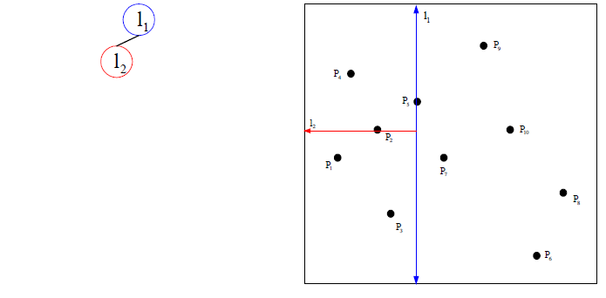
Example – using median
(data stored at the leaves)

Slide 33
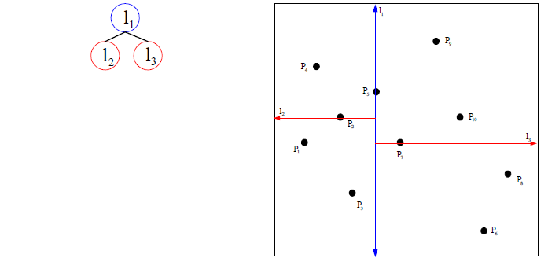
Example – using median
(data stored at the leaves)

Slide 34
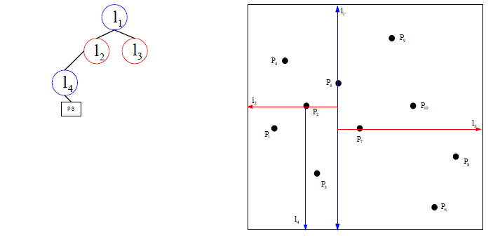
Example – using median
(data stored at the leaves)

Slide 35
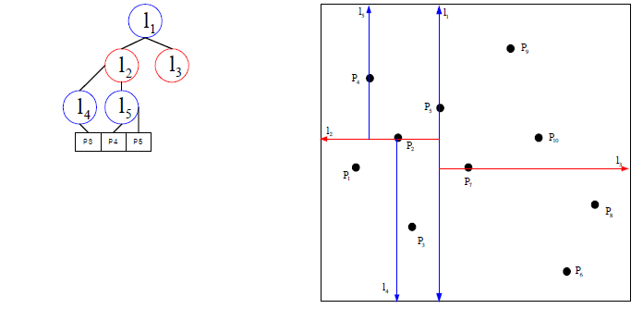
Example – using median
(data stored at the leaves)

Slide 36
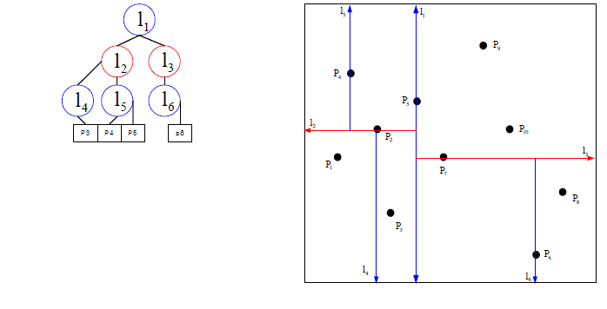
Example – using median
(data stored at the leaves)

Slide 37
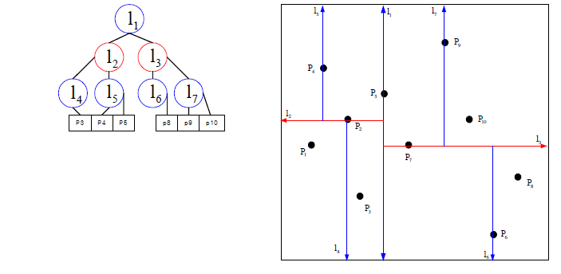
Example – using median
(data stored at the leaves)

Slide 38
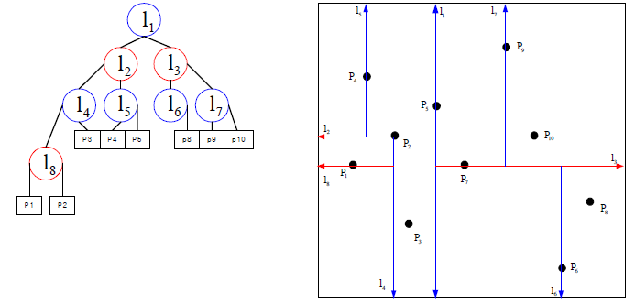
Example – using median
(data stored at the leaves)

Slide 39
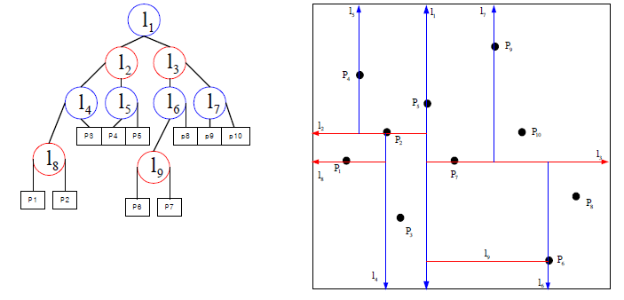
Example – using median
(data stored at the leaves)

Slide 40
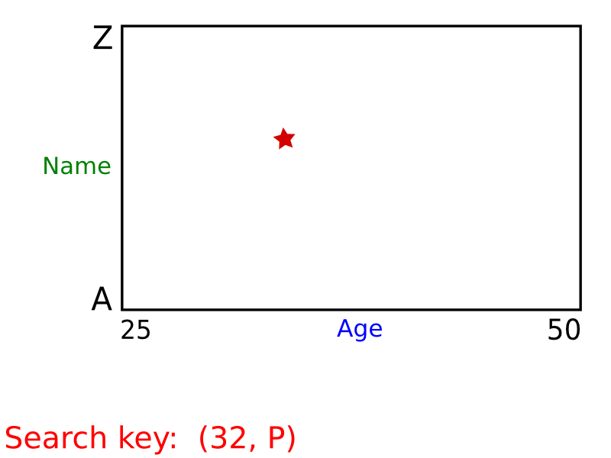
KD Tree – Exact Search

Slide 41
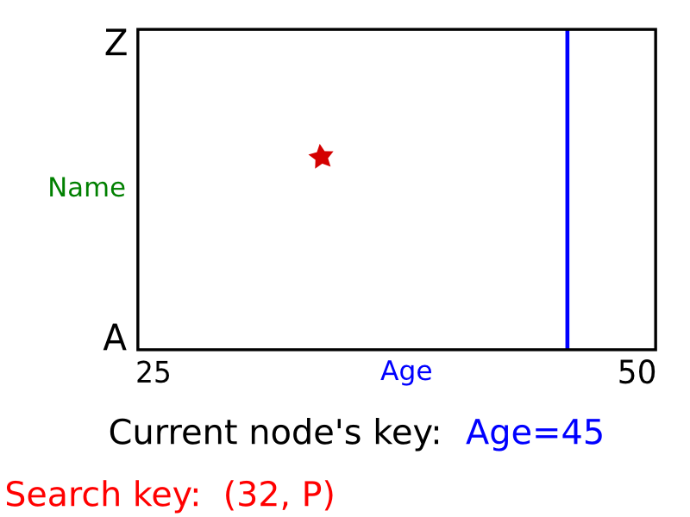
KD Tree – Exact Search

Slide 42
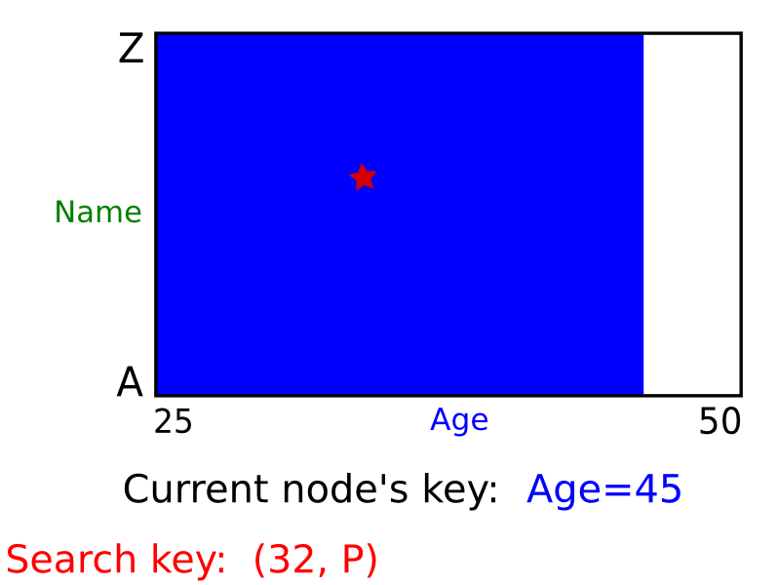
KD Tree – Exact Search

Slide 43
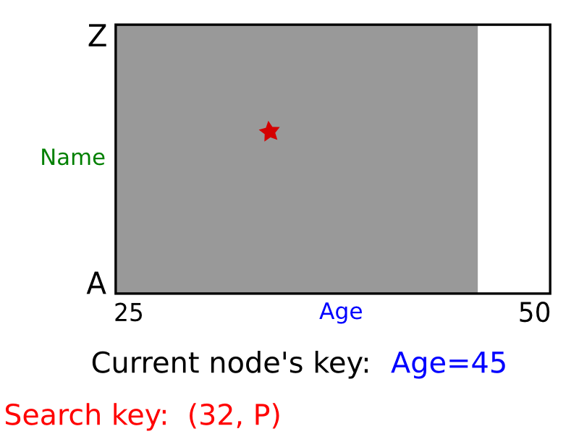
KD Tree – Exact Search

Slide 44
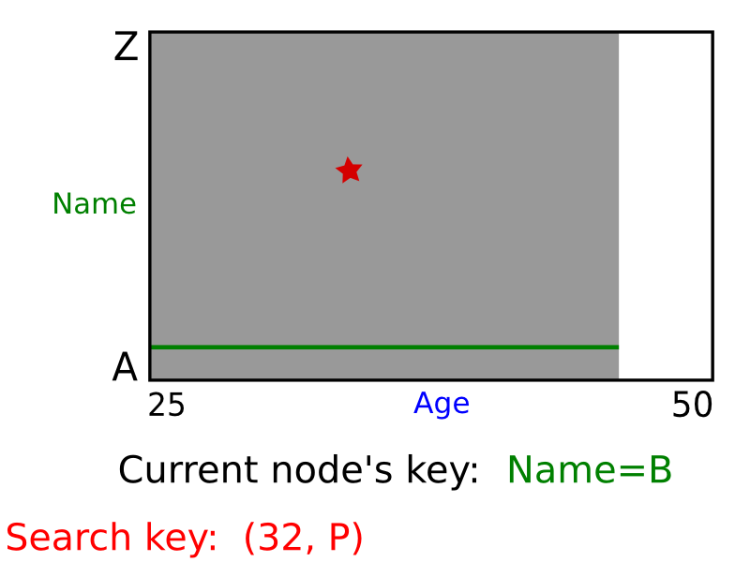
KD Tree – Exact Search

Slide 45
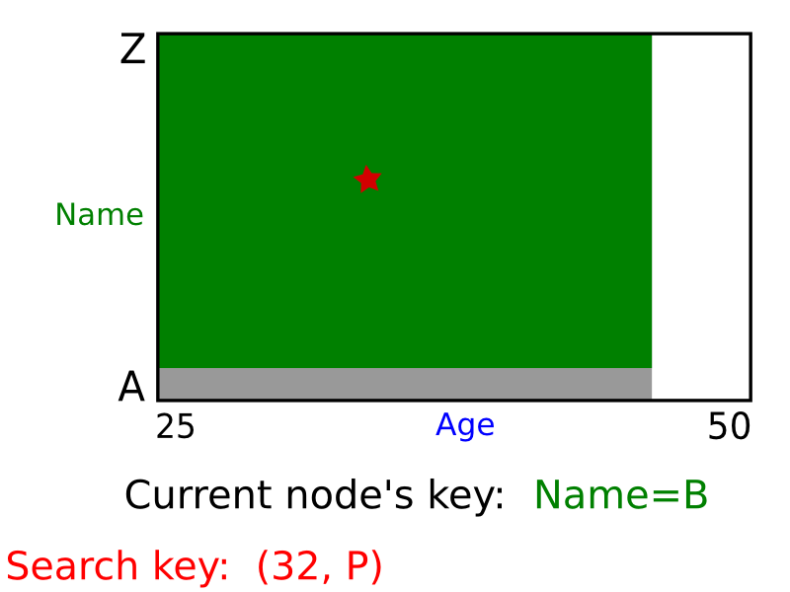
KD Tree – Exact Search

Slide 46
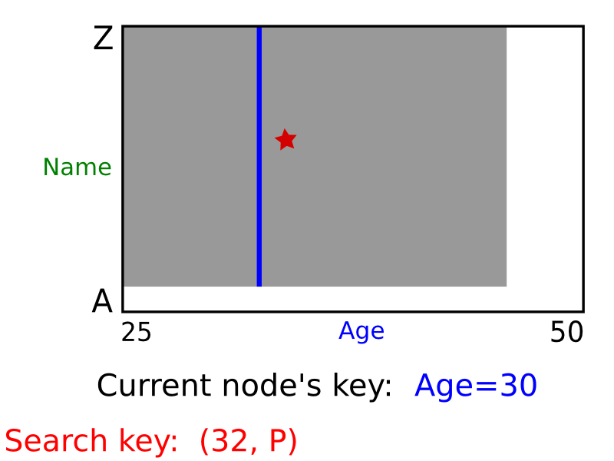
KD Tree – Exact Search

Slide 47
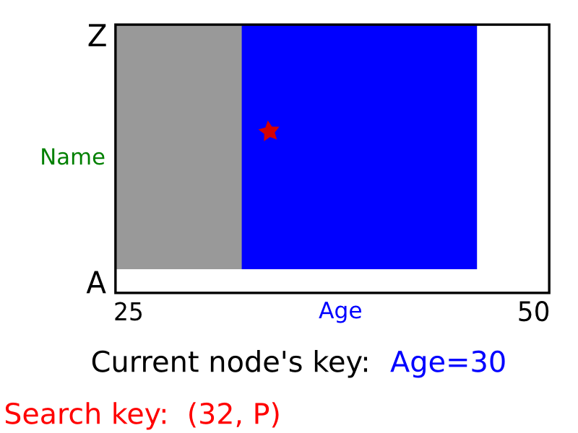
KD Tree – Exact Search

Slide 48
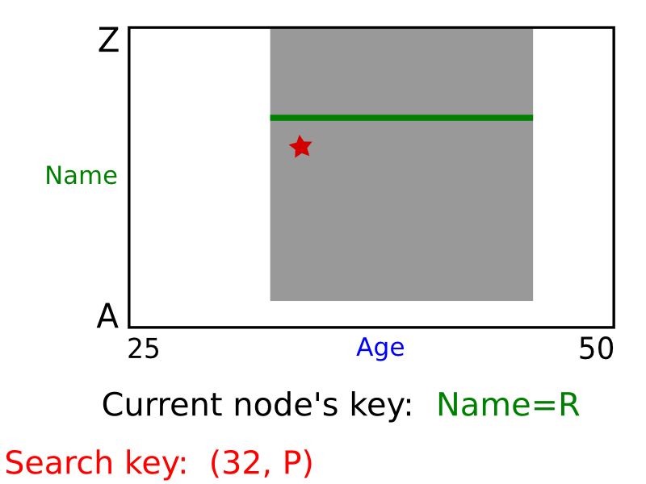
KD Tree – Exact Search

Slide 49
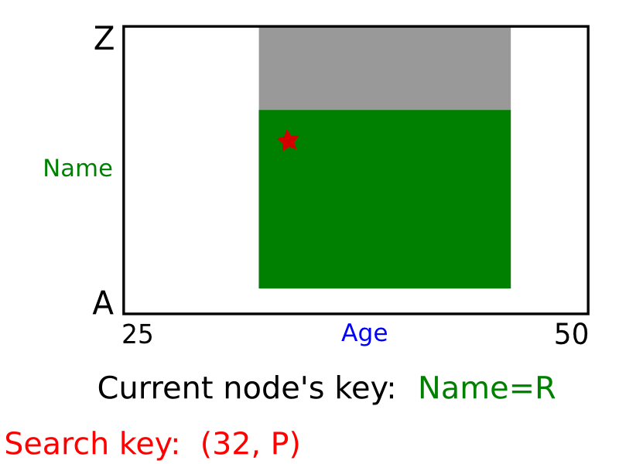
KD Tree – Exact Search

Slide 50
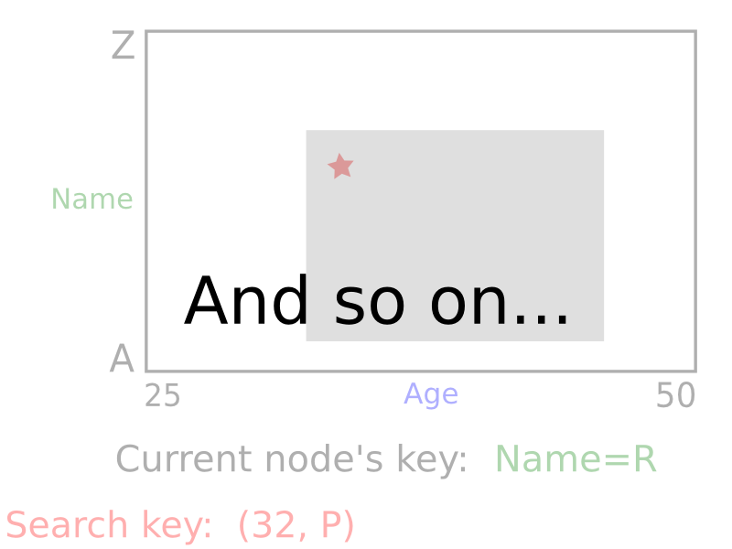
KD Tree – Exact Search

Slide 51
Nearest Neighbor with KD Trees
Traverse the tree, looking for the rectangle that contains the query.

Slide 52
Nearest Neighbor with KD Trees
Explore the branch of the tree that is closest to the query point first.

Slide 53
Nearest Neighbor with KD Trees
Explore the branch of the tree that is closest to the query point first.

Slide 54
Nearest Neighbor with KD Trees
When we reach a leaf, compute the distance to each point in the node.

Slide 55
Nearest Neighbor with KD Trees
When we reach a leaf, compute the distance to each point in the node.

Slide 56
Nearest Neighbor with KD Trees
Then, backtrack and try the other branch at each node visited.

Slide 57
Nearest Neighbor with KD Trees
Each time a new closest node is found, we can update the distance bounds.

Slide 58
Nearest Neighbor with KD Trees
Each time a new closest node is found, we can update the distance bounds.

Slide 59
Nearest Neighbor with KD Trees
Using the distance bounds and the bounds of the data below each node, we can prune parts of the tree that could NOT include the nearest neighbor.

Slide 60
Nearest Neighbor with KD Trees
Using the distance bounds and the bounds of the data below each node, we can prune parts of the tree that could NOT include the nearest neighbor.

Slide 61
Nearest Neighbor with KD Trees
Using the distance bounds and the bounds of the data below each node, we can prune parts of the tree that could NOT include the nearest neighbor.

Slide 62
“Curse” of dimensionality
Much real world data is high dimensional
Quad Trees or KD-trees are not suitable for efficiently finding the nearest neighbor in high dimensional spaces -- searching is exponential in d.
As d grows large, this quickly becomes intractable.

Slide 63
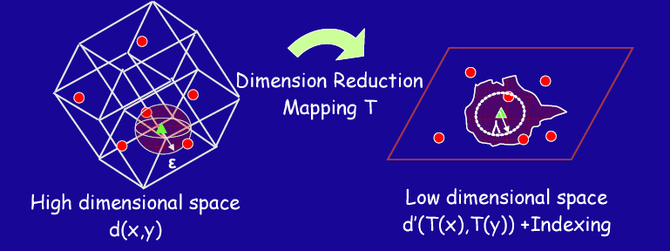
Dimensionality Reduction
Idea: Find a mapping T to reduce the dimensionality of the data.
Drawback: May not be able to find all similar objects (i.e., distance relationships might not be preserved)

Slide 64
Locality Sensitive Hashing
Hash the high dimensional points down to a smaller space
Use a family of hash functions such that close points tend to hash to the same bucket.
Put all points of P in their buckets. Ideally we want the query q to find its nearest neighbor in its bucket

Slide 65
Locality-Sensitive Hashing
Hash functions are locality-sensitive, if, for a random hash random function h, for any pair of points p,q we have:
  Pr[h(p)=h(q)] is “high” if p is “close” to q
  Pr[h(p)=h(q)] is “low” if p is “far” from q

Slide 66
Do such functions exist ?
Consider the hypercube, i.e.,
  points from {0,1}^{d}
  Hamming distance D(p,q)= # positions on which p and q differ
Define hash function h by choosing a set I of k random coordinates, and setting
h(p) = projection of p on I

Slide 67
Example
Take
  d=10, p=0101110010
  k=2, I={2,5}
Then h(p)=11
Can show that this function is locality sensitive

Slide 68
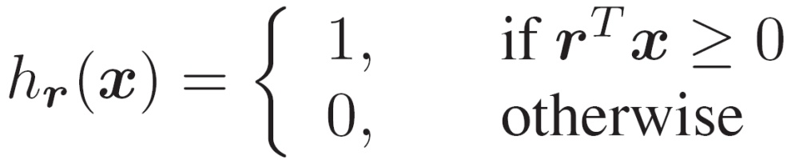



Another example
Divide the space using randomly chosen hyperplanes
is a hyperplane separating the space (next page for example)
Notes:
68

Slide 69
Locality Sensitive Hashing
Take random projections of data
Quantize each projection with few bits
0
101
Input vector
1
0
1
1
Fergus et al
0

Slide 70
How to search from hash table?
A set of data points
N
h
Hash function
r₁…r_{k}
Search the hash table
for a small set of images
X_{i}
<< N
Hash table
110101
Q
h
r₁…r_{k}
Q
110111
111101
New query
[Kristen Grauman et al]
results
Notes:
70
Dd definition

