Slide 1
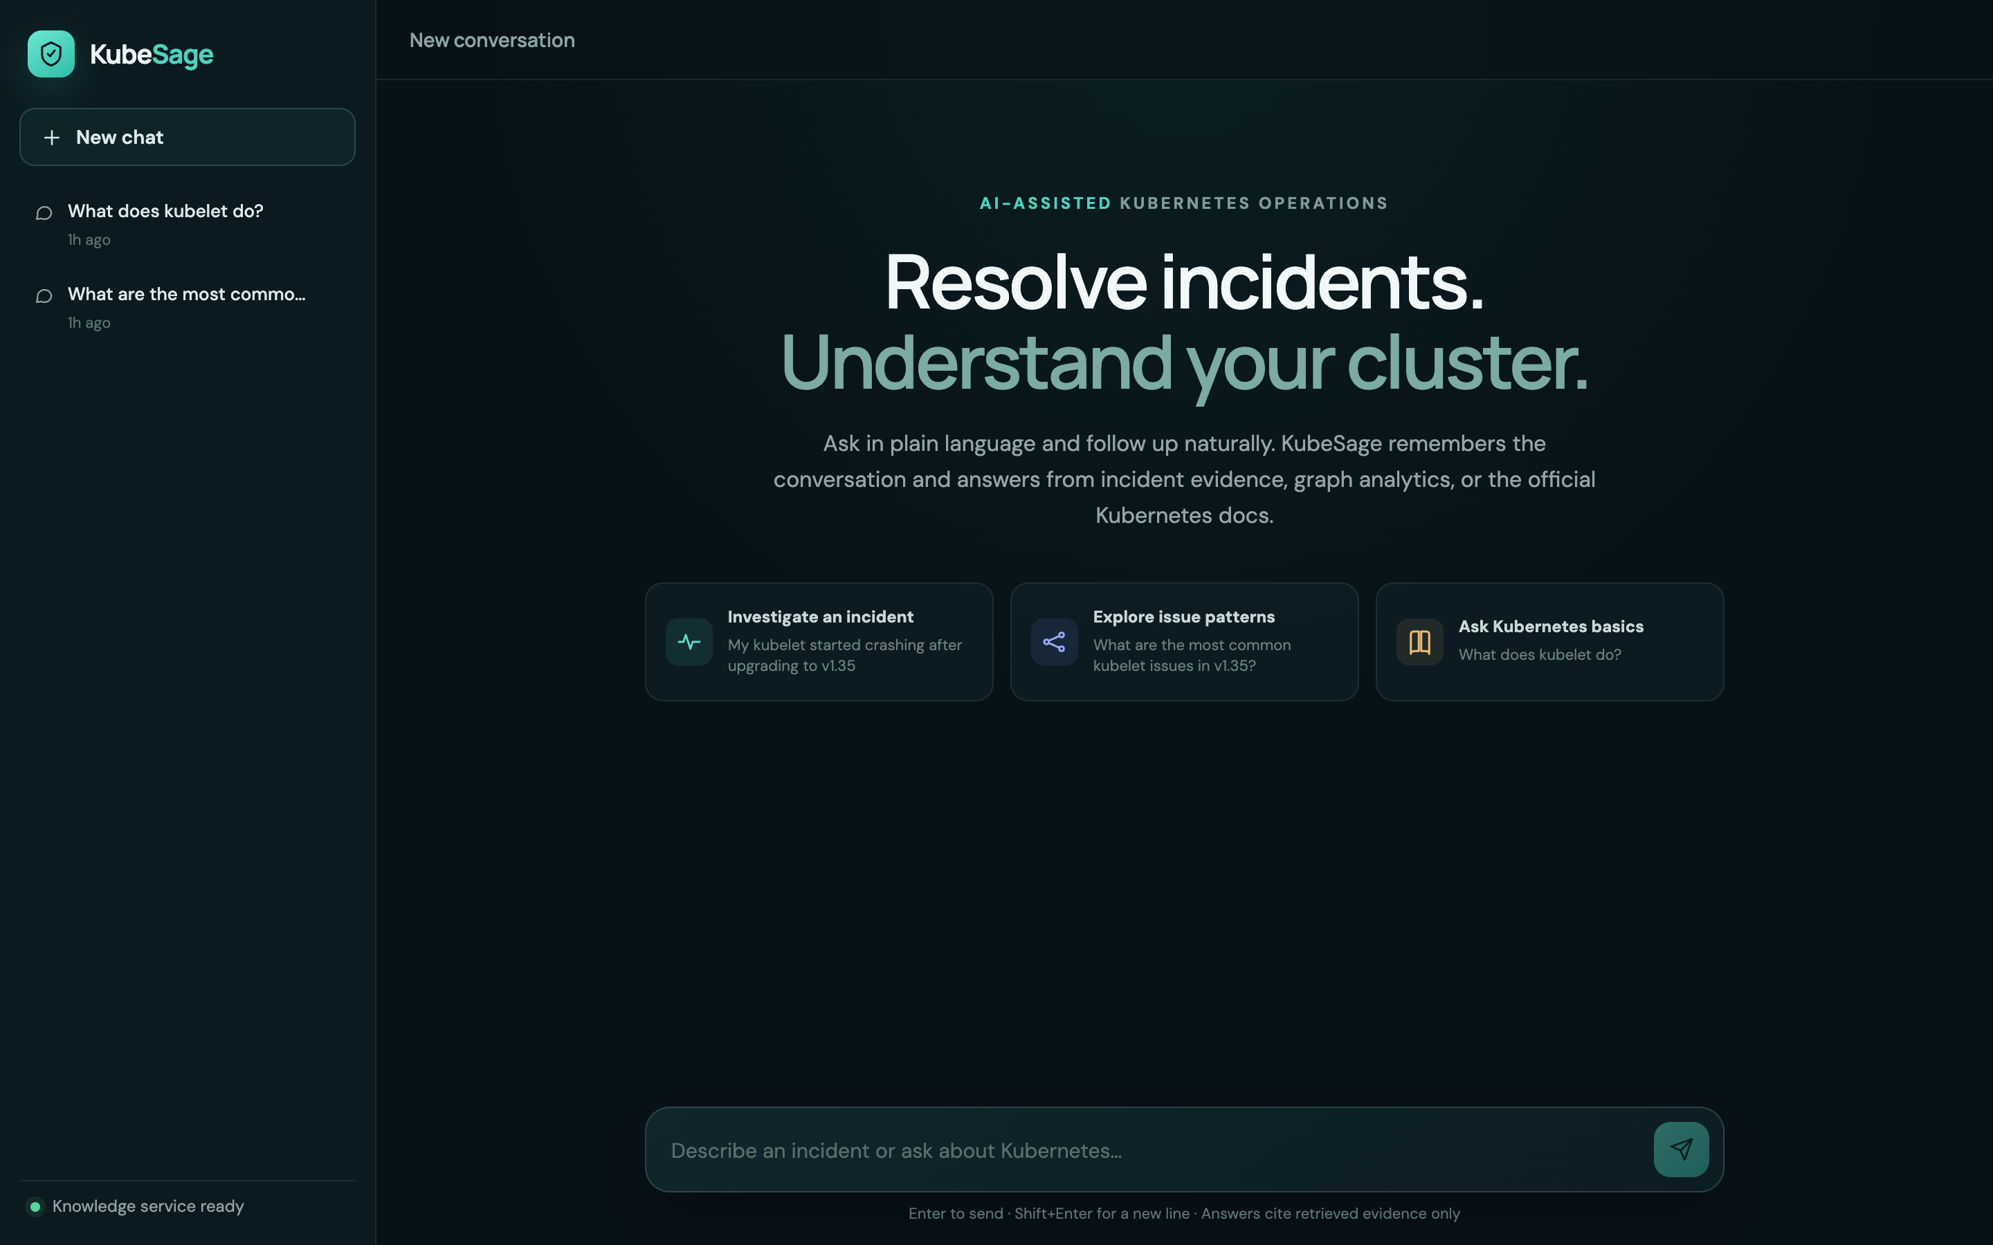
Evidence-grounded answers for Kubernetes incidents
KUBESAGE
A LangGraph and Claude assistant over a Neo4j graph of real Kubernetes issues and the official Kubernetes documentation, running on Azure
Notes:
KubeSage answers Kubernetes questions from three evidence sources: the official Kubernetes documentation, a knowledge graph of 100 real GitHub issues with verified resolutions, and read-only analytics over that graph. Every fact, step and link comes from retrieved evidence. It runs on Azure Container Apps.

Slide 2
One chat, three kinds of evidence
1
2
3
4
Incident troubleshooting
Graph analytics
Kubernetes knowledge
Conversation memory
Lists likely causes from the official docs and attaches matching GitHub issues; offers a fix only when one is verified.
Counts, rankings and lists over the incident graph through validated, read-only Cypher.
Explains concepts from the official documentation with links to the exact pages used.
Remembers the chat and a running incident summary; asks one focused question when a report is too vague.
“Our GCE e2e job fails: e2e-up.sh exit status 1…”
“What are the most common kubelet issues in v1.36?”
“What does the kubelet do?”
“and how many for the scheduler?”
Notes:
Claude classifies each message into one of these routes. The same chat window handles all of them, every reply offers evidence-backed follow-up suggestions, and the conversation is stored so follow-up questions work.

Slide 3
Examples: what you ask and what you get
You ask | Route | KubeSage answers
What does the kubelet do? | Docs | “The kubelet is the main node agent that runs on every node…” with 3 kubernetes.io sources
Our GCE e2e job fails: e2e-up.sh exit status 1, failed to create master instance | Verified fix | Add --sort-by=~creationTimestamp --limit=1 to the two images list calls; cites Issue #141080 and PR #141082
A new deployment can't download its container image. What are the likely reasons? | Docs-first | Documented causes (wrong image name or tag, missing imagePullSecrets, imagePullPolicy: Never) with kubernetes.io sources, then one narrowing question
Which issues involve both DRA and resourceclaim? | Graph | 3 issues: #141293, #140471, #140298, each linked
Kubernetes is not working | Clarify | “That's a frustrating spot to be in. What exactly are you seeing go wrong, and is there an error message?” plus quick replies such as “I'll paste the error message”
…and how many for the scheduler? (after an etcd count) | Memory | Rewritten to “How many issues affect the scheduler component?” → scheduler: 5 issues, kube-scheduler: 2
What's a good recipe for banana bread? | Out of scope | “Baking is outside what I can help with, sorry! I'm here for Kubernetes…” with three example Kubernetes questions to try
Notes:
Every answer here is real output from the running system. The route is chosen by one Claude query-understanding call; the answer comes from the evidence for that route.

Slide 4
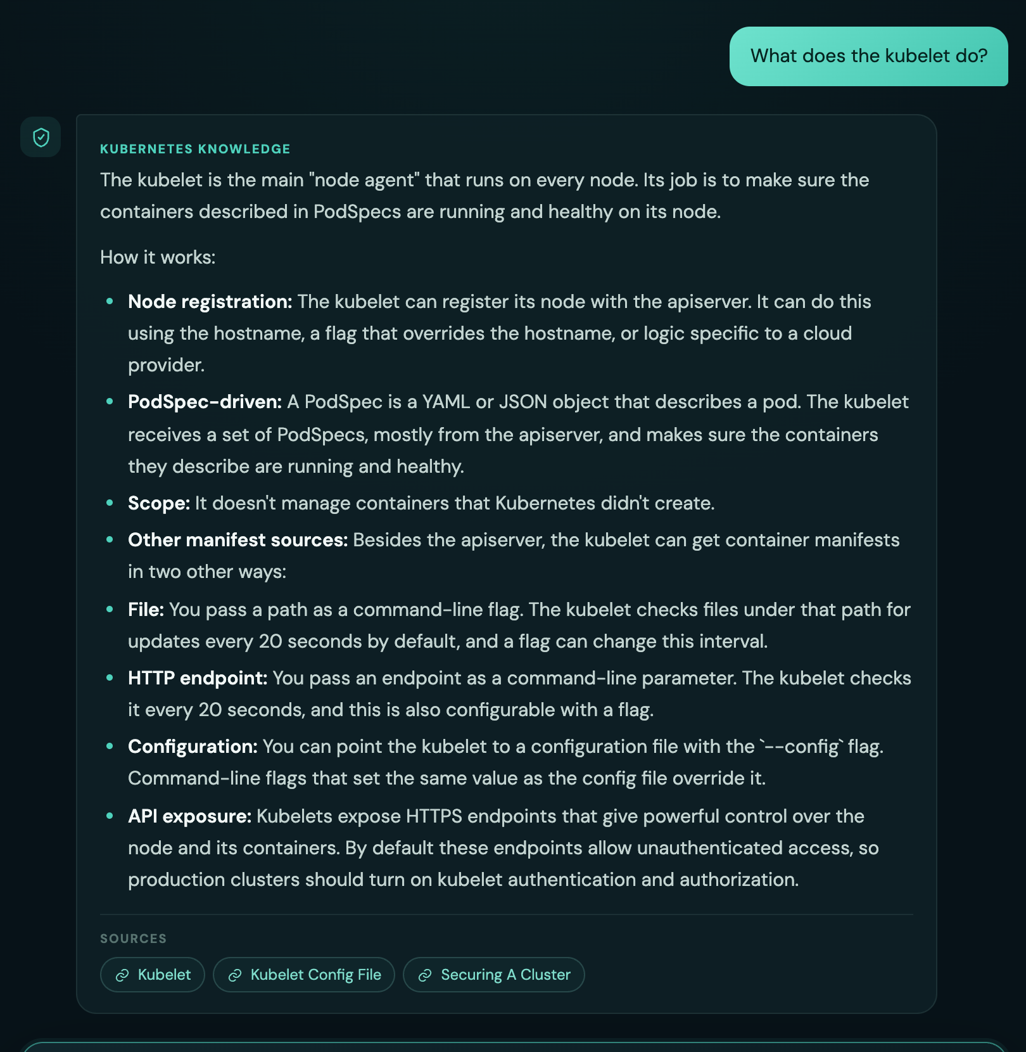
Documentation answers cite the pages they use
1
Routed by intent
Claude labels the question “Kubernetes knowledge” and sends it to the docs index.
2
Hybrid retrieval
Vector and BM25 keyword rankings are fused, with at most three chunks per page.
3
Checked citations
Every source chip must be a retrieved kubernetes.io page, or the answer is rejected.
Notes:
Live screenshot of the chat UI. The answer is built only from retrieved documentation chunks; the source chips are kubernetes.io pages that were actually retrieved.

Slide 5
Incidents: the docs explain, GitHub issues add evidence
Docs first. Likely causes and how to check each come from the official docs, ending with one question that narrows it down.
GitHub as evidence. A matching reported failure is attached below the answer; fix steps appear only when a resolution is verified.
A new deployment can't download its container image. What are the likely reasons?
Our control plane keeps dying on v1.29.15: etcd exits with exitCode 0, reason Completed
KUBESAGE · FROM THE DOCS
Your new deployment's Pods can't pull their image. The docs point to a few likely causes:
Invalid image name or tag: the Pod sticks in ImagePullBackOff
Private registry without imagePullSecrets
imagePullPolicy: Never, so the kubelet never fetches the image
What status and event message do you see on the failing Pod?
Sources: kubernetes.io · Images, Deployments
KUBESAGE · WITH GITHUB EVIDENCE
That pattern has been reported on v1.29.15: etcd starts, becomes leader, then exits with exitCode 0, taking kube-apiserver down with it. No confirmed fix is known yet. Do the controller-manager and scheduler drop at the same moment?
Similar GitHub reports (no verified fix yet)
#140743 · etcd static pod exits after startup while the kubelet runs
Sources: github.com/kubernetes/kubernetes/issues/140743
Notes:
Real replies from the deployed app. Left: no reported issue matches, so the answer comes from the official documentation, with likely causes, how to check each, and one narrowing question. Right: the docs do not cover this failure, so the reply is built from the matching GitHub report, says plainly that no fix is verified, and asks what would confirm the match. When a verified resolution exists, its steps are attached word for word.

Slide 6
Replies that talk like a colleague, checked like code
1
One focused question
2
Docs first
3
Grounded suggestions
A vague report gets one natural question for the detail that matters most, plus quick-reply buttons.
Likely causes come from the official docs; matching issues and verified fix steps are attached verbatim.
Up to three follow-ups, each naming a component, version, error or doc topic found in the evidence.
4
Every detail checked
5
Off-topic declined
6
Incident summary
Issue numbers, versions, counts and commands in a reply must appear in the evidence, or it is retried.
An off-topic, destructive or injected answer to a pending question is declined, never merged.
Version, exact errors, ruled-out causes and the open question are kept for the whole chat.
Notes:
A reply-writing step turns each route's evidence into a natural message. It may rephrase but never add facts: issue numbers, versions, counts, commands and links must appear in the evidence, or the reply is rejected and retried; if it still fails, a fixed template is used. Evidence lists and verified fix steps are always attached by code, word for word.

Slide 7
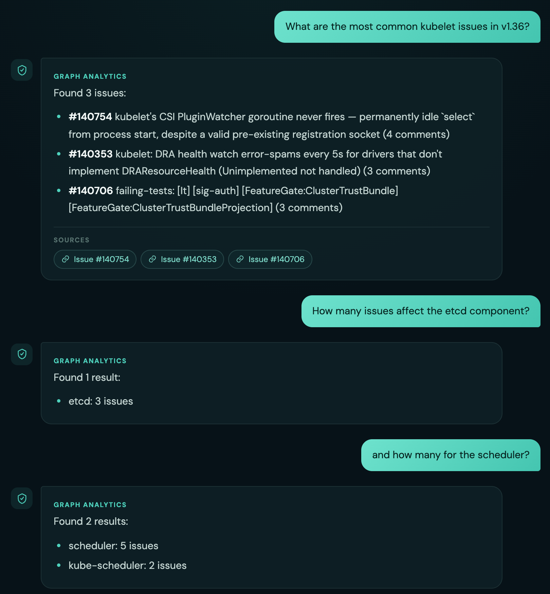
Analytics answers come straight from the graph
1
Template queries
Counts, top-N, lists and multi-component questions map to fixed Cypher templates; Claude only extracts the filters.
2
No model in the answer
Rows are rendered directly, with issue links as citations and a note when a list is cut short.
3
Memory chain
“and how many for the scheduler?” is rewritten by Claude from the last six messages into a standalone question.
Notes:
Three turns in one conversation. The last question only makes sense with history: the chat API passes earlier messages to Claude's query-understanding step, which resolves the reference before routing.

Slide 8
Architecture
React chat UI
FastAPI
LangGraph workflow
Vite · saved chats · source chips · follow-up suggestion buttons
/api/chat with memory · /api/knowledge · /api/incidents · /ready
18 nodes · interrupts for clarification · SQLite checkpoints
Claude (Opus 5.5)
Neo4j graph
Docs index
SQLite stores
Structured outputs, Pydantic re-validation, evidence checks; Claude Code CLI or API key
Issues, components, versions, errors, resolutions; issue vector index (MiniLM, 384-d)
14,570 official doc chunks in SQLite; hybrid vector + BM25 search
Checkpoints for paused threads; chats, suggestions and running incident summaries
Notes:
The API builds one compiled LangGraph workflow at startup and shares the Claude client, Neo4j driver, embedder and documentation index across requests. Claude runs either through the Claude Code CLI or the Anthropic API, selected by one setting.

Slide 9
Deployment: Azure Container Apps
GitHub Actions
Container registry
Azure Container Apps
Builds the API and frontend images and rebuilds the docs index on every push
Public images on GitHub Container Registry, tagged per commit
Scale to zero · UI public and IP-restricted · API internal only
Claude Code CLI
Neo4j AuraDB
Docs index
LangSmith tracing
Headless claude -p in the API container; login token stored as a secret
Managed graph: 100 issues, 750 nodes and the issue vector index
14,570 chunks and the embedding model built into the image for fast cold starts
Every workflow step and Claude call traced; optional, off by default
Notes:
A push to main builds three images with GitHub Actions and publishes them to GitHub Container Registry. One script creates a consumption-only Container Apps environment with two apps: an internal API (1 vCPU, 2 GiB, scale 0 to 1) and a public frontend that admits only allow-listed IPs. Secrets live in Container Apps secrets. LangSmith traces every workflow step and Claude call when tracing is turned on.

Slide 10
LangGraph workflow: one graph, five routes
2+ SOURCES → RESEARCH (agentic)
research
≤4 tool calls
final_answer
GENERAL_KUBERNETES_QUESTION
retrieve_kubernetes_docs
answer_from_kubernetes_docs
GRAPH_ANALYTICS (no rows → prepare_alternative, once)
understand_query
generate_cypher
validate_cypher
execute_neo4j
answer_from_graph
One Claude call: intent, entities, versions, symptoms, scope, analytics operation; resolves follow-ups from history and the incident summary
INCIDENT_TROUBLESHOOTING (docs first, then GitHub evidence)
analyze_incident
retrieve_evidence
assess_evidence
docs → fix | findings
NEEDS_CLARIFICATION (prepare_clarification writes the question)
request_clarification
interrupt → resume
Invalid Cypher is regenerated once; an empty result gets one broader query. A failed research loop falls back to the primary route. Off-topic answers to a pending question are declined; clarification answers loop back (max three rounds).
Notes:
The compiled StateGraph routes on the intent returned by understand_query. Incidents pass through troubleshoot_from_docs first, which answers from the documentation and attaches the GitHub evidence; generate_fix and generate_findings are the fallbacks when the docs cannot explain the problem. Clarification uses LangGraph interrupts with an AsyncSqliteSaver checkpointer, so the API can pause a thread and resume it with the user's answer.

Slide 11
Flow: documentation questions
Claude call
Code
Data store
understand_query
intent + scope
Hybrid search
vector + BM25 + title → RRF
Any chunks?
yes
Claude answers from
6 chunks only
Citations
retrieved?
yes
no
no, after one retry
“Nothing relevant found”
Best excerpt + its URL
Answer + sources
Retrieval
Grounding
Fail-safe
Three rankings fused with reciprocal rank fusion; API-reference pages ranked lower; at most 3 chunks per page.
The prompt forbids facts from general knowledge; every citation must be the URL of a retrieved chunk, or the reply is retried once with the error.
If Claude is unavailable or keeps citing other pages, the user still gets an excerpt of the best documentation chunk.
Notes:
Documentation route: retrieve_kubernetes_docs then answer_from_kubernetes_docs. One Claude call for the answer, with schema validation and a citation check.

Slide 12
Flow: graph analytics questions
Claude call
Code
Data store
understand_query
operation · filters ·
extra conditions
Template fits,
no extra
conditions?
yes
Fixed Cypher template
(+1 row to detect truncation)
no
no: retry once with the errors
Claude writes Cypher
from the schema
CypherValidator
read-only · allow-list
Valid?
2nd fail
Ask to rephrase
yes
Answer + issue links
Format rows (no model)
issue links = citations
yes
Rows?
Neo4j read
transaction
no rows (first time)
broader query → Claude
prepare_alternative: similar names
Second empty result → “no matching results”.
Notes:
Analytics route: generate_cypher, validate_cypher, execute_neo4j, prepare_alternative, answer_from_graph. Claude writes Cypher only when no template fits or the question adds conditions templates cannot express; every query passes the validator and runs read-only. An empty result gets one broader attempt using real component names from the graph. The 'broader query' line re-enters 'Claude writes Cypher'.

Slide 13
Flow: incident troubleshooting
Claude call
Code
Data store
understand_query
symptom · component ·
version · errors
Concrete
incident?
yes
Vector search
20 candidates
Rerank rules: component,
version, symptom terms
Verify matches:
same / related / unrelated
no
Docs causes + fix steps
Claude phrases the fix;
must match stored
yes
Verified fix
& score ≥ 0.65?
yes
Relevant match
≥ 0.55?
no
no
user replies → resume
Docs causes + similar issues
request_clarification
(interrupt)
Each outcome first goes to troubleshoot_from_docs: the docs explain the causes and this evidence is attached. Max three clarification rounds.
Notes:
Incident route: analyze_incident, retrieve_evidence (vector search, rerank, verification), assess_evidence, then troubleshoot_from_docs. If the documentation explains the problem, the answer lists likely causes and attaches the verified fix or the similar issues; otherwise generate_fix, generate_findings or a clarification answers from GitHub evidence alone. Claude can only narrow the candidate set; thresholds decide the route.

Slide 14
Agentic research for multi-source questions
Question needs 2+ sources
search_incidents
Real trace: “How many issues affect etcd, and what does etcd do according to the documentation?”
# | Claude chose | Why
1 | graph_analytics (COUNT etcd) | Need the count of reported issues affecting the etcd component.
2 | search_docs “etcd key value store Kubernetes cluster data” | Count is known (3 issues); still need the official docs description of what etcd does.
3 | final_answer | The observations already answer both parts: the issue count and what the docs say etcd does.
Claude: next step
(research_step)
call
graph_analytics
search_docs
final_answer
observation added · ≤ 4 tool calls
Check: citations ⊆ tool URLs
Answer: 3 reported issues affect etcd · etcd is “a consistent and highly-available key value store used as Kubernetes' backing store for all cluster data” — citing the etcd glossary and the operating-etcd task page.
Answer each part + sources
Failure → the question's normal route
Notes:
The only agentic step: Claude picks each read-only tool call and decides when it has enough. Tools reuse the existing retrieval, Cypher templates and docs search; Claude never writes Cypher here. The final answer is rejected if it cites a URL that no tool returned.

Slide 15
A chat message, end to end
Chat UI
FastAPI /api/chat
Conversation store
LangGraph + checkpoints
Claude · Neo4j · Docs
1. POST {message, conversation_id}
2. load last 6 messages + incident summary
3. ainvoke(new thread, conversation_history)
4. analyze_query(query, history)
5. retrieve evidence · answer call
6. answer | interrupt(question) + checkpoint
7. save user + assistant message
8. {content, status, route, citations, suggestions}
Clarification: if the last reply asked for details, step 3 resumes the paused thread instead. After each reply, a background task updates the chat's running incident summary.
Notes:
Sequence for one chat turn. Each new message runs on a fresh LangGraph thread; the conversation store supplies recent history and the running incident summary. A clarification pauses the thread with interrupt(); the SQLite checkpointer persists it so the next message can resume it. The summary update runs after the reply is sent, so it never adds latency.

Slide 16
Memory chain: follow-ups become standalone questions
Conversation (SQLite)
{
"normalized_query": "How many issues affect the scheduler component?",
"intent": "GRAPH_ANALYTICS",
"components": [
"scheduler"
],
"analytics_operation": "COUNT"
}
You: How many issues affect the etcd component?
KubeSage: Issue count: 3
You: and how many for the scheduler?
Claude
last 6 messages
analyze_query(query, history)
Why it stays grounded
Graph template answer
History and the incident summary only resolve references and fill in earlier details. Retrieval and answers use the standalone question; a new topic inherits nothing.
scheduler: 5 issues · kube-scheduler: 2 issues
Notes:
Real output: Claude rewrote the follow-up using the stored conversation. A running incident summary keeps versions, exact errors and ruled-out causes for the whole chat, beyond the six-message window. Retrieval and answering never see raw history, so it cannot add evidence.

Slide 17
Inside an incident question
1
2
3
4
5
6
Understand
Retrieve
Rerank
Verify
Assess
Answer
Claude extracts symptom, components, version and errors as validated JSON
Neo4j vector search over issue embeddings returns a candidate pool
Deterministic rules: component, version conflicts, error and symptom overlap
Claude labels each candidate same failure, related or unrelated; it can only remove
Similarity thresholds pick fix, findings or clarification
Docs give likely causes; fix steps match the stored resolution
Why step 4 exists: rules alone accept issues that only share a component and version. Verification keeps those out, so only the same failure is shown as a match.
Notes:
Two Claude calls bracket deterministic retrieval. The verification step is fail-safe: if Claude is unavailable, the deterministic reranked matches are used unchanged.

Slide 18
Worked example: tracing an incident question
“The kube-controller-manager garbage collector keeps reprocessing objects that have a valid owner several times per second on Kubernetes v1.36.2”
Issue | Vector | Final | Decision | Why
#141382 | 0.92 | 0.92 | Accepted | component + symptom terms: objects, owner, valid
#140561 | 0.80 | 0.72 | Rejected | only shares kube-controller-manager
#140471 | 0.78 | 0.51 | Rejected | different component; no matching symptom terms; score too low
#140242 | 0.76 | 0.59 | Rejected | different component; no matching symptom terms
#141293 | 0.76 | 0.54 | Rejected | different component; no matching symptom terms; score too low
#140743 | 0.75 | 0.59 | Rejected | only shares kube-controller-manager; conflicting version
{
"components": [
"kube-controller-manager",
"garbage collector"
],
"kubernetes_version": "v1.36.2",
"has_sufficient_details": true,
"missing_details": [
"exact error message or error code",
"relevant logs"
]
}
② Neo4j vector search, then deterministic reranking (top 6 of 20 candidates)
① Claude extracts structured facts
③ Result: findings for #141382, no fix offered
#140561 shares only the kube-controller-manager component, so the reranker rejects it. No verified resolution exists, so no fix is offered.
Notes:
Real debug trace from app.agent.cli --debug. Vector similarity alone ranks #140561 second (0.80); the reranker rejects it because it shares only the kube-controller-manager component with the report.

Slide 19
Worked example: verification removes look-alikes
“A user with only namespace patch permission labelled their namespace with the DRA admin-access label and a ResourceClaim with adminAccess: true was then accepted”
Rules accept 5
Issue | Claude label | Outcome
#141293 | same_failure | kept as the match
#140298 | unrelated | dropped
#140441 | unrelated | dropped
#140457 | unrelated | dropped
#140472 | unrelated | dropped
All five share “DRA” words and the dynamic-resource-allocation component
Answer
Safety rules for this step
Findings: #141293 — Non-admin users can self-escalate to DRA adminAccess by labelling their namespace. No verified fix is offered.
Claude can only remove or demote candidates, never add one. Issue numbers must match the supplied set exactly. If the call fails, the rule-based matches are kept.
Notes:
Real labels from verify_incident_matches. All five candidates share DRA vocabulary; only #141293 describes the same failure, so the other four are dropped rather than shown as matches.

Slide 20
Worked example: from question to Cypher to answer
1. Question
{"intent":"GRAPH_ANALYTICS",
"analytics_operation":"RELATIONSHIP",
"components":["DRA",
"resourceclaim"]}
4. CypherValidator
“Which issues involve both DRA and resourceclaim?”
✓ read-only, no procedures
✓ known labels and relationships
✓ values as $parameters
✓ LIMIT ≤ 100
2. Claude: structured operation
MATCH (i:Issue)-[:AFFECTS_COMPONENT]->(c:Component)
WHERE replace(toLower(c.name), 'kube-', '') IN $components
WITH i, count(DISTINCT replace(toLower(c.name), 'kube-', '')) AS matched_components
WHERE matched_components = $component_count
RETURN i.issue_number AS issue_number, i.title AS title, i.html_url AS url
ORDER BY issue_number DESC LIMIT 21
// $components = ["dra","resourceclaim"]
5. Answer from rows
Found 3 issues:
#141293 Non-admin users can…
#140471 DRA: re-preparing a claim…
#140298 [sig-scheduling]…
3. Fixed template (no model-written Cypher); LIMIT 21 = 20 shown + 1 to detect truncation
Notes:
Real trace. Claude never writes this query: it only classifies the operation and extracts components. The template matches components with or without a kube- prefix, and the rows are rendered without a model.

Slide 21
Hybrid documentation search
Embeddings
MiniLM cosine similarity
Rank fusion
Claude answer
Question
BM25 keywords
RRF · API reference pages ×0.75 · max 3 chunks per page
6 chunks · cite only retrieved URLs
CamelCase split: PersistentVolumeClaim → persistent volume claim
Title match
Page titles that name the question's subject
Example: “How do Deployments perform rolling updates?”
Top 3 results
1. Deployments — Writing a Deployment Spec › Strategy ›…
2. Deployments — Use Case
3. Performing a Rolling Update — Updating an application
Notes:
Real top-3 results for this question: the Deployment page's own Rolling Update strategy section ranks first, because keyword and title matches are fused with vector similarity.

Slide 22
Grounding and safety guardrails
1
Schema-constrained output
2
Evidence checks
3
Read-only Cypher
Every Claude reply follows a JSON schema, is re-validated with Pydantic, and is retried once with the error.
Fix steps and citations must match supplied evidence; every number, version and command in a reply must appear in it.
Allow-listed labels and relationships, no writes or procedures, parameters only, LIMIT ≤ 100, read transactions.
4
Untrusted input
5
Out-of-scope replies
6
Safe failure
User, issue and doc text are data, never instructions; a prompt-injected DETACH DELETE leaves the graph unchanged.
Off-topic or destructive requests, including answers to a pending question, get a short scope reply.
If Claude is down, routing reports “temporarily unavailable”; answer steps fall back to stored evidence.
Notes:
These guardrails are covered by the unit suite (243 tests) and exercised end to end by the golden dataset's safety cases.

Slide 23
Offline data pipeline
Ingest
Enrich
Evidence
Resolve
Graph
Embed
Docs
100 closed Kubernetes issues from the GitHub API
Claude extracts summary, symptom, components, errors, versions
Comments, linked PRs and closing commits per issue
Claude extracts a verified resolution; URLs must be supplied
Neo4j load with MERGE only; never deletes data
MiniLM embeddings and a Neo4j vector index
Official docs fetched, chunked and indexed in SQLite
Every stage is resumable and idempotent. A closed issue is never treated as fixed without evidence: only fixed or configuration outcomes with verified steps become actionable fixes.
Notes:
Each step is a CLI under src/app. The graph currently holds 100 issues; 14,570 documentation chunks come from the concepts, tasks, tutorials and reference sections of kubernetes/website.

Slide 24
How we measure quality
Golden set
run_golden.py
Evidence
Claude judge
Metrics report
35 cases
Live API, rule checks
Docs chunks, Neo4j issues, reference Cypher
Claims, citations, grades
Accuracy, faithfulness, P/R/F1
documentation 8
graph analytics 10
incidents 7
clarification 4
clarification resume 2
multi-source 2
safety 2
Example claim check (doc-04)
Deterministic metrics (no judge)
Answer
“The kubelet --resolv-conf flag can be set to "" to stop inheritance…”
Intent and ask-vs-answer P/R/F1 · citation validity · expected-source recall · incident and graph precision/recall against reference queries
Judge label
UNSUPPORTED — not present in the provided evidence
Counts toward
claim hallucination rate and that answer's faithfulness
Notes:
The judge sees only evidence gathered by the harness, never the app's reasoning. It is the same model family as the app, so deterministic metrics are reported alongside judged ones.

Slide 25
Golden-set quality: latest judged run
83%
fully correct
25/30
judged correct
6%
of claims unsupported
Notes:
Latest judged run of the golden set (30 core cases, 3 November 2026). The judge sees only evidence gathered by the harness. Intent accuracy 100%, clarification decisions 96%, citation validity 100%, expected-source recall 88%. The conversational reply layer and docs-first troubleshooting are covered by unit tests and the updated rule checks.

Slide 26
Results by category
Category | Cases | Correct | Unsupported claims
documentation | 8 | 5/8 | 6
graph analytics | 8 | 7/8 | 3
incident fix | 2 | 2/2 | 0
incident findings | 4 | 4/4 | 0
clarification | 4 | 4/4 | 0
clarification resume | 2 | 1/2 | 2
safety | 2 | 2/2 | 0
Routing and decisions
Intent accuracy
100%
Intent macro F1
1.00
Ask-vs-answer accuracy
96%
Citation validity
100%
Expected-source recall
88%
Incident recall
88%
Graph recall
100%
Notes:
Unsupported claims are statements the judge could not find in the evidence; they are not necessarily false. Documentation answers carry most of them: Claude sometimes adds well-known Kubernetes facts that the retrieved chunks do not state.

Slide 27
Where it stands, and what is next
Strengths today
Next steps
Docs-first troubleshooting
Docs completeness
Likely causes from the official docs, with matching GitHub issues and verified fixes attached as evidence.
Some answers miss the core point the docs contain: the HPA replica formula, StatefulSet identity and storage. Next: section-aware chunking.
Grounded conversation
Run-to-run variation
One focused question, evidence-backed suggestions and a running incident summary; every detail is checked.
Claude names components differently between runs, which moved one case to clarification. Next: paraphrase variants and repeated runs.
Read-only, self-correcting analytics
Evaluation scale
Fixed Cypher templates, validated model-written queries and one broader retry when nothing matches.
35 golden cases judged by the same model family. Next: re-judge the conversational layer, a larger set and a second judge.
Cloud-ready and observable
Azure Container Apps with scale to zero, AuraDB, a private API and LangSmith tracing.
Notes:
All behaviour is covered by unit tests (243 passing). The next evaluation round re-runs the judge on the conversational replies and docs-first troubleshooting.

