Slide 1

ASSIGNMENT – II TURTLE Graphics
Submitted by – GROUP 6
(Abhik De, Koyel Chakraborty, Kushaal Agarwal, Soumitro Mukherjee, Susnato Chakraborty, Anubhab Maity)

Slide 2
TURTLE GRAPHICS
1
A Turtle Graphics toolkit provides a simple and enjoyable way to draw pictures in a window.
Turtle is an open-source Python module.
Turtle graphics originally developed as part of the children’s programming language “Logo”.
Created by Seymour Papert and his colleagues at MIT in the late 1960s.

Slide 3
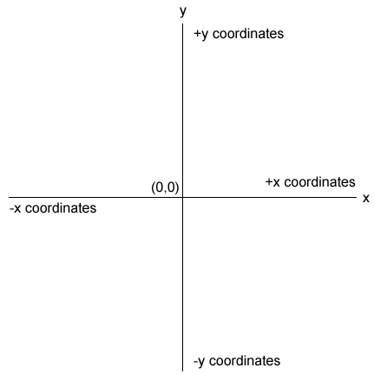
Analogy
2
Turtle crawling on a piece of paper, with a pen tied to its tail.
Sheet of paper is a window on a display screen.
Position specified with (x, y) coordinates.
Cartesian coordinate system, with origin(0,0) at the center of a window.

Slide 4
TURTLE OPERATIONS
3
Installation
Import
> pip install turtle
from turtle import *
Turtle Method | What it does
t = Turtle() | Creates a new Turtle object and opens its window.
t.home() | Moves t to the center of the window and then points t east.
t.shape(“string”) | To change turtle shape. Shapes are – “arrow”, “turtle”, “circle”, “square”, “triangle”, “classic”.
t.setheading(degrees) | Points t in the indicated direction, which is specified in degrees, East is 0 degrees, north is 90 degrees, west is 180 degrees, and south is 270 degrees , again to east set degree either 360 or 0.
t.left(degrees) t.right(degrees) | Rotate t to the left or the right by the specified degrees.

Slide 5
TURTLE OPERATIONS
4
Turtle Method | What it does
t.penup( ) t.pendown( ) | Raises or Lowers t’s pen from or to the drawing surface.
t.goto(x , y) | Moves t to the specified position.
t.forward(distance)/ t.fd(distance) t.backward(distance)/t.bd(distance) | Moves t to the specified distance in the specified direction.
t.pencolor(r, g, b) t.pencolor(string) | Change the pen color of t to the specified RGB value or the specified string, such as ‘red’. Returns the current color of t when the arguments are omitted.
t.fillcolor(r, g, b) t.fillcolor(string) | Changes the fill color of t to the specified RGB value or to the specified string, such as ‘red’ . Returns the current fill color of t when the arguments are omitted.

Slide 6
TURTLE OPERATIONS
5
Turtle Method | What it does
t.begin_fill ( ) t.end_fill ( ) | Enclose a set of turtle commands that will draw a filled shape using the current fill color.
t.width(pixels) | Changes the width of t to the specified number of pixels. Returns t’s current width when the argument is omitted.
t.hideturtle( ) t.showturtle( ) | Makes the turtle invisible or visible.
t.position( ) | Returns the current position (x , y) of t.
t.heading( ) | Returns the current direction of t.
t.isdown( ) | Returns True if t’s pen is down or false otherwise.

Slide 7
TURTLE OPERATIONS
6
Turtle Method | What it does
Screen().bgcolor(r, g, b) Screen().bgcolor(string) | Change the background color of Turtle screen.
Screen().bgpic(“file name.gif”) | Insert a background picture. Image should be in “.gif” format. Turtle file location and image file location must be same.
Screen().title(‘titlestring’ ) | Gives a title of Turtle window
t.circle(radius, extent=None, steps=None) | To draw circle, extent is angle, how many steps to draw polygon.
t.undo( ) | Undo the last turtle action
t.speed( number) | Set the turtle speed to an integer value in the range 0…10.If no argument is given, return current speed.
t.clear ( ) | Delete the turtle’s drawing from the screen.

Slide 8
TURTLE OPERATIONS
7
Turtle Method | What it does
write(arg, move=False, align='left', font='Arial', 8, 'normal') | Write text - the string representation of arg - at the current turtle position according to align (“left”, “center” or “right”) and with the given font. If move is true, the pen is moved to the bottom-right corner of the text.
t.clone() | Create and return a clone of the turtle with same position, heading and turtle properties.
Screen().resetscreen() | Reset all Turtles on the Screen to their initial state.
Screen().screensize(canvwidth=None, canvheight=None, bg=None) | Set screen size.
Screen().onkey(fun, key=None) Screen().listen() | Bind the user defined function fun to the mentioned key.

Slide 9
8
Some examples are followed with code

Slide 10
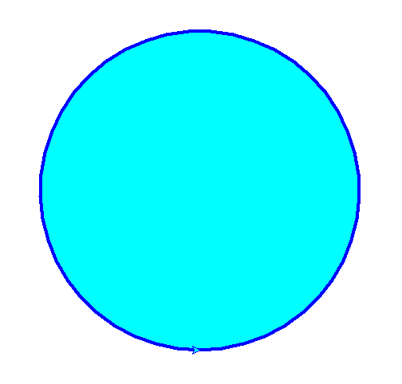
BASIC GEOMETRIC PATTERNS
9
Circle:
import turtle
t = turtle.Turtle()
s = turtle.Screen()
t.fillcolor('cyan')
t.penup()
t.rt(90)
t.forward(200)
t.lt(90)
t.pendown()
t.pencolor('blue')
t.width(4)
t.begin_fill()
t.circle(200)
t.end_fill()
turtle.done()

Slide 11
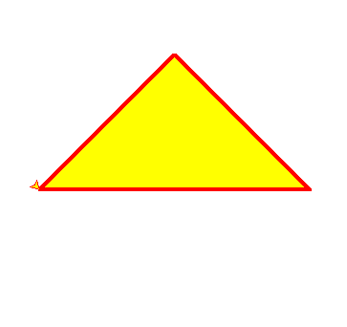
BASIC GEOMETRIC PATTERNS
10
Triangle:
import turtle
t = turtle.Turtle()
s = turtle.Screen()
t.fillcolor(‘yellow')
t.pencolor(‘red')
t.width(4)
t.begin_fill()
t.backward(100)
t.lt(45)
t.forward(200)
t.rt(90)
t.forward(200)
t.goto(-100,0)
t.end_fill()
turtle.done()

Slide 12
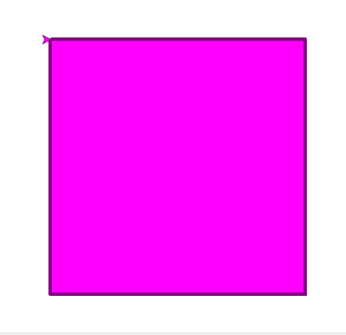
BASIC GEOMETRIC PATTERNS
11
Square:
import turtle
tur = turtle.Turtle() tur.fillcolor('magenta')
tur.pencolor('purple')
tur.width(4)
tur.begin_fill()
for i in range(4):
tur.forward(300)
tur.rt(90)
tur.end_fill()
turtle.done()

Slide 13
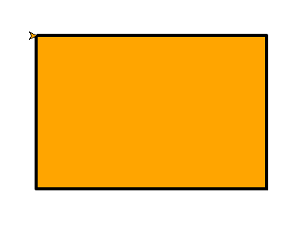
BASIC GEOMETRIC PATTERNS
12
Rectangle:
import turtle
tur = turtle.Turtle()
tur.fillcolor('orange')
tur.pencolor('black')
tur.width(4)
tur.begin_fill()
for i in range(2):
tur.forward(300)
tur.rt(90)
tur.forward(200)
tur.right(90)
tur.end_fill()
turtle.done()

Slide 14
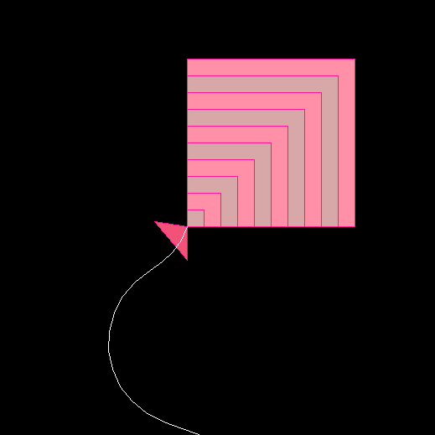
REPEATING PATTERNS
13
from turtle import *
k = Turtle()
scr = Screen()
colorlist = ['#FF90A8','#D8A8A8']
scr.bgcolor('black')
k.pencolor('#FF1493')
i = 200
while i>0:
k.fillcolor(colorlist[(i//20)%2])
k.begin_fill()
for p in range(4):
k.forward(i)
k.lt(90)
k.end_fill()
k.penup()
k.home()
k.pendown()
i-=20
k.begin_fill()
k.fillcolor('#F25278')
k.rt(90)
k.forward(40)
k.rt(140)
k.forward(60)
k.goto(0,0)
k.end_fill()
k.lt(120)
k.pencolor('white')
k.circle(-100,40)
k.circle(100,130)
k.forward(50)
k.hideturtle()
done()

Slide 15

REPEATING PATTERNS
14
import turtle as tl
a = tl.Turtle()
s = tl.Screen()
s.bgcolor('black')
a.fillcolor('red')
a.pencolor('white')
a.begin_fill()
i = 0
while i<=100:
i+=1
a.circle(i,90)
a.lt(100)
a.circle(i,90)
a.lt(10)
a.end_fill()
a.hideturtle()
tl.done()

Slide 16
REFERENCES
15
Original Documentation (https://docs.python.org/3/library/turtle.html)
2. Tutorials by ‘Tech with Tim’ (https://youtu.be/p7CiFhiTdvY)
3. Geeks for Geeks Tutorial (https://www.geeksforgeeks.org/turtle-programming-python/)

Slide 17
Wait for a Live Demonstration

