Slide 1
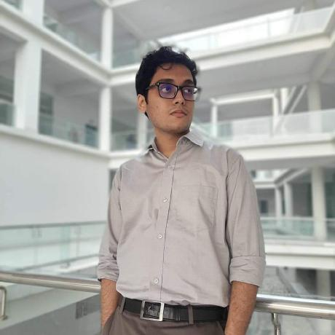
Education
Bsc from Khulna University of Engineering and Technology
( Result CGPA-3.42 )
Student
Highlighted Projects
Personal Details
Starktech | FoodMart
Management System | Product Database
3d Printer | CardiacRecorder
Soummo Bhattacharya
24 years old
soummossj@gmail.com
+88 01933283930
(All projects can be found on GitHub).
Rashid Hall, KUET, Khulna
Achievements
SoummoSsj
Regional Champion Physics Olympiad 2016
Regional Champion Physics Olympiad 2017
Regional Champion Physics Olympiad 2017
Regional Champion Astro Olympiad 2017
Soummo Bhattacharya
Technical Skills
C
C++
Java
Python
Laravel
Android
SQL
References
Nazia Jahan Khan Chowdhury Assistant Professor, CSE Department, KUET.
Dr. Muhammad Sheikh Sadi Professor, CSE Department, KUET.

