Slide 1

AI-Based Fresher Recruitment System
B.Tech (AIDS)
UG-II (III-Semester)
Subject Coordinator
Dr. Sakshi Ahuja
Assistant Professor
Presented By:
Diksham Jindal (DL.AI.U4AID25069)
Soumy Mittal (DL.AI.U4AID25095)
Daksh Rautela (DL.AI.U4AID25065)
Suyash Dubey (DL.AI.U4AID25097)
AMRITA VISHWA VIDYAPEETHAM, DELHI NCR, FARIDABAD
Department of Artificial Intelligence & Data Science (AIDS)

Slide 2

CONTENTS
Roles
Problem Statement
Literature Review
Objectives of the project
Proposed Methodology
Tools and Technologies
Data Understanding
Data Types
EDA & Preliminary Results
Challenges & Data Validation
Conclusions & Future scope

Slide 3
Roles
Tech Lead - Diksham Jindal
Developer - Soumy Mittal
Tester - Daksh Rautela
Q/A - Suyash Dubey

Slide 4
Problem Statement
High-volume recruitment: AI and software companies receive a large number of fresher resumes, making manual evaluation time-consuming.
Unreliable resume information: Candidate details may be incomplete, inconsistent, exaggerated, or fabricated.
Verification difficulty: Recruiters face challenges in determining whether candidate’s stated qualifications and skills are authentic.
Role-based shortlisting: Candidates need to be evaluated against specific technical requirements for different job roles.
ML-ready recruitment dataset: The project creates a synthetic dataset of 10,000 candidates and 16,508 applications with realistic recruitment attributes.
Target roles & outcomes: The framework covers AI/ML Engineer, Data Analyst, Python Developer, and Software Engineer, including candidate qualifications, missing data, and recruitment outcomes.

Slide 5
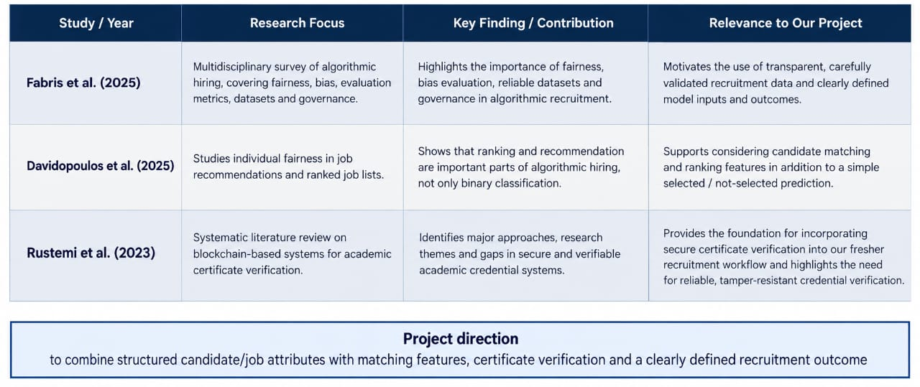
Literature Review

Slide 6

Objective of the Project
To develop an ML-ready recruitment framework that validates resume information, identifies potentially fraudulent or unverifiable claims, evaluates candidate qualifications, and supports systematic role-specific candidate shortlisting.

Slide 7
Proposed Methodology
1
Synthetic
Dataset
2
Missing Value
Addition
3
Missing Value
Handling
4
Feature
Engineering
5
EDA &
Validation
6
StratifiedGroupedKFold
Data Split
Data construction
10,000 unique candidates
16,508 applications
4 job roles
Candidate profiles remain consistent across applications.
Feature & outcome layer
Candidate + job features → matching features → Recruitment Score → job-wise Rank → 3.5× Opening shortlist convention.
ML readiness
Shortlisted is the target. Recruitment Score, Rank and Shortlist Limit are excluded from predictive inputs to reduce target leakage.
Current boundary: data preparation and splitting are complete, model training is planned for the next phase.

Slide 8
Tools & Technologies
Programming & Data
Python
• pandas
• NumPy
• random
Used for synthetic generation, data manipulation and validation.
Visualization
Matplotlib
Seaborn
Used for distributions, class balance, comparisons, box plots and correlation analysis.
Machine Learning Preparation
scikit-learn
Used for train/validation/test splitting with stratification.
Jupyter Notebook used for the six-stage workflow.

Slide 9
Data Understanding
Dataset | Synthetic AI Fresher Recruitment Dataset
Applications | 16,508
Unique candidates | 10,000
Columns | 41
Target | Shortlisted (0/1)
Job roles | AI/ML Engineer, Data Analyst, Python Developer, Software Engineer
Feature types | Numerical + categorical + text
Shortlist convention | Approximately 3.5 × Number of Openings
Before → After preprocessing
Missing values were intentionally introduced in selected fields.
After candidate-aware imputation and fallback handling: 0 missing values remained in the final dataset.
Data quality checks
• Candidate profile consistency: 0 inconsistent candidates
• Negative experience counts: 0
• Duplicate records checked
• Final dataset ready for splitting

Slide 10
Data Types
Category | Variables
Numerical | Number of Openings, CGPA, Class 10 Percentage, Class 12 Percentage, Backlogs, Number of Projects, Number of Internships, Number of Certifications, Number of Achievements, Minimum CGPA, CGPA Score,CGPA Gap, Skill Match, Project Score, Internship Score, Certification Score, Achievement Score, Backlog Score, Recruitment Score, Rank, Shortlist Limit
Categorical – Nominal | Job Role, Degree, Specialization, Preferred Degree, Degree Match, CGPA Eligible, Shortlisted
Text | Skills, Projects, Internships, Certifications, Achievements, Required Skills
Identifiers | Application ID, Candidate ID, Job ID

Slide 11
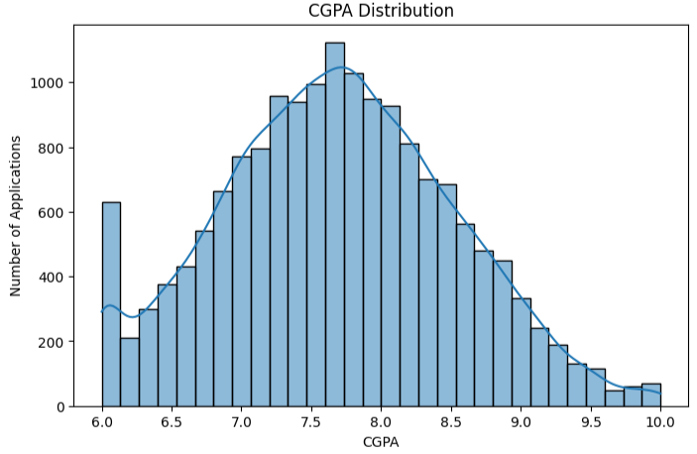
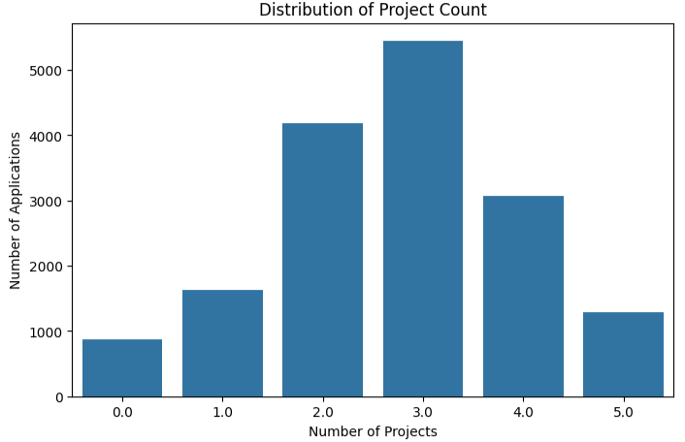
EDA and Preliminary Results
CGPA Distribution:
Project Count Distribution:
Candidates have 0–5 projects.
Most applications correspond to candidates with 2–4 projects.
The highest concentration is observed around 3 projects.
CGPA values range approximately from 6.0 to 10.0.
Most applications are concentrated around 7.0–8.5 CGPA.
The distribution shows a higher concentration around the 7.5–8.0 range.

Slide 12
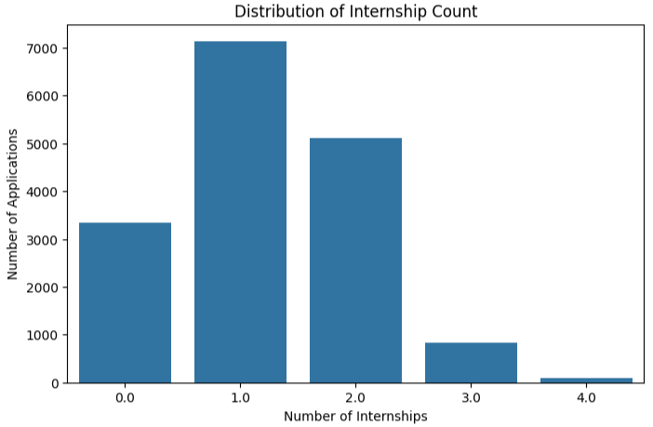
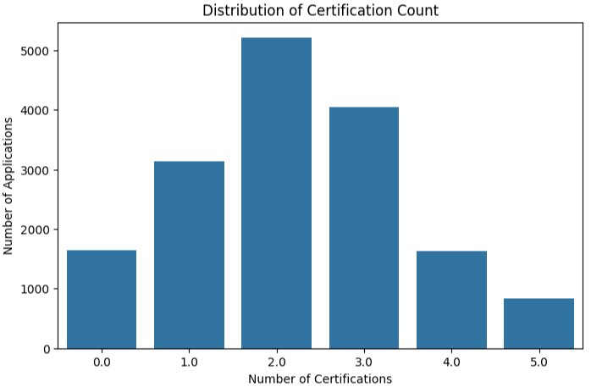
EDA and Preliminary Results
Internship Count Distribution:
Certification Count Distribution:
Candidates have 0–4 internships.
Most applications have 1–2 internships.
Applications with 3 or more internships are comparatively fewer.
Candidates have 0–5 certifications.
The highest concentration is around 2–3 certifications.
Candidates with 5 certifications form a relatively smaller group.

Slide 13
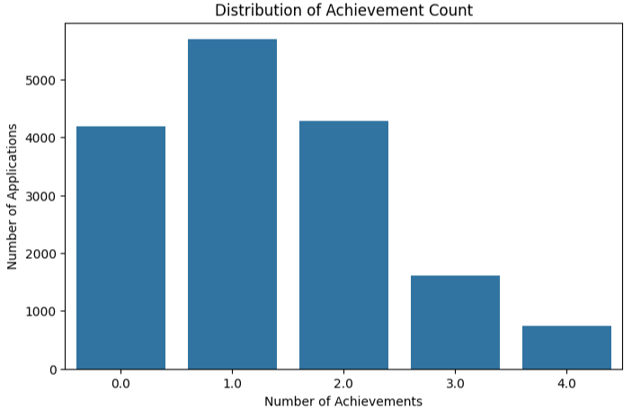
EDA and Preliminary Results
Achievement Count Distribution:
Candidates have 0–4 achievements.
Most applications have 1–2 achievements.
Applications with 3–4 achievements are less frequent.
The dataset represents a diverse range of fresher profiles, with variation in CGPA, projects, internships, certifications, and achievements. These features are used during the recruitment-score generation process.

Slide 14
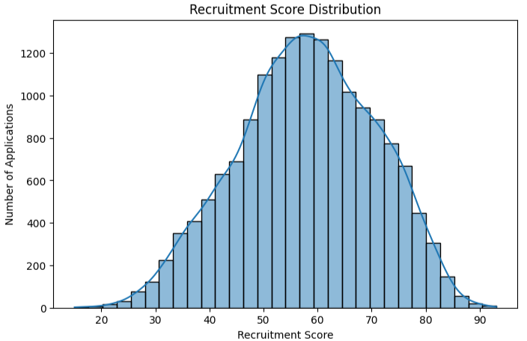
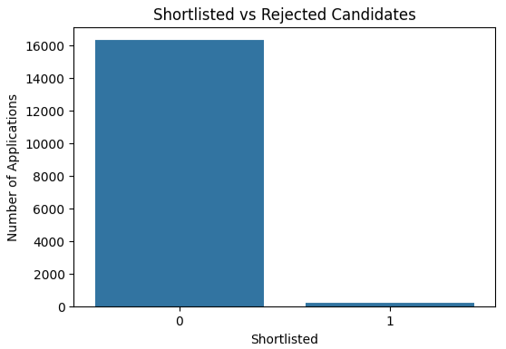
EDA and Preliminary Results
Recruitment Score Distribution:
Shortlisted vs Rejected:
Recruitment Score ranges approximately from 20 to 90.
The distribution is concentrated around the 50–70 range.
The highest concentration occurs around 55–65.
Higher scores correspond to stronger candidate profiles under the synthetic scoring framework.
Total applications: 16,508
Shortlisted: 209
Not shortlisted: 16,299
Shortlisted:1.27%
Not shortlisted:98.73%

Slide 15
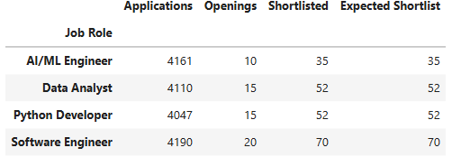
EDA and Preliminary Results
Application Distribution by Job Role:
Shortlisting is performed independently for each job role.
Candidates are ranked using the Recruitment Score.
The shortlist size is approximately 3.5× the available openings.
This creates an interview/assessment pool larger than the final hiring capacity.

Slide 16
Challenges and Data Validation
Validation completed
✓ Missing values after handling: 0
✓ Inconsistent candidate profiles: 0
✓ Negative project/internship/certification/achievement counts: 0
✓ Data types checked
✓ Target distribution checked
✓ Train/validation/test split verified
Key challenges
• Designing realistic synthetic candidate/job relationships
• Adding missingness without destroying candidate consistency
• Removing missingness without destroying candidate consistency
• Making proper features for model training
Current limitations
• Dataset is synthetic, not observed hiring data
• Shortlisted is generated by a defined scoring/ranking rule
• Model creation and selection is not be done yet

Slide 17
Challenges and Data Validation
Completed
• Synthetic dataset generated
• Missing values introduced and handled
• Candidate consistency verified
• Candidate–job features engineered
• Recruitment Score and job-wise Rank generated
• 3.5× opening shortlist convention implemented
• EDA completed
• StratifiedGroupedKFold split completed
Next phase
ML algorithm implementation → model training → validation → final testing → evaluation → model comparison.
Expected direction
• Predict Shortlisted applications
• Compare suitable classification models
• Use imbalance-aware metrics
• Investigate feature importance / explainability
• Consider candidate-grouped splitting for rigorous ML evaluation
Team contribution: Developer – implementation | Tester – validation | Team Lead – scope/coordination | QA – quality/documentation

Slide 18
Conclusions & Future Scope
The project successfully developed and prepared a synthetic AI fresher recruitment dataset for machine learning-based recruitment analysis. The dataset contains 16,508 application records from 10,000 candidates across four job roles: AI/ML Engineer, Data Analyst, Python Developer, and Software Engineer.
The complete data preparation pipeline included synthetic data generation, controlled missing-value introduction, candidate-aware missing-value handling, feature engineering, exploratory data analysis, validation, and train-validation-test splitting. The final dataset contains 41 columns, with recruitment-related numerical, categorical, and text features.
The EDA showed meaningful variation in CGPA, projects, internships, certifications, achievements, and recruitment scores. The final target contains 209 shortlisted and 16,299 non-shortlisted applications, resulting in a highly imbalanced classification problem. Data-quality checks confirmed zero remaining missing values and no inconsistent candidate profiles after preprocessing.
The next phase will focus on developing, validating, and interpreting ML models while maintaining strict leakage control and addressing the highly imbalanced recruitment outcome and authenticity verification.

Slide 19
Thank
You

