Slide 1
CARDIOVASCULAR RISK PREDICTION
CAPSTONE PROJECT
Presented By:
1. Soumya Choudhury-Techno Main Salt Lake-B.Tech(IT)

Slide 2
OUTLINE
Problem Statement (Should not include solution)
Proposed System/Solution
System Development Approach (Technology Used)
Data Visualization
Algorithm & Deployment
Result
Conclusion
Future Scope
References

Slide 3
PROBLEM STATEMENT
The dataset is from an ongoing cardiovascular study on residents of the town of Framingham, Massachusetts. The classification goal is to predict whether the patient has a 10-year risk of future coronary heart disease (CHD). The dataset provides the patients’ information. It includes over 4,000 records and 15 attributes. Each attribute is a potential risk factor. There are both demographic, behavioral, and medical risk factors.

Slide 4
PROPOSED SOLUTION
The proposed system aims to address the challenge of predicting the risk of future coronary heart disease in the upcoming 10 years of a patient based on their demographic,behavioral and medical risk factors . This involves leveraging data analytics and machine learning techniques to forecast patterns and the relationships between different features accurately. The solution will consist of the following components:
Data Collection:
The given dataset(CVD_cleaned) consists of over 3 lakh records and 19 attributes of different patients .
It has patients of different age categories having different medical history,exercise patterns and different habits.
Data Preprocessing:
Clean and preprocess the data to handle duplicate values by dropping such rows,apply different encoding techniques for numerical representation of categorical data, and solving the class imbalance problem by the process of undersampling.
Visualizing the data to extract relevant features and relationships from the data that might impact the target feature i.e., Heart Disease.
Machine Learning Algorithm:
Implementing various machine learning algorithms such as Logistic Regression,Random Forest Classifier,KNN and Cat Boost.
Consider incorporating other factors like weather conditions, day of the week, and special events to improve prediction accuracy.
Deployment:
Develop a user-friendly interface or application that provides real-time predictions for risks of future heart disease with the help of patient details.
Deploy the solution on a scalable and reliable platform, considering factors like server infrastructure, response time, and user accessibility.
Evaluation:
Assessing all the models performance using appropriate metrics such as Accuracy, Precision,Recall and F1 score.
Fine-tune the model based on feedback and continuous monitoring of prediction accuracy.
Result: The accuracy ranges from 70% to 76% across different models.

Slide 5
SYSTEM APPROACH
The cardiovascular risk prediction requires the following components and resources:
System requirements:-
i) Hardware requirements such as a working laptop/desktop with sufficient storage and RAM to be able to load datasets and train machine learning models.
ii) Software requirements such as latest version of python should be installed along with all the necessary libraries for data visualization, preprocessing and model training.
Libraries required for building the model are:-
i) pandas for data manipulation and preprocessing ,
ii) numpy for numerical computations and array operations,
iii) scikit learn for implementing machine learning algorithms including data preprocessing,model training and evaluation.
iv) matplotlib for data visualization including plotting graphs and charts.
v) seaborn for enhancing the visual aesthetics of the matplotlib and also for some additional plotting functionalities.
vi) imblearn provides various sampling techniques to work with imbalanced dataset.
vii) catboost is powerful gradient boosting library specifically designed to handle categorical features seamlessly, often leading to superior performance in classification and regression tasks.

Slide 6
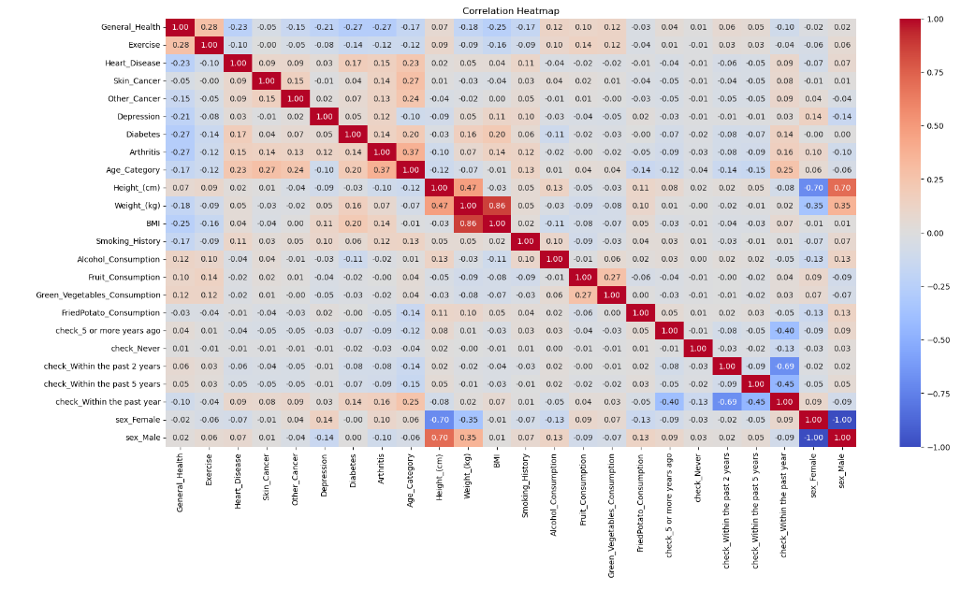
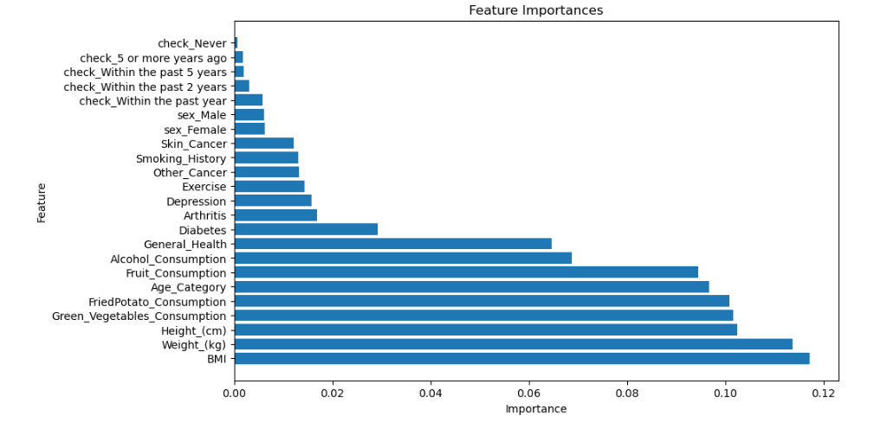
DATA VISUALIZATION
Correlation map:-The map highlights the relationships between different features in the dataset and the target feature which is, Heart_Disease.
Feature Importance Chart:-The chart displays the significance of each feature in predicting heart disease.

Slide 7
ALGORITHM & DEPLOYMENT
Algorithm Selection:
For predicting cardiovascular risk I have used a variety of machine learning algorithms such as Logistic Regression, Random Forest Classifier, KNN and Cat Boost.Each algorithm provides some unique
strengths and characteristics that make them suitable for different aspects of predictive modelling task.
i) Linear Regression: It is a supervised machine learning algorithm used for regression tasks. It models the relationship between a dependent variable and one or more independent variables by fitting
a linear equation to the observed data in order to find the best-fit line.
ii) Random Forest Classifier: A versatile ensemble learning method that constructs multiple decision trees during training and outputs the mode of the classes (classification) or mean prediction
(regression) of the individual trees.
iii) K-Nearest Neighbors (KNN): A simple and intuitive classification algorithm that classifies new data points based on the majority class among their K nearest neighbors in the feature space.
iv) CatBoost: An efficient gradient boosting framework that utilizes categorical feature support and implements a novel algorithm to handle categorical variables automatically, achieving high accuracy
with minimal hyperparameter tuning.
Data Input:
After data cleaning and preprocessing the input features Height,Weight,Age,BMI,Sex,etc all are stored in an input variable ‘X’ except the target variable Heart Disease which is stored in another variable ‘Y’.The test set is 10% of the dataset, the validation set is 20% and the remaining is used for training.
Training Process:
i) Linear Regression: Utilized and trained the simplified linear regression model using standardized input data to improve performance.Then testing them on the validation and test sets separately.
ii) Random Forest Classifier: Utilized a simplified random forest model with optimized hyperparameters to prevent overfitting and evaluated it using validation and test sets.
iii) K-Nearest Neighbour: It is trained with 5 neighbours for classification and then evaluated on test and validation sets to determine its accuracy and classification performance.
iv) CatBoost: It is trained with optimized hyperparameters including iterations, learning rate and tree depth.Utilized early stopping and validation set to monitor and prevent overfitting during training.Evaluate the model on training,validation and test sets to measure accuracy and model performance.
Prediction Process:
Based on the input like the medical history,physical attributes and other habits of each patient the models are able to predict whether they can have heart disease or not as this is a classification
problem.

Slide 8
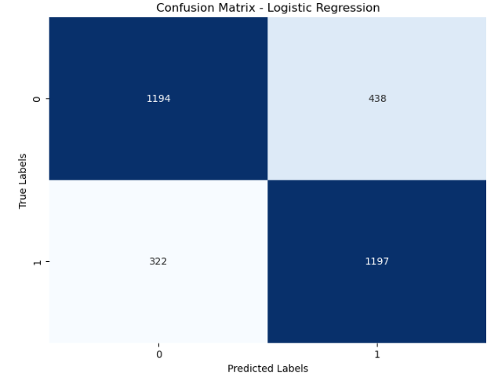
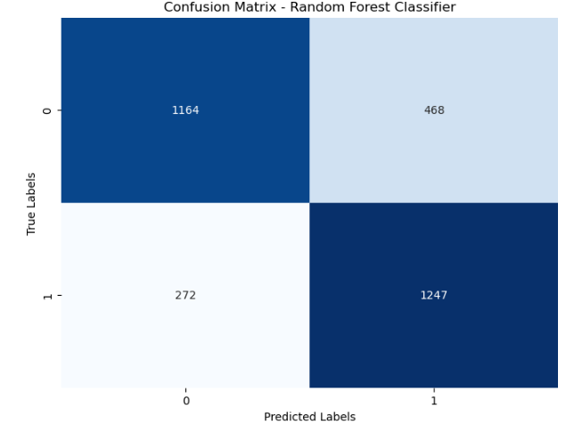
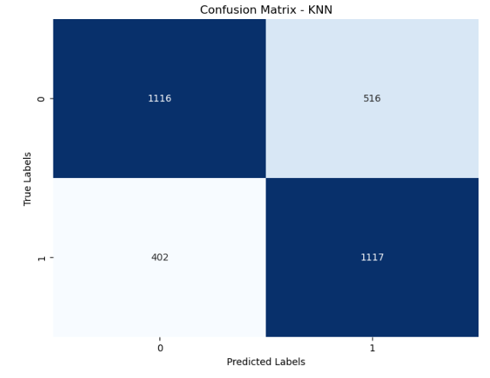
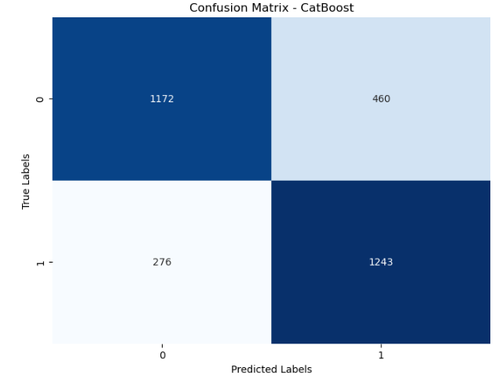
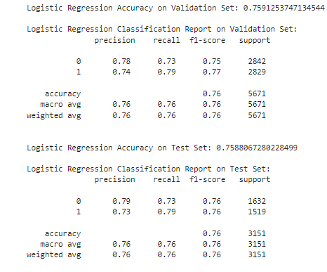
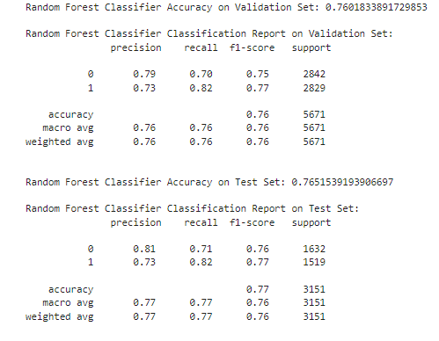
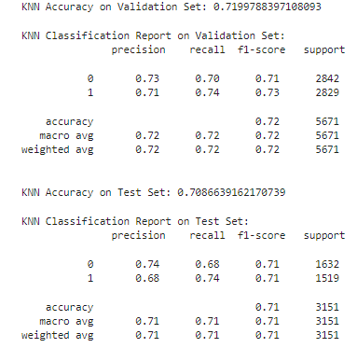
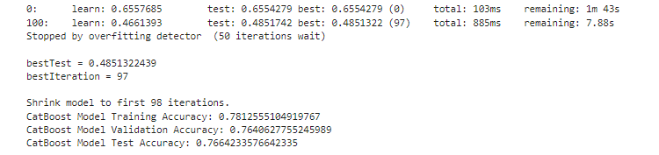
RESULT
After addressing the issue of class imbalance, there is a noticeable drop in accuracy. Initially, the accuracy was as high as 91%, but upon removing the imbalance using undersampling techniques, the accuracy decreased to 76%. Additionally, some columns such as Weight, Height, BMI, Fruit Consumption, Green Vegetable Consumption, and Fried Potato Consumption exhibit outlier issues. While these outliers do not significantly impact model performance, their removal tends to improve performance slightly on the test set.

Slide 9
CONCLUSION
In conclusion the cardiovascular risk prediction developed in this project demonstrates the effectiveness of machine learning in the world of healthcare applications. The dataset contains various health and demographic attributes including medical history,exercise habits,age,sex and the history of other habits by which the model can accurately predict the likelihood of individuals having heart disease.
Through extensive data preprocessing, including dropping duplicate values and applying different encoding techniques to transform the data into a numerical representation and also handling the problem of class imbalance for training all the different models. Several machine learning algorithms such as logistic regression,random forest classifier,k-nearest neighbour and catboost are used to come up how each models are performing on the given dataset. These models went through various evaluations using validation and test sets, assessing metrics such as accuracy, precision,recall and F1 score.
The results obtained from model evaluation indicate promising performance ranging from 70% to 75% on the validation and test sets. Further optimization of hyperparameters and exploration of alternative algorithms could potentially enhance model performance.
Overall the cardiovascular risk prediction system represents a valuable tool for healthcare professionals in assessing cardiovascular risk factors and guiding preventive measures for the patients.

Slide 10
FUTURE SCOPE
i) Incorporating additional data sources: Expanding the project by integrating additional relevant data sources such as lifestyle choices.This could provide a better and comprehensive understanding of cardiovascular risk factors and improve the accuracy and predictions.
ii) Geographic Expansion: Extend the system to cover multiple cities or regions to provide personalized heart disease risk assessments tailored to different populations which would require collecting region specific data and customizing the algorithm to account for regional variations in risk factors.
iii)Collaboration with Healthcare Providers: Collaborate with healthcare providers and institutions to validate the predictive models and collect feedbacks.After getting satisfactory results the models can be integrated to the clinical workflow for early detection of individuals at the risk of cardiovascular risk.

Slide 11
REFERENCES
i) Pal M, Parija S, Panda G, Dhama K, Mohapatra RK. Risk prediction of cardiovascular disease using machine learning classifiers. Open Med (Wars). 2022 Jun 17;17(1):1100-1113. doi: 10.1515/med-2022-0508. PMID: 35799599; PMCID: PMC9206502.
ii) National Institute of Standards and Technology
iii) ScienceDirect

Slide 12
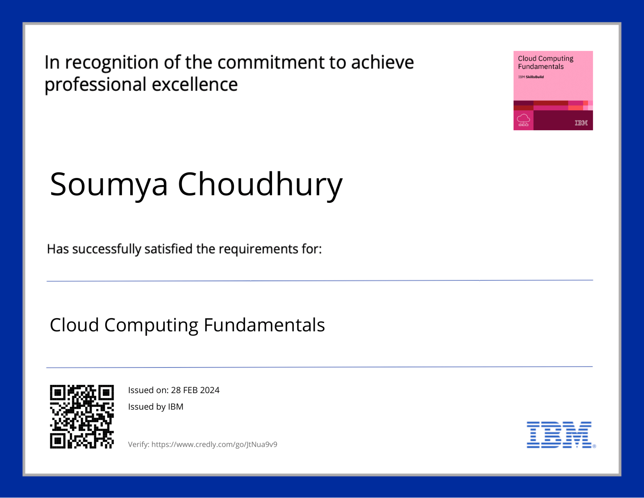
COURSE CERTIFICATE 1

Slide 13
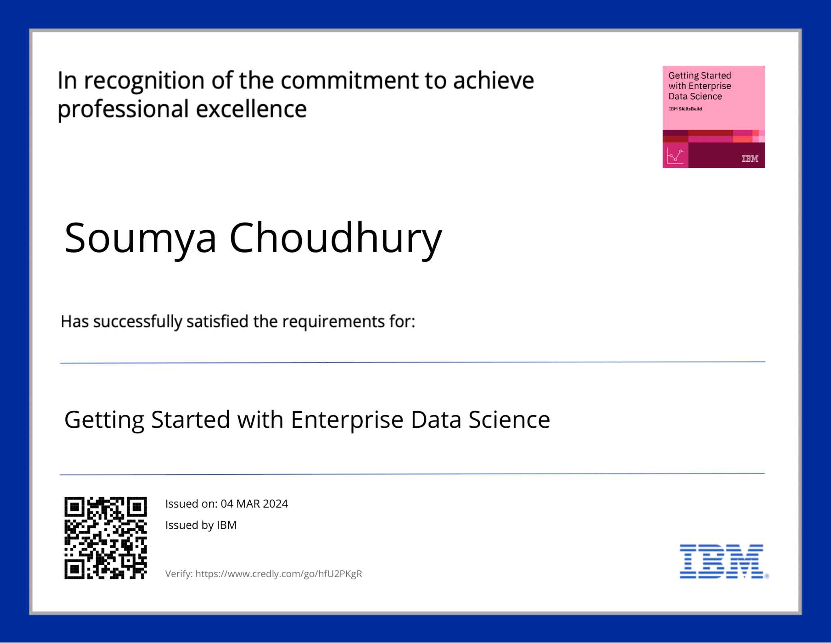
COURSE CERTIFICATE 2

Slide 14
THANK YOU

