Slide 1


RESEARCH METHODOLOGY
AND IPR
MVJMBA23
PRESENTED BY GROUP 5
•CHANDANA
•KIRAN
•NANDHINI
•PRIYANKA
•SUDEEP

Slide 2
TABLE OF CONTENTS
1.INTRODUCTION
2. DEFINE RESEARCH PROBLEM
3. REVIEW OF LITERATURE
4. RESEARCH OBJECTIVES AND HYPOTHESIS
5. CHOOSE A RESEARCH DESIGN
6. CHOOSE THE DATA COLLECTION METHOD
7. DATA ANALYSIS AND INTERPRETATION
8. CONCLUSION

Slide 3
INTRODUCTION
  Market competition plays a crucial role in influencing the performance and survival of tech startups. To gain a competitive advantage, startups employ various strategies such as innovation, product differentiation, cost efficiency, customer-centric approaches, and strategic partnerships.
  This study focuses on examining the market competition and competitive strategies adopted by selected tech startups in Bengaluru. It aims to understand how startups compete in the market, respond to competitive challenges, and implement strategies that contribute to their growth and success.

Slide 4

DEFINE RESEARCH PROBLEM
Topic : Success factors of tech based startup in Bengaluru
Title : A study on market competition and competitive strategies of selected tech companies in Bengaluru.

Slide 5
LITERATURE REVIEW
2025
Bhattacharjee & Balakrishnan (2025): Found that differentiation, innovation, and strategic alliances help EdTech startups gain market share.
Devi & Shunmugasundaram (2025): Highlighted the role of financial innovation in improving startup competitiveness.
Bhushan (2025): Identified innovation, government support, and entrepreneurial culture as drivers of competitiveness.
Khokha & Ritcher (2025): Found that adaptability and continuous innovation are essential for maintaining competitiveness.
2024
Patel et al. (2024): Identified innovation, strategic partnerships, market understanding, and customer-centric solutions as key success factors.

Slide 6
LITERATURE REVIEW
2021
Satyanarayana, Chandrashekar & Hillemane (2021): Found that innovation, finance access, market responsiveness, and ecosystem support influence startup competitiveness.
Rietveld & Schilling (2021): Emphasized network effects, ecosystem development, and pricing strategies as sources of competitive advantage.
2017
Santisteban & Mauricio (2017): Identified innovation, leadership, strategic planning, and resource availability as key factors for startup competitiveness.
Gans, Stern & Wu (2017): Found that strategic partnerships and alliances help startups gain market access and overcome resource constraints.
Bajwa et al. (2017): Highlighted business model pivoting and strategic flexibility as important responses to market competition.

Slide 7
RESEARCH OBJECTIVE AND HYPOTHESIS
Specific Objectives
To examine the level of market competition among tech-based startups in Bengaluru.
To identify the competitive strategies adopted for sustainable growth.
To analyze factors influencing startups' competitive position.
To evaluate the role of innovation and technology in gaining competitive advantage.
To assess the impact of competitive strategies on startup performance and growth.
To compare competitive strategies used by different startups.
To suggest measures to improve startup competitiveness.

Slide 8
RESEARCH OBJECTIVE AND HYPOTHESIS
Research Hypotheses
H₀ (Null Hypothesis):
There is no significant relationship between competitive strategies and the market performance of selected tech-based startups in Bengaluru.
H₁ (Alternative Hypothesis):
There is a significant relationship between competitive strategies and the market performance of selected tech-based startups in Bengaluru.

Slide 9
CHOOSE A RESEARCH DESIGN
Descriptive Research Design
Meaning:
Describes and analyzes the current competitive environment and strategies of tech startups.
Provides a clear understanding of market competition.
Helps compare different competitive strategies.
Collects factual data through surveys, interviews, and company reports.
Focuses on the existing market situation without manipulating variables.

Slide 10

CHOOSE THE DATA COLLECTION METHOD
Secondary Data :
The study is based on secondary data collected from company annual reports, official websites, research journals, government publications, Startup India reports, and industry reports published by NASSCOM, Deloitte, EY, and KPMG to analyze market competition and competitive strategies of selected tech startups in Bengaluru.

Slide 11
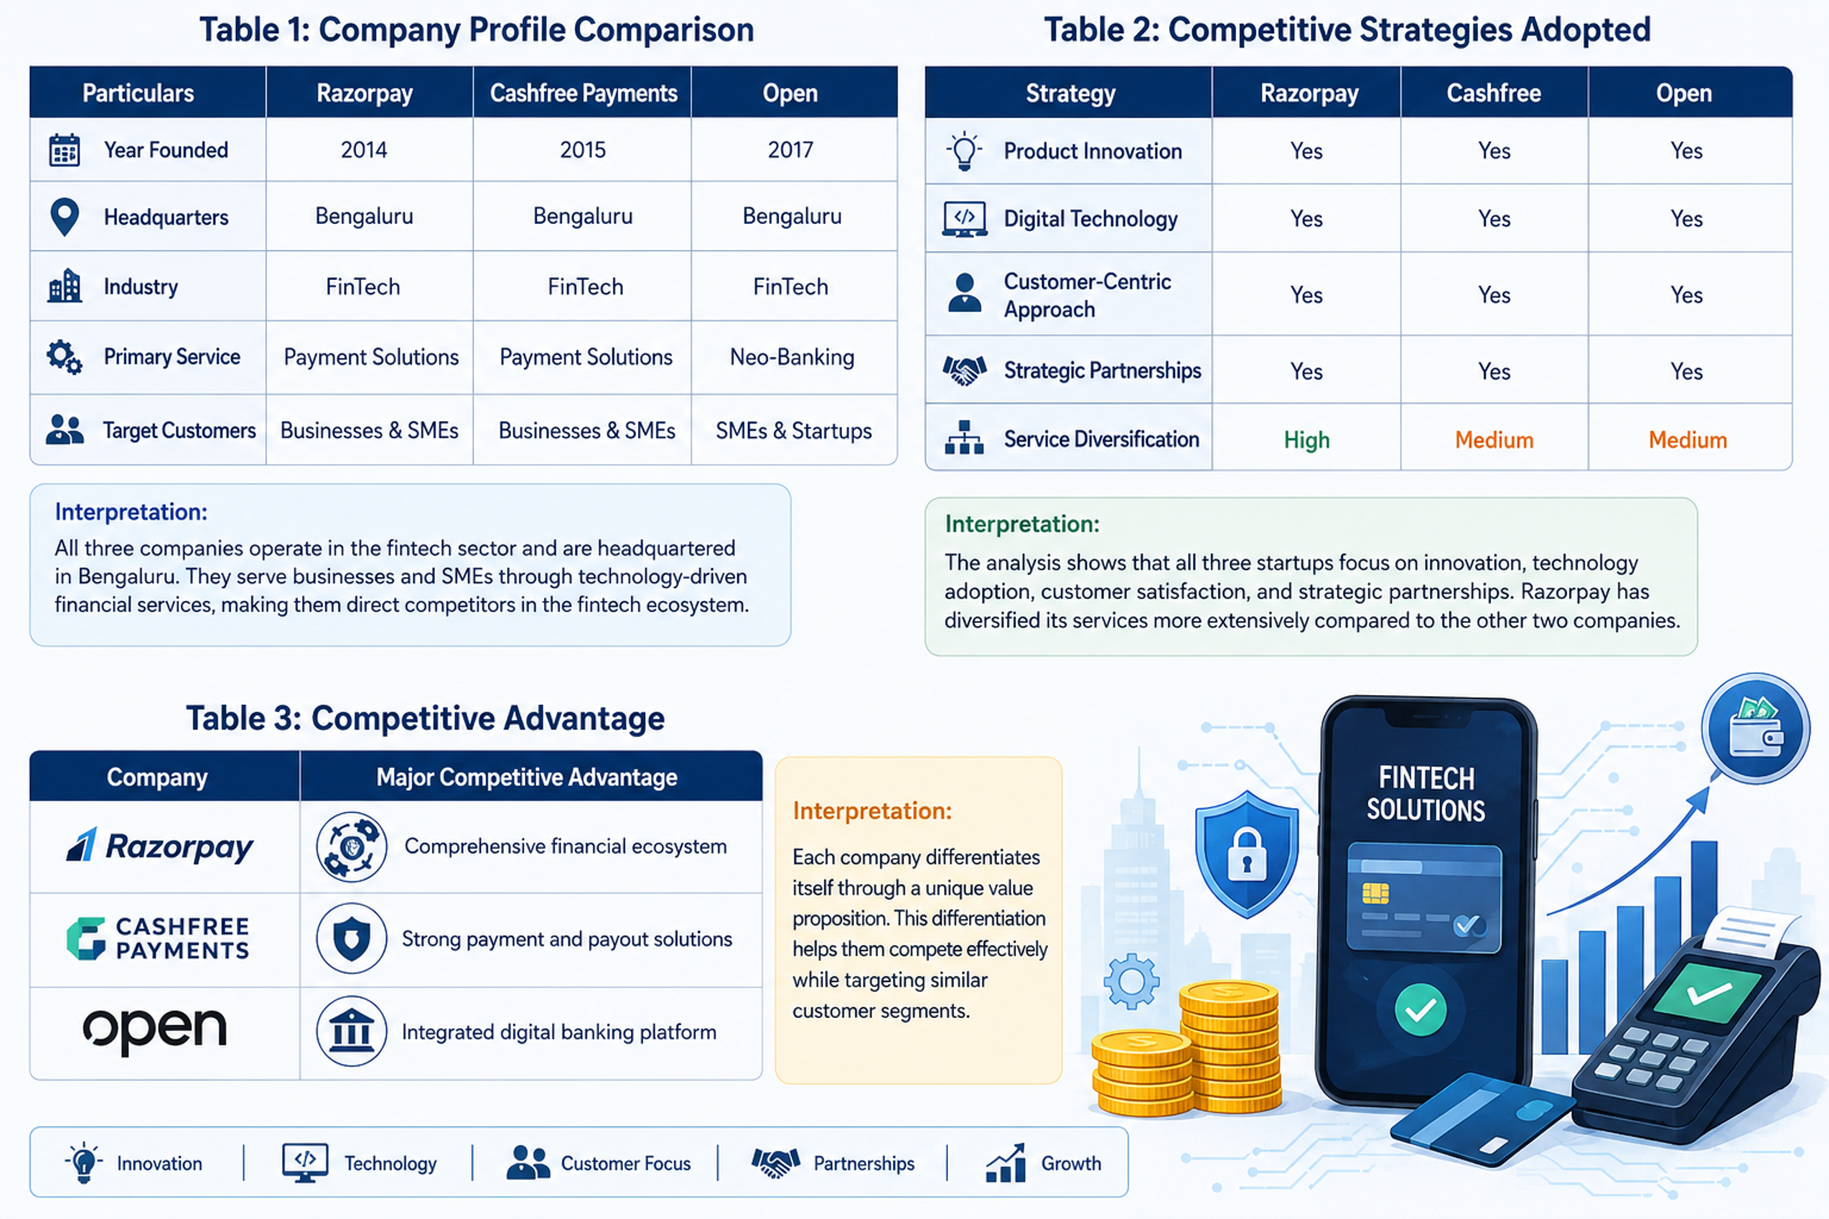
DATA ANALYSE AND INTERPRETATION

Slide 12
CONCLUSION
The study on market competition and competitive strategies of selected tech-based startups in Bengaluru highlights the dynamic and competitive nature of the fintech industry. The analysis shows that startups compete by adopting innovative technologies, customer-focused services, and strategic partnerships to strengthen their market position and attract customers.
The study concludes that competitive strategies play a vital role in the growth and success of tech-based startups. Continuous innovation, service differentiation, and adaptability to market changes help startups achieve a sustainable competitive advantage and maintain long-term growth in the competitive business environment

