Slide 1




RESEARCH METHODOLOGY
AND IPR
MVJMBA23
PRESENTED BY GROUP 5
•CHANDANA
•KIRAN
•NANDHINI
•PRIYANKA
•SUDEEP

Slide 2
TABLE OF CONTENTS
1.INTRODUCTION
2. DEFINE RESEARCH PROBLEM
3. REVIEW OF LITERATURE
4. RESEARCH OBJECTIVES AND HYPOTHESIS
5. CHOOSE A RESEARCH DESIGN
6. CHOOSE THE DATA COLLECTION METHOD
7. DATA ANALYSIS AND INTERPRETATION
8. CONCLUSION

Slide 3
INTRODUCTION
  Market competition plays a crucial role in influencing the performance and survival of tech startups. To gain a competitive advantage, startups employ various strategies such as innovation, product differentiation, cost efficiency, customer-centric approaches, and strategic partnerships.
  This study focuses on examining the market competition and competitive strategies adopted by selected tech startups in Bengaluru. It aims to understand how startups compete in the market, respond to competitive challenges, and implement strategies that contribute to their growth and success.

Slide 4
DEFINE RESEARCH PROBLEM
Topic: Success factors of tech based startup in Bengaluru
Title : A study on market competition and competitive strategies of selected tech companies in Bengaluru.

Slide 5
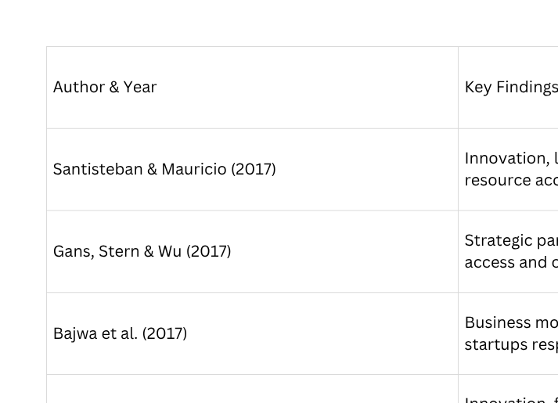
LITERATURE REVIEW

Slide 6
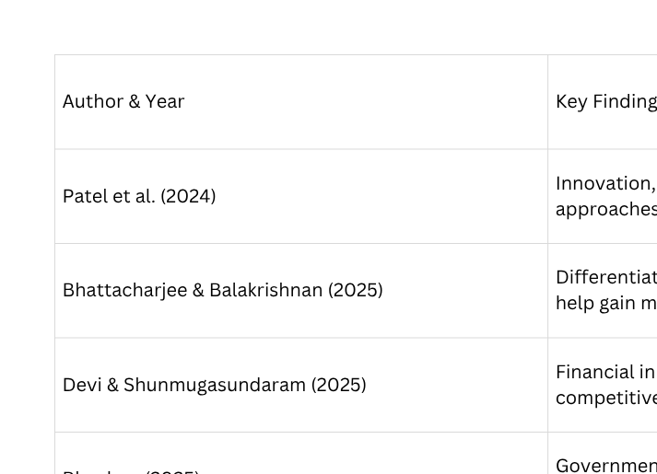
LITERATURE REVIEW

