Slide 1

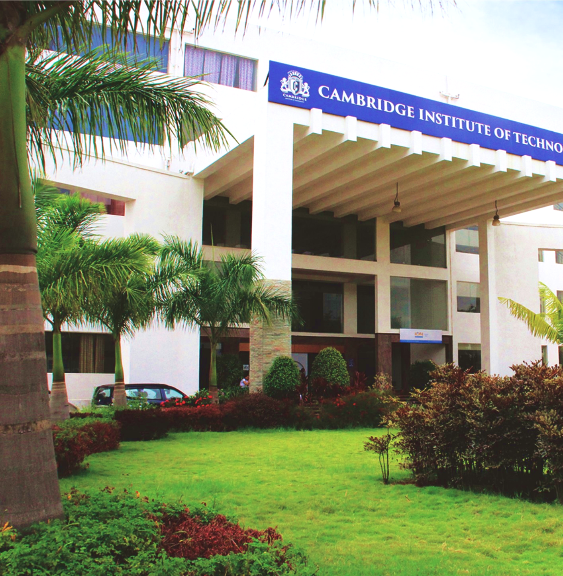
Department of Computer Science & Engineering
Project Presentation
On
“End-to-End Brain Tumor Detection using Deep Learning ”
By
Soumya Suresh Marennavar (1CD23CS160)
Ankita Palled(1CD23CS016)
Soumya (1CD23CS159)
Under the Guidance of
Prof. Lokesh
www.cambridge.edu.in

Slide 2
End-to-End Brain Tumor Detection using Deep Learning

Slide 3
Contents
Introduction
Objectives
Literature Survey
Proposed Method
Architecture
Algorithms/ Methdology
Implementation Modules Identified
Works completed
Works to be completed.
References

Slide 4
Introduction
Brain tumors are caused by abnormal and uncontrolled cell growth in the brain and are among the most serious neurological disorders. Early detection is very important to improve patient survival rates. Magnetic Resonance Imaging (MRI) is commonly used to detect brain tumors.
However, manual analysis of MRI images by radiologists is difficult, time-consuming, and may lead to human errors. Therefore, Artificial Intelligence (AI) based automated systems are used to improve accuracy and speed in brain tumor detection.
This project proposes an automated brain tumor detection and classification system using Deep Learning and Machine Learning techniques.

Slide 5
Introduction(Cont…)
The system uses Convolutional Neural Networks (CNN) with transfer learning models such as ResNet for feature extraction and Support Vector Machine (SVM) for classification.
The system classifies MRI images into four categories:
Glioma Tumor
Meningioma Tumor
Pituitary Tumor
No Tumor
The model is deployed using a Flask web application where users can upload MRI images and get real-time predictions. Grad-CAM is used to highlight tumor regions for better interpretability.

Slide 6
Objectives
Develop an automated brain tumor classification system.
Extract meaningful features from MRI images using ResNet50.
Classify tumors using Support Vector Machine (SVM).
Generate explainable heatmaps using Grad-CAM.
Deploy the system through a web application.
Specific Goals
Achieve high classification accuracy.
Improve model interpretability.
Create a user-friendly interface.
Support real-time MRI image prediction.
Demonstrate practical use of AI in healthcare.

Slide 7
SLNO | TITLE | PUBLISHED BY | YEAR | ADVANTAGES | DISADVANTAGES
1 | Brain Tumor Detection Using Deep Learning and Web Deployment | R. Sharma et al. | 2025 | • High classification accuracy (98%) • Uses CNN for effective feature extraction • Integrated Flask web deployment for accessibility | • Limited dataset • Lacks multi-class classification support
2 | Automated Brain Tumor Classification Using Transfer Learning | A. Verma et al. | 2025 | • Utilizes transfer learning (ResNet, VGG16) • High accuracy (97%) • Reduced training effort | • High computational cost • Not deployed as a web application
Small dataset and high training time

Slide 8
SLNO | TITLE | PUBLISHED BY | YEAR | ADVANTAGES | DISADVANTAGES
3 | Brain Tumor Detection Using Deep Neural Networks | S. Kumar et al. | 2024 | • Deep CNN provides accurate classification • Good feature learning capability | • No real-time user interface • Limited accessibility for end users
4 | Lightweight CNN for Accurate Brain Tumor Detection from MRI with Limited Training Data | A. Naeem et al. | 2025 | • Lightweight architecture • Works well with limited training data • High accuracy (97%) | • Supports only binary classification

Slide 9
SLNO | TITLE | PUBLISHED BY | YEAR | ADVANTAGES | DISADVANTAGES
5 | Accurate Brain Tumor Detection Using Deep Convolutional Neural Network | H. Mohsen et al. | 2022 | • Deep CNN achieves high accuracy (94%) • Strong feature extraction capability | • No web or mobile deployment support
6 | Employing Deep Learning and Transfer Learning for Accurate Brain Tumor Detection | S. K. Mathivanan et al. | 2024 | • High classification accuracy using transfer learning • Effective MRI feature extraction • Reduces training time | • Requires large computational resources • Dependent on quality MRI datasets

Slide 10
Research Gap
Many existing systems only detect tumor presence but do not classify tumor types.
Some models have low accuracy due to small datasets.
Many systems do not provide explainable results.
Few systems combine Deep Learning and Machine Learning together.
Our project solves this by:
Using CNN + SVM hybrid model
Performing multiclass classification
Using Grad-CAM for explainability
Deploying as a web application

Slide 11
Proposed Method
The project follows a hybrid approach:
MRI Image Input
Image Preprocessing
Feature Extraction using ResNet50
Classification using SVM
Heatmap Generation using Grad-CAM
Result Display through Flask Web Application

Slide 12
Dataset Used
Dataset Name : Kaggle Brain Tumor MRI (7,200 images)
Dataset Classes :
Glioma
Meningioma
Pituitary Tumor
No Tumor
Dataset Statistics :
Class Distribution :
Class | Training | Testing
Glioma | 1,400 | 400
Meningioma | 1,400 | 400
Dataset Split | Images
Training Set | 5,600
Testing Set | 1,600
Total Images | 7,200
Pituitary | 1,400 | 400
No Tumor | 1,400 | 400

Slide 13
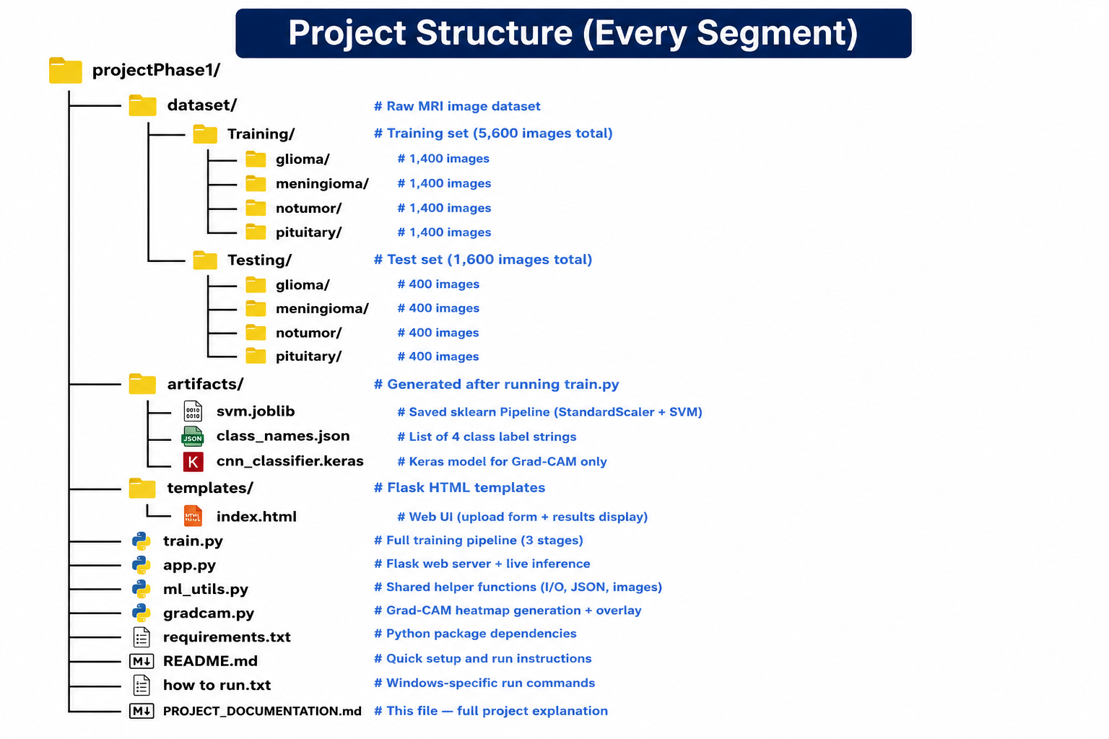

Slide 14
Hardware/Software Requirements
Hardware Requirements
Intel i5/i7 Processor
8 GB RAM or above
20 GB Free Storage
Software Requirements
Python 3.10+
TensorFlow
Scikit-Learn
Flask
OpenCV
NumPy
Pillow
VS Code

Slide 15
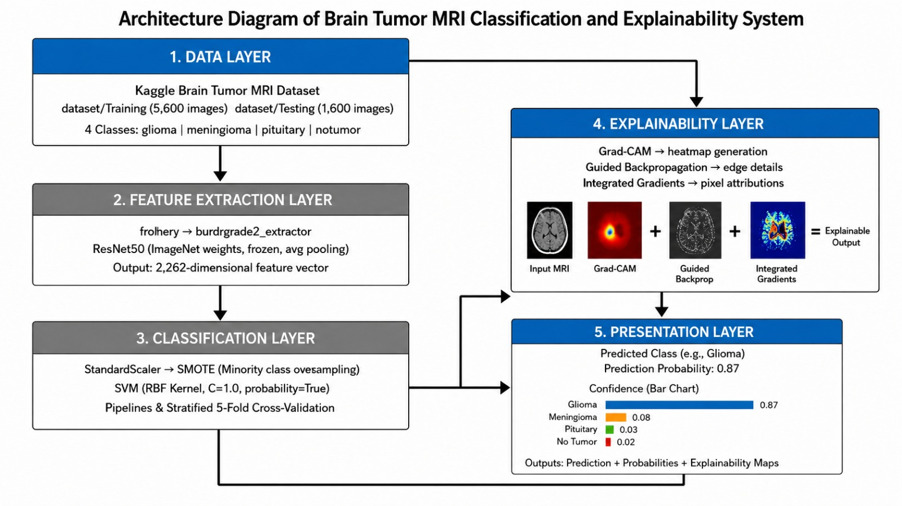
Architecture

Slide 16
Algorithms
.
1. ResNet50
Pre-trained CNN model.
Uses transfer learning.
Extracts 2048-dimensional feature vectors.
Frozen weights reduce training time.
2. Support Vector Machine (SVM)
Used for final classification.
Uses RBF Kernel.
Classifies MRI features into four classes.
3. Grad-CAM
Gradient-weighted Class Activation Mapping
Explain model predictions.
Highlight important tumor regions.

Slide 17
Implementation Modules
Module 1: Dataset Preparation
Kaggle Brain Tumor MRI Dataset
7200 MRI Images
Four Classes
Module 2: Data Preprocessing
Image resizing (224×224)
RGB conversion
Normalization
Module 3: Feature Extraction
ResNet50
Transfer Learning
2048 Feature Vector Generation
Module 4: Classification
StandardScaler
SVM Classifier
Probability Prediction
Module 5: Explainability
Grad-CAM Heatmap Generation
Module 6: Deployment
Flask Web Application

Slide 18
Works Completed
✅ Dataset Collection
✅ Data Preprocessing
✅ ResNet50 Feature Extraction
✅ SVM Model Training
✅ Grad-CAM Integration
✅ Flask Web Application Development
✅ Prediction and Visualization Module
✅ Model Testing

Slide 19
Works to be Completed
Future Enhancements
Fine-tuning ResNet50 for higher accuracy.
Support for 3D MRI scans.
Mobile Application Deployment.
Cloud-based deployment.
Integration with hospital systems.
Multi-disease detection

Slide 20
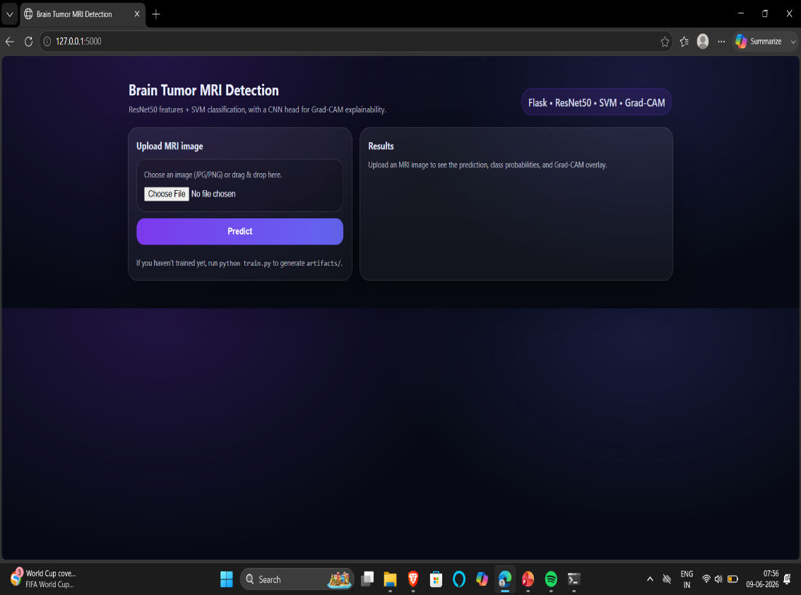
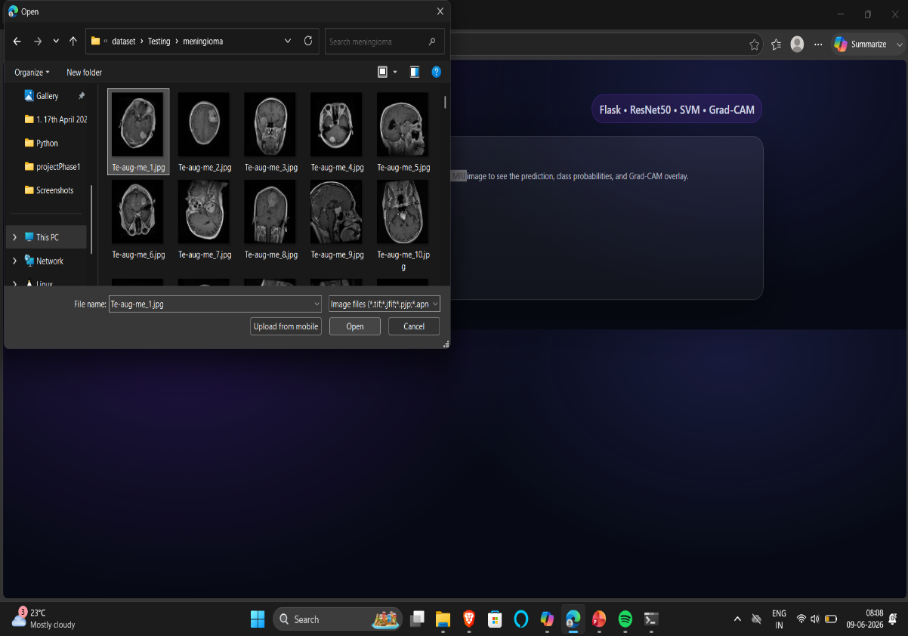

Results

Slide 21
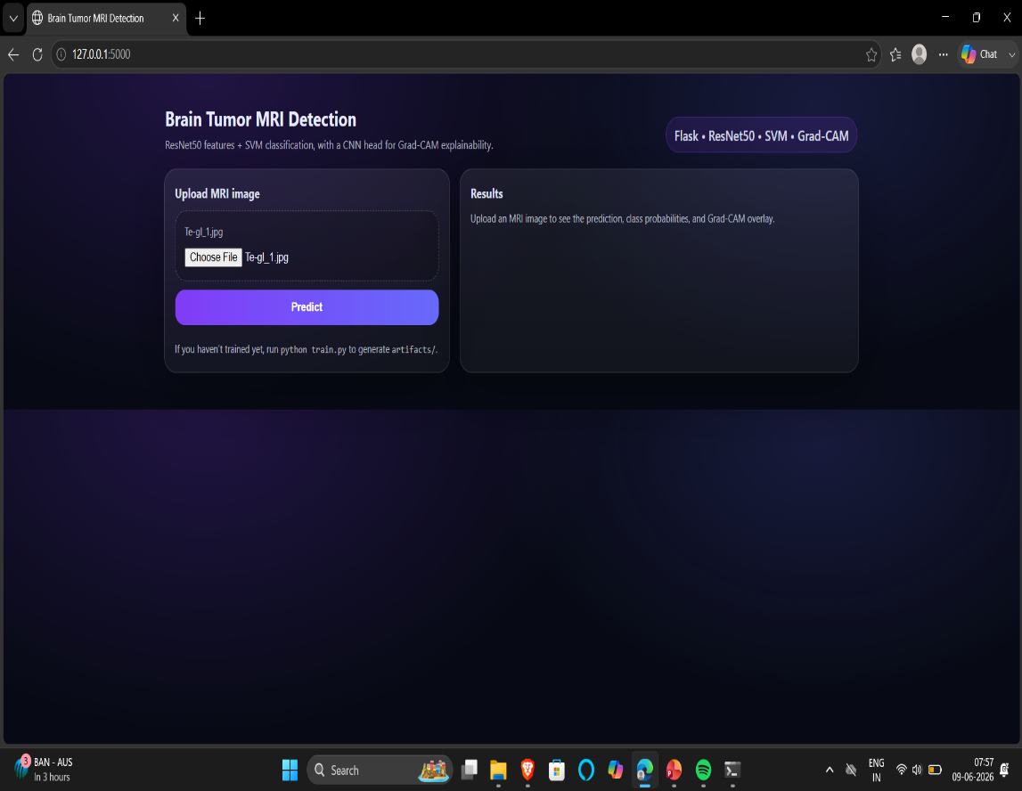
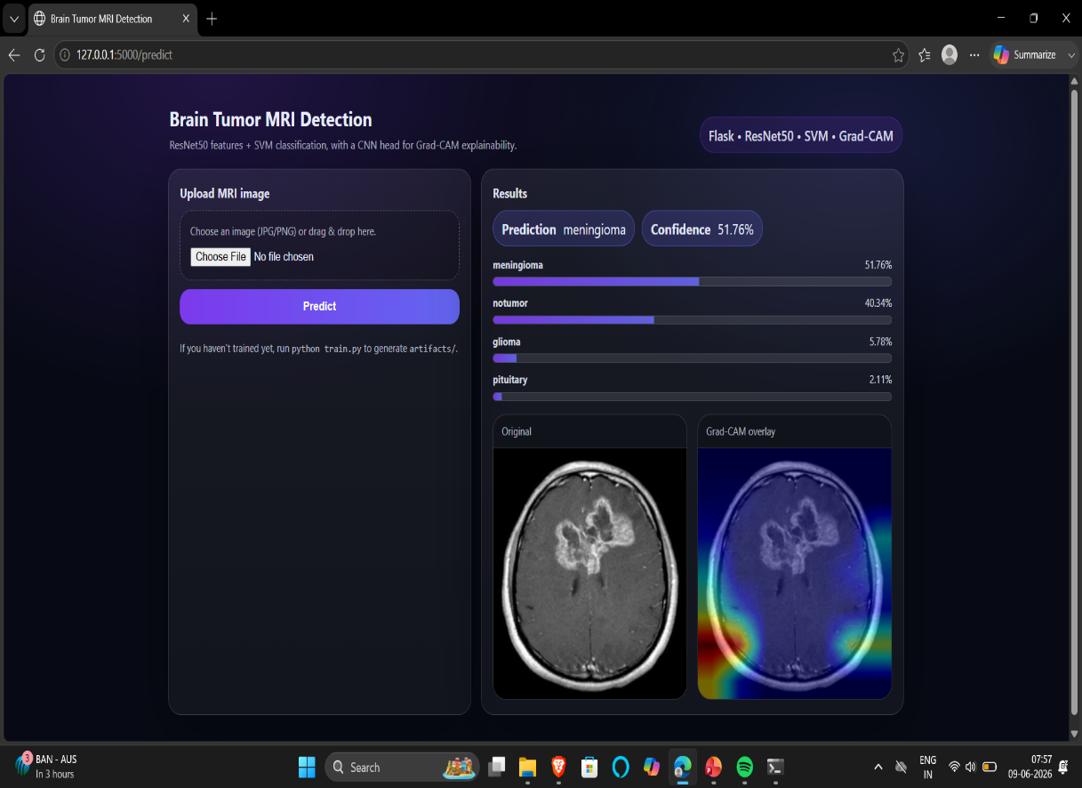
Results

Slide 22
Application/Use Cases
Hospitals and Diagnostic Centers – Used to assist doctors in detecting and classifying brain tumors quickly from MRI scans.
Radiology Labs – Helps radiologists analyze MRI images more accurately and reduce manual workload.
Medical Colleges for Research – Useful for students and researchers to study AI-based brain tumor detection methods.
Remote Diagnosis (Telemedicine) – Enables doctors to detect brain tumors from MRI scans uploaded from remote locations.
AI-Assisted Healthcare Systems – Can be integrated into healthcare software to provide automated tumor detection support.

Slide 23
References
Ref No | References
1 | A. B. Naeem et al., “Lightweight CNN for Brain Tumor Detection from MRI,” Frontiers in Medicine, 2025.Google Scholar
2 | P. Tiwari et al., “CNN-Based Multiclass Brain Tumor Detection,” Computational Intelligence https://www.ijariit.com/manuscript/brain-tumor-detection-and-classification-using-convolutional-neural-network/and Neuroscience, 2022.Google Scholar
3 | A. Gholami, “Brain Tumor Detection and Classification Using CNN-SVM,” International Journal of Computational Intelligence Systems, 2025. Google Scholar
4 | K. R. Reddy and R. Dhuli, “Lightweight CNN Architecture for Brain Tumor Diagnosis,” Diagnostics, 2023.Google Scholar
5 | M. Aamir et al., “Optimized CNN for Brain Tumor Detection,” Diagnostics, 2024.Google Scholar

