Slide 1
DESKTOP VOICE ASSISTANT
Presented by: Batch 10
A.Akhila - 15325A0405
K.Soumya - 15325A0406
P.Nishitha - 15325A0407
N.Deepa - 15325A0408
Under the guidance of:
G. Ramya
(Assistant Professor)
Department of ECE

Slide 2
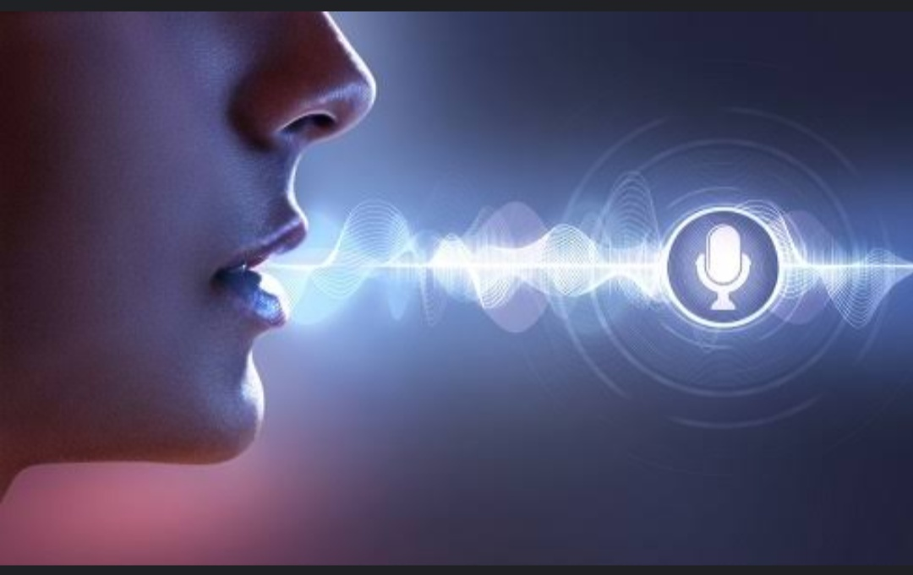
DAMN --your personal assistant

Slide 3
Introduction:
Owning a business, many of our important tasks can be neglected due to a busy schedule. In such circumstances, having a Virtual Assistant will always come in handy as they can help you with many tasks.
A remarkable increase in the development and deployment of voice-controlled Personal Digital Assistant has been seen in the recent years. The amazing feature of these assistants in common is their ability to interact with the human through oral communication.

Slide 4
Problem statement:
Physical interaction in order to provide commands or gain access to a computer system is now a history. For the voice assistant all you need is concepts of python. A code which is used to understand our need is transformed accordingly.
Virtual Assistants are known for being great at many things and can make a positive contribution to the success of your SME. They can also assist with your organization skills and productivity by freeing up your time for you to focus on other important activities.

Slide 5
Literature survey
Sl.No | Title of paper | Authors | Limitations/ Remarks
1. | Personal Assistant with Voice Recognition Intelligence,2017 | Dr. Kshama V. Kulhalli Dr.Kotrappa Sirbi Mr. Abhijit J. Patankar | Have a description of Voice Recognition Engine which has an ability to work without internet connection i.e. Offline Voice Recognition.
2. | Digital Life Assistant using Automated Speech Recognition ,2014. Published by : (CIPECH14) | Seema Rawat Parv Gupta Praveen kumar | Provided the Overview of Speech Recognition

Slide 6
i
3 | A Virtual Assistant for Visually Impaired Persons,2019 Published by : (ICCIT) | Youhao Yu Md.Rakibuz Sultan Md Moinul Hoque | Have insights of Bing Speech API And Microsoft SAPI 5
4. | Research on Speech Recognition Technology and Its Application,2012 Published by : IEEE | Youhao Yu | Speech Recognition Technology and its Applications were clearly described.

Slide 7
Motivation:
Every system around us is becoming automatic and making our lives more comfortable . The underlying aim of every technology is to ease human efforts as far as possible, so with this objective in mind we set off to achieve another such goal.
A virtual desktop assistant which can perform different tasks without any physical intervention with keyboard and mouse. The system takes the voice commands of the user, analyzes the commands using speech recognition technology and acts accordingly.

Slide 8
Objective:
To enhance the code in an precise manner and strategically develop an interface which is easily accessible with out any trouble.
The main objectives of the project is to develop a system with the following features:
Wikipedia Search
Automate your home
Plays music
Greets you
YouTube Search
Send Emails and Messages and many more

Slide 9
Flow Chart
start
Capture Voice Commands
Perform Speech Recognition
no
Does Speech contain known commands?
yes
Perform task based on the command

Slide 10
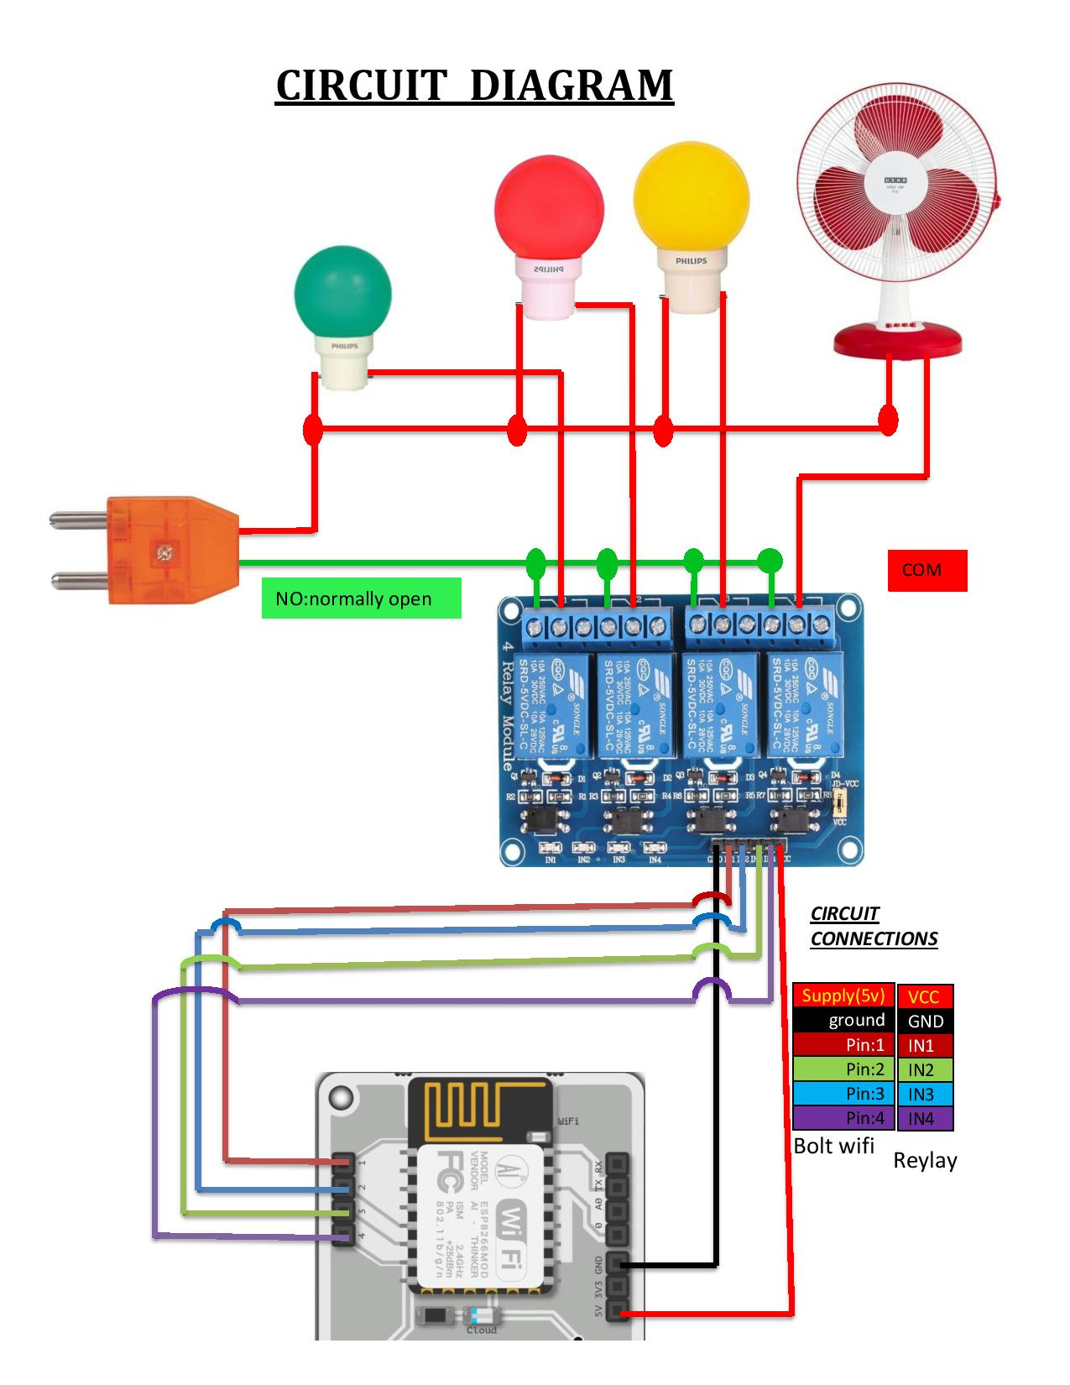
Circuit Diagram:

Slide 11
Conclusion:
Desktop Assistant has various functionalities, and works only based on the voice commands. This is language barrier independent, we can develop the system in various languages. It actively responds to user’s voice commands.
The Assistant developed using python and speech recognition technology. Speech Recognition is an excellent application of artificial intelligence to work with since speech is one of the most basic activities of humans.

Slide 12
References:
Digital Life Assistant using Automated Speech Recognition ,2014. International Conference on Innovative Applications of Computational Intelligence on Power, Energy and Controls with their Impact on Humanity (CIPECH14) .
https://www.ripublication.com/irph/ijert_spl17/ijertv10n1spl_80.pdf. International Journal of Engineering Research and Technology. ISSN 0974-3154 Volume 10, Number 1 (2017) © International Research Publication House http://www.irphouse.com
Personal Assistant with Voice Recognition Intelligence,2017. International Journal of Engineering Research and Technology. ISSN 0974-3154 Volume 10, Number 1 (2017) © International Research Publication House http://www.irphouse.com

Slide 13
Thank you

