Slide 1
Calories burnt prediction

Slide 2

Objective
To predict the calories burnt during the exercise using parameters like duration, average heartbeat, body temperature, height and weight.

Slide 3
Algorithm used
Supervised learning algorithm
regression

Slide 4
Tools used
Visual studio code
Python 4
Pandas
Numpy
Matplotlib
Xgboost
sklearn

Slide 5
Applications
Daily anaylsis of calories burnt
Maintain healthy lifestyle

Slide 6
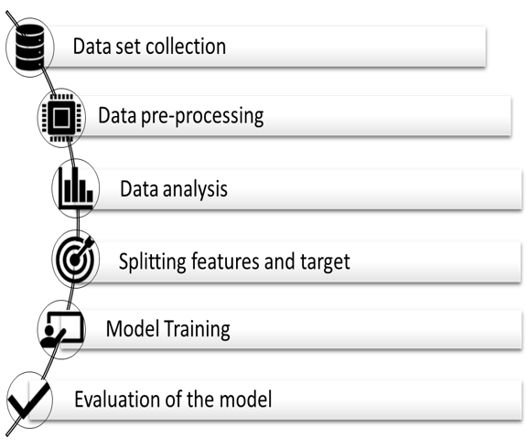
Workflow

Slide 7
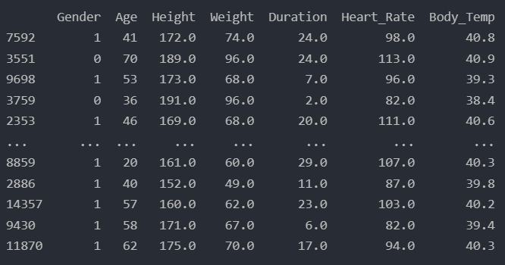
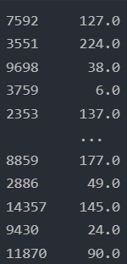
Result
X_test
Actual Y_test
Predicted Y_test

Slide 8
Thank you

