Slide 1

GoParking
Smart Parking
Management System
DSA Major Project
Student: Tesh Kumar Sahu | Soumya Ranjan Dash
College : Rungta College of Engg. & Technology, Bhilai
Notes:
Good morning. My project is GoParking, a local parking management application. It combines a Streamlit interface, a Java parking engine and a SQLite database. My focus today is how real data structures from DSA are used in the actual code. Fill in your official college name before presenting. Evaluator may ask: why two languages? Answer: Python for UI and database, Java for the parking logic.

Slide 2
Problem Statement
Unclear free-space status
Weak entry/exit records
Staff cannot easily see which numbered slots are free
Paper registers are hard to keep consistent
Slow vehicle lookup
No fee/history record
Finding a car by registration or color takes time
Visits and fees need one reliable record
GoParking | DSA Major Project
2
Notes:
Manual parking is hard to track. Staff may not know which slots are free, paper records get lost, and finding a car takes time. This project shows a software workflow for this. It does not use sensors or number-plate recognition; users type vehicle details. Evaluator may ask: is this real-time sensing? Answer: no, it is application-driven.

Slide 3
Objectives
Show total, occupied and available slots
Allocate and release numbered slots (lowest free slot first)
Prevent duplicate active registrations
Search vehicles by registration number and color
Record user-owned history and parking fees
Give administrators fee-setting and system-wide views
GoParking | DSA Major Project
3
Notes:
Each objective maps to a real feature or Java command. The key DSA objective is the allocation rule: always give the lowest-numbered free slot. Not implemented: reservations and vehicle-size matching.

Slide 4
Proposed Solution and Features
Streamlit UI
(Python)
Java Parking Engine
SQLite Database
Account registration and sign-in
Vehicle registration, parking, removal, search
Live slot layout and occupancy display
Parking history, fee estimate, recorded payments
Admin controls: users and hourly rates
GoParking | DSA Major Project
4
Notes:
Streamlit handles the interface and SQLite. Java handles live slot allocation and active-vehicle lookup. The fee is recorded in the database; there is no real payment gateway. Evaluator may ask: is payment real? Answer: no, only a fee and payment row are recorded.

Slide 5
Technology Stack
Area | Technology used
Web interface | Python + Streamlit
Data display / CSV export | pandas
Parking logic | Java (ParkingLot, ParkingServer)
Persistence | SQLite via built-in sqlite3
Password security | hashlib, hmac, secrets
Python-Java link | TCP socket, line-based text protocol
Tests | unittest + Java smoke test
GoParking | DSA Major Project
5
Notes:
These are the verified technologies only. Python and Java have separate responsibilities. There is no requirements file or Maven/Gradle file in the project, so setup is manual (Streamlit, pandas, JDK).

Slide 6
System Architecture
Java ParkingServer
127.0.0.1:5000
TCP commands
Browser
Streamlit app
(app.py)
ParkingLot (in-memory)
TreeSet | HashMap | ArrayList
SQL queries
SQLite
goparking.db
GoParking | DSA Major Project
6
Notes:
The browser talks to Streamlit. Python sends text commands like PARK|reg|color|type to Java on port 5000, and separately reads and writes SQLite. Java holds live occupancy in memory; SQLite is the durable store. On restart Python restores active vehicles to Java, best effort. Honest caveat: Java server does not bind explicitly to loopback and has no authentication, so do not expose port 5000.

Slide 7
Application Workflow
VEHICLE ENTRY
Submit reg,
color, type
Python: save
vehicle (SQLite)
Java PARK:
lowest free slot
Python: insert
active event
Slot shown
to user
VEHICLE EXIT
Select vehicle
(ownership check)
Java REMOVE:
free the slot
Python: compute
fee (hours)
Update event +
insert payment
Slot available
again
GoParking | DSA Major Project
7
Notes:
Entry: Python validates ownership and saves the vehicle, sends PARK to Java, Java picks the smallest free slot, then Python logs an active event. Exit: Python checks ownership, sends REMOVE, Java frees the slot, then Python calculates the fee (hours rounded up, minimum one hour) and records the payment row.

Slide 8
DSA Concepts Used (Verified in Code)
Structure | Where used | Why
TreeSet<Integer> | Free slot numbers | Always pick the lowest free slot
HashMap<String,ParkingSlot> | Active registration -> slot | Fast duplicate check and lookup
ArrayList<Vehicle> | Active vehicles | Ordered storage, easy iteration
ArrayList<ParkingHistory> | In-memory history | Append visit records
HashSet<String> | Allowed vehicle types | Fast membership check
Linear scan | Color search, history lookup | Simple at small scale
Python sorted() and SQL ORDER BY are library features, not custom sorting algorithms.
GoParking | DSA Major Project
8
Notes:
All of these come from ParkingLot.java and are standard Java collections. We did not implement their internals. We do NOT implement a stack, queue, linked list, heap, graph algorithm, recursion or custom sorting. Evaluator may ask: why not a heap? Answer: a heap could also give the minimum, but TreeSet is simple and keeps slots unique and ordered.

Slide 9
DSA in Code: TreeSet + HashMap
private final TreeSet<Integer> availableSlots;
private final HashMap<String, ParkingSlot> vehicleMap;
String reg = vehicle.getRegistrationNumber()
.trim().toUpperCase();
if (vehicleMap.containsKey(reg)) {
return "ERROR|Vehicle already parked";
}
if (availableSlots.isEmpty()) {
return "ERROR|Parking lot is full";
}
int slotNumber = availableSlots.first();
availableSlots.remove(slotNumber);
vehicleMap.put(reg, slot);
containsKey: duplicate check, expected O(1)
isEmpty: full-lot check
first(): smallest free slot
remove(): slot becomes occupied
put(): record active vehicle
Example
Free {1,3,5} -> park -> slot 1
Free {3,5} -> exit -> {1,3,5}
GoParking | DSA Major Project
9
Notes:
Left: the real code from ParkingLot.java. The TreeSet keeps free slot numbers sorted, so first() returns the smallest. Example: free {1,3,5}, the next car gets 1 and the set becomes {3,5}. On exit, the slot number is added back. The HashMap uses the uppercase registration as key, so duplicate parking is rejected quickly. Evaluator may ask: is first() O(1)? Answer: no, in a tree-backed set selection and removal are O(log s).

Slide 10
Algorithm and Flowchart: Park a Vehicle
Start: PARK(vehicle)
PARK(vehicle):
reg = trim(upper(registration))
if invalid: return ERROR
if reg in vehicleMap: return ERROR
if availableSlots empty: return ERROR
slot = min(availableSlots)
remove slot from availableSlots
vehicleMap[reg] = slot
append to vehicles, history
return OK(slot)
Valid details
and type?
Error
Already parked?
Error
Lot full?
Error
Take min free slot,
update structures
GoParking | DSA Major Project
10
Notes:
The Java method validates, rejects duplicates, rejects a full lot, then takes the smallest free slot and updates its structures. Python then logs the successful event in SQLite. A registered vehicle is not necessarily parked; the duplicate check concerns active parking only.

Slide 11
Time and Space Complexity
Operation | Time | Space
Initialize free slots (TreeSet) | O(s log s) | O(s)
Allocate lowest free slot | O(log s) | O(1) extra
Duplicate check / find by registration | Expected O(1) | O(n) map
Search by color (linear scan) | O(n) | O(r)
Remove: map + ArrayList + history scan | O(n + h) | O(1)
Build slot status response | O(s x n) | O(s)
Append vehicle / history record | Amortized O(1) | O(n + h)
Total Java memory: O(s + n + h)
GoParking | DSA Major Project
11
Notes:
s = total slots (10 now), n = active vehicles, h = in-memory history records, r = color matches. These are asymptotic estimates, not benchmarks. Slot display is O(s x n) because each slot scans the occupied map; with 10 slots this is tiny. SQL query cost is not included because no query plans or benchmarks were run. Improvement idea: a slot-indexed array removes the nested scan.

Slide 12
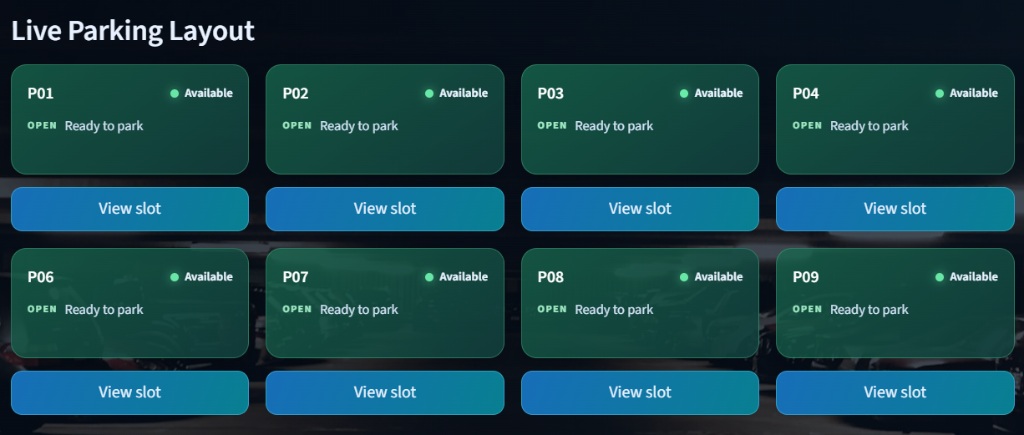
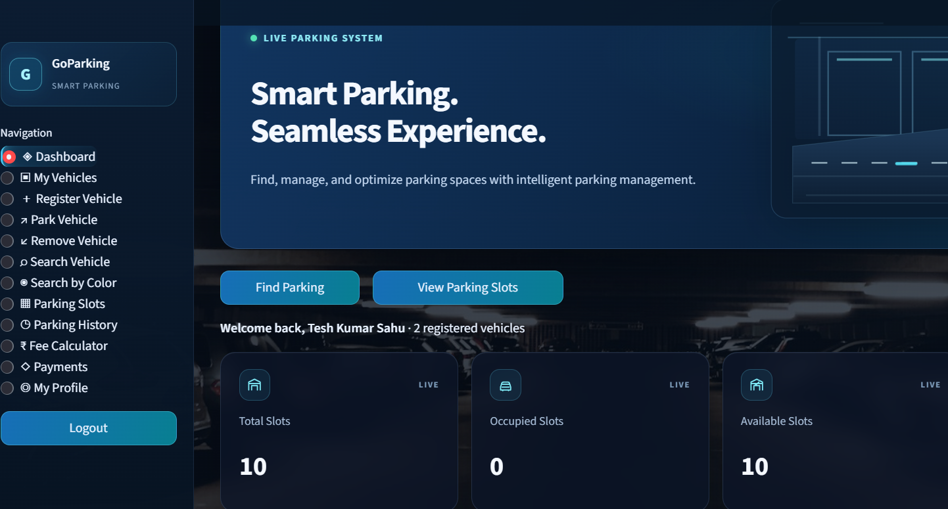
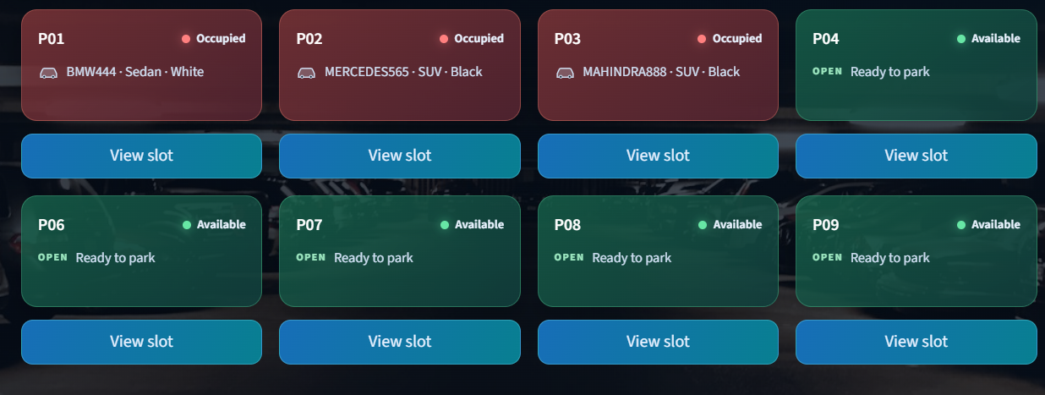
Demonstration and Testing
Screenshot 1
Dashboard / slots
[replace with real screenshot]
Screenshot 2
Park: slot assigned
[replace with real screenshot]
Screenshot 3
Slot freed after exit
[replace with real screenshot]
PASSED: 4 Python unit tests (password and email helpers)
PASSED: Java smoke test (allocation, duplicate, full lot, invalid type, removal, lookup, restore)
PASSED: Python syntax check (app.py, auth_security.py)
NOT TESTED: full UI-Java-SQLite integration, benchmarks
GoParking | DSA Major Project
12
Notes:
Demo one full lifecycle: sign in, show the dashboard, park a vehicle and note its slot, search it, remove it and show the slot free again. Insert your REAL screenshots in the placeholders. Test results shown were actually run during the code review: 4 Python tests, the Java smoke test and Python syntax compile all passed. Not tested: full browser flow, end-to-end fee flow, performance.

Slide 13
Limitations and Future Improvements
CURRENT LIMITATIONS
FUTURE ENHANCEMENTS
Java occupancy is in memory; restore is best effort
Java and SQLite are not one transaction
No protocol authentication; not explicitly loopback-bound
Color search and slot layout use linear scans
No reservations, sensors or real payments
Bind server to loopback or add authentication
Keep Java and database state consistent
Add end-to-end integration tests
Slot-indexed array to replace nested scans
Color index (HashMap) if the lot scales
GoParking | DSA Major Project
13
Notes:
Be honest here; evaluators respect it. Limitations are current facts. Future items are proposals only and not implemented. Evaluator may ask: what would you fix first? Answer: bind Java to loopback or add authentication, then add integration tests.

Slide 14
Conclusion
Problem: manual parking is hard to track and search
Built: Streamlit UI + Java engine + SQLite storage
Core DSA: TreeSet (lowest free slot), HashMap (active lookup)
Also used: ArrayList, HashSet and linear scans
Learned: choosing structures by operation cost, and integrating two languages
Next: improve consistency, security and testing
GoParking | DSA Major Project
14
Notes:
Summarize in your own words: the problem, what was built, and the DSA link. The core DSA contribution is the TreeSet for ordered slot selection plus the HashMap for active registration lookup. Be precise: expected O(1) applies to the Java HashMap, not every database-backed search.

