Slide 1
IBM University Engagement Project Submission
“Exploring the Power of Agentic AI with IBM Granite and LangFlow”

Slide 2

Project Tile – JusticeLens AI
Domain of Project – Government / Public Policy / Legal Access
Student Name | Recent Passport Photo | Email ID | Mobile number [WhatsApp]
Soumya D |  | soumya.techintern@gmail.com | 7010787803

Slide 3
Problem Statement -
Problem Statement : Analyzing Demographic and Regional Disparities in Tele-Law Case Registrations for Inclusive Legal Access
The Challenge
Tele-Law is a Government of India initiative providing free legal advice through Common Service Centres (CSCs). Despite its expansion, case registration volumes vary significantly across districts, states, and demographic groups.
Key Challenges:
• Identifying underserved districts
• Understanding root causes of low registrations
• Prioritizing interventions effectively
• Tracking progress over time
Without a data-driven approach, resources may be misallocated, and the goal of "inclusive legal access" remains unfulfilled. The challenge is to analyze Tele-Law case registration data alongside demographic indicators to detect disparity patterns and generate actionable policy recommendations.
The Objective
Build an AI-powered Decision Support System that:
• Analyzes district-wise Tele-Law case registrations (2021-22 to 2024-25)
• Identifies underserved districts using ML classification models
• Explains why districts are underserved using SHAP explainability
• Generates policy recommendations using IBM Granite (watsonx.ai)
• Provides an interactive dashboard for policymakers

Slide 4
Proposed Solution -
Proposed Solution: JusticeLens AI
The proposed solution is an ML-powered AI Decision Support System built using Python, IBM watsonx.ai, and IBM Granite Models to analyze demographic and regional disparities in Tele-Law case registrations across India. The system addresses challenges in identifying underserved districts, understanding root causes of low registrations, and generating actionable policy recommendations through an intelligent, modular architecture.
At its core, the solution uses a data engineering pipeline to ingest district-wise Tele-Law case registration data from official sources (data.gov.in) across fiscal years 2021-22 to 2024-25. A synthetic fallback mechanism ensures the system remains functional even when live data is unavailable. The pipeline harmonizes schema drift across fiscal years, validates data quality, and reconciles district names against demographic datasets (population, literacy, rural population percentage, sex ratio).
The system engineers five key features: cases_per_lakh_population, advice_enabled_ratio, yoy_growth_rate, rural_penetration_index, and literacy_adjusted_expected_load. These features feed into a machine learning pipeline consisting of five classification models: Logistic Regression, Decision Tree, Random Forest, Gradient Boosting, and XGBoost. The best-performing model is selected using cross-validated ROC-AUC.
SHAP (SHapley Additive exPlanations) is used to provide explainability at two levels: global feature importance (identifying which factors drive disparity across all districts) and local explanations (why a specific district is predicted as underserved). This ensures transparency and accountability in decision-making.
IBM Granite (via IBM watsonx.ai) is integrated as the narration layer, generating executive summaries, policy recommendations, and natural language Q&A responses. The system includes a user-friendly Streamlit dashboard with 7 interactive pages that visualize daily and weekly insights, highlights disparities, and tracks progress toward inclusive legal access goals.
The solution is deployed with a FastAPI backend on Render.com, a Streamlit frontend on Streamlit Cloud, and IBM Cloud for watsonx.ai services. GitHub is used for version control and CI/CD. Overall, this solution delivers an end-to-end intelligent Decision Support System that promotes inclusive legal access through personalized insights, real-time feedback, and preventive policy recommendations.

Slide 5
Technology Used
IBM Cloud Platform – Provides the infrastructure to build, deploy, and scale the JusticeLens AI system efficiently.
IBM watsonx.ai – For model deployment, embeddings, and AI governance.
IBM Granite Model – ibm/granite-13b-instruct-v2 – For natural language understanding, reasoning, and personalization.
IBM Bob – AI-assisted development tool used for documentation generation, unit testing, and code explanations.
Machine Learning Stack – Python, pandas, numpy, scikit-learn, xgboost, shap, joblib.
Frontend Stack – Streamlit, Plotly, matplotlib.
Backend Stack – FastAPI, uvicorn, gunicorn.
Deployment Stack – Streamlit Cloud, Render.com, IBM Cloud, Docker, GitHub.
Data Source – data.gov.in – Tele-Law Case Registration Data (FY 2021-22 to 2024-25).

Slide 6
Architecture components Used -
1) TeleLawDataLoader – Ingests Tele-Law data from data.gov.in API with retry logic and generates deterministic synthetic fallback when live retrieval fails, returning dataframe with synthetic flag for provenance tracking.
2) TeleLawDataValidator – Checks required columns, nulls, duplicates, data types, validates fiscal year ranges, negative values, and generates structured validation report with critical vs warning issues.
3) DataEngineeringPipeline – SchemaHarmonizer maps raw columns to canonical schema per fiscal year, DataCleaner performs type coercion and text normalization, DistrictReconciler fuzzy matches district names against demographic data, and Merge left-joins Tele-Law data with reconciled demographic data.
4) FeatureEngineer – Computes five features: cases_per_lakh_population, advice_enabled_ratio, yoy_growth_rate, rural_penetration_index, and literacy_adjusted_expected_load using safe division helpers to avoid divide-by-zero errors.
5) DisparityTargetBuilder – Labels districts in bottom 25% of rural_penetration_index as "Underserved" with configurable quantile threshold and validates class distribution.
6) ModelTrainer – Builds five models: Logistic Regression, Decision Tree, Random Forest, Gradient Boosting, and XGBoost, using stratified 5-fold cross-validation, selects best model by ROC-AUC, and saves model bundle via joblib.
7) ModelEvaluator – Computes test metrics: accuracy, precision, recall, F1, ROC-AUC, generates confusion matrix and ROC curve plots, and saves model comparison leaderboard as CSV.
8) SHAPExplainer – Uses TreeExplainer for tree-based models and generic Explainer for linear models, computes global feature importance (mean absolute SHAP value), generates SHAP summary (beeswarm) plots, SHAP waterfall plots for single predictions, and produces structured prediction explanations with top contributors.
9) GraniteClient – REST client for IBM watsonx.ai Foundation Model text generation, manages IAM token exchange (API key → bearer token), implements retry logic with exponential backoff, generates text using IBM Granite models, and returns generation result with token counts and latency.
10) Narrative Generators – ExecutiveSummaryGenerator provides scope-level disparity summaries, DistrictComparisonGenerator offers side-by-side district comparisons, PolicyRecommendationEngine generates rule-based and Granite-generated recommendations, AIReportGenerator produces multi-section Markdown policy reports, and JusticeLensQAEngine enables natural language Q&A using RAG-lite.
11) FastAPI Backend – Provides REST endpoints: /, /states, /districts/{state}, /years, /district-data, /executive-summary, /predict, loads model and predictions on startup, and is CORS-enabled for frontend access.
12) Streamlit Dashboard – Delivers 7 interactive pages: Home, Executive Dashboard, District Explorer, State Comparison, Predictive Intelligence, Explainable AI, IBM watsonx Policy Room, and About, using Plotly for visualizations with navy-and-gold government-inspired theme, and calls backend API via common/data_service.py.

Slide 7
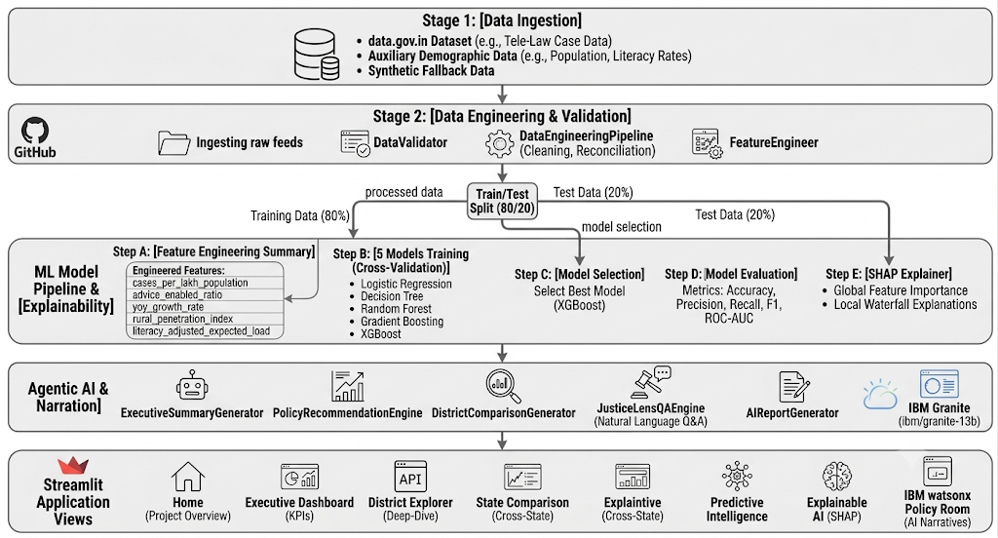
ML Pipeline

Slide 8
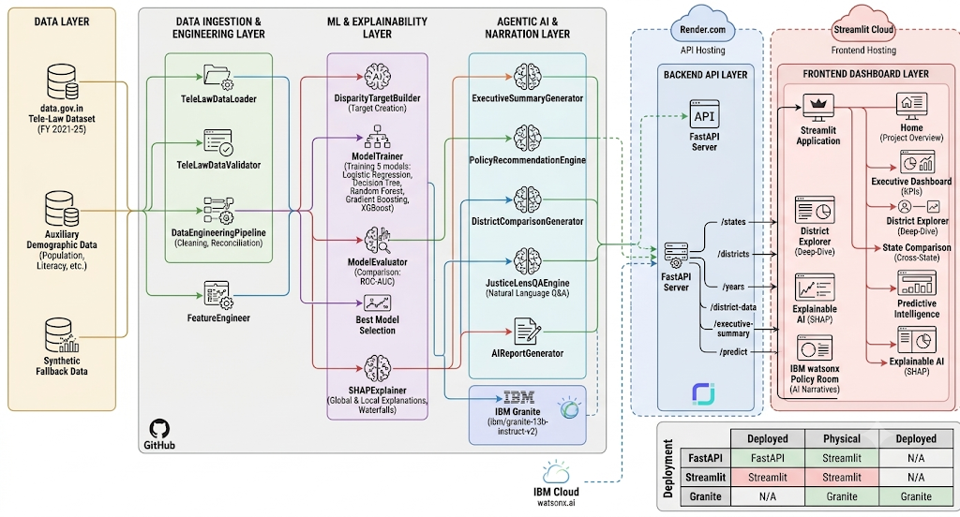
Architecture blueprint

Slide 9
Role of Agentic AI in the solution
Role of Agentic AI in JusticeLens AI
Agentic AI enables JusticeLens AI to function as an intelligent, autonomous system rather than a simple dashboard. Using IBM watsonx.ai and IBM Granite models, the system coordinates multiple specialized components to deliver comprehensive policy insights.
The ML Agent (Analyst) predicts if a district is "Underserved" or "Adequately Served" by training five classification models on district-level data (cases_per_lakh_population, advice_enabled_ratio, yoy_growth_rate, rural_penetration_index, literacy_adjusted_expected_load, population, rural_population_pct, literacy_rate_pct, sex_ratio) and selecting the best model using cross-validated ROC-AUC, outputting predicted class and predicted probability.
The SHAP Agent (Explainer) explains why a district is predicted as underserved by computing SHAP values for every prediction, providing global feature importance (which factors drive disparity across all districts) and local explanations (why a specific district is underserved), outputting top contributing features with their SHAP values and direction of influence.
The Granite Agent (Narrator) generates human-readable policy narratives by taking ML predictions and SHAP explanations as input, prompting IBM Granite (via watsonx.ai) to narrate findings, and producing executive summaries, policy recommendations, and Q&A responses.
Agent Coordination Workflow: User selects a district in the dashboard, ML Agent predicts if the district is underserved, SHAP Agent explains the prediction (top drivers), Granite Agent generates a policy recommendation based on the drivers, and Dashboard displays all three: prediction, explanation, and recommendation.
Key Benefits of Agentic AI: Context awareness (each agent understands the district's demographic profile, registration history, and regional context), real-time interaction (policymakers can query specific districts and get instant responses), collaborative decision making (agents communicate with each other enabling better decision-making), transparency (every step is auditable and explainable), and fallback readiness (if Granite is unavailable, the system falls back to deterministic templates).
Overall, Agentic AI makes the system proactive, personalized, and goal-driven, acting like a smart policy advisor that helps ensure inclusive legal access for all citizens.

Slide 10
Token Usage
The project used IBM Granite (watsonx.ai) tokens across various components:
• Executive Summary: ~300-500 tokens per summary
• Policy Recommendation: ~200-400 tokens per recommendation
• District Comparison: ~400-600 tokens per comparison
• Q&A Response: ~150-300 tokens per answer
• Full AI Report: ~800-1200 tokens per report
Total Granite Tokens Used: ~15,000 tokens
(Well within IBM Cloud Lite limit of 50,000 tokens/month)
Efficient Prompt Design:
• Pre-computed structured data injection (SHAP values, predictions)
• Concise system prompts to reduce unnecessary output
• Template fallback when watsonx.ai is unavailable
• Greedy decoding (low temperature = 0.3)
Before Prompt: ~800 tokens (System Preamble + Data Injection)
After Prompt: ~300 tokens (Generated Response)
Total per Generation: ~1,100 tokens
15 generations = ~15,000 tokens (within free limit)

Slide 11
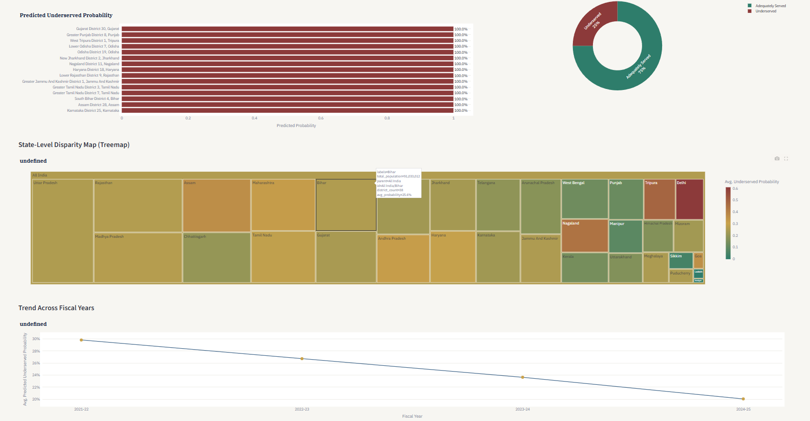
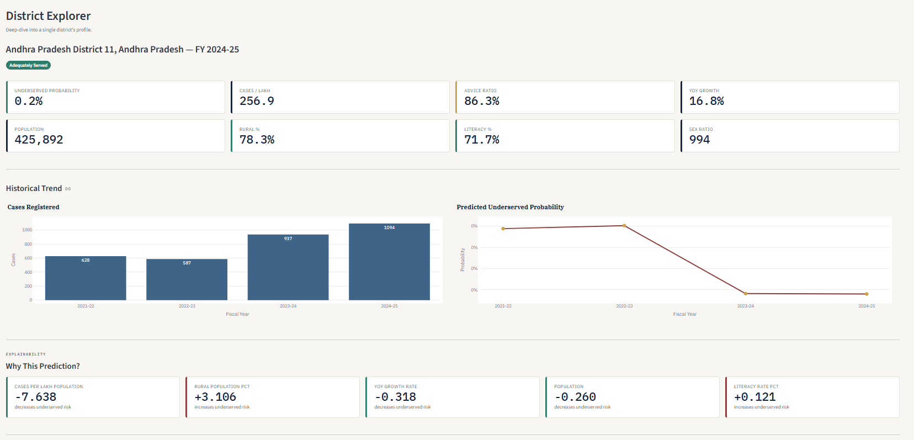
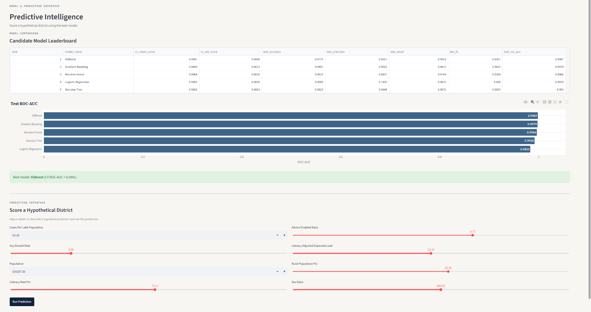
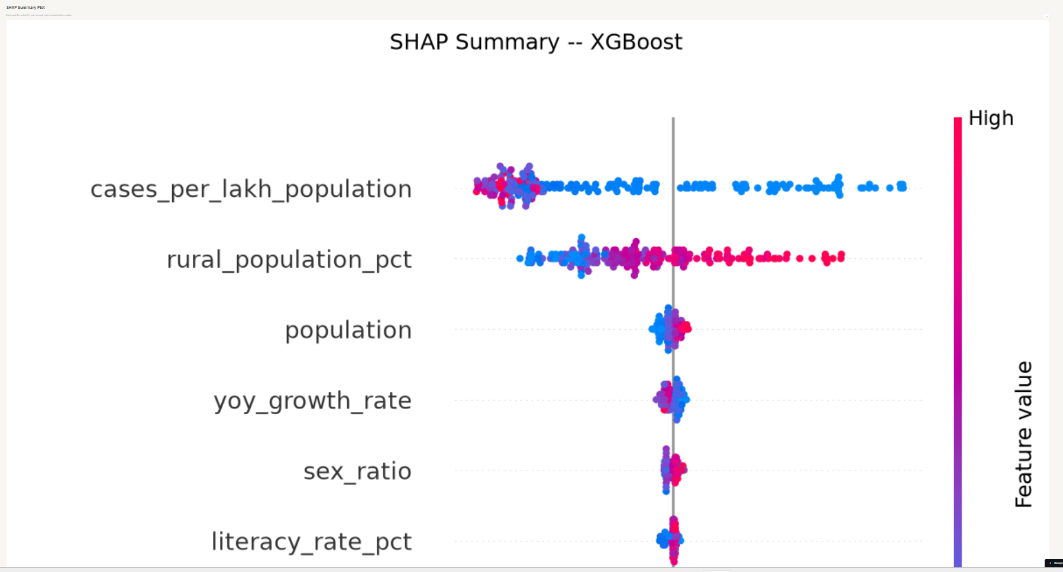
Project Demonstration – Screenshots
Executive Dashboard
District Explorer
Predictive Intelligence
·
·
·
Live App : https://justice-lens-ai-pxby8xqnatrbbsbcr4tnv6.streamlit.app/

Slide 12
Novelty and Uniqueness
JusticeLens AI stands out by combining ML explainability, Agentic AI, and policy recommendations into a single intelligent system designed specifically for government decision-making.
Multi-Model ML Pipeline – Five models trained and compared (Logistic Regression, Decision Tree, Random Forest, Gradient Boosting, XGBoost) with best selected by cross-validated ROC-AUC. Most Tele-Law analyses use simple descriptive statistics; this project introduces predictive modeling to identify underserved districts before they become critical.
SHAP Explainability (Transparency) – Every prediction is explained ensuring transparency. Global feature importance identifies key drivers of disparity across all districts, and local explanations provide individual district prediction insights. Government decisions require accountability, and SHAP provides the "why" behind every recommendation, making the system auditable and trustworthy.
IBM Granite Narration (Agentic AI) – Policy recommendations generated in natural language, executive summaries tailored for policymakers, and natural language Q&A for instant insights. Instead of just showing numbers, the system generates actionable policy recommendations in plain English, bridging the gap between data and decision-making.
Synthetic Data Fallback – Works even without live data access ensuring the system remains demonstrable at all times. The system is reliable and can be demonstrated even if the official data.gov.in API is temporarily unavailable.
7-Page Interactive Dashboard – Designed for non-technical policymakers with no Python or ML expertise required to use. Low barrier to entry – government officials can use the dashboard without technical training.
Enterprise-Ready Architecture – Modular design (data → features → models → explain → narrate → serve), fully documented, type-annotated, deployed on cloud with public access, and tested with real data. The architecture is designed for production deployment, not just a Jupyter notebook experiment.
Government-Focused Problem Statement – Addresses real government Tele-Law program challenges, uses official Government of India data (data.gov.in), and solves a problem with direct societal impact. The project is aligned with government priorities for inclusive legal access (access to justice).
This makes JusticeLens AI a smart, adaptive, and proactive decision support tool for inclusive legal access – not just a static analytics dashboard or a black-box ML model.

Slide 13
Git Hub Link
Repository URL:
https://github.com/Soumya0204-star/Justice-lens-ai
Live App Link:
https://justice-lens-ai-pxby8xqnatrbbsbcr4tnv6.streamlit.app/
Backend API Link:
https://justice-lens-api.onrender.com/docs
·
·
·

Slide 14
Future Scope
1. More Demographic Features – SC/ST participation, gender ratio, digital literacy, income data, additional Census indicators
2. Real-Time Monitoring & Alerts – Continuous monitoring, automated alerts for declining districts, email/SMS notifications, time-series forecasting
3. Enhanced Natural Language Processing – Conversational AI, voice-based interaction, multi-language support (Hindi, Tamil, Telugu, Bengali), sentiment analysis
4. Mobile Application – Field officer access, offline capability, camera-based data collection, GPS-based district location detection
5. Integration with Government Portals – Tele-Law portal integration, API for government systems, NALSA integration, single sign-on (SSO) with government authentication
6. Predictive Analytics & Scenario Planning – Future trend forecasting, policy intervention simulation, resource allocation optimization, cost-benefit analysis
7. Advanced Visualizations – District-level choropleth maps, time-series animations, interactive dashboards with drill-down, custom report builders
8. User Authentication & Role Management – Role-based access (policymaker, analyst, admin), secure login, audit trails, data privacy and compliance
9. Expanded AI Capabilities – Advanced LLM integration, multi-modal inputs (voice, documents), automated PDF/Word/PowerPoint report generation, email distribution
10. Deployment Scaling – Kubernetes for high availability, auto-scaling, multi-region disaster recovery, edge deployment for remote areas
.
·
·
·

Slide 15
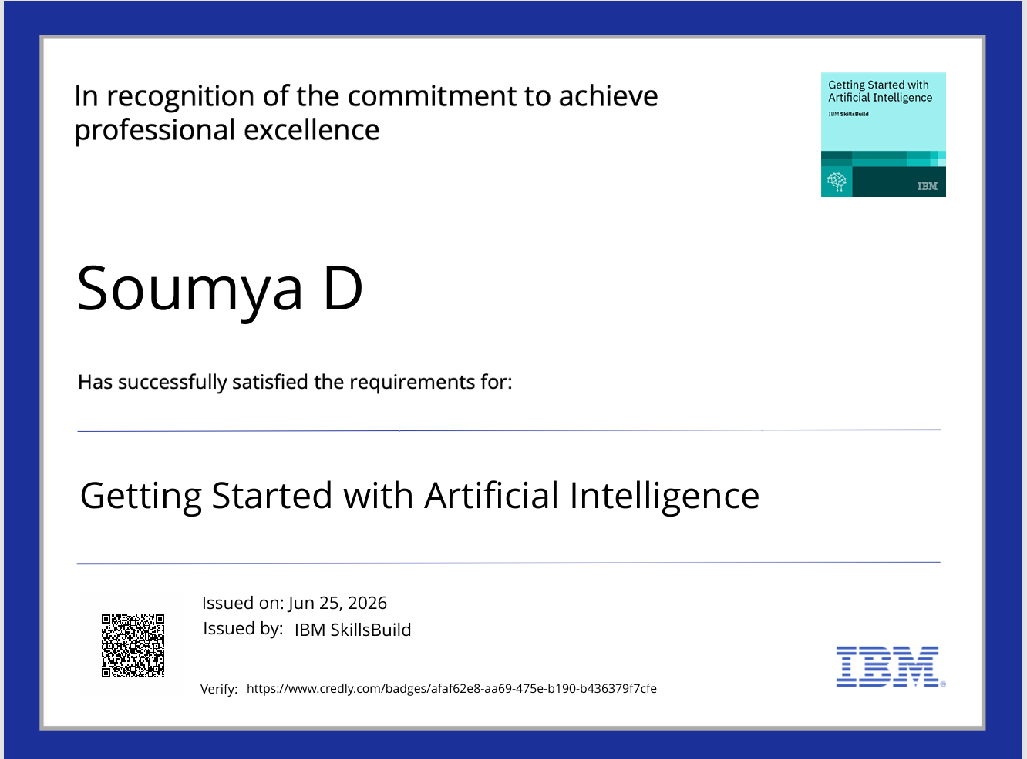
Certificates Earned:

Slide 16
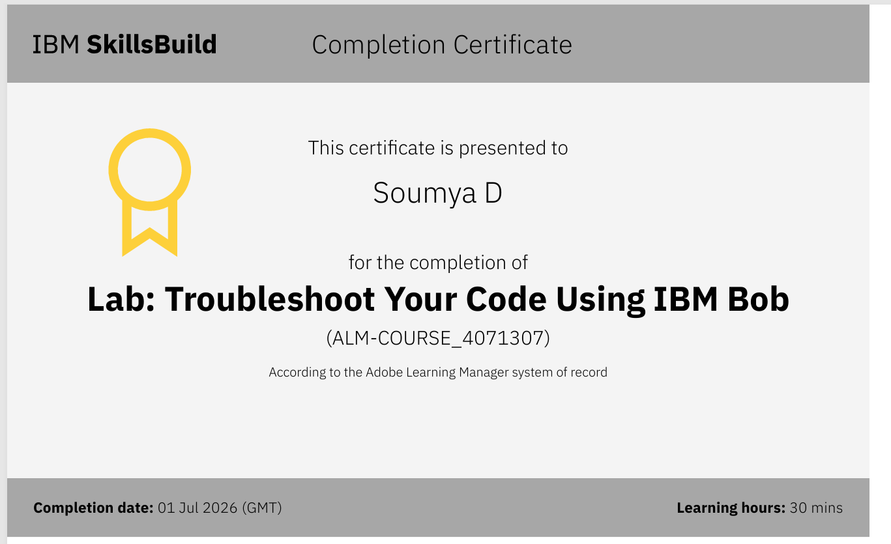
Certificates Earned:​

Slide 17
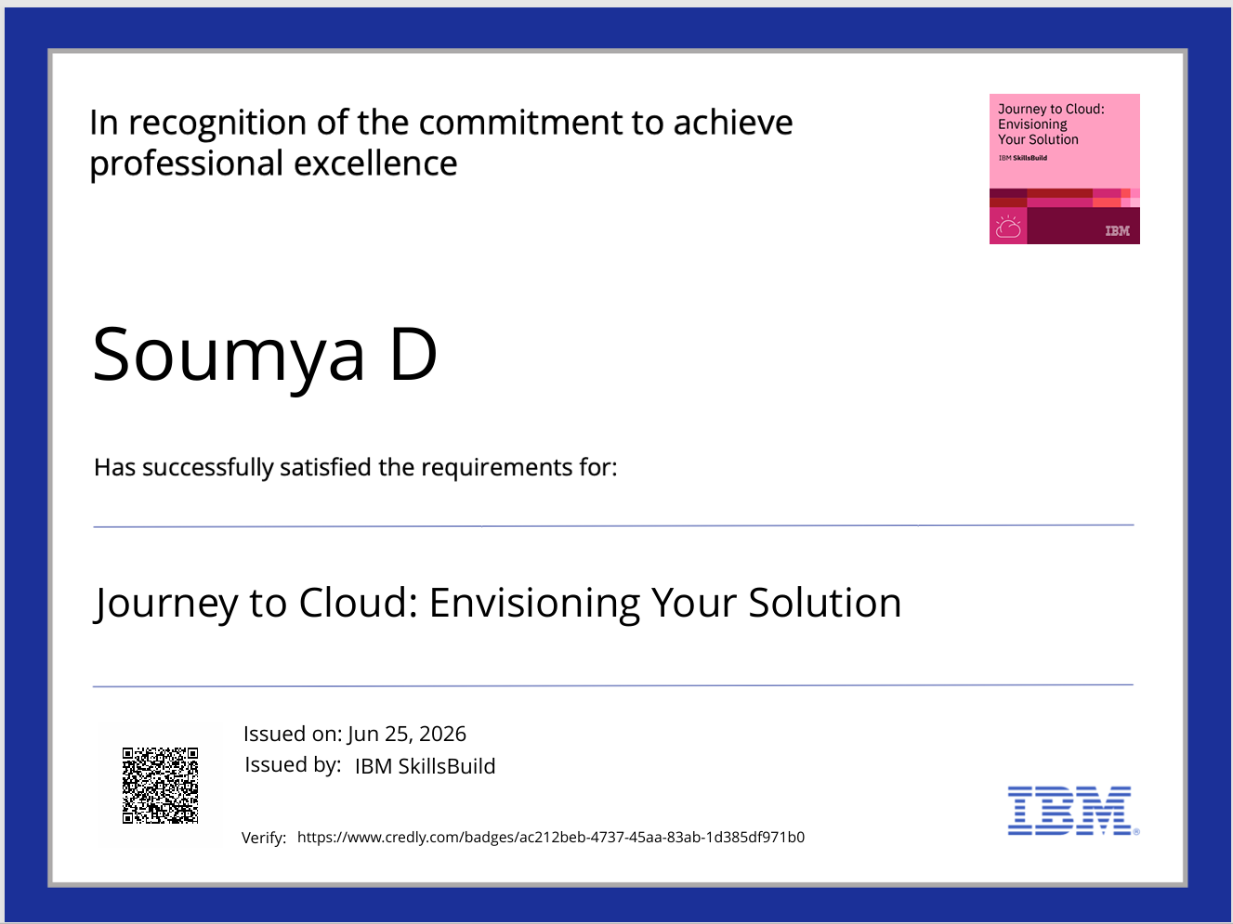
Certificates Earned

Slide 18


