Slide 1
Comparative Community Detection
Louvain · Fast Greedy · BLDLP on the LastFM Asia social network
7,624 users · 27,806 mutual-follow links · one graph, three algorithms
Notes:
Introduce the project: three community detection algorithms compared on the LastFM Asia social network.

Slide 2
What we did:
Same graph
1
One undirected network of LastFM users, loaded and cleaned once, shared by all three algorithms.
Three approaches
2
Two modularity optimisers (Louvain, Fast Greedy) and one label-propagation method (BLDLP).
Same yardstick
3
Modularity computed the same way on the same graph, plus community counts, sizes, run time and structure.
Notes:
The question is not which algorithm is best in the abstract, but how different objectives shape the groups found in the same graph.

Slide 3
The dataset: LastFM Asia
7,624
27,806
What the files contain
Users from Asian countries; edges are mutual follower relationships (LastFM API, March 2020).
Edge list: node_1, node_2 — undirected.
Target file: integer class per user derived from country (not used for scoring).
Checked: no self-loops, duplicates or missing values; counts match the SNAP description.
users (nodes)
mutual-follow links
1
18
connected component
country-derived classes
Notes:
Source: Stanford SNAP (FEATHER). Figures were verified against the downloaded files; they match the published description.

Slide 4
What counts as a community here
In this project
A community is a group of users who follow each other far more than they follow outsiders.
Each algorithm returns a partition: every user is in exactly one community.
Community IDs are arbitrary labels, so only whole partitions are compared.
No ground truth: country labels are not used as the answer.
Modularity (Q)
Share of edges inside communities minus the share expected by chance for the same degrees. One score for the whole partition, not per community.
Notes:
A community is purely the algorithm's output: a group of users more densely linked to each other than to the rest. No ground truth exists, so community IDs are arbitrary labels and are never compared across algorithms; partitions are compared with ARI/NMI.

Slide 5
Louvain: move nodes, then merge
Louvain
Local moving
In this project
1
Each node joins the neighbouring community that raises modularity the most.
Library: igraph community_multilevel.
Settings: resolution 1, seed 42.
Count: found automatically.
Optimises: modularity.
Aggregate
2
Communities become super-nodes; links between them are summed.
Repeat
3
Continue on the smaller graph until no move improves modularity.
Notes:
Louvain is a greedy two-phase modularity optimiser. Randomised node order, so the seed is recorded.

Slide 6
Fast Greedy: broadly hierarchical clustering
Fast Greedy
Start alone
In this project
1
Every user begins as its own community.
Library: igraph community_fastgreedy.
Selection: maximum-modularity dendrogram cut.
Randomness: none, deterministic.
Optimises: modularity.
Merge greedily
2
Repeatedly merge the pair of communities with the largest modularity gain, building a dendrogram.
Cut the tree
3
Choose the level with maximum modularity; the count is not forced to match Louvain.
Notes:
Fast Greedy is the Clauset-Newman-Moore agglomerative method. It is deterministic.

Slide 7
BLDLP: label propagation with link density
BLDLP
1
Unique labels
In this project
Each node starts with its own label.
Source: notebook sna_partb.ipynb, section 2.3 (SophiaVei repo). It cites no paper.
Settings: alpha 15, seed 42.
Result: did not converge in 10,000 iterations.
Optimises: not modularity.
2
Majority vote
In random order, each node adopts the most common label among its neighbours.
3
Link-density tie-break
Ties use summed edge weights w = floor(15 / (|E| + 1)); still tied: pick randomly.
4
Stop
When no ties remain, or after 10,000 iterations.
Notes:
BLDLP here reproduces the only accessible reference implementation. The weight code was checked against the notebook's literal loop. Because random tie-breaks can recur, convergence is not guaranteed; the run hit the iteration cap.

Slide 8
How the comparison is made fair
1
One graph
2
One modularity
Loaded and validated once; undirected, simple, no nodes removed.
igraph unweighted undirected modularity, resolution 1, same graph for all.
3
Recorded runs
4
Timing
Seed 42 for the randomised methods; one run each.
Algorithm core only; excludes loading and plotting.
Notes:
All numbers on the following slides are read from the saved result files of the actual runs.

Slide 9
Louvain scores highest; BLDLP splits finest
Modularity 0.8159 vs 0.7966 vs 0.7627: different objectives, so this is not a ranking of overall quality.
Notes:
Modularity: Louvain 0.8159, Fast Greedy 0.7966, BLDLP 0.7627. Louvain and Fast Greedy optimise modularity directly; BLDLP does not, so a lower score is expected and is not by itself a verdict. BLDLP is pure Python, so its run time is not comparable to compiled igraph code.

Slide 10
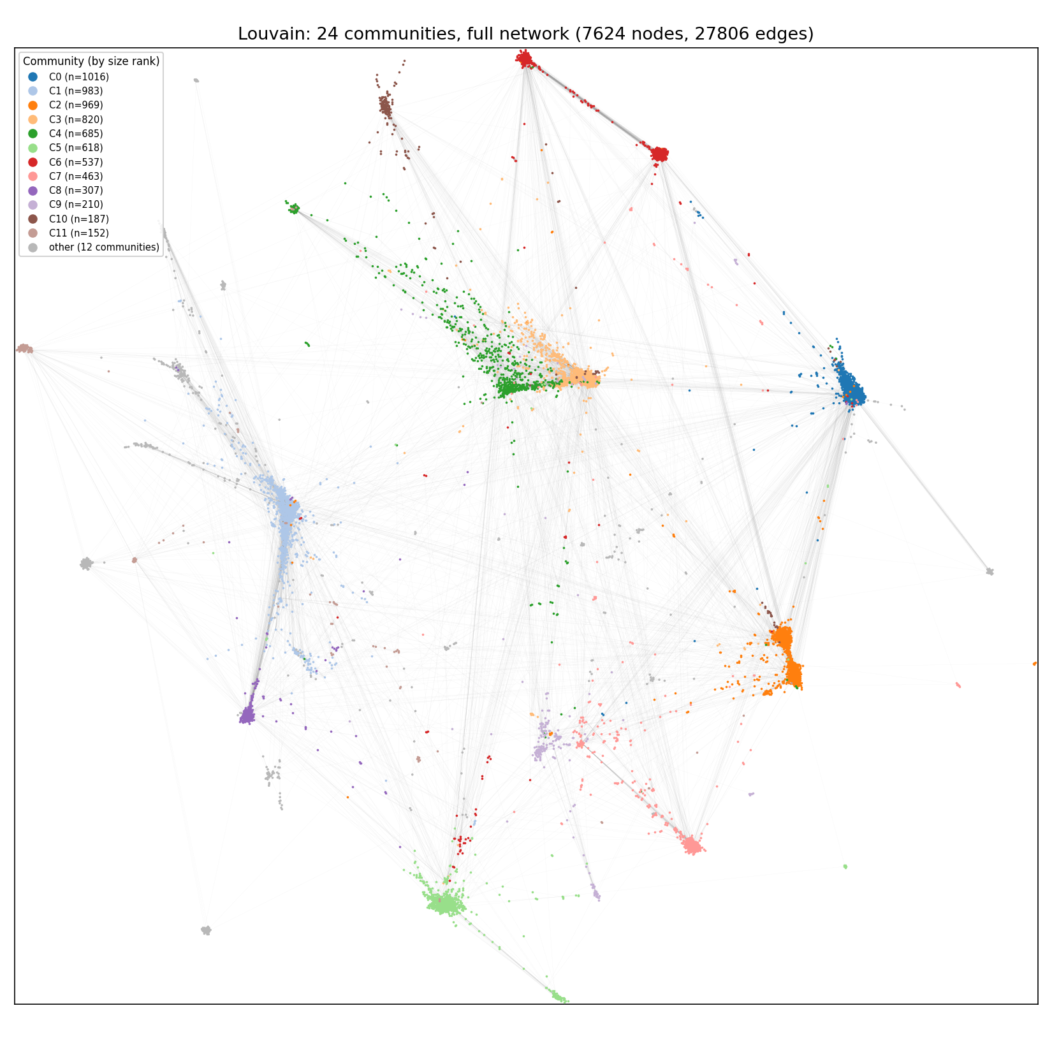
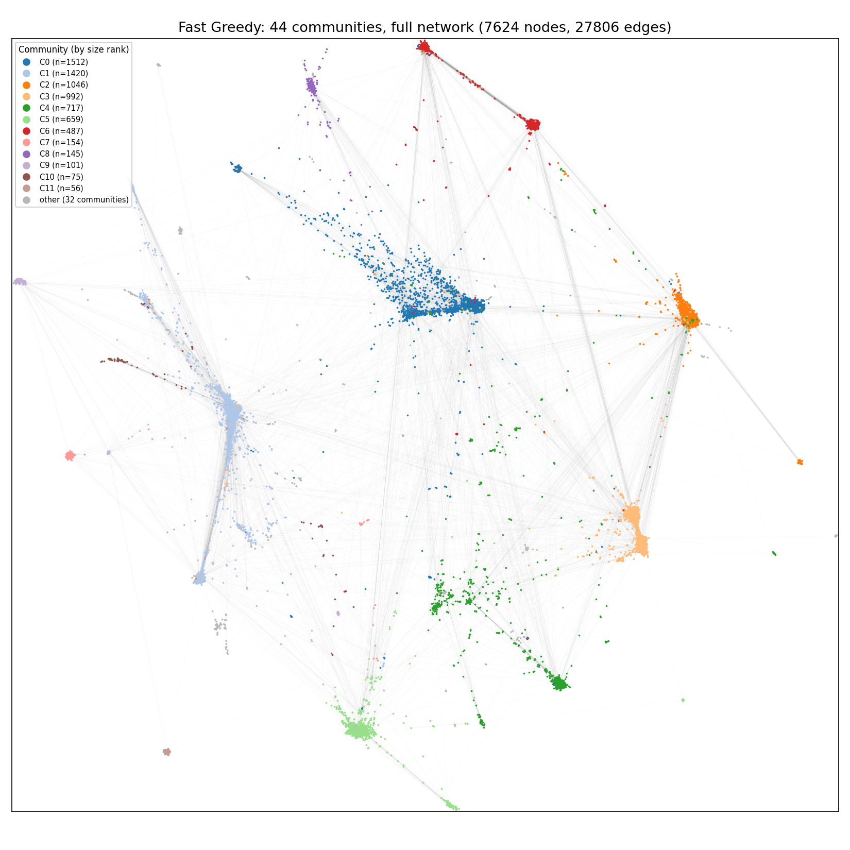
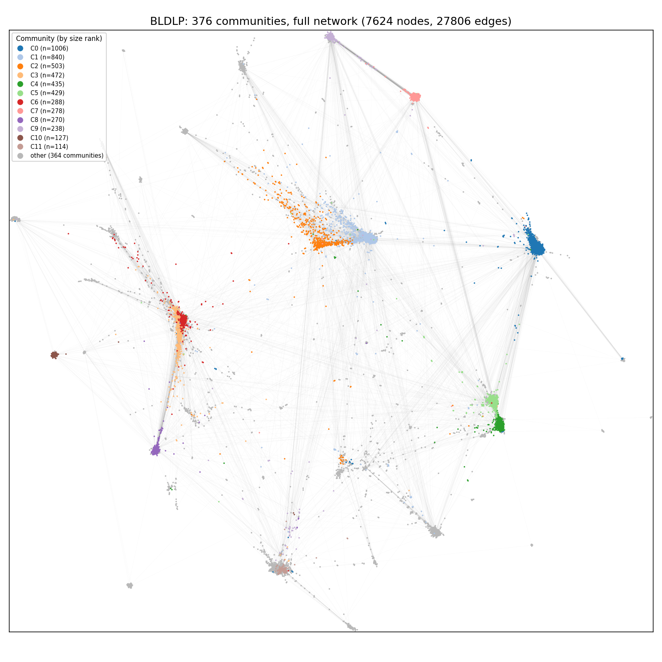
Communities:
Louvain: 24 communities
Fast Greedy: 44 communities
BLDLP: 376 communities
Colour = community (12 largest coloured, rest grey). Node positions are identical in all three panels.
Notes:
The layout coordinates were computed once (DrL, seed 42) and reused so the three pictures are directly comparable. Only the 12 largest communities per algorithm are coloured; the rest are grey.

Slide 11
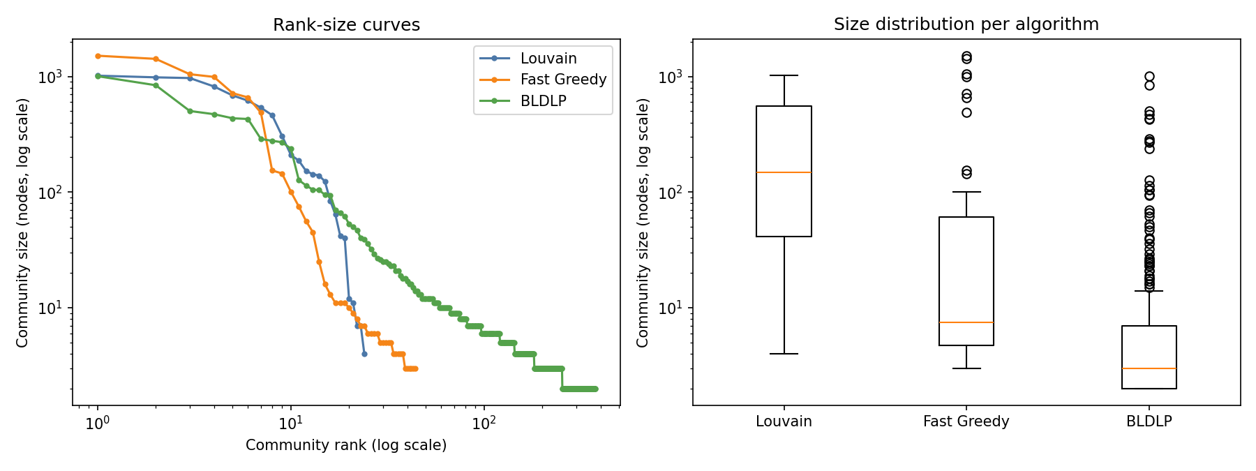
BLDLP adds a long tail of tiny communities
 | Louvain | Fast Greedy | BLDLP
Median size | 147.5 | 7.5 | 3
Communities ≥ 100 nodes | 15 | 10 | 14
Communities < 10 nodes | 3 | 24 | 310
Largest / smallest | 1016 / 4 | 1512 / 3 | 1006 / 2
Log scales on both axes of the rank-size curves.
Notes:
All three methods find roughly 10 to 15 communities with 100 or more users. BLDLP additionally leaves hundreds of very small groups, which is why its count is 376.

Slide 12
Largest communities: sparse yet clustered
Algorithm | Rank | Nodes | Internal edges | Density | Avg clustering | Avg path length | Diameter
Louvain | 1 | 1016 | 4586 | 0.0089 | 0.243 | 3.52 | 8
 | 2 | 983 | 3629 | 0.0075 | 0.239 | 3.77 | 11
 | 3 | 969 | 3482 | 0.0074 | 0.227 | 3.77 | 11
Fast Greedy | 1 | 1512 | 4804 | 0.0042 | 0.159 | 3.97 | 11
 | 2 | 1420 | 5874 | 0.0058 | 0.273 | 3.91 | 9
 | 3 | 1046 | 4674 | 0.0086 | 0.252 | 3.56 | 8
BLDLP | 1 | 1006 | 4549 | 0.0090 | 0.241 | 3.48 | 8
 | 2 | 840 | 2787 | 0.0079 | 0.211 | 3.57 | 9
 | 3 | 503 | 1326 | 0.0105 | 0.142 | 4.06 | 10
Densities are low (under 1.1%) but clustering is 0.14 to 0.27 and typical paths are 3.5 to 4.1 hops. All nine communities are connected. Density falls as community size grows, so compare within similar sizes.
Notes:
Properties are of each community's induced subgraph. Density depends on community size, so densities are not directly comparable between communities of different sizes. All nine communities are connected, so path length and diameter are computed on the whole community. These properties are not shares of overall modularity.

Slide 13
Partitions agree on structure, not on detail
Reading the scores
ARI: 1 = identical, about 0 = chance.
NMI: 0 to 1 shared information.
Community IDs are arbitrary, so IDs are never matched across algorithms.
Notes:
ARI and NMI compare whole partitions and ignore community IDs, which are arbitrary. Louvain and Fast Greedy are the most similar pair; BLDLP differs most because it is much finer-grained.

Slide 14
Key takeaways and limits
Takeaways
Limitations
Louvain gives the best modularity and the quickest run.
Fast Greedy finds a coarser, deterministic partition.
BLDLP agrees on the big communities but fragments the periphery.
Partitions overlap substantially but are not identical.
One seed per randomised method.
No ground-truth communities.
BLDLP follows a notebook; no paper was available.
BLDLP timing reflects pure Python.
Notes:
Close with the takeaways and the honest limitations: single seed, no ground truth, BLDLP source is a notebook rather than a paper.

