Slide 1
DATA ANALYTICS CASE STUDY
RESOLVR 2021

Slide 2
BUSINESS PROBLEM
MilFalConGalaxy suppliers is a well known CPG (consumer packaged goods) company operating primarily out of Asia. They cater to four regions in Asia (from where 80% of their revenue comes) and four important products (contributing ~70% of the sales).
MilFalConGalaxy suppliers, has approached our team to come up with an analytical model to predict the demand for each of the products in the respective regions for 2015 in order to help them make the appropriate decisions. We have the historical demand data of the four products for four regions over the last 6 years (from 2009 to 2014).

Slide 3
ROADMAP
Exploratory Data Analysis
Model Selection and Application
Time Series Data Preparation for ML Algorithm
Result & Conclusion

Slide 4
Exploratory Data Analysis
1

Slide 5
STEPS INVOLVED
Data Manipulation
Understanding of the given data, as well as, reshaping it for further analysis.
Visualization & Analysis
Plotting visual representation of the given data to understand patterns and trends.
Outlier Detection
Checking outliers in the data and removing them using an appropriate technique.
Decomposition of Time Series
Deconstructing the given time series data into separate components to represent the underlying categories of patterns.
Stationarity Check
Checking the stationarity of the given time series data to make it compatible for further analysis.
Distribution Check
Determining if the given data follows Gaussian or non-Gaussian distribution.

Slide 6
DATA MANIPULATION
The given dataset has dimensions (312, 8) with observations being made on weekly basis for 6 years
The dataset has no explanatory variables. Thus, it is a univariate Time-Series data with a period ranging '2009-01-01’ to '2014-12-18'
Therefore, we have separated the entire dataset into 16 Individual Time-Series such that each product for each of the 4 regions has a separate time series
This gives us a dataframe with the ‘Date’ as the index column and 16 columns of the training dataset of the various products and regions
The data description key is as follows:
mw: Milky Way m: Medusa c: Cosmos Redshift a: Andromeda
r1: Region 1 r2: Region 2 r3: Region 3 r4: Region 4

Slide 7
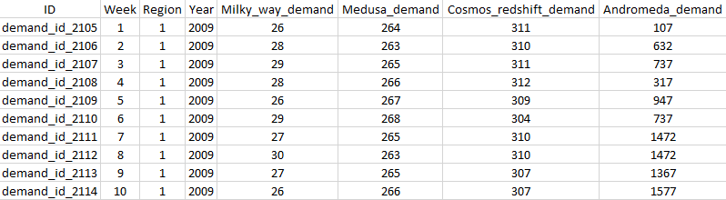
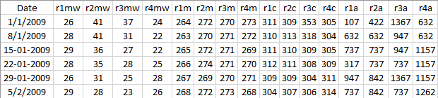
AFTER BEFORE

Slide 8
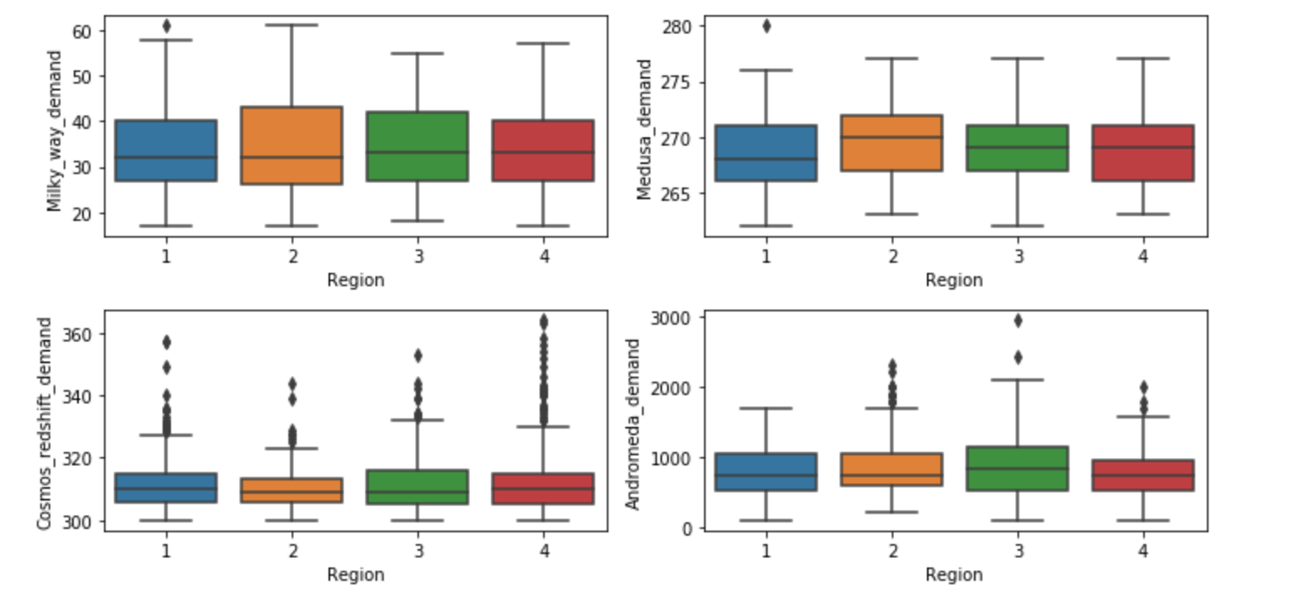
VISUALISATION & ANALYSIS
The following box-plots shows us the region-wise univariate analysis of each of the four products.
It can be observed that over the period of 5 years, the demand of each product across all regions remains relatively same.
INSIGHT DERIVED: Thus, it can be inferred that no particular region varies with respect to the demand of the product from others.
Also, it is apparent from the graph that the data has presence of outliers.

Slide 9
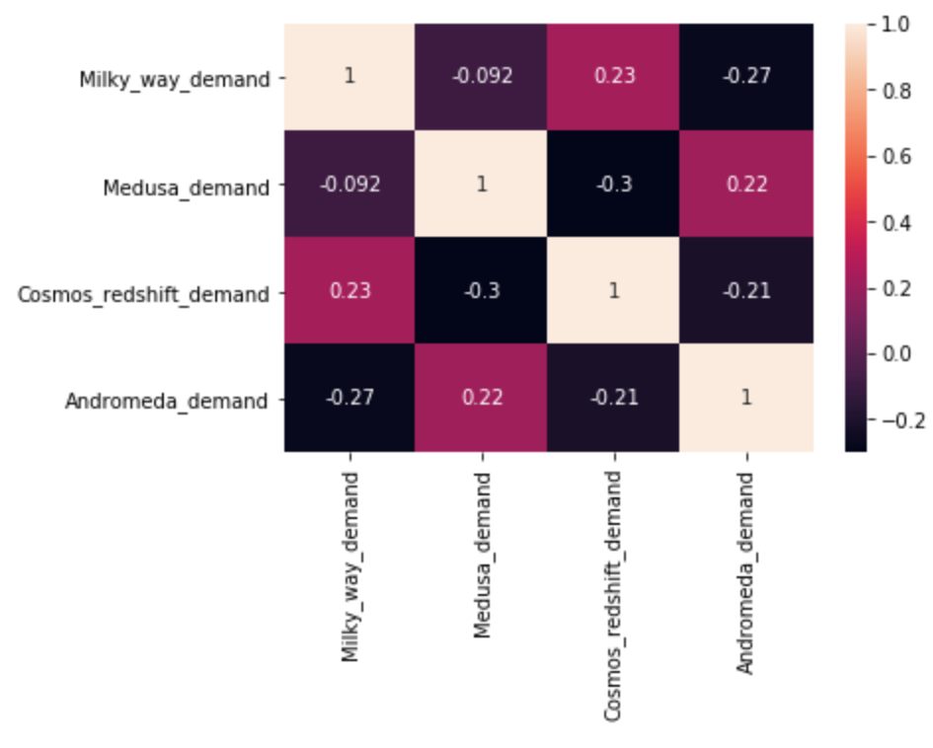
VISUALISATION & ANALYSIS
The following correlation matrix shows us the region-wise bivariate analysis of each of the four products.
It can be observed that there is no significant correlation present between demands of different products.
INSIGHT DERIVED: This implies that demand of one product is not linearly dependent with the demand of any other product.

Slide 10
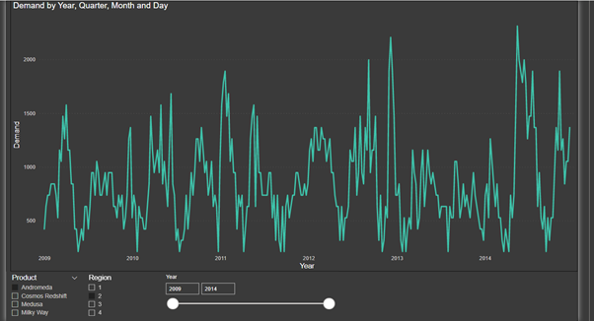
TIME SERIES PLOTS
The graph shown represents the weekly demand for the product ‘Andromeda’ for region 2 across the years 2009-2014.
The demand for various products across the 4 regions have been shown in a dynamic dashboard (made with the help of PowerBI).
The PowerBI dashboard is available in the GitHub repository.

Slide 11
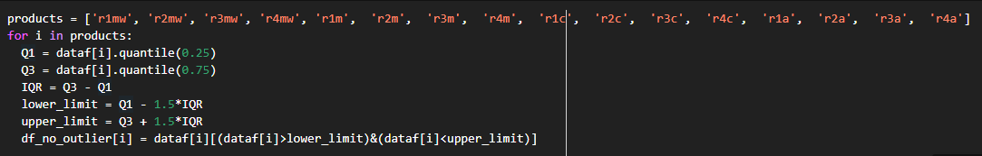
OUTLIER DETECTION
Interquartile Range Method
Sort the dataset in ascending order to calculate Q₁ and Q₃
Compute IQR = Q₃ - Q₁
Set lower bound = (Q₁–1.5*IQR) and upper bound = (Q₃+1.5*IQR)
Loop through the values of the dataset and check for those who fall below the lower bound and above the upper bound and mark them as outliers.

Slide 12

OUTLIER TREATMENT
Mean Imputation
Remove the outliers from the dataset based on IQR method criteria
Substitute those data points with the average value of the entire data series excluding outliers
The dataset obtained after performing the aforementioned steps would be used for the further analysis.
Python Code:

Slide 13
DECOMPOSITION OF TIME SERIES
TREND
A long-term tendency of the data that doesn’t reflect sudden changes but gradual changes. The trend may be linear or curvilinear.
SEASONAL
It tends to repeat itself at a regular interval of time. A peak or dip is seen in a time interval which continues to repeat year after year.
T
S
It is a recurrent upward or downward movement in a time series but the period of the cycle is greater than a year. There is no fixed period of oscillations.
CYCLIC
The uncontrolled situation which arises and causes a change in the values of the data.
RANDOM
C
R

Slide 14

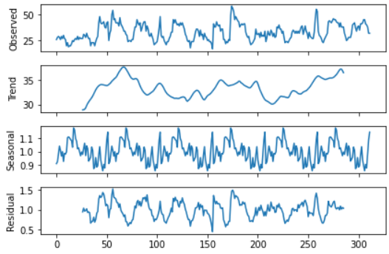
DECOMPOSITION OF TIME SERIES
Next we perform the decomposition of each time series into its 4 components like trend, cyclic, seasonal and random component and plot them to help improve understanding of the time series, which eventually will help to improve forecast accuracy.
Python Code:
The following graph shows the various components of the time series assuming a multiplicative model .The series has been detrended using the moving average method taking the frequency as 52 since each year has 52 weeks.
Similar graphs for each of the time series is available in the GitHub repository.

Slide 15
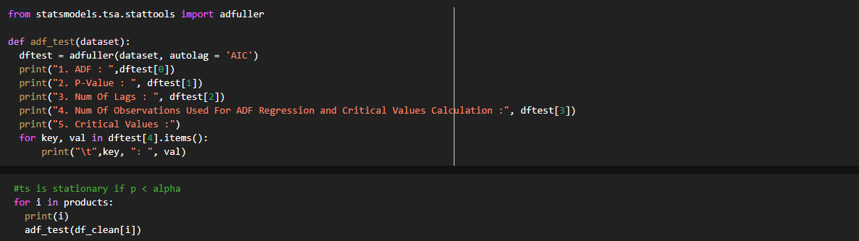
STATIONARITY TEST
Augmented Dickey-Fuller test / Unit Root Test
H0: The time series has a unit root and is non-stationary. It has some time dependent structure.
H1: The time series doesn't have a unit root and is stationary. It doesn't have time dependent structure.
Through the results of Augmented Dickey-Fuller test, we observed that the given 16 univariate time series doesn't have a unit root and are stationary. Thus, they doesn't have time dependent structure.

Slide 16
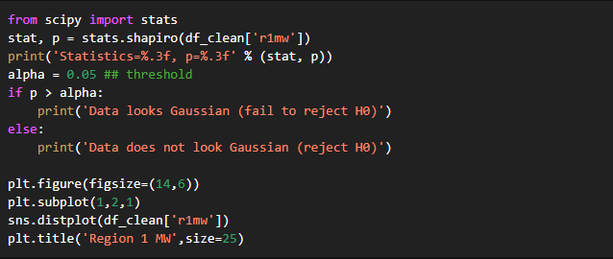
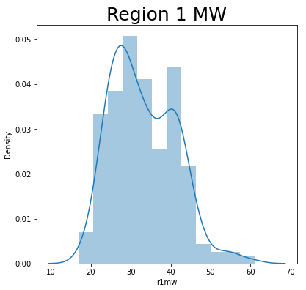
DISTRIBUTION TEST
Shapiro–Wilk Test
H0: The time series follows a Gaussian distribution.
H1: The time series does not follows a Gaussian distribution.
Through the results of Shapiro–Wilk Test, we observed that the given 16 univariate time series doesn't follow a Gaussian distribution. Similarly, the distribution lot also confirms a non-gaussian distribution.

Slide 17
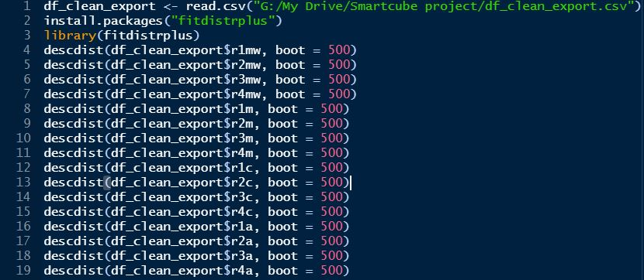
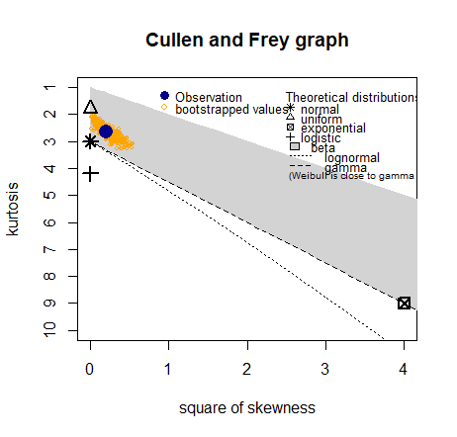
USING THE FITDISTRPLUS LIBRARY TO IDENTIFY THE DISTRIBUTION
The Cullen and Frey Graph above is a good way to exempt some distributions by the parameters of skewness and kurtosis using the descdist function; the bootstrapped values are from random samples (with replacement) of the data.
All the observations for the 16 distributions lie in the grey region of the graph , hence , it is difficult to pin down a particular distribution to the time series. Similar graphs for each of the time series is available in the GitHub repository.

Slide 18
Time Series Modelling
2

Slide 19
MODELS USED
ARIMA Model
An ARIMA model is a class of statistical models for analyzing and forecasting time series data.
Multiple Linear Regression
A linear approach for modelling the relationship between a scalar response and one or more explanatory variables.
Random Forest Regression
Random Forest Regression is a supervised learning algorithm that uses ensemble learning method. It operates by constructing several decision trees.
Support Vector Regression (SVR)
Support Vector Regression is a supervised learning algorithm whose basic idea is to find the best fit line using the hyperplane that has the maximum number of points.
Recurrent Neural Networks (RNN) LSTM
Long short-term memory is an artificial recurrent neural network architecture used in the field of deep learning. Unlike standard feedforward neural networks, LSTM has feedback connections. It can process not only single data points, but also entire sequences of data.

Slide 20
ARIMA MODEL
2.1

Slide 21
ARIMA MODEL
Autoregressive Integrated Moving Average is a class of models that ‘explains’ a given time series based on its own past values, that is, its own lags and the lagged forecast errors, so that equation can be used to forecast future values. The key aspects of the model are:
Autoregression (AR): Using the dependent relationship between an observation and some number of lagged observations. Here, p is the order of the AR term and refers to the number of lags of Y to be used as predictors
Integrated (I): The use of differencing of raw observations in order to make the time series stationary. Here, d is the number of differencing required to make the time series stationary
Moving Average (MA): Using the dependency between an observation and a residual error from a moving average model applied to lagged observations. Here, q is the order of the MA term and refers to refers to the number of lagged forecast errors that should be used
EVALUATION METRIC
AIC (Akaike Information Criterion) → It is one of the most common methods of model selection, i.e., is an estimator of prediction error which estimates the relative amount of information lost by a given model; the less information a model loses, the higher the quality of that model) and lowest RMSE. The lower the AIC, the better the model.

Slide 22
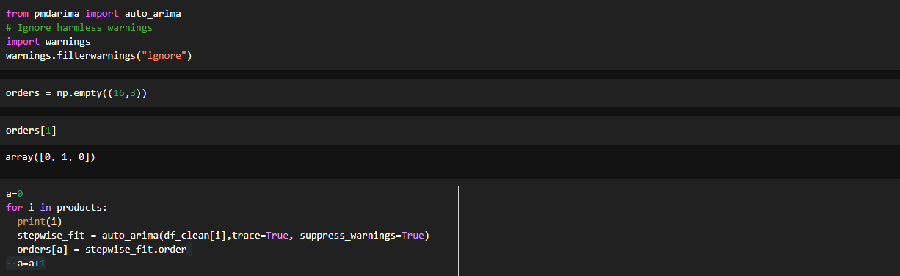
ARIMA MODEL
From the “pmdarima” package we have used the auto_arima library to fit appropriate ARIMA models to the various time series.In Auto ARIMA, the model itself will generate the optimal p, d, and q values which would be suitable for the data set to provide better forecasting.
Python Code:

Slide 23
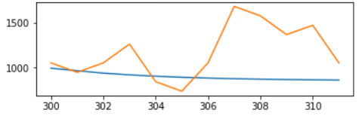
RESULTS FROM ARIMA
RMSE: 222.3627895117305
MAPE: 47.36761357168011
It can be observed that the ARIMA model fits the data well but there is a scope for improvement and this is the case for all the 16 time series. Therefore, we would proceed ahead with other ML Algorithms.
All the other graphs and metrics for the other time series can be seen in the GitHub repository.

Slide 24
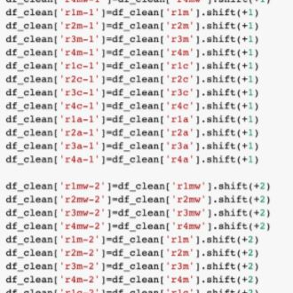
TIME SERIES DATA PREPARATION FOR ML ALGORITHMS
Restructuring the Time Series dataset to a supervised learning problem

Slide 25
TIME SERIES DATA PREPARATION FOR ML ALGORITHMS
Given a sequence of numbers for a time series dataset, we can restructure the data to look like a supervised learning problem.
We can restructure this time series dataset as a supervised learning problem by using the value at the previous time step to predict the value at the next time-step. We can do this by using previous time steps as input variables and use the next time step as the output variable.
This representation is called a sliding window, as the window of inputs and expected outputs is shifted forward through time to create new “samples” for a supervised learning model.
If we are interested in making a one-step forecast, e.g. one month, then we can evaluate the model by training on the training dataset and predicting the first step in the test dataset. We can then add the real observation from the test set to the training dataset, refit the model, then have the model predict the second step in the test dataset.
Repeating this process for the entire test dataset will give a one-step prediction for the entire test dataset from which an error measure can be calculated to evaluate the skill of the model.

Slide 26
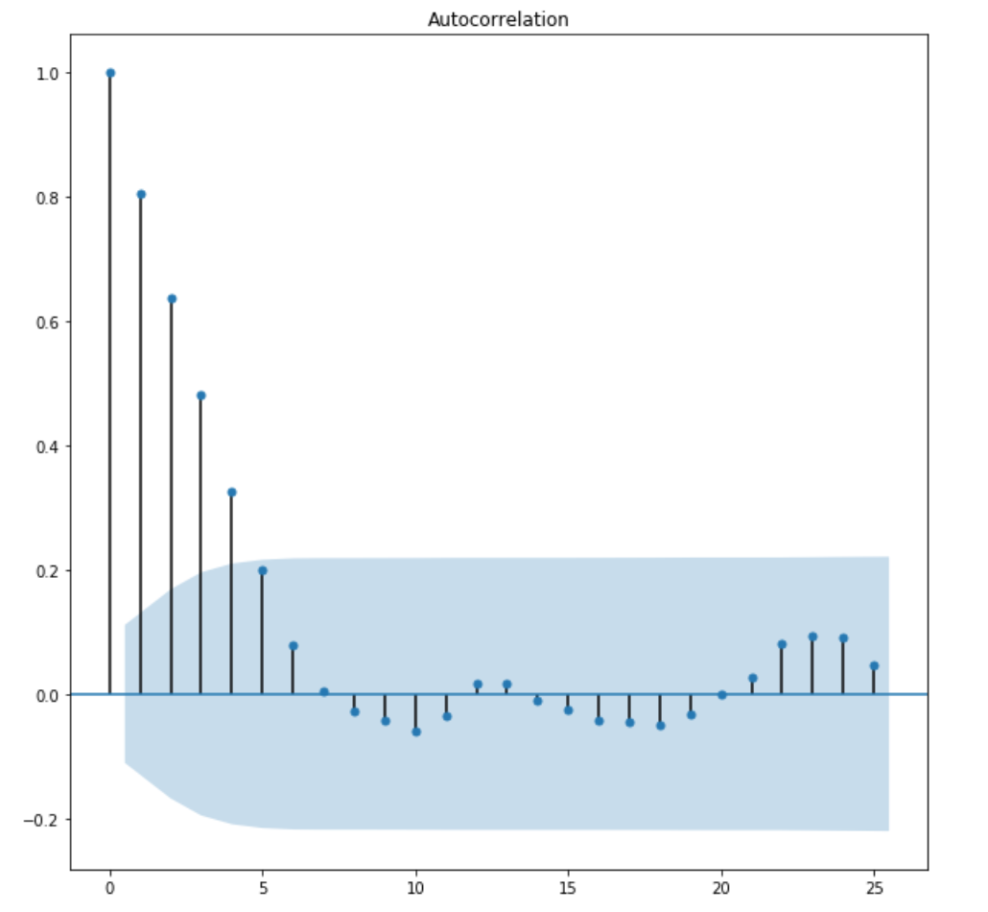
TIME SERIES DATA PREPARATION FOR ML ALGORITHMS
ACF GRAPH
A correlogram (also called Auto Correlation Function ACF Plot or Autocorrelation plot) is a visual way to show serial correlation in data that changes over time (i.e. time series data).
In simple terms, it describes how well the present value of the series is related with its past values.
Based upon the graph, it can be seen that the Autocorrelation is significant upto 4 lags.
We have fitted our models using 3 and 4 previous lags, however, the adjusted R² value suggests that it is better to use only ‘3’ lags.

Slide 27
TIME SERIES DATA PREPARATION FOR ML ALGORITHMS
The dataset has been split into train and test sets . For time series data, the data should be split into chronological sets or sequential manner. Taking any random observation without a chronological order would not be right because in time series, observations are not independent as every value is dependent on its previous observation.
EVALUATION METRICS:
RMSE: Root Mean Squared Error is a simple square root of mean squared error. It is the average amount that the response will deviate from the true regression line. It is considered a measure of the lack of fit of the model to the data. It solves the disadvantage of MSE of giving the result is squared units but is not as robust to outliers as MAE. However, RMSE is not robust to outliers.
MAE: Similar to MSE but take the sum of the absolute value of error. MAE is a more direct representation of the sum of error terms. The primary advantage of MAE is that it is robust to outliers.
In the subsequent sections we will apply various machine learning algorithms and note the performance metrics for each of the time series and finally use the best performing model for each time series.

Slide 28
Linear Regression
2.2

Slide 29
LINEAR REGRESSION
The regression model allows for a linear relationship between the forecast variable y and a single predictor variable x: y_{t} = β0 + β1 * x_{t}+ ε_{t}
The intercept β0 represents the predicted value of y when x = 0. The slope β1 represents the average predicted change in y resulting from a one unit increase in x.
The assumptions taken into consideration are as follows:
1) The relationship between the forecast variable and the predictor variables satisfies this linear equation
2) Errors are normally distributed with mean zero and constant variance; otherwise the forecasts will be biased.
3) Errors are not autocorrelated; otherwise the forecasts will be inefficient.
4) No existence of multicollinearity between predictor variables

Slide 30
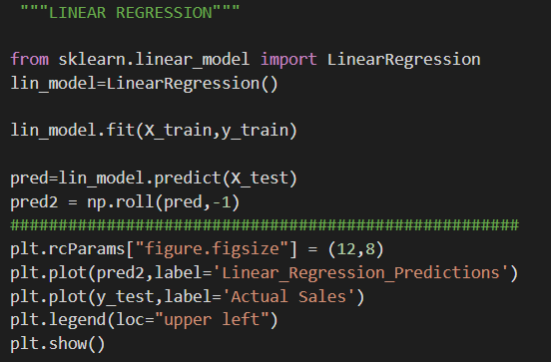
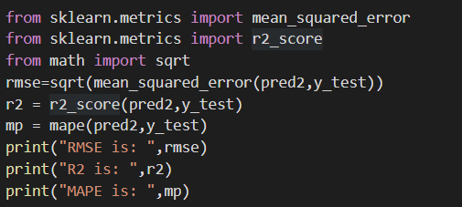
LINEAR REGRESSION
We have used the scikit learn library to fit the linear regression model on the training and testing dataset as mentioned above.
As mentioned earlier, we have applied the ingenious way of creating lags and converting this into a supervised learning problem to use the linear regression model for our time series prediction.
Python Code:

Slide 31
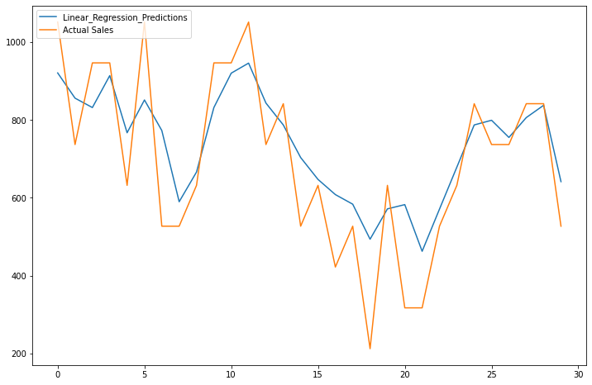
RESULTS FROM LINEAR REGRESSION
RMSE: 126.32628057407749
R²: 0.09313163548701164
MAPE: 14.956639467857476
Now, it can be clearly seen that the RMSE and MAPE values have reduced considerably. Hence, it can be concluded that converting our data into a supervised machine learning problem is a wise decision.
All the other graphs and metrics for the various time series can be seen in the GitHub repository.

Slide 32
Random Forest Regressor
2.3

Slide 33
RANDOM FOREST REGRESSOR
Random forest is an ensemble of decision tree algorithms. It is an extension of bootstrap aggregation (bagging) of decision trees.
It involves constructing a large number of decision trees from bootstrap samples from the training dataset, like bagging.
Random forest also involves selecting a subset of input features (columns or variables) at each split point in the construction of the trees.
The effect is that the predictions, and in turn, prediction errors, made by each tree in the ensemble are more different or less correlated. When the predictions from these less correlated trees are averaged to make a prediction, it often results in better performance than bagged decision trees.

Slide 34
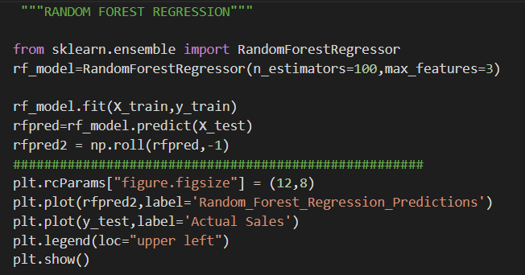
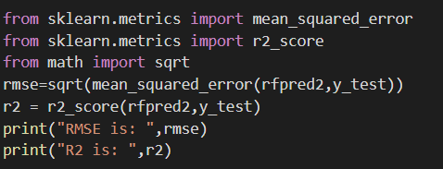
RANDOM FOREST REGRESSOR
We have used the RandomForestRegressor library to fit the random forest regressor model on the training and testing dataset .
Python Code:

Slide 35
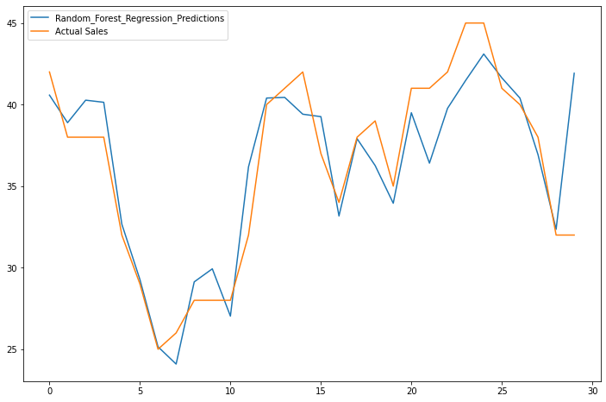
RESULTS FROM RANDOM FOREST REGRESSOR
RMSE: 2.6222555396772953
R²: 0.7508637346866426
It can be concluded that Random Forest Regressor improves the predictions for certain time series.
All the other graphs and metrics for the various time series can be seen in the GitHub repository.

Slide 36
Support Vector Regression
2.4

Slide 37
SUPPORT VECTOR REGRESSOR
An SVM (Support Vector Machine) tries to find a line/hyperplane (in multidimensional space) that separates the two classes. Then it classifies the new point depending on whether it lies on the positive or negative side of the hyperplane depending on the classes to predict.
Support Vector Regression (SVR) uses the same principle as SVM, but for regression problems.
The problem of regression is to find a function that approximates mapping from an input domain to real numbers on the basis of a training sample.
In essence SVR transforms the data into higher dimension data where classification/regression is possible through a hyperplane and then inverse transforms the data into the original dimension.

Slide 38
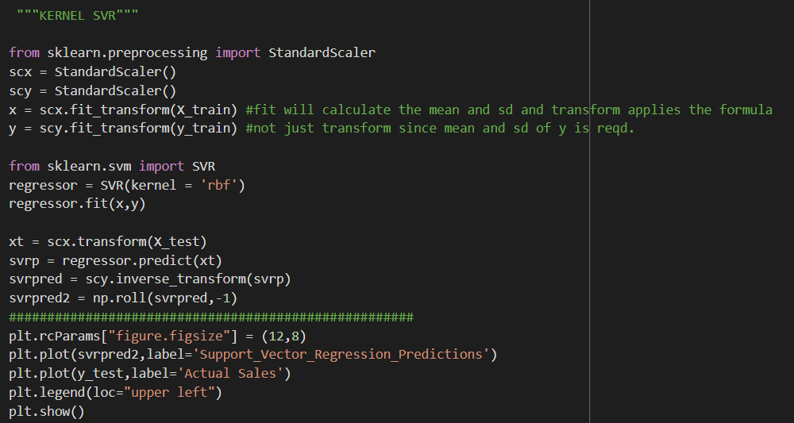
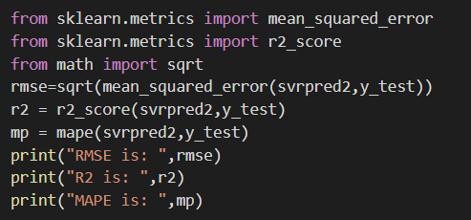
SUPPORT VECTOR REGRESSOR
We have used the SVR library to fit the SVR model on the training and testing dataset .
Scaling the data before fitting the model enhances the results.
Python Code:

Slide 39
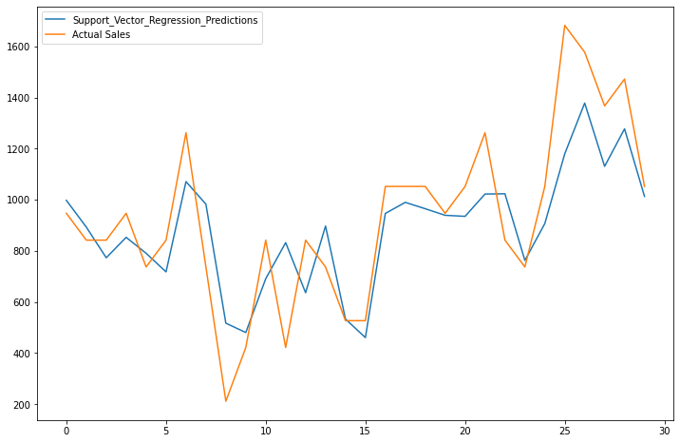
RESULTS FROM SUPPORT VECTOR REGRESSOR
RMSE: 185.24873390756042
MAPE: 39.90809731124633
It can be concluded that Support Vector Regressor improves the predictions for certain time series.
All the other graphs and metrics for the various time series can be seen in the GitHub repository.

Slide 40
RNN LSTM (Long-Short Term Memory)
2.5

Slide 41
RNN LONG SHORT TERM MEMORY (LSTM)
Long Short Term Memory networks – usually just called “LSTMs” – are a special kind of RNN, capable of learning long-term dependencies.
LSTMs are explicitly designed to avoid the long-term dependency problem. Remembering information for long periods of time is practically their default behavior, not something they struggle to learn
Hence, they can be a good fit for the current forecast.

Slide 42
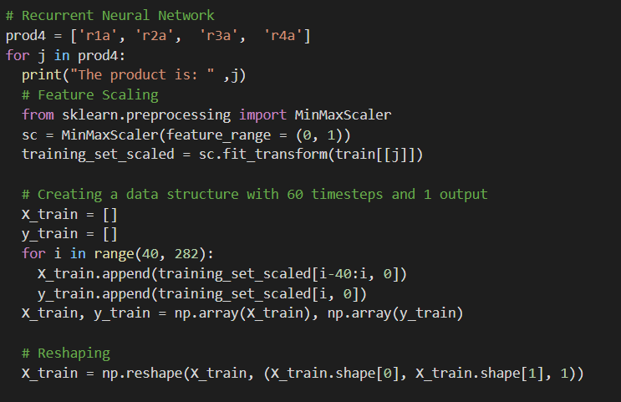
LONG SHORT TERM MEMORY NETWORKS - 1/3

Slide 43
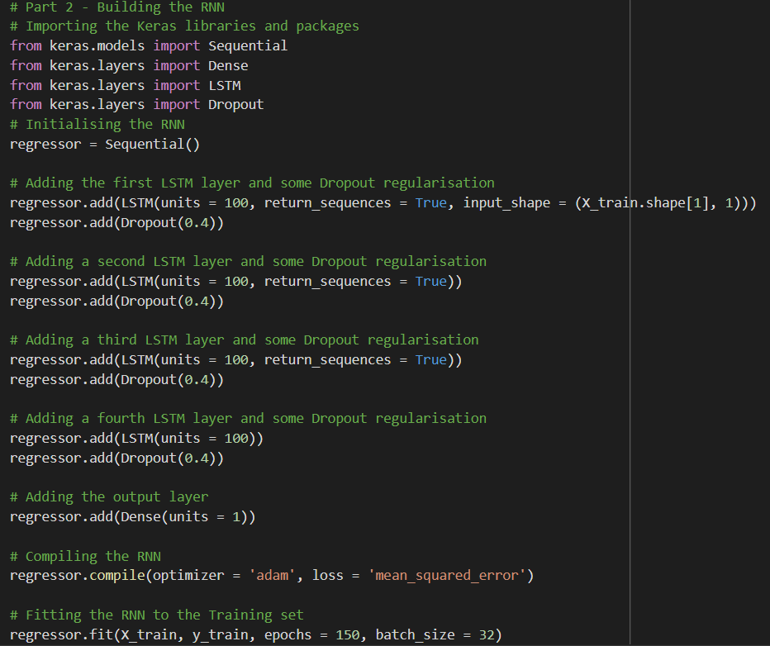
LONG SHORT TERM MEMORY NETWORKS - 2/3

Slide 44
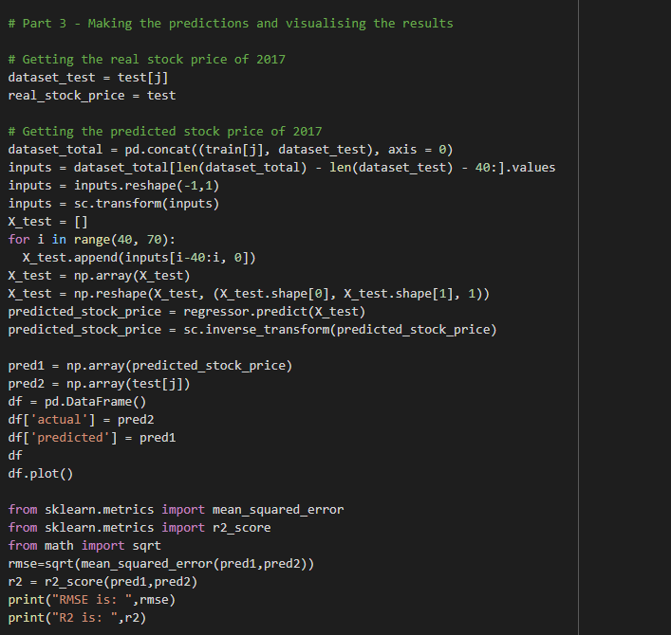
LONG SHORT TERM MEMORY NETWORKS - 3/3

Slide 45
RESULTS OF LONG SHORT TERM MEMORY NETWORKS
Although LSTMs suit the prediction for time series forecast, in our case,they were not able to provide as efficient results as the previous ML algorithms.
So, they were not used for the final prediction.
The complete set of results is available in the GitHub repository.

Slide 46
Result & Conclusion
3

Slide 47
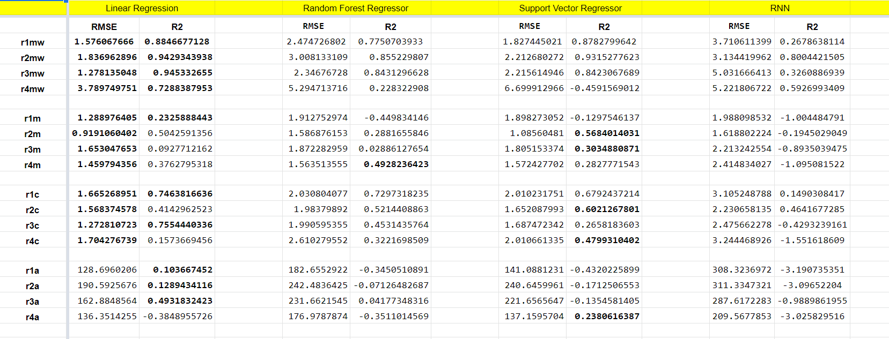
The best model for the various time series have been highlighted in bold.

Slide 48
CONCLUSION
The final prediction results from all the algorithms for all the time series have been provided in the Excel sheet provided.
To conclude, “Linear Regression Model” has performed the best for most of the Time Series. On the other hand, “Random Forest Regressor” and “Support Vector Regressor” has performed the significantly better than the “LSTM” model.
The Excel sheet is uploaded on the GitHub repository.
GitHub Repo Link: https://github.com/SoumyaBahuguna05/Data-Analytics-Case-Study-Resolvr-2021

Slide 49





PRESENTED BY TEAM ‘S3V’
Vidur Walia
M.Sc. Statistics, University of Delhi
linkedin/vidurwalia
Soumya Bahuguna
M.Sc. Statistics, University of Delhi
linkedin/soumyabahuguna
Saloni Aggarwal
M.Sc. Statistics, University of Delhi
linkedin/saloniaggarwal
Simran Goswami
M.Sc. Statistics, University of Delhi
linkedin/simrangoswami

