Slide 1

AI-Powered Resume Optimization and Job Matching Platform
Mini Project / 5th Sem/ BCS554
STUDENT NAME
1.Soumya Joshi(2400320101117)
2.Tanishka Verma(2400320101163)
3.Vanshika Gupta(2400320101230)
SUPERVISOR NAME:
Prof. Anshul Tickoo

Slide 2
ABSTRACT
AI-powered full-stack web application for analyzing resumes.
Extracts relevant skills and information from uploaded resumes.
Generates an overall resume/ATS score with actionable feedback.
Provides actionable suggestions to improve resume quality.
Recommends suitable job roles and current job openings based on resume–job matching.
Uses Ollama for intelligent resume analysis.

Slide 3
OBJECTIVE
To develop an AI-based system for automated resume analysis.
To identify and extract important skills and information from resumes.
To evaluate the quality and effectiveness of resume content.
To generate a resume score based on the analysis.
To identify skill gaps and recommend suitable career roles.
To match resumes with relevant job descriptions and job openings.
To provide meaningful suggestions for improving resumes.
To assist users in discovering relevant job opportunities.

Slide 4
SCOPE of the Problem Statement
Automates the initial analysis of resumes using AI.
Helps students and job seekers identify weaknesses in their resumes.
Provides personalized feedback instead of relying only on manual review.
Can assist users in improving resume content before applying for jobs.
Integrates job suggestions based on the user's profile and resume.
Skill Gap Analysis – identifies missing/high-priority skills for target roles.
Can be extended with additional AI models, job platforms, and advanced resume metrics.
Resume Version Tracking – compares versions and shows improvement over time.

Slide 5
RELATED WORK
AI Resume Analyzer — Ratna-Babu
- https://github.com/Ratna-Babu/AI-Resume-Analyzer?
AI Resume Analyzer — Adrian Hajdin
- https://github.com/adrianhajdin/ai-resume-analyzer?
AI Job Portal with Resume Analyzer — Codebun
- https://codebun.com/ai-powered-resume-analysis-job-matching-platform/?
Spring Boot AI Resume Analyzer — d-Subrahmanyam
- https://github.com/d-subrahmanyam/spring-boot-ai-resume-analyzer?

Slide 6
Applications
Resume evaluation for college students and fresh graduates.
Resume improvement before internship and job applications.
Skill identification and analysis.
Career preparation and self-assessment.
Useful for placement preparation and recruitment assistance.
Can be used as a learning and career-development tool.

Slide 7
Limitations
AI-generated analysis may vary depending on the resume and AI model response.
Analysis results should not be treated as professional career advice.
Job recommendations depend on the availability, freshness, and reliability of external job data.
The system should not invent skills or experience while optimizing resume content.
Changes in external APIs or AI models may require modifications to the application.
The project is primarily developed for learning and demonstration purposes.

Slide 8
Conclusion and Future Scope
Conclusion
Successfully provides an AI-based approach to resume evaluation.
Helps users understand the strengths and weaknesses of their resumes.
Generates resume scores and improvement suggestions.
Combines AI analysis with job recommendations in a single platform.
Demonstrates integration of React.js, Spring Boot, MySQL, APIs, and AI services.

Slide 9
Future Scope
Add support for multiple AI providers and models.
Improve resume scoring using more advanced evaluation criteria.
Provide personalized career recommendations.
Add detailed analytics and resume comparison features.
Provide resume version comparison, progress analytics, and improvement tracking.
Develop advanced dashboards for tracking resume improvements.

Slide 10
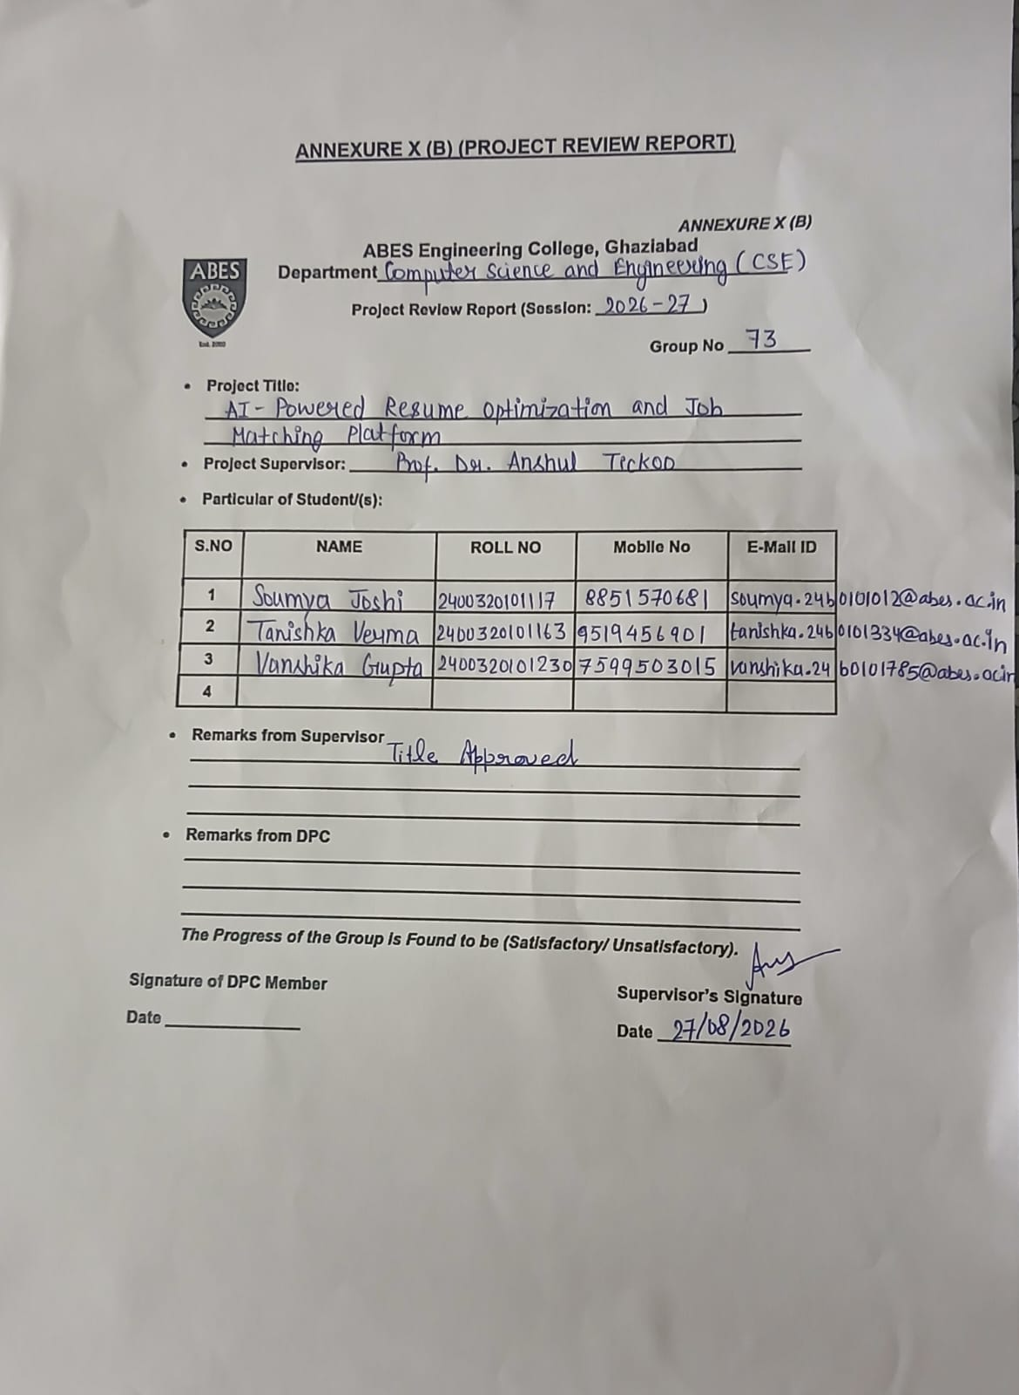
Annexure 10 B (Screenshot :Duly Signed by Supervisor)

Slide 11
References
A Machine Learning Approach for Automation of Resume Recommendation System — Pradeep Kumar Roy, Sarabjeet Singh Chowdhary, Rocky Bhatia, 2020
https://www.sciencedirect.com/science/article/pii/S187705092030750X
Resumegan: An Optimized Deep Representation Learning Framework for Talent-Job Fit via Adversarial Learning — Yong Luo et al., 2019
- https://dl.acm.org/doi/10.1145/3357384.3357899?
Salience and Market-aware Skill Extraction for Job Targeting — Baoxu Shi et al., 2020
- https://dl.acm.org/doi/10.1145/3394486.3403338?
Spring Boot AI Resume Analyzer — d-Subrahmanya
- https://github.com/d-subrahmanyam/spring-boot-ai-resume-analyzer?
Resume-Analyser- Mohamed-Imran-12
- https://github.com/Mohamed-Imran-12/Resume-Analyser

