Slide 1
Prediction of Yelp Review Star Rating Using User Based Collaborative Filtering
Presented by
Soumya Medapati
Under guidance of
Dr. Deepak Venugopal

Slide 2
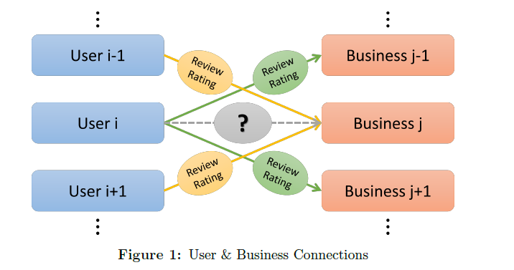
Problem
Given the database of review ratings from other users, predict
how likely a given user would be interested in particular business

Slide 3
Motivation
Online reviews and their rating play a very important role in
information dissemination
Currently they are the most influencing factor in user decisions
in today’s competitive market
Analyzing reviews can help in understanding the customer needs
and demands

Slide 4
Background
The GroupLens is one of the earliest implementation of collaborative filtering recommendation of netnews
Its rating servers predict scores based on the heuristic that people who agreed in the past will probably agree again
News reader clients display predicted scores and make it easy for users to rate articles after they read them
It helped people find articles they will like in the huge stream of available articles

Slide 5
Implementation
Dataset : Yelp dataset challenge (Round 8)
Algorithm : User based collaborative filtering Algorithm
Programming Language : Python 3.5
Editor/Distribution : Anaconda

Slide 6
Dataset Description
Yelp released data (2.5 GB) about reviews, users and businesses from 4 US cities
4.1M reviews and 947K tips by 1M users for 144K businesses
1.1M business attributes, e.g., hours, parking availability, ambience
Aggregated check-ins over time for each of the 125K businesses
200,000 pictures from the included businesses
Each file in the dataset composed of a single object type, one json-object per-line

Slide 7
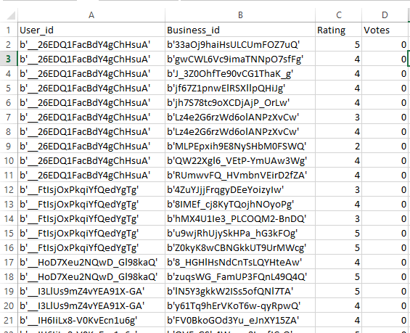
Dataset Preprocessing
Converted the json file to CSV file
Removed all data which is irrelevant for predictions leaving only
the review data to keep the size of dataset manageable

Slide 8
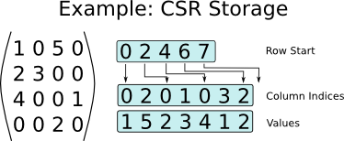
Dataset Preprocessing
To handle sparsity of data, stored the data in Compressed Sparse Row matrix (CSR)
Mapped the ASCII user_id and business_id to integer indices in CSR matrix
Scaled the original votes column which ranged from 0 to 75000 to a new range (0,1)

Slide 9
User based Collaborative Filtering
From Wikipedia (Author of gif Moshanin)

Slide 10

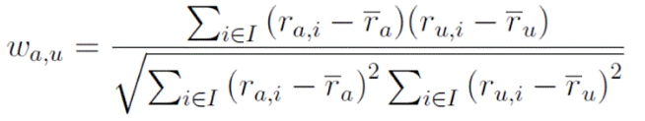
User based Collaborative Filtering
Compute mean vote of user
2. Compute Similarity between active user and other users
In order to determine the usefulness of review, average vote of both users is multiplied to the similarity value
W(a,u) = w(a,u) + average [ vote(a), vote(u) ]

Slide 11
User based Collaborative Filtering
3. Predict the rating for a given user, business pair
Where,
ru is the average rating for user u
wau is similarity weight between active user ‘a’ and u
K is the set of nearest neighbors for ‘a’ based on wau

Slide 12
Results
Folds | RMSE (with votes) | RMSE
0 | 1.169 | 1.193
1 | 1.168 | 1.195
2 | 1.168 | 1.209
3 | 1.168 | 1.163
4 | 1.156 | 1.161
5 | 1.150 | 1.153
6 | 1.171 | 1.173
7 | 1.160 | 1.165
8 | 1.165 | 1.168
9 | 1.175 | 1.200
Predictions get better with each fold

Slide 13
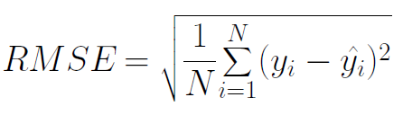
Evaluation Metrics
Accuracy : (No of times predicted value is equal to actual value)/ N * 100
Root mean square error (RMSE) : Measures the deviation of predicted value from actual rating value
where yi = predicted value of rating
yi(bar) = actual value of rating in data
N= total no of ratings in test set

Slide 14
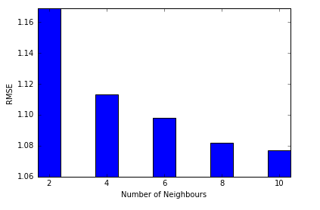
Analysis
RMSE decreases with increase in number of neighbors (K)
Number of neighbors vs rmse

Slide 15
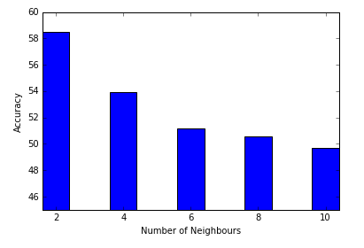
Analysis
Maximum K value does not guarantee maximum Accuracy
Considering neighbors that are irrelevant to active users will deteriorate prediction values
Number of neighbors vs accuracy

Slide 16
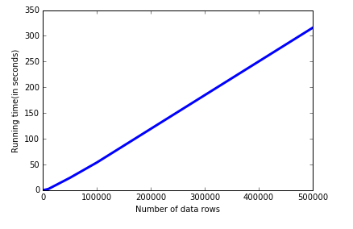
Analysis
500 to 100000 data rows: 50 sec
Entire dataset (500000 rows) : 315 secs
Running time increases linearly with number of data rows
Number of data rows vs running time

Slide 17
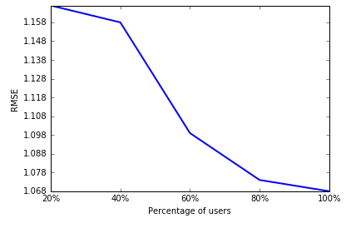
Analysis
Higher the percentage of users considered, lesser is the rmse value
For entire dataset (100% users) rmse is 1.068
Percentage of users vs rmse

Slide 18
Conclusion
This tool can predict the review ratings with 60% accuracy
We observed that for each dataset there is an optimal value of ‘k’
(number of neighbors) for which maximum accuracy can be achieved
Collaborative filtering applied to yelp dataset gives maximum
accuracy when K is 2
Running time will increase linearly with the size of the dataset

Slide 19
Questions
&
Thank you

