Slide 1
SMARTDEL By Soumya Medapati

Slide 2
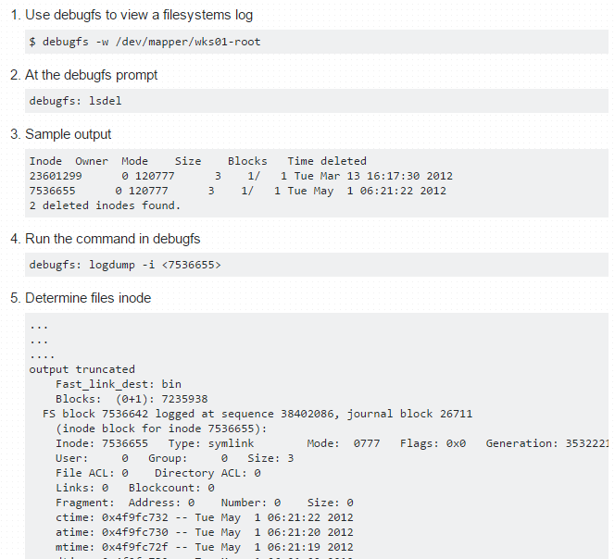
GOAL
Provide an easy to use command to restore files

Slide 3
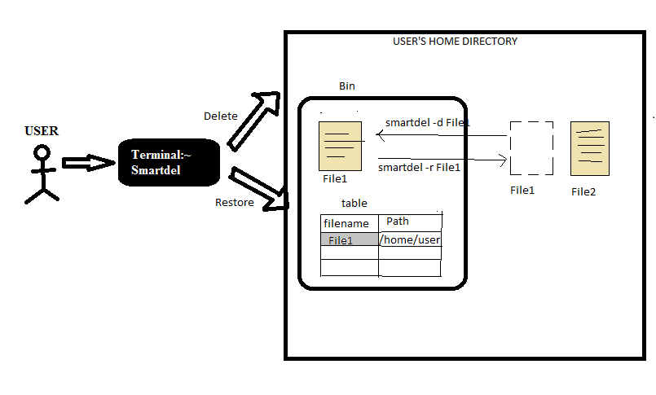
BASIC MODEL OF SMARTDEL
Smartdel_recycle

Slide 4
SMARTDEL DESCRIPTION
Creates a recycle bin in current working directory to store all the deleted files.
Create a table inside the smartdel recyclebin which can store a 2-tuple (filename,filepath)
Delete operation takes 2 arguments namely the option name and filename
1. Extract the filename and path to store it in the table. 2. Move the file from the current working directory to the smartdel recyclebin
Restore operation 1. Search for the specified file in the table 2. Extract 2-tuple if it exists and get its path 3. Move the file from the smartdel_recycle bin to the current working directory or the path specified by the 2-tuple depending on what is needed by the user 4. Delete the record for that file from the table

Slide 5
HOW TO EXECUTE?
Smartdel script file should be placed in the bin directory
Execute permissions must be granted using chmod command
Smartdel can be executed with the following options :
Command syntax | Purpose
smartdel –d filename /filepath | Deletes specified file from current working directory or filepath
smartdel –r filename | Restores specified file to current working directory
smartdel –o filename | Restores specified file to its original location
smartdel -c | Removes all files from smartdel recycle bin
smartdel –d filename* /filename? | Deletes all files matched by the wildcard character
smartdel -s filename* /filename? | Restores all files matched by the wildcard character
smartdel filename | Default option for deleting file from current working directory

Slide 6
DEMO

