Slide 1

CONVERSQL WEEK 5 UPDATES
Soumya Ranjan Mishra PES2UG22CS571
Sanket Bhandarkar PES2UG22CS506
Mentor: Dr Richa Sharma
Domain Expert: Dr Suja CM

Slide 2

Input from last presentation
Mistral-7B – High-quality output with strong reasoning, slower on lower GPUs.
TinyLlama (1.1B) – Extremely fast but weak in reasoning and factual accuracy.
Phi-3 Mini (3.8B) – Strong reasoning and quality responses while staying efficient.
Gemma-2B – Lightweight Google model with decent performance for general tasks.
Local LLM usage :
We experimented usage of below models for various use cases ->

Slide 3
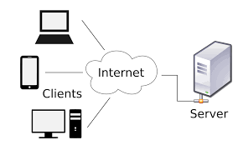
Implementation progress
We converted our standalone local application into a client-server architecture by separating the user interface (client) from the backend logic and data processing (server). This transformation enabled network-based communication between components, improved scalability, and allowed multiple clients to interact with the application remotely and also increased execution speed by 2-3 times faster .

Slide 4
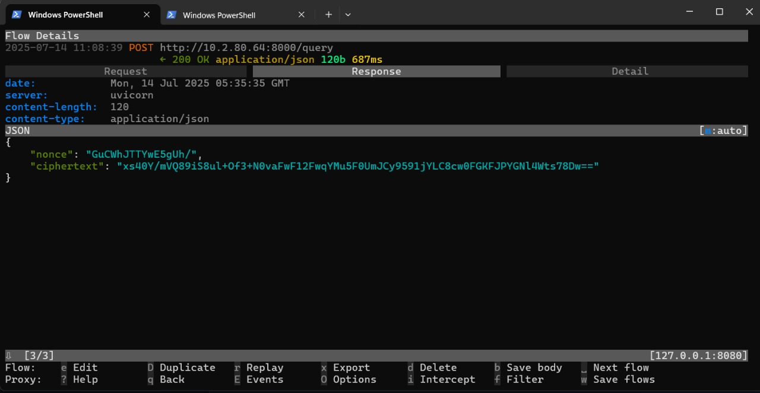
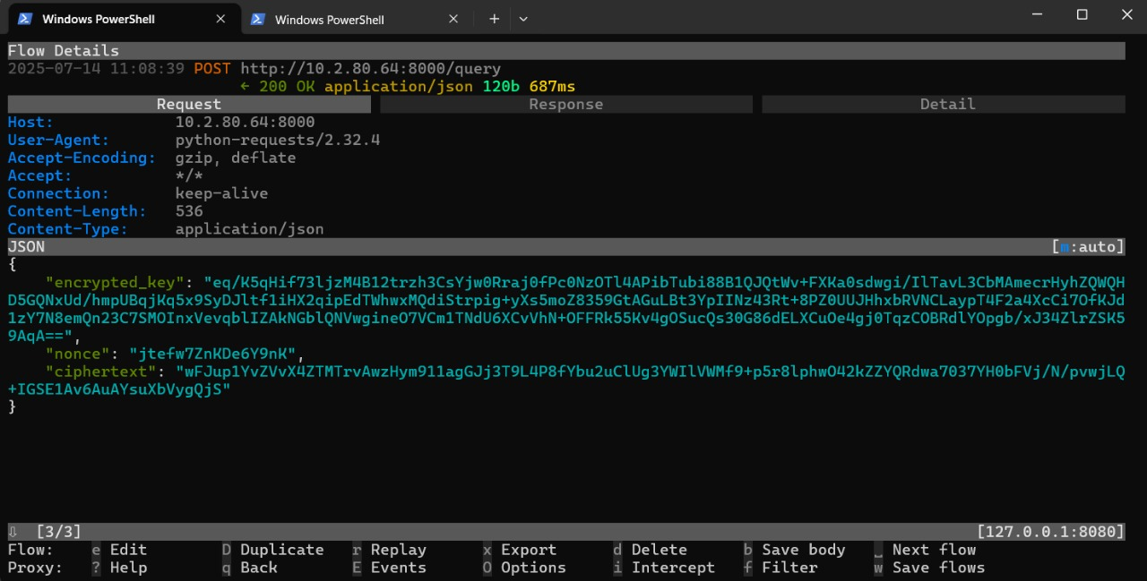
Implementation progress
We worked on end-to-end encryption for data transfer between client and server encrypting the username , password payloads and the query payloads .
Additionally, we also verified encryption and tested MITM attacks on it to ensure the encryption is working .

Slide 5
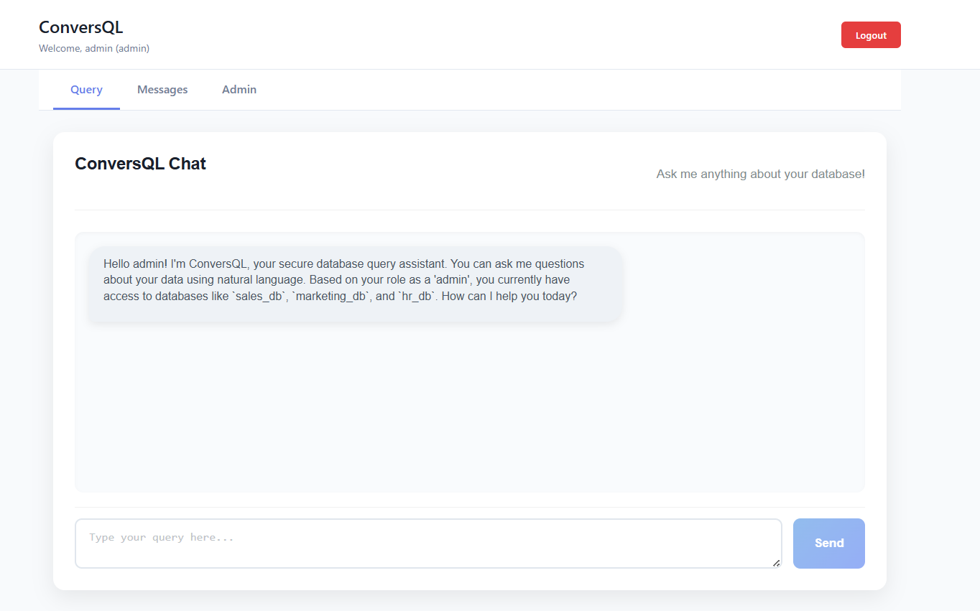
Implementation progress
Developed a basic professional looking fully functional frontend with additional features like sending admin to user messages and user to admin messages , creating new users .
Integrated a model for communication between user and system which leverages our existing pipeline for communicating with the user and displaying results .

Slide 6
Final deliverables
We have finished the base frontend with a fully functional backend but we still have following deliverables left ->
Support for DDL , DCL and TCL commands .
Support for variety of joins ,
Hosting server on a cloud platform with Kubernetes .
Looking into more secure practices and finalization of frontend .
Fine tuning of model for better results .

