Slide 1
USING STATISTICAL ANALYSIS TO SOLVE THE PRESSING ISSUE OF SORTING BIG DATA
Soumya Mishra
10/23/2018

Slide 2
What is sorting?
25% - 50% of what computers do require sorting algorithms
Efficiency, speed, processing data
Search Engines (sort through websites to find relevant one)
Graphical processes (layering is necessary)
Government organizations, financial institutions, commercial enterprises (transactions, accounts)

Slide 3
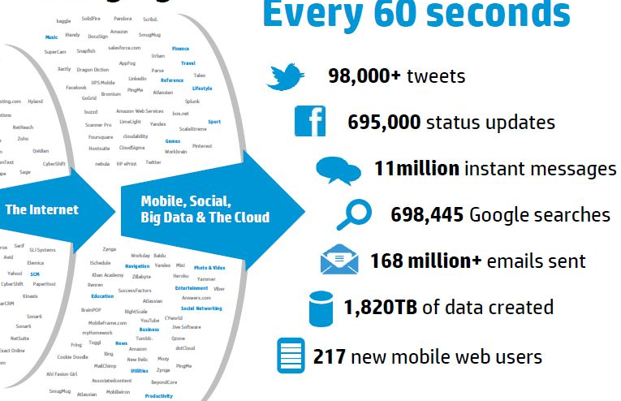
What is big data?
Volume, veracity, variety, and velocity
Data sets are so large and complex
IT systems have trouble processing data
https://onlinembapage.com/data-analytics-mba/

Slide 4
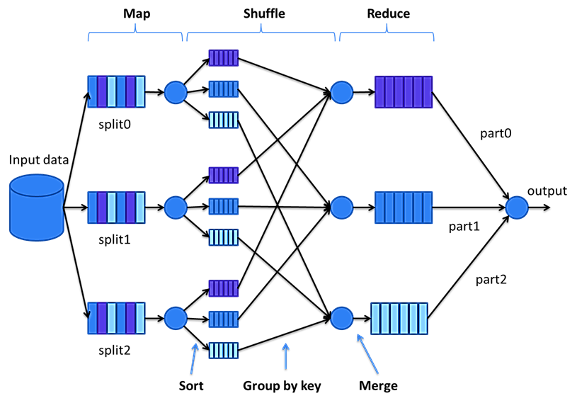
Hadoop MapReduce/Apache Spark
http://sci2s.ugr.es/BigData

Slide 5
Current sorting algorithms
 | Merge Sort | Quick Sort | Bucket Sort
Date: | 1945 – John Von Neumann | 1960 – Sir Charles Antony Richard Hoare | 1950s – Harold H. Seward
Method: | Divide and conquer | Recursive partitioning | Distribution
Time complexity (worst): | O(n log n) | O(n^2) | O(n^2)
Space complexity: | O(n) | O(log n) | O(n*k)

Slide 6
Current sorting algorithms
 |  | Cases
Sorting Algorithm | Method | Best | Worst | Average
Stat | Distribution | n | n | n
Merge | Divide and Conquer | n log (n) | n log (n) | n log (n)
Bucket | Distribution | n+k | n^2 + k | n^2
Radix | Non-comparison | N/A | n * (k/d) | n * (k/d)
Heap | Selection | n or n log(n) | n log (n) | n log (n)
Insertion | Insertion | n | n^2 | n^2
Bubble | Exchanging | n | n^2 | n^2
Pancake | Comparison | N/A | n | n
Quick | Partitioning | n log(n) - variation of n | n log (n) | n^2
Bead | Non-comparison | n | S | S

Slide 7
Current sorting algorithms
 |  | Cases
Sorting Algorithm | Method | Best | Worst | Average
Stat | Distribution | n | n | n
Merge | Divide and Conquer | n log (n) | n log (n) | n log (n)
Bucket | Distribution | n+k | n^2 + k | n^2
Radix | Non-comparison | N/A | n * (k/d) | n * (k/d)
Heap | Selection | n or n log(n) | n log (n) | n log (n)
Insertion | Insertion | n | n^2 | n^2
Bubble | Exchanging | n | n^2 | n^2
Pancake | Comparison | N/A | n | n
Quick | Partitioning | n log(n) - variation of n | n log (n) | n^2
Bead | Non-comparison | n | S | S

Slide 8
Current sorting algorithms
 |  | Cases
Sorting Algorithm | Method | Best | Worst | Average
Stat | Distribution | n | n | n
Merge | Divide and Conquer | n log (n) | n log (n) | n log (n)
Bucket | Distribution | n+k | n^2 + k | n^2
Radix | Non-comparison | N/A | n * (k/d) | n * (k/d)
Heap | Selection | n or n log(n) | n log (n) | n log (n)
Insertion | Insertion | n | n^2 | n^2
Bubble | Exchanging | n | n^2 | n^2
Pancake | Comparison | N/A | n | n
Quick | Partitioning | n log(n) - variation of n | n log (n) | n^2
Bead | Non-comparison | n | S | S

Slide 9
Current sorting algorithms
 |  | Cases
Sorting Algorithm | Method | Best | Worst | Average
Stat | Distribution | n | n | n
Merge | Divide and Conquer | n log (n) | n log (n) | n log (n)
Bucket | Distribution | n+k | n^2 + k | n^2
Radix | Non-comparison | N/A | n * (k/d) | n * (k/d)
Heap | Selection | n or n log(n) | n log (n) | n log (n)
Insertion | Insertion | n | n^2 | n^2
Bubble | Exchanging | n | n^2 | n^2
Pancake | Comparison | N/A | n | n
Quick | Partitioning | n log(n) - variation of n | n log (n) | n^2
Bead | Non-comparison | n | S | S

Slide 10
What’s the issue?
highly iterative processes
require intense data churning
large memory requirements to execute these processes

Slide 11
StatSort
Reduce computation time and ram requirements
Statistical instances can give bucket ranges
Equal sized buckets
Sort data sets that follow any type of distribution
Theoretical worst case of O(n)
3 passes through data set, no nested loops

Slide 12
StatSort
µ = 5.5
Median = 5.5
σ = 2.88
5 9 8 1 4 6
Bucket 1
Bucket 2
Bucket 3
-2 σ to –.5 σ
-.18 σ to 0 σ
0.1 σ to 1 σ
1 4 5 6 8 9
1 4
5 6
9 8

Slide 13
Data
 | Stat | Merge | Bucket | Radix | Heap | Insertion | Bubble | Pancake | Quick | Bead
1,000 | 0.023 | 0.032 | 0.026 | 0.032 | 0.050 | 0.038 | 0.032 | 0.031 | 0.024 | 0.052
10,000 | 0.031 | 0.037 | 0.026 | 0.050 | 0.050 | 0.048 | 0.243 | 0.116 | 0.096 | 0.025
100,000 | 0.054 | 0.057 | 0.049 | 0.161 | 0.213 | 1.331 | 7.352 | 5.234 | 0.914 | 0.049
1,000,000 | 0.192 | 0.293 | 0.146 | 1.356 | 0.453 | 8.652 | 60.230 | 22.802 | 10.399 | 0.277
10,000,000 | 0.496 | 1.765 | 1.765 | 6.876 | 20.789 | 23.232 | 422.420 | 51.490 | 792.438 | 1.810
100,000,000 | 4.053 | 17.974 | 39.405 | 41.256 | 90.259 | ---- | ---- | 140.234 | ---- | ----

Slide 14
Data
 | Stat | Merge | Bucket | Radix | Heap | Insertion | Bubble | Pancake | Quick | Bead
1,000 | 0.023 | 0.032 | 0.026 | 0.032 | 0.050 | 0.038 | 0.032 | 0.031 | 0.024 | 0.052
10,000 | 0.031 | 0.037 | 0.026 | 0.050 | 0.050 | 0.048 | 0.243 | 0.116 | 0.096 | 0.025
100,000 | 0.054 | 0.057 | 0.049 | 0.161 | 0.213 | 1.331 | 7.352 | 5.234 | 0.914 | 0.049
1,000,000 | 0.192 | 0.293 | 0.146 | 1.356 | 0.453 | 8.652 | 60.230 | 22.802 | 10.399 | 0.277
10,000,000 | 0.496 | 1.765 | 1.765 | 6.876 | 20.789 | 23.232 | 422.420 | 51.490 | 792.438 | 1.810
100,000,000 | 4.053 | 17.974 | 39.405 | 41.256 | 90.259 | ---- | ---- | 140.234 | ---- | ----

Slide 15
Time Complexity

Slide 16
Time Complexity
Chi-square statistic: 18340.7
P-value > 0.05
Experimental ≈ theoretical

Slide 17
 |  | Cases
Sorting Algorithm | Method | Best | Worst | Average | Chi-squared Statistic
Stat | Distribution | n | n | n | 18340.7
Merge | Divide and Conquer | n log (n) | n log (n) | n log (n) | 4335.53
Bucket | Distribution | n+k | n^2 + k | n^2 | 9665.3
Radix | Non-comparison | N/A | n * (k/d) | n * (k/d) | 5235.23
Heap | Selection | n or n log(n) | n log (n) | n log (n) | 9723.332
Insertion | Insertion | n | n^2 | n^2 | 1342.234
Bubble | Exchanging | n | n^2 | n^2 | 199.323
Pancake | Comparison | N/A | n | n | 904.42
Quick | Partitioning | n log(n) - variation of n | n log (n) | n^2 | 101.14
Bead | Non-comparison | n | S | S | 200.42

Slide 18
Applications
http://sci2s.ugr.es/BigData

Slide 19
Applications
StatSort implementation
http://sci2s.ugr.es/BigData

Slide 20
Applications

Slide 21
In short…
StatSort – worst case linear time complexity
Fastest method of sorting is distribution
Possible implementation of this method in big data cluster-computing frameworks
No more external sorting
Less space requirement
Possible faster time
Easier analysis

Slide 22
References
Wang, L., et al. (2012). G-Hadoop: MapReduce across distributed data centers for data-intensive computing. Future Generation Computer Systems. doi:10/1016/j.future.2012.09.00
Monaknov, A. (2016). Composable multi-threading for python libraries.
Goel, N., Laxmi, V., Saxena, A. (2015). Handling multithreading approach using java. International Journal of Computer Science Trends and Technology.3.2.
Hai, H., Guang-hui, J., & Xiao-tian, Z. (2013). A fast numerical approach for Whipple shield ballistic limit analysis. Acta Astronautica. 93. 112-120. Retrieved from http://dx.doi.org/10.1016/j.actaastro.2013.06.014
Dehne, F., & Zaboli, H. (2016). Parallel sorting for GPUs. Emergent Computation. 293 – 302. doi:10.1007/978-3-319-46376-6_12

Slide 23
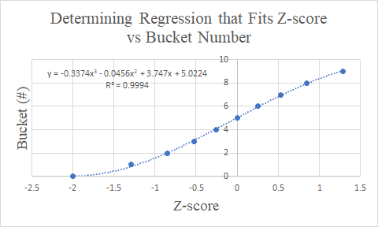
Z-score Lower Limit | Bucket Number
-2 | 0
-1.2865 | 1
-0.8445 | 2
-0.5265 | 3
-0.255 | 4
0 | 5
0.255 | 6
0.5265 | 7
0.8445 | 8
1.2865 | 9

Slide 24
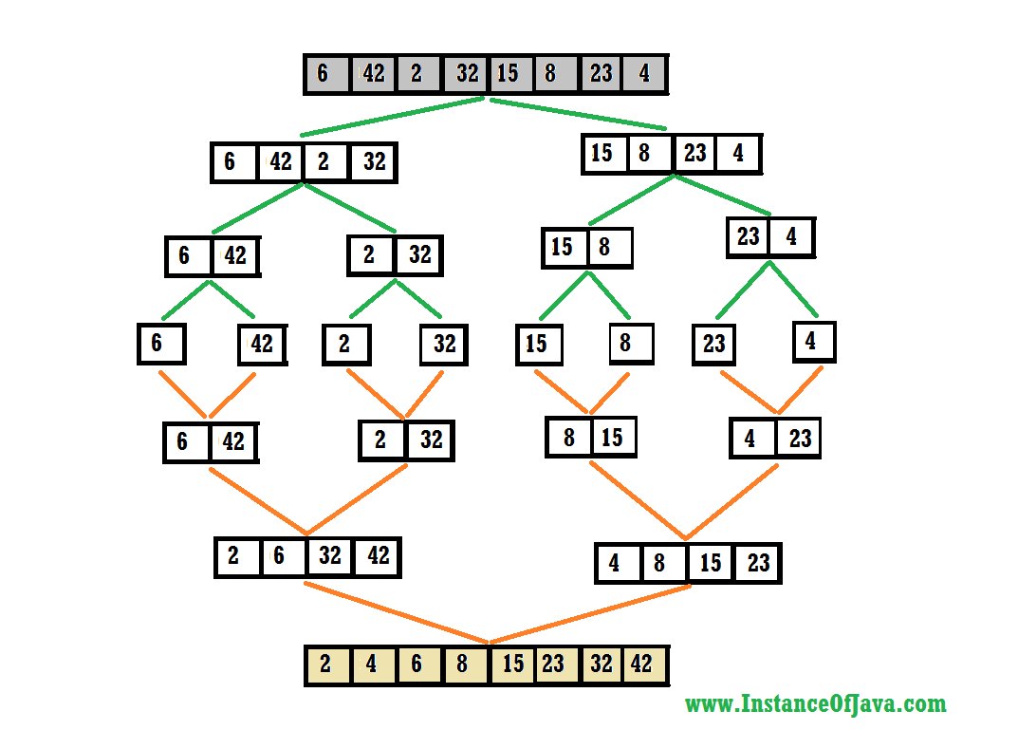
Merge sort

Slide 25
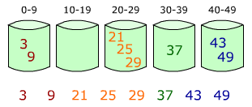
Bucket Sort

Slide 26
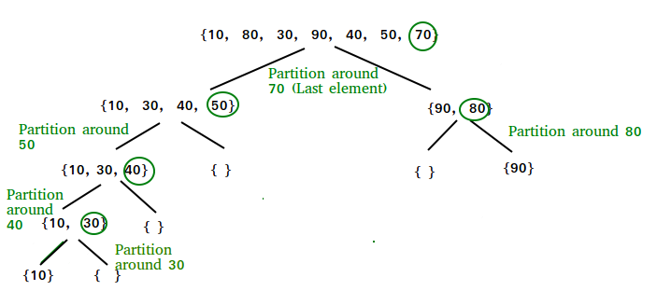
Quick Sort

Slide 27
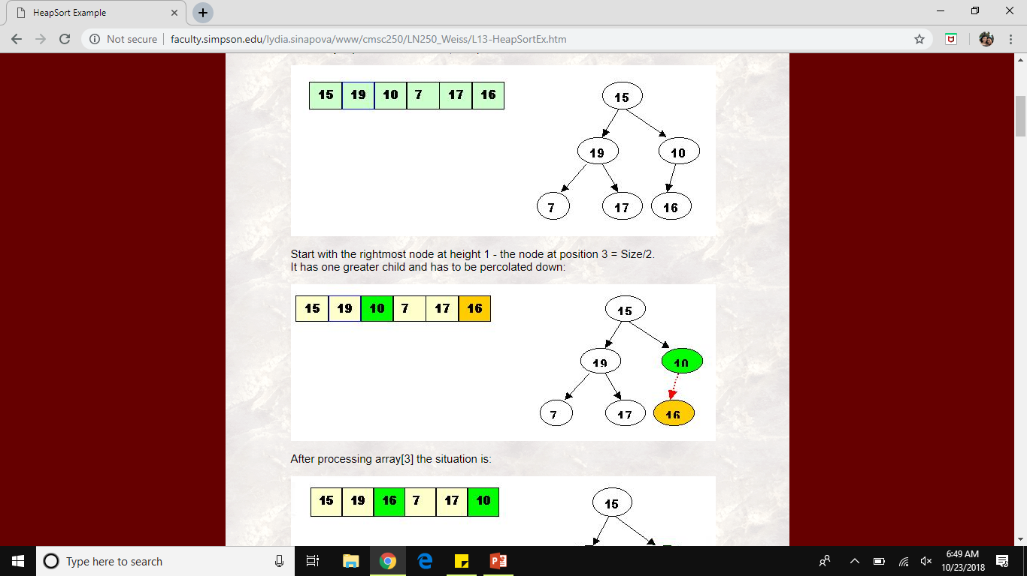
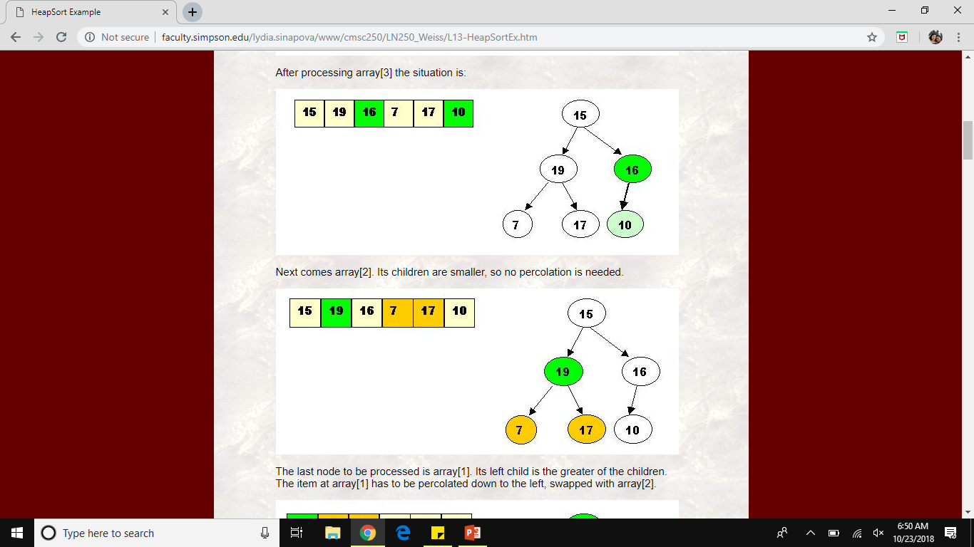
Heap Sort

Slide 28
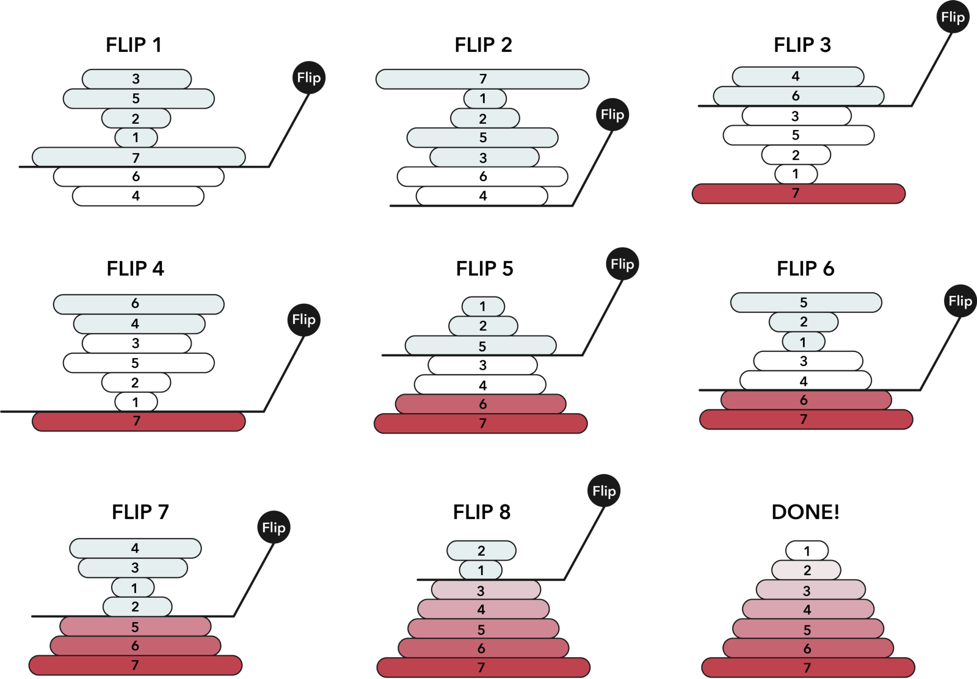
Pancake Sort

Slide 29
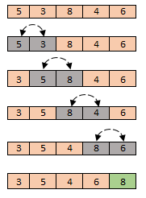
Bubble Sort

Slide 30
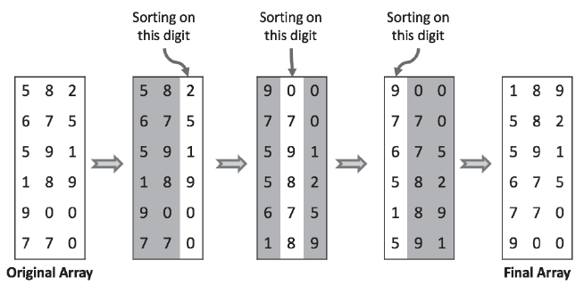
Radix Sort

Slide 31
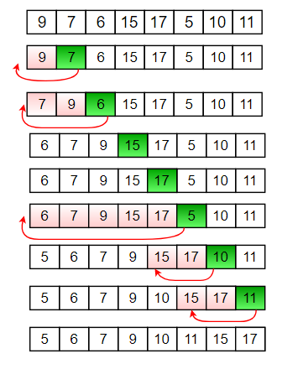
Insertion Sort

Slide 32
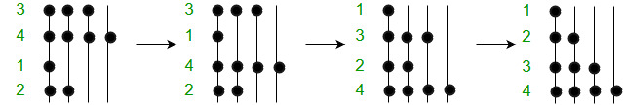
Bead Sort

