Slide 1
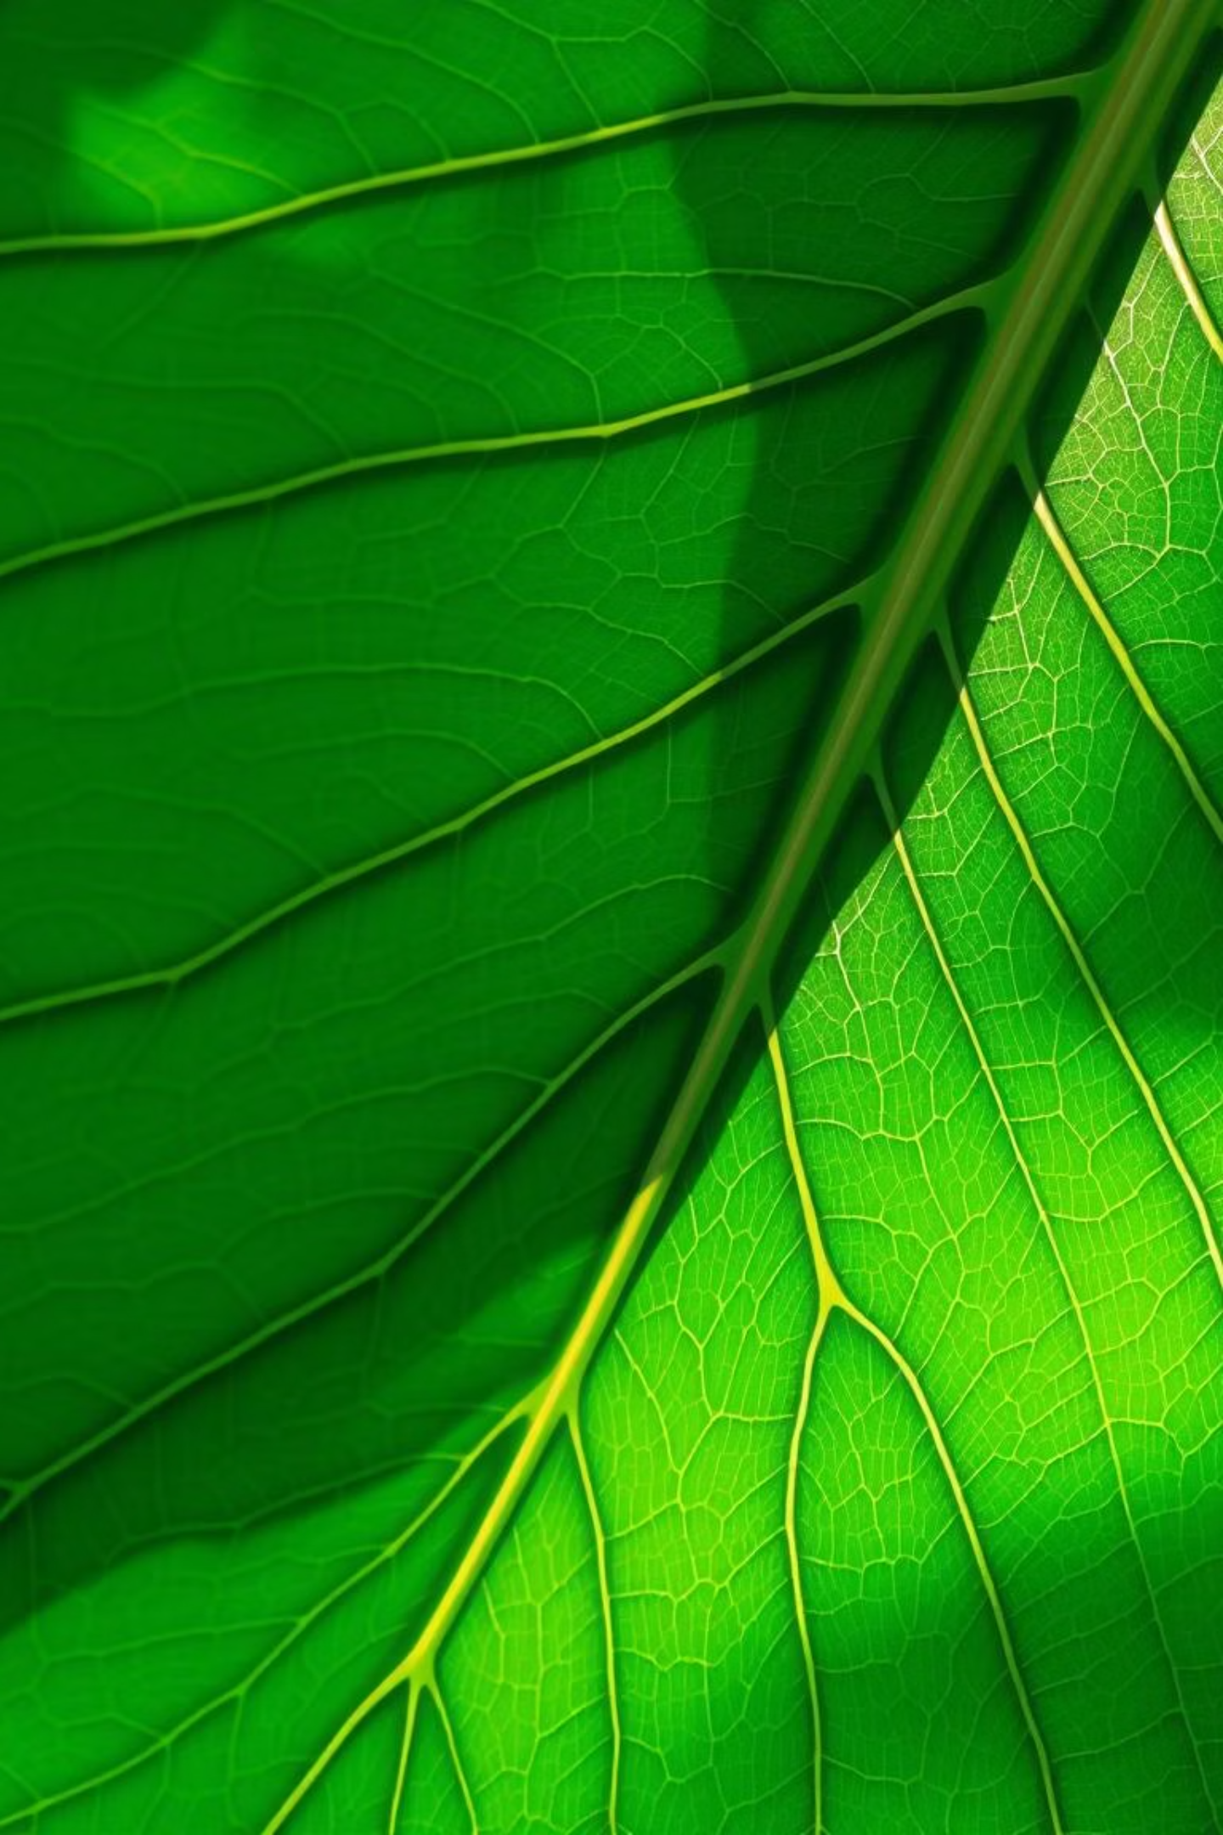
Edge-Aided Plant Species Identification Using Leaf Image Analysis and Hybrid Classification Techniques
Group Members
Supervisor
Abinash Jyoti Ratha Bharat
(22CSE080, 22UG010167)
Mr. Sitanshu Kar
Rajat Kumar Dash
(22CSE139, 22UG010272)
Soumya Ranjan Mohapatra
(22CSE215, 22UG010348)
Domain/Area:
Image Processing, Machine Learning, Computer Vision, Agriculture Informatics

Slide 2
Problem Statement & Objectives
The Challenge:
Project Objectives:
Accurate and rapid plant species identification is crucial for ecological monitoring, agriculture, and biodiversity conservation. Traditional methods are often time-consuming, resource-intensive, and require expert knowledge, leading to delays and inefficiencies. This project addresses the need for a more accessible and efficient identification system, especially in remote or resource-constrained environments.
1
Develop an edge-aided hybrid algorithm for
accurate plant leaf classification.
2
Incorporate vein pattern analysis and
morphological features
3
Train and evaluate hybrid ML/DL models for
species recognition.
4
Build a scalable pipeline for dataset preprocessing,
feature extraction, and classification

Slide 3
Literature Survey: Key Insights & Gaps
Our comprehensive review of over 10 research papers highlights significant advancements and identifies critical areas for further exploration.
Deep Learning Dominance
Feature Engineering
Convolutional Neural Networks (CNNs) are highly effective in feature extraction from leaf images, often outperforming traditional methods in accuracy. Models like VGG, ResNet, and InceptionNet show promising results in various plant classification tasks.
Traditional image processing techniques, such as texture analysis (GLCM, LBP) and shape descriptors (Fourier descriptors, aspect ratio), provide valuable complementary features, especially when integrated with deep learning outputs.
Edge Computing Emergence
Identified Gap: Hybrid Edge Optimization
The shift towards edge deployment for real-time applications is gaining traction. Papers explore model compression, quantization, and specialized hardware to run inference on resource-constrained devices.
While individual aspects are well-studied, there's a notable gap in optimizing hybrid classification techniques for efficient and high-accuracy deployment specifically on edge devices, particularly concerning the fusion of deep learning and traditional features in a resource-conscious manner.

Slide 4
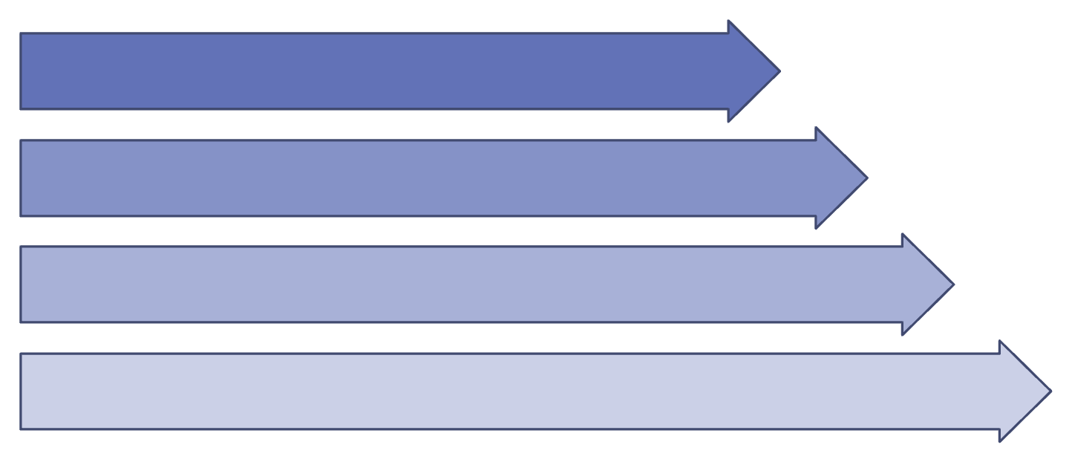
Preliminary Design / Algorithms
Overall Architecture Diagram:
Algorithmic Flow:
Preprocessing: Image segmentation (Otsu's method/watershed), resizing (224x224), normalization.
Leaf Image Input
Deep Feature Extraction: Transfer learning using pre-trained MobileNetV2. Last classification layers removed, output from global average pooling layer used as features.
Feature Extraction
Handcrafted Feature Extraction: OpenCV used to compute shape features from contours, GLCM for texture, and color histograms for color representation.
Preprocessing Module
Feature Fusion: Concatenation of deep features (1280 dimensions) and handcrafted features (approx. 50-100 dimensions).
Hybrid Classifier
Hybrid Classification: Initial tests with SVM and Random Forest on fused features show promising results. Exploring a small, custom-built dense neural network for final classification on edge.

Slide 5
Workflow Highlights
Step 1: Input Image
1
User provides a plant image.
2
Step 2: Leaf Detection (New Algorithm)
Checks if the input is a leaf; rejects if not.
Step 3: Preprocessing
3
Background removal, resizing, noise reduction, edge & vein feature extraction.
4
Step 4: Feature Extraction
Collect shape, texture, edge, and vein features.
Step 5: Classification (Hybrid Model)
5
If leaf detected, classify into plant species using CNN + SVM/Random Forest hybrid model.
6
Step 6: Output
Show "Not a Leaf" if rejected, else display predicted plant species name.

Slide 6
Dataset & Requirement Analysis
Dataset Source & Description:
Key Features & Parameters:
We are primarily utilizing the “Plant Village Dataset”, which is publicly available and contains high-resolution images of leaves from various tree species. It includes:
Morphological Features: Area, perimeter, aspect ratio, eccentricity, solidity, convex hull area.
Texture Features: Haralick features (contrast, correlation, energy, homogeneity) derived from GLCM, Local Binary Patterns (LBP).
Over 10 tree species
Approximately 10,000 images
Color Features: Color histograms (RGB, HSV), color moments.
Images captured in diverse conditions, including laboratory and field settings, which helps in generalizing the model.
Deep Learning Features: Embeddings extracted from intermediate layers of pre-trained CNNs.
Additionally, we plan to explore the Plant Village Dataset for further validation due to its controlled environment images.
Preprocessing Status:
Initial image preprocessing (resizing, normalization, basic noise reduction) has been completed on a subset of the Leafsnap dataset to establish a baseline. Further augmentation and advanced segmentation techniques are in planning.

Slide 7
Progress Till Date
40%
100%
25%
Literature Review
Dataset Acquisition & Preprocessing
Traditional Feature Extraction Module
Comprehensive analysis of relevant research papers, identifying key insights and gaps.
Leafsnap dataset acquired; initial cleaning, resizing, and normalization performed. Ongoing work on data balancing.
Development of scripts for extracting morphological, texture, and color features from leaf images.
Overall work completed: 30%, encompassing data collection, initial preprocessing, and balancing efforts within the identified modules.

Slide 8




Challenges Faced & Solutions
Dataset Imbalance
Edge Device Performance
Feature Fusion Optimization
Some species in the Leafsnap dataset have fewer samples, leading to potential model bias.
Solution: Employing data augmentation techniques (rotation, zoom, flip) and exploring synthetic data generation for minority classes.
Balancing model complexity with real-time inference on low-power devices.
Solution: Focusing on lightweight CNN architectures, post-training quantization, and model pruning. Comparative analysis across Raspberry Pi and Jetson Nano.
Determining the optimal method to combine deep and handcrafted features for maximum accuracy gain.
Solution: Experimenting with different concatenation strategies, weighted fusion, and exploring attention mechanisms if feasible within edge constraints.

Slide 9




Next Steps (Till September 15)
Complete Advanced Preprocessing
Refine Hybrid Feature Extraction
Implement robust leaf segmentation and data augmentation pipelines.
Fine-tune deep feature extractors and optimize handcrafted feature computation for efficiency.
Develop & Evaluate Hybrid Classifiers
Initial Edge Deployment & Benchmarking
Train and rigorously evaluate multiple hybrid classification models (e.g., SVM, Random Forest, compact NN) on the fused feature set.
Port the best performing hybrid model to an edge device (Raspberry Pi/Jetson Nano) and conduct preliminary performance benchmarking (inference time, accuracy).
Expected Deliverables:
Functional code for optimized leaf image preprocessing and feature extraction.
Trained hybrid classification models with performance metrics (accuracy, precision, recall).
Comparative analysis report of different hybrid model configurations.
Initial demonstration of the model running on an edge device.

Slide 10

Conclusion & Novelty
Our project is making substantial progress towards developing an efficient and accurate edge-aided plant species identification system. The combined power of deep learning and traditional feature engineering, optimized for edge devices, offers a promising solution to real-world challenges.
Project Novelty:
Current Progress Summary:
Hybrid Feature Fusion: Novel combination and optimization of deep and handcrafted features for enhanced classification on resource-constrained platforms.
We have established a strong foundation with comprehensive literature review, dataset preparation, and preliminary model development. The hybrid methodology is conceptually solid, and initial results are encouraging. We are well-positioned to achieve our objectives in the coming phases.
Edge-Centric Design: Focus on tailoring the entire pipeline, from feature extraction to classification, specifically for efficient deployment on low-power edge devices.
Practical Application: Addressing a critical need for accessible and rapid plant identification in ecological studies and agriculture.
Plagiarism Report: Current draft of the report has a plagiarism percentage of 4% . Declaration: All content not explicitly cited or attributed has been generated through original thought and research by the group members. AI tools were used for minor grammatical corrections and idea generation, with proper human oversight and review.

Slide 11

Thank You
We appreciate your time and attention to our progress.

