Slide 1
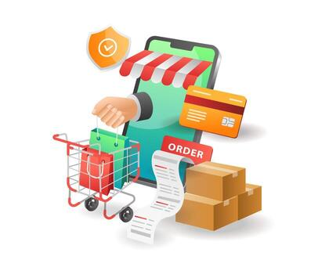
OLIST E-COMMERCE CUSTOMER INSIGHTS ANALYSIS Customer Behaviour, Payment & Delivery Analysis using MySQL|powerbi|excel and Tableau
Presented by Group 1
Date:16-03-26

Slide 2
Team Members 👥
Rushikesh Jadhav
Susmitha kandikatla
Soumya Ranjan khatoi
Srilakshmi
Pushkar Chandra
Aaman mubin inamdar

Slide 3

Agenda
1. Project Overview
2. Dataset Description
3. Key Performance Indicators (kpis)
4. Project Process
5. mySQL Analysis
6. Dashboard Visualizations (excel,powerbi &tableau)
7. Business Insights
8. Recommendations
9. Business Impacts
10.Challenges faced
11. Conclusion

Slide 4
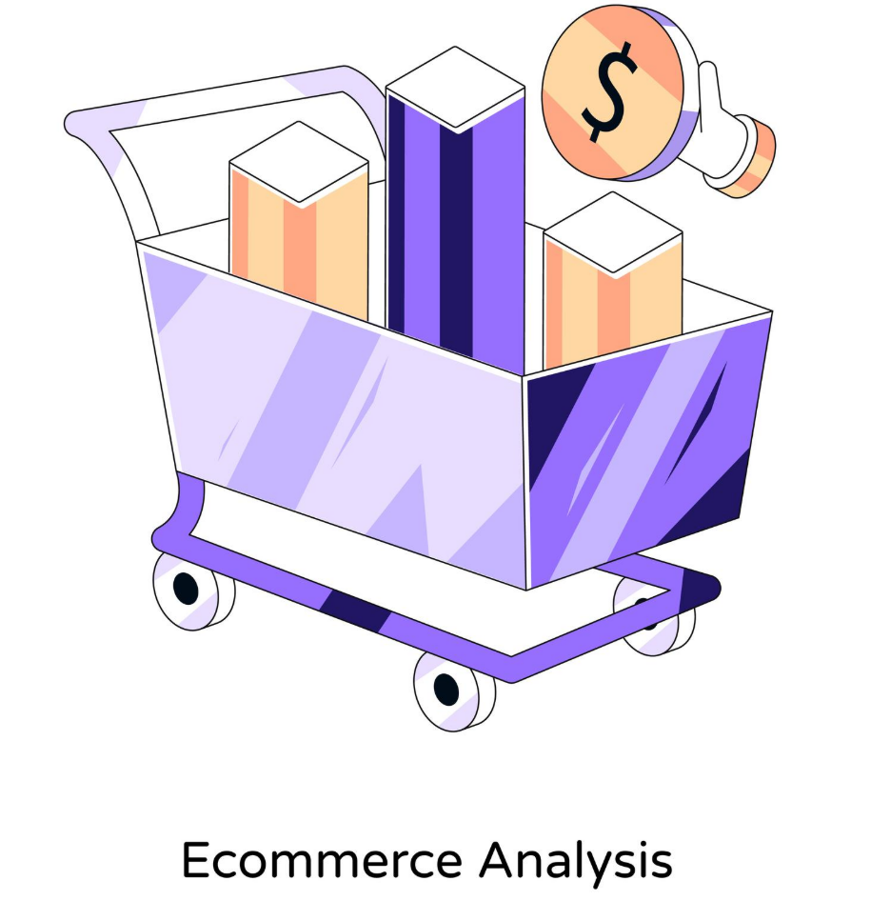
Project Overview
The Olist E-Commerce Data Analysis project analyses an online retail dataset to understand customer purchasing behavior, payment methods, delivery performance, and sales trends.
The dataset contains 9 CSV files, including customers, orders, products, sellers, payments, reviews, geolocation, and product categories.
The project is divided into four analytical modules using different tools: MySQL, Microsoft Excel, Power BI, and Tableau.
Across all modules, the same five Key Performance Indicators (KPIs) were analysed to generate business insights.
The main objective is to transform raw transactional data into meaningful insights that improve logistics efficiency, customer satisfaction, and sales strategies.

Slide 5
KEY PERFORMANCE INDICATORS KPIS
Weekday vs Weekend Payment Statistics
Number of Orders with Review Score 5 and Credit Card Payment
Average Delivery Time for Pet Shop Products
Average Price and Payment Value from São Paulo Customers
Relationship Between Shipping Days and Review Scores

Slide 6

PROJECT PROCESS
1
2
Extract Data:
Transformation:
Gather raw data from Olist's databases. Ensure comprehensive data collection covering all necessary aspects.
Clean and prepare data.
Handle missing values, remove duplicates, correct errors.
Standardize data formats.
3
4
KPI & Visualization:
Dashboard:
Identify KPIs: Total sales, number of orders, review scores, payment types.
Create charts and graphs to represent data trends.
Develop an interactive dashboard to present findings.
Design layout for clarity and impact.

Slide 7




TOOLS USED FOR ANALYSIS

Slide 8
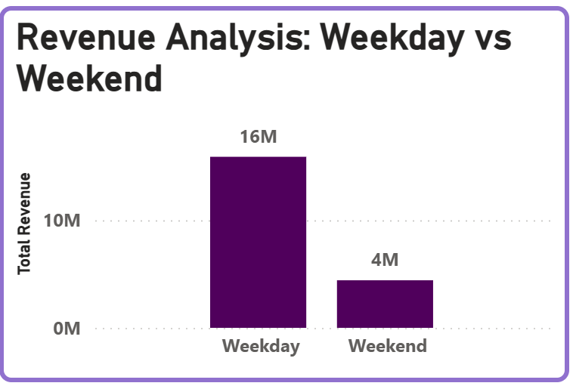
KPI-1:Weekday vs Weekend Payment Statistics
The analysis shows that 77% of total payments occur on weekdays, while 23% occur on weekends.
This indicates that weekday payments are approximately 3.4 times higher than weekend payments.
The data highlights that most customers prefer making purchases during weekdays.
Business Insight
Businesses can focus marketing strategies and promotions during high-traffic weekday periods to maximize revenue.

Slide 9
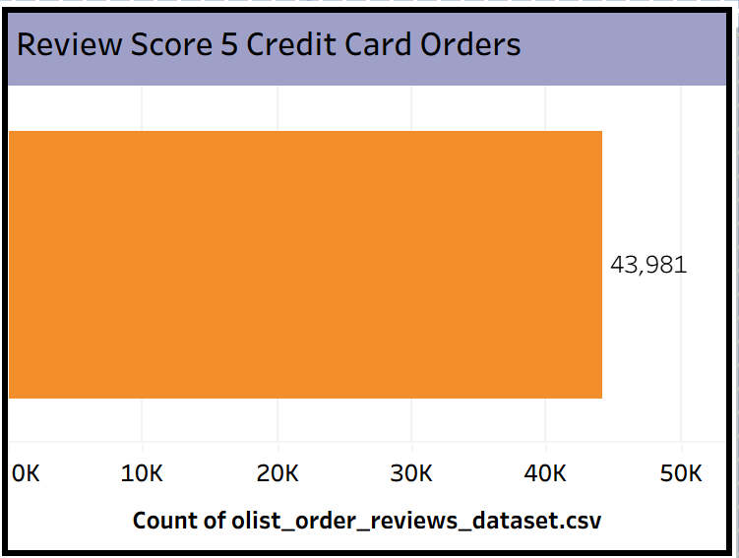
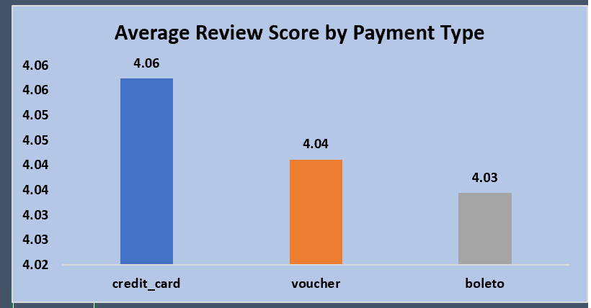
KPI-2-Number of Orders with Review Score 5 and Credit Card Payment
This KPI measures the number of orders that received a review score of 5 and were paid using credit cards.
The analysis shows that 43,981 orders received a 5-star review with credit card payment.
This indicates that credit cards are a commonly used payment method among highly satisfied customers.
The results help analyze the relationship between payment method and customer satisfaction.
Business Insight
• The high number of 5-star reviews with credit card payments suggests strong customer trust in digital payment methods, encouraging businesses to maintain secure and convenient credit card payment options.

Slide 10
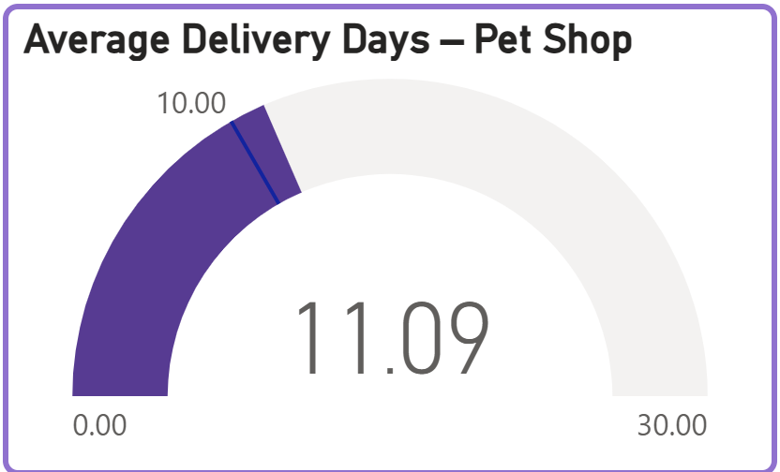
KPI-3 Average Delivery Time for Pet Shop Products
This KPI measures the average number of days taken to deliver orders for the pet_shop product category using the order_delivered_customer_date.
The analysis shows that the average delivery time for pet shop products is around 11 days.
This metric helps evaluate the efficiency of the delivery and logistics process for this category.
Monitoring delivery time helps businesses identify delays and improve operational performance.
Business Insight
Improving logistics efficiency and reducing delivery time can enhance customer satisfaction and provide a better delivery experience.

Slide 11
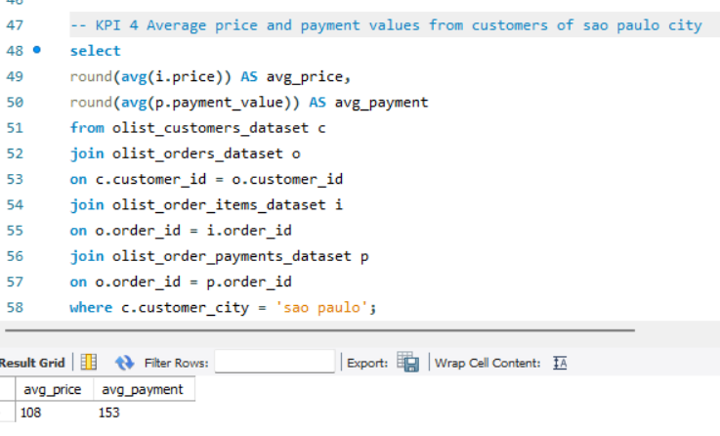
KPI-4 Average Price and Payment Value from São Paulo Customers
This KPI analyzes the average product price and payment value for customers located in São Paulo city.
The analysis shows that the average product price is around 108, while the average payment value is about 153.
This means customers pay about 41% more than the product price, which may include shipping charges or additional costs.
The KPI helps understand the spending patterns and purchasing behavior of customers in this region.
Business Insight
Higher payment values in São Paulo indicate strong purchasing power and a willingness to spend more, allowing businesses to target this region with premium products and focused marketing strategies.

Slide 12
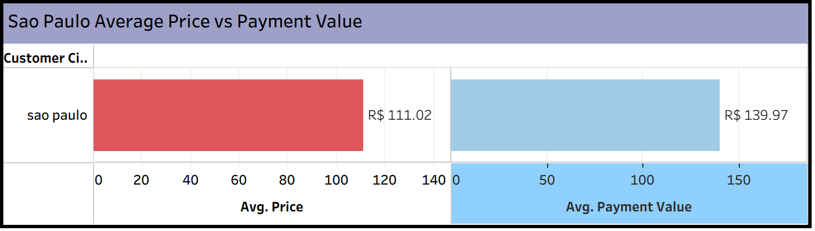
KPI-5 Relationship Between Shipping Days and Review Scores
This KPI analyzes the relationship between shipping days and customer review scores
.
The analysis shows that orders delivered in fewer days receive higher review scores, indicating better customer satisfaction.
In contrast, orders with longer shipping times tend to receive lower ratings.
This demonstrates that delivery speed plays an important role in shaping the customer experience and satisfaction levels.
Business Insight
Faster deliveries lead to higher customer satisfaction and better review scores, so improving logistics efficiency can help businesses increase positive reviews and strengthen customer loyalty.

Slide 13
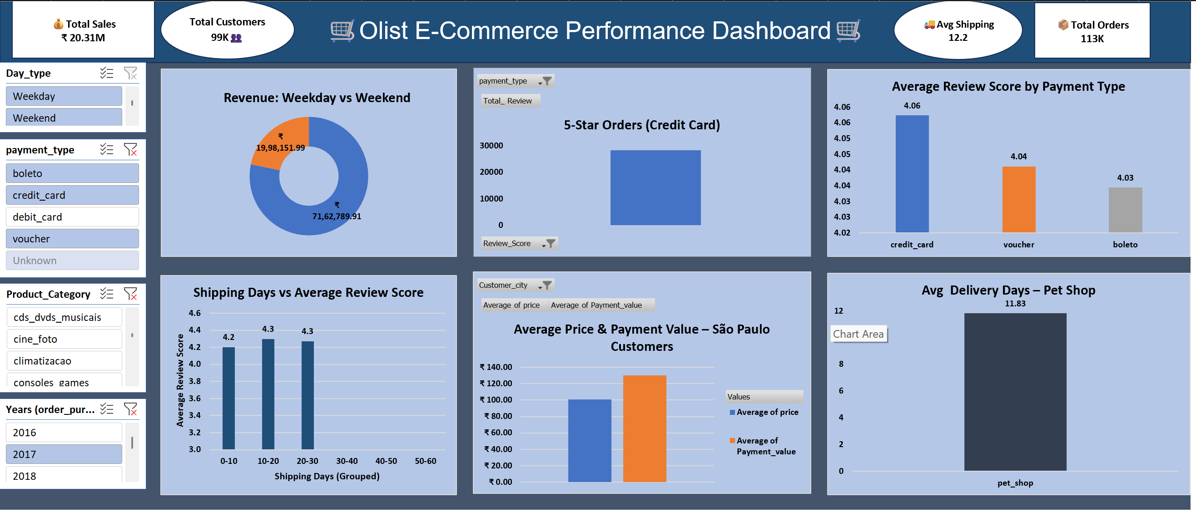
Excel Dashboard

Slide 14
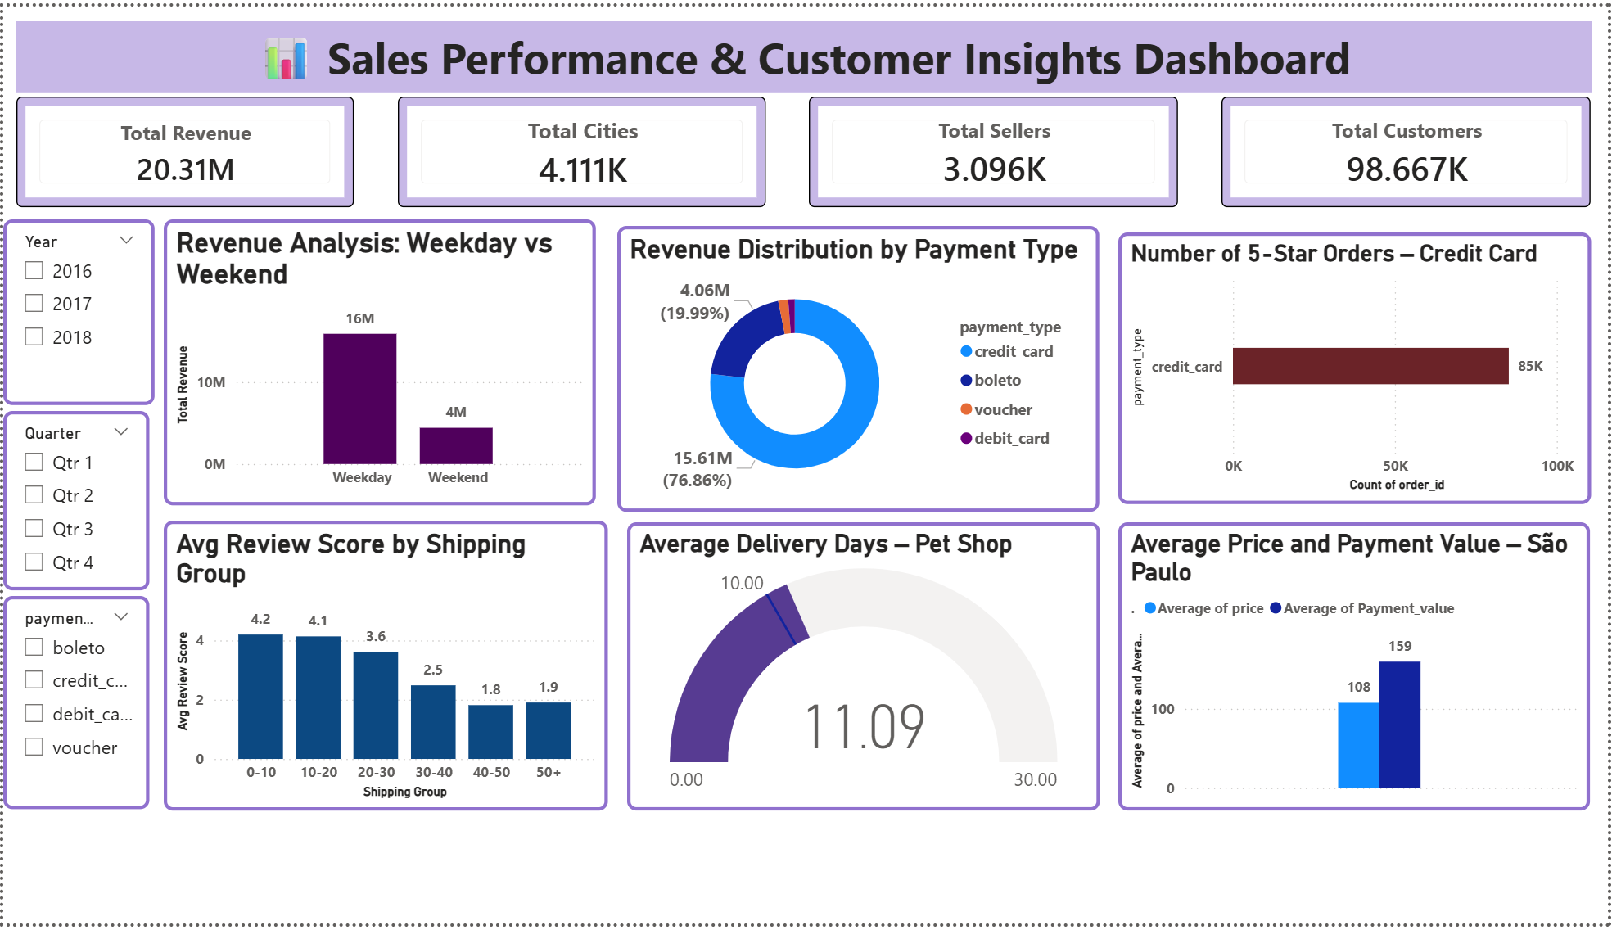
Power BI Dashboard

Slide 15
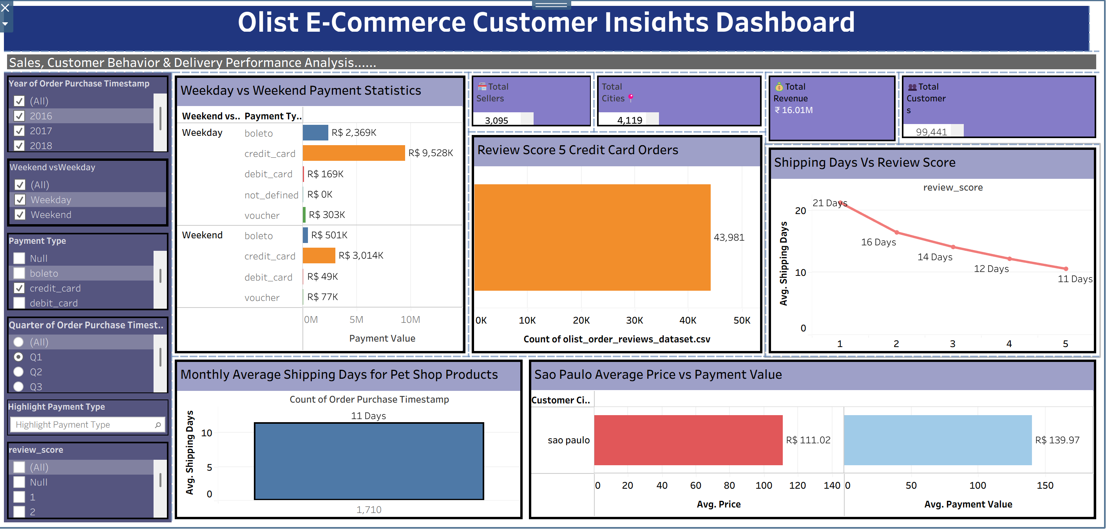
Tableau Dashboard

Slide 16
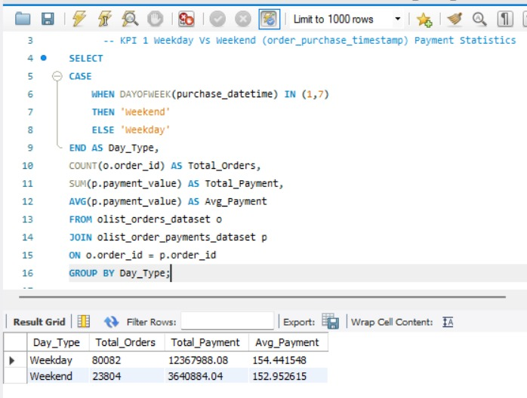
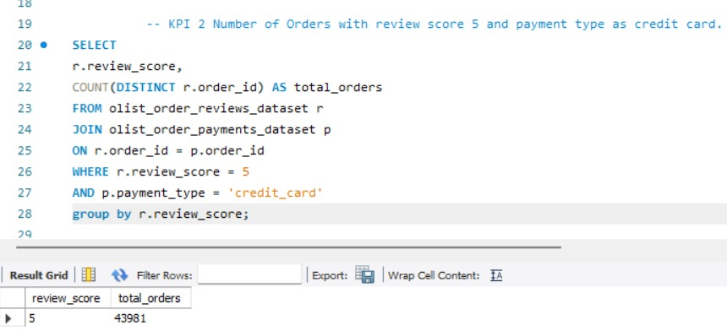
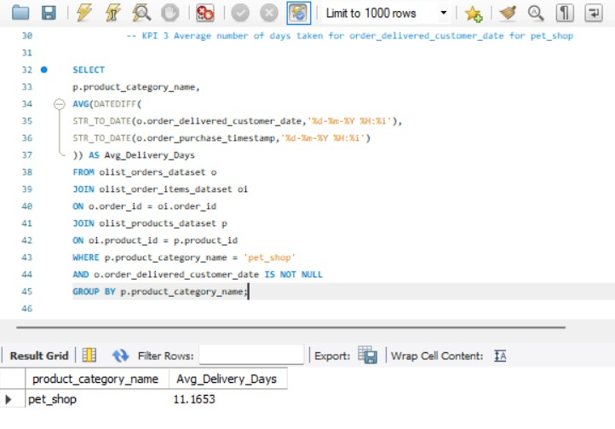
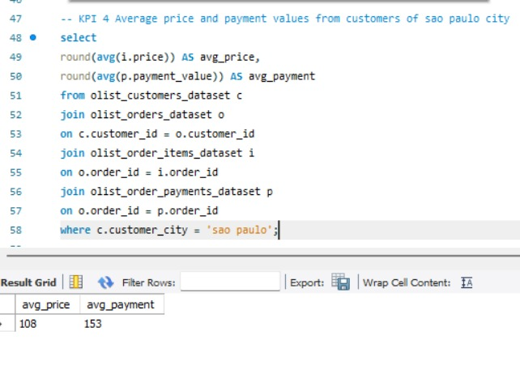
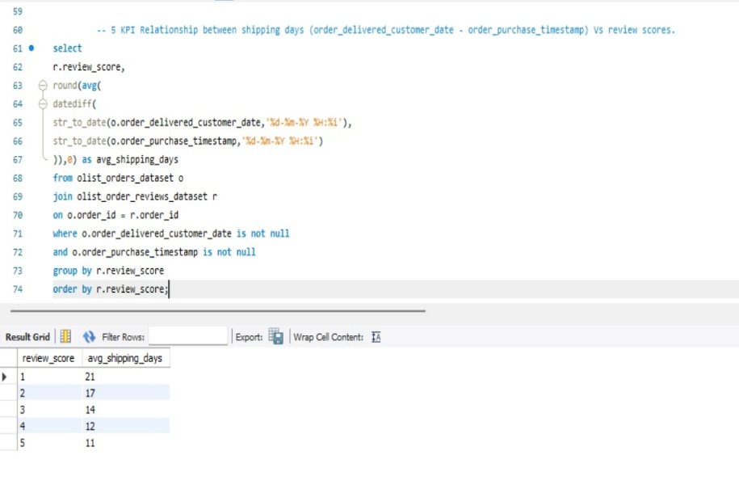
SQL Queries

Slide 17
Business Insights
Weekday transactions dominate, contributing around 78% of total payments, while weekends account for about 22%, showing customers prefer shopping on weekdays.
A large share of customers provide high review ratings, with approximately 61% of orders receiving 5-star reviews, indicating strong customer satisfaction.
The average delivery time is about 12.5 days, highlighting the importance of improving logistics and delivery efficiency.
Customers from São Paulo demonstrate higher purchasing activity, with payment values around 24% higher than the average product price.
Faster deliveries result in higher review scores, while delayed deliveries significantly reduce customer satisfaction.

Slide 18
Recommendations
Since around 78% of transactions occur on weekdays, businesses can introduce weekend promotions, discounts, or flash sales to increase weekend purchases.
As over 60% of credit card transactions receive 5-star reviews, maintaining secure and convenient digital payment options can strengthen customer trust and encourage repeat purchases.
The average delivery time of about 12.5 days indicates the need to improve logistics efficiency by optimizing shipping routes and delivery partnerships.
Customers from São Paulo show strong purchasing behavior, so businesses should focus targeted marketing campaigns and promotional offers in high-demand cities.
Implement better shipment tracking and communication systems to provide regular delivery updates and improve overall customer experience.

Slide 19
Business Impact
▪ Improved Sales Performance Weekend promotions and targeted campaigns can increase sales and balance transaction activity.
▪ Higher Customer Satisfaction Faster delivery times and efficient logistics improve the overall customer experience and review scores.
▪ Stronger Customer Trust Secure and convenient payment options encourage repeat purchases and long-term customer relationships.
▪ Better Marketing Strategies Focusing on high-demand cities like São Paulo helps businesses target customers with higher spending power.
▪ Improved Operational Efficiency Analyzing delivery performance helps businesses optimize logistics and reduce delays

Slide 20
Challenges faced
Handling Multiple Datasets The Olist dataset contains multiple tables such as customers, orders, payments, and reviews, which required proper joins and relationships.
Data Cleaning and Preparation Some fields contained missing values and inconsistent formats, requiring cleaning before analysis.
Complex Table Joins in SQL Combining multiple datasets using joins was necessary to extract meaningful insights.
Designing Clear Visualizations Creating dashboards that clearly communicate insights in Excel, Power BI, and Tableau required careful design.
Ensuring Accurate KPI Calculations Building KPIs such as average delivery time, review score analysis, and payment patterns required correct calculations and validation.

Slide 21
Conclusion
The Olist e-commerce data analysis provides valuable insights into customer purchasing behavior, payment patterns, delivery performance, and review trends.
The analysis shows that most transactions occur on weekdays, and credit card payments are associated with higher customer satisfaction and positive reviews.
Delivery time plays a critical role in customer experience, as faster deliveries tend to receive higher review scores.
Cities such as São Paulo contribute significantly to overall sales, highlighting the importance of focusing on high-demand regions.
Overall, improving logistics efficiency, delivery speed, and customer experience can help businesses increase customer satisfaction and drive better sales performance.

Slide 22

THANK YOU
Presented by: Group 1
Date: 16-03-2026

