Slide 1

HEALTHCARE DATA PIPELINE & ANALYTICS

Slide 2




AGENDA
Warehouse Design /
Dimension Modeling
Data Exploration /
Analysis
Business Implications
Background and
Dataset Description
Data Preparation /
ETL

Slide 3

BACKGROUND
BUSINESS PROBLEMS
Patient Profile Intelligence
Hospital Utilization Efficiency
Revenue & Billing Optimization
Medical Condition Analytics
Insurance Coverage Optimization

Slide 4

DATA WAREHOUSE DESIGN

Slide 5
DATASET DESCRIPTION
DATA GRAIN
FACTS
DIMENSIONS
One row per patient in the dataset will represent a unique patient encounter, capturing relevant information such as patient demographics, medical conditions, treatments, and outcomes for that encounter.
Hospital Encounter
HospitalEncounterID (PK)
PatientID (FK)
HospitalID (FK)
InsuranceProviderID (FK)
MedicationResult
LengthOfStay
BillingAmount
AmountPaid
AmountOwed
Patient
Hospital
Insurance Provider

Slide 6
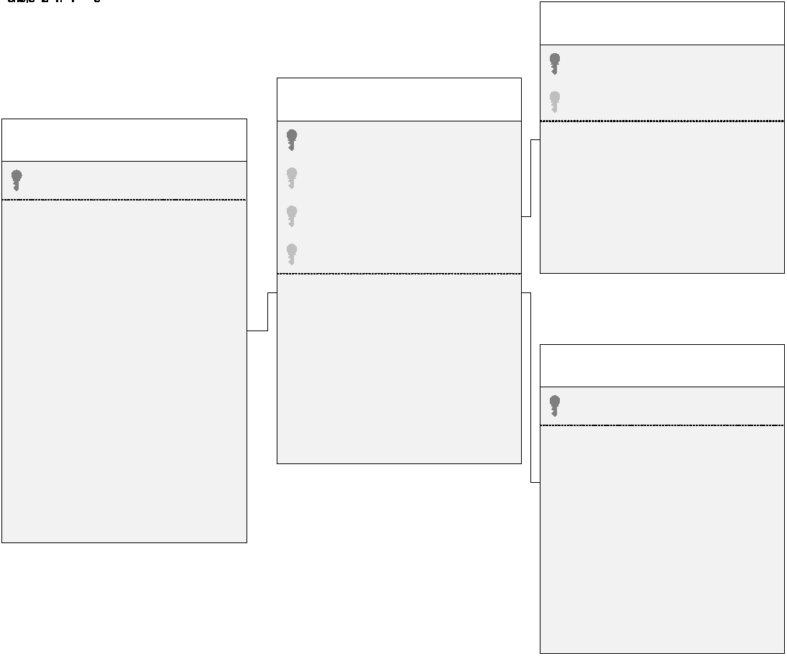
STAR SCHEMA

Slide 7
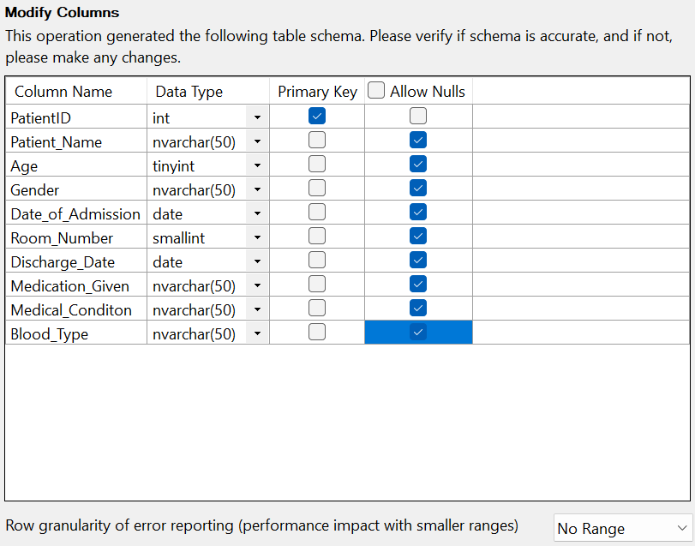
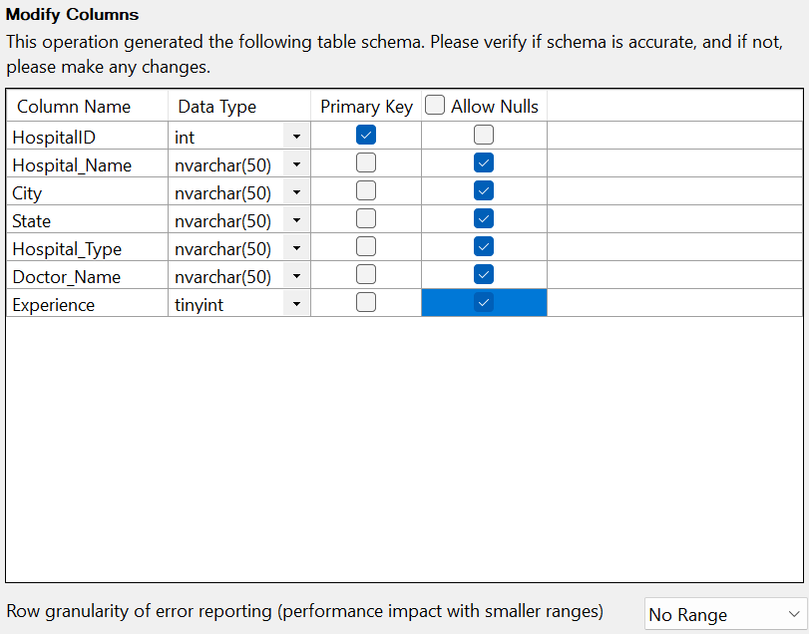
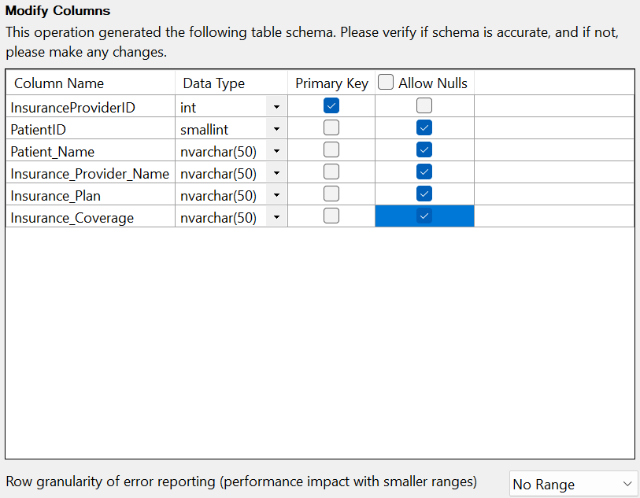
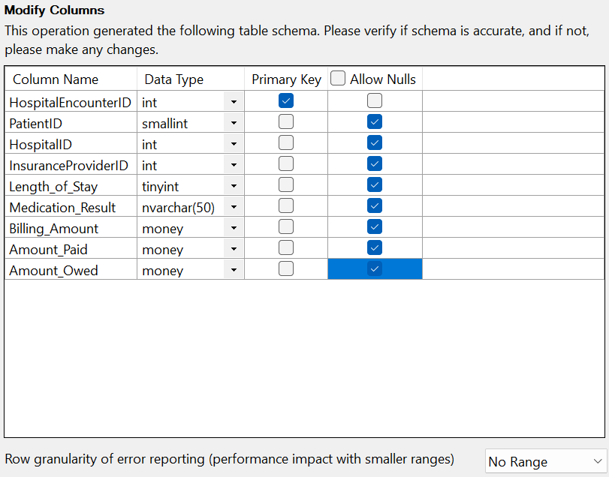
SSMS – IMPORTING FILES

Slide 8
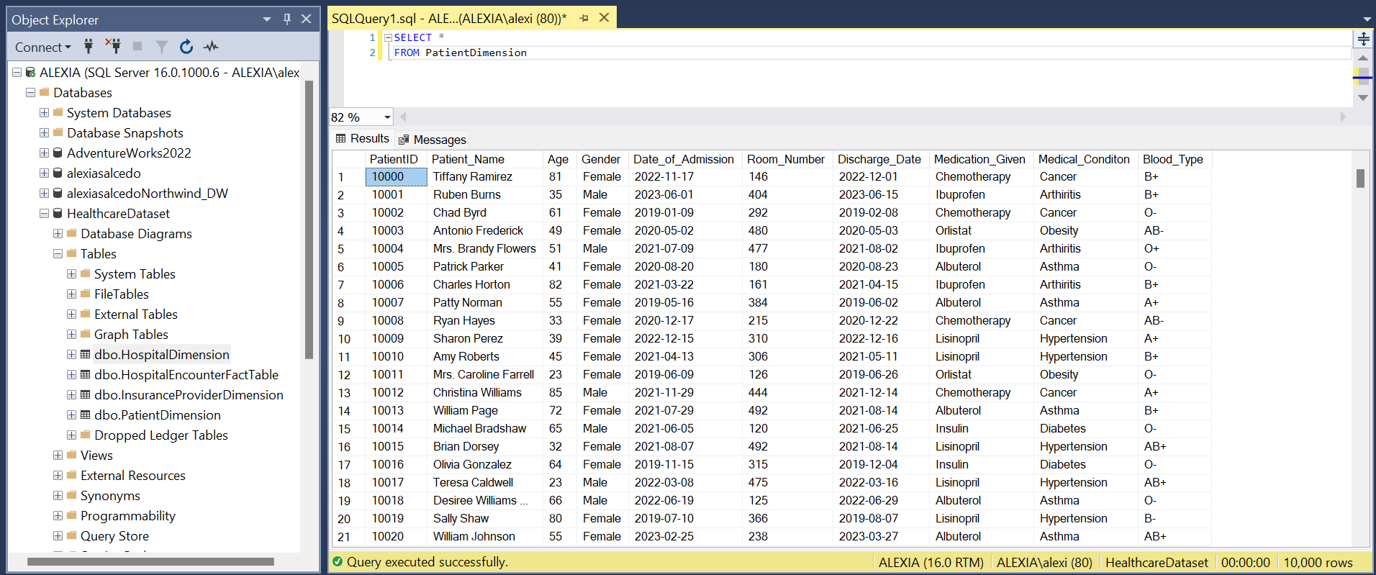
PATIENT DIMENSION

Slide 9
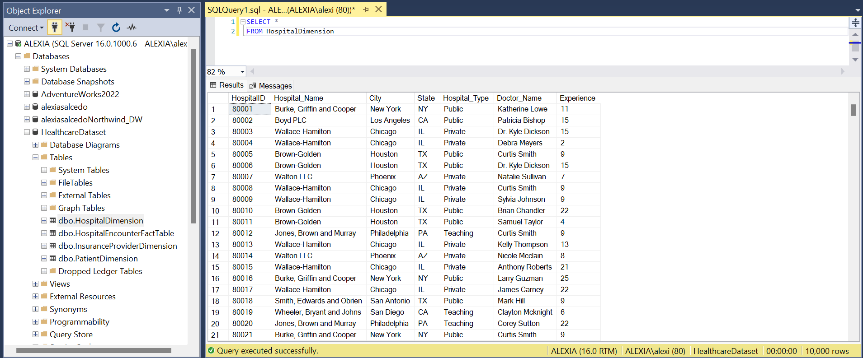
HOSPITAL DIMENSION

Slide 10
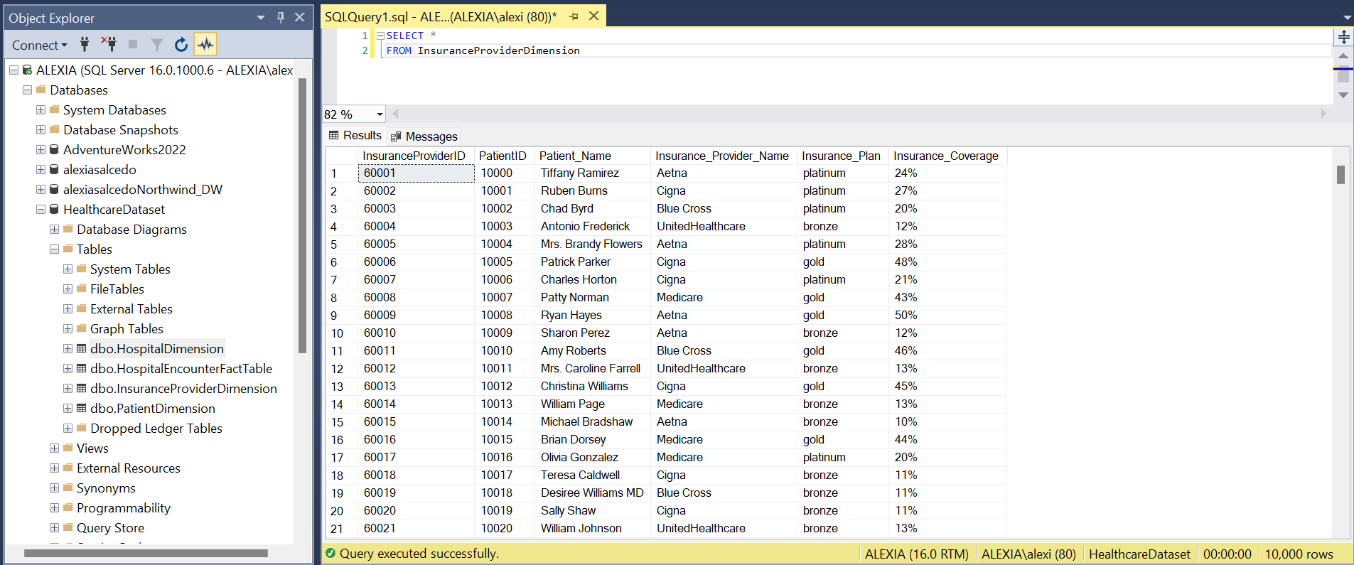
INSURANCE PROVIDER DIMENSION

Slide 11
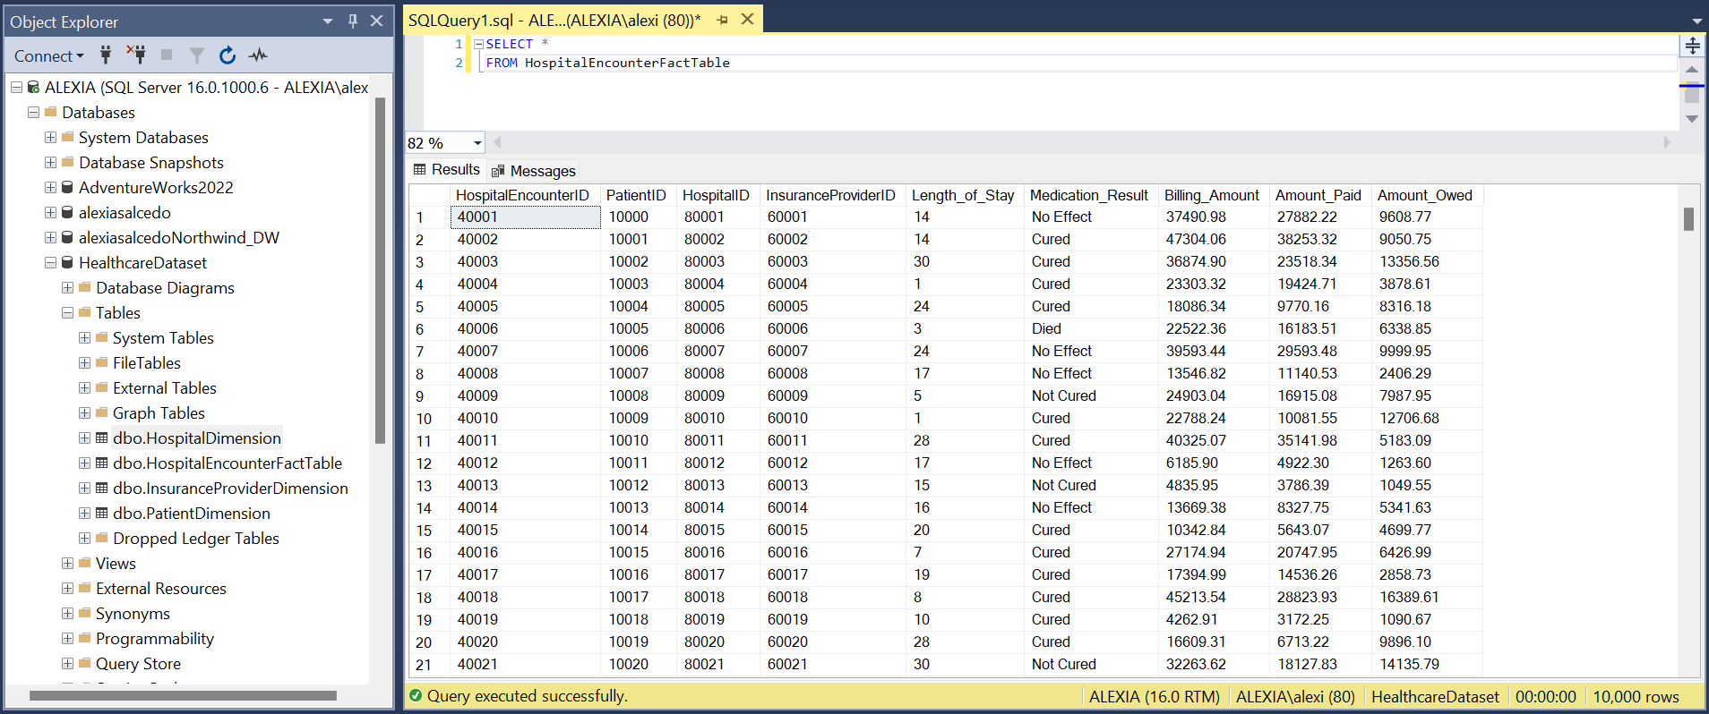
Hospital Encounter Fact Table

Slide 12
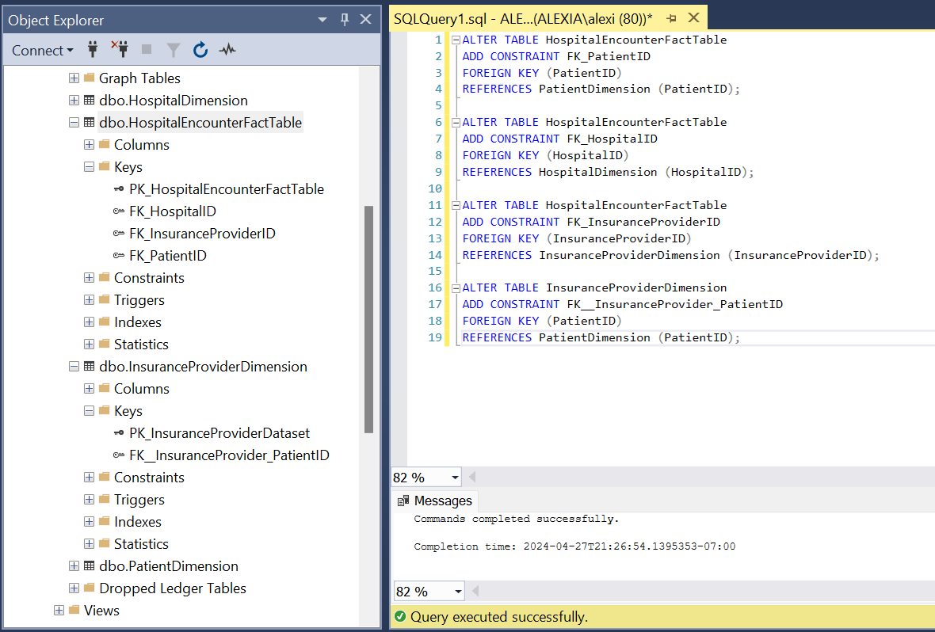
FOREIGN KEYS

Slide 13
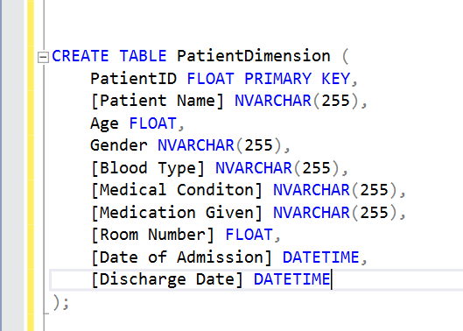
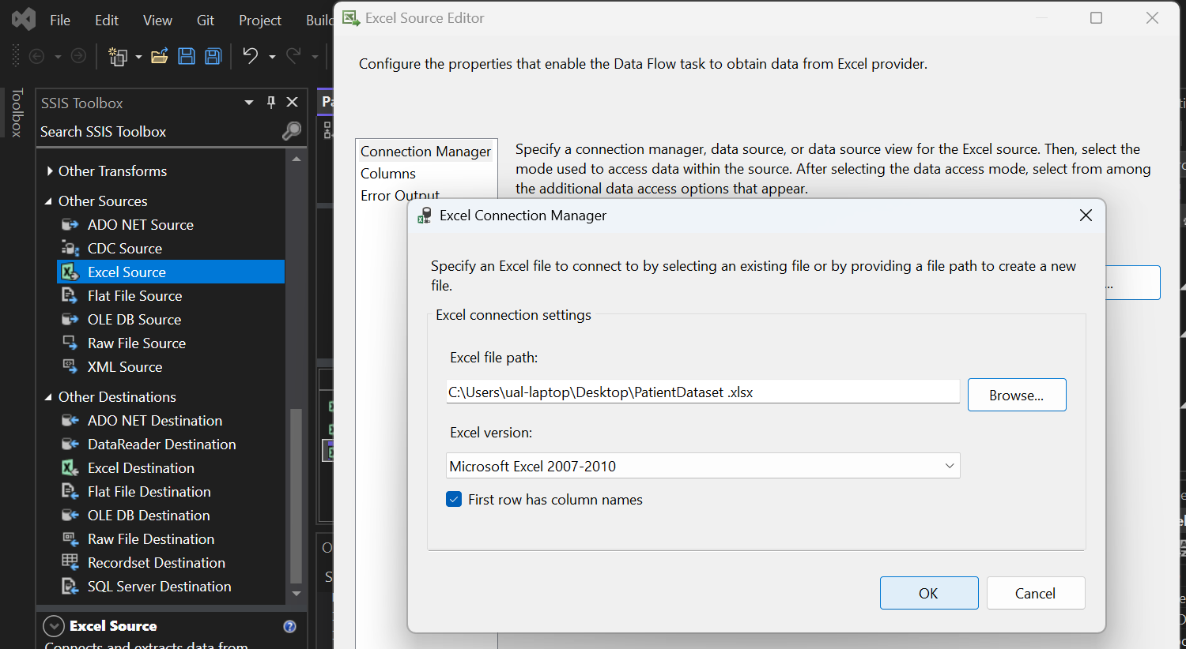
DATA WAREHOUSE IMPLEMENTATION

Slide 14
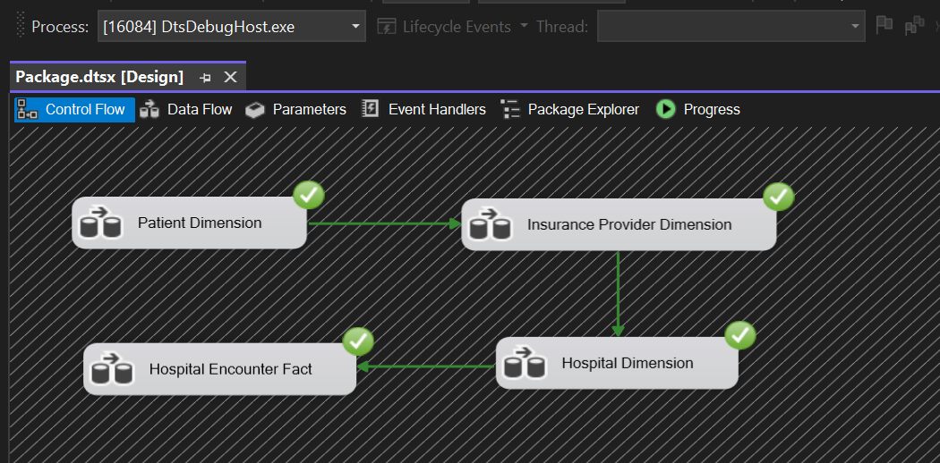
ETL CONTROL FLOW (SSIS)
Source: Excel File
Destination: Data Warehouse (SQL Server)

Slide 15

Exploratory Data Analysis
Descriptive Statistics
Data Preprocessing
Data Transformation
Visual Exploration

Slide 16
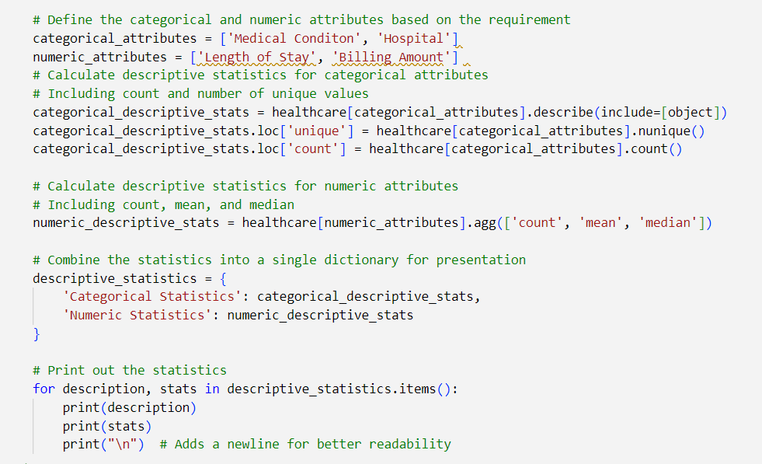
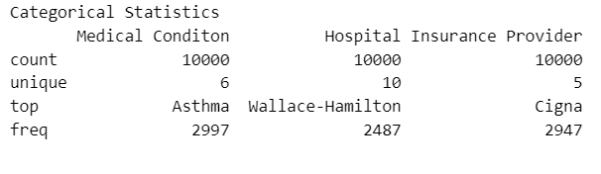
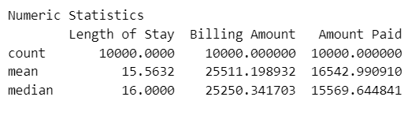
Descriptive Statistics

Slide 17
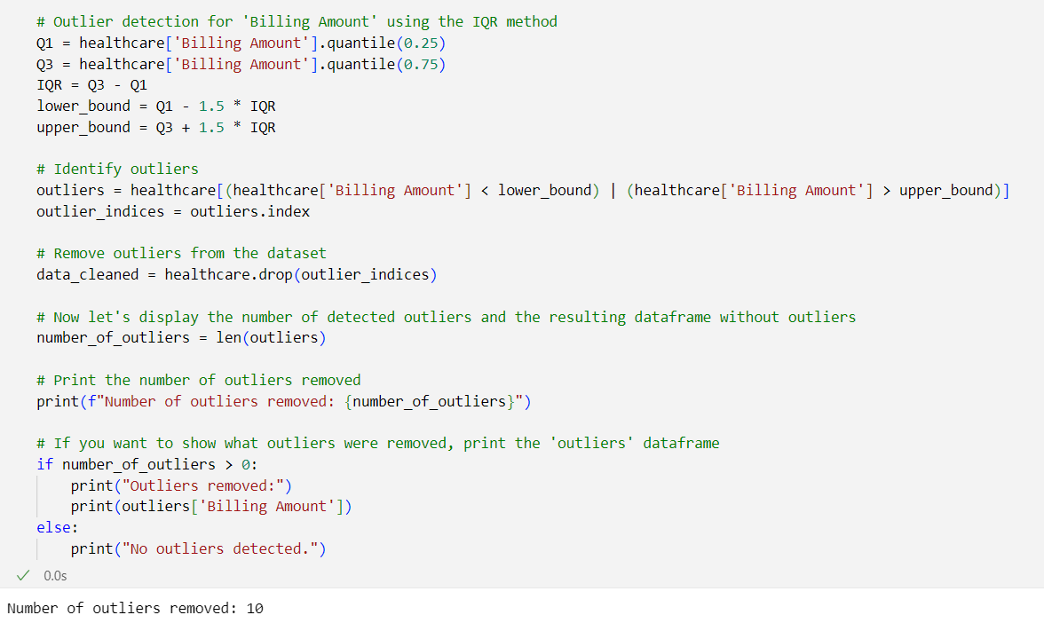
Data Preprocessing
Outlier Detection

Slide 18
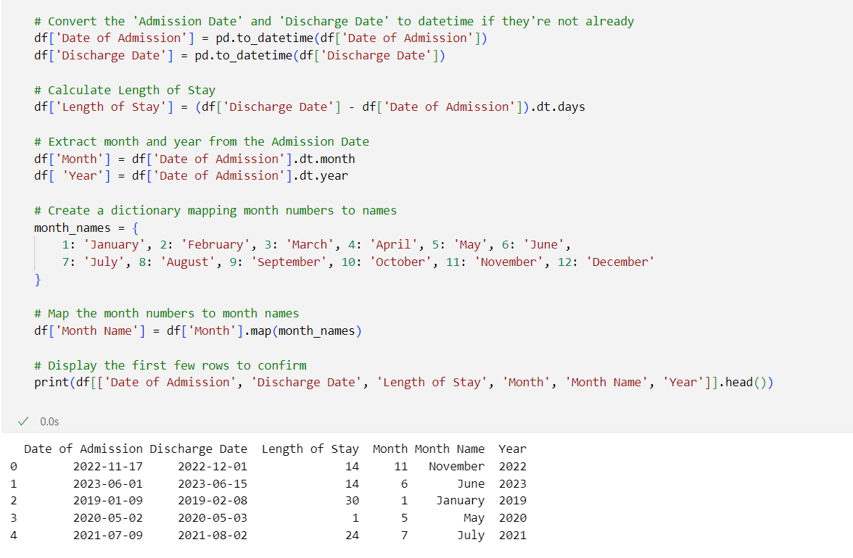
Data Transformation
Derived Columns

Slide 19
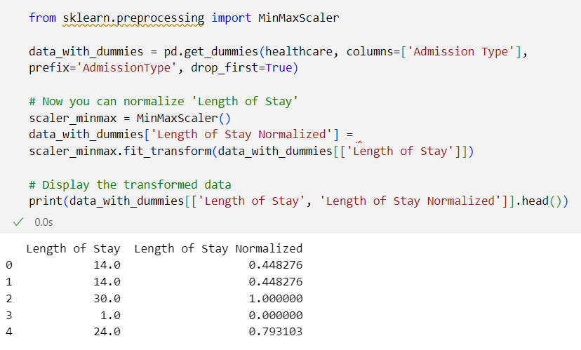
Data Transformation
Normalization of Length of Stay

Slide 20
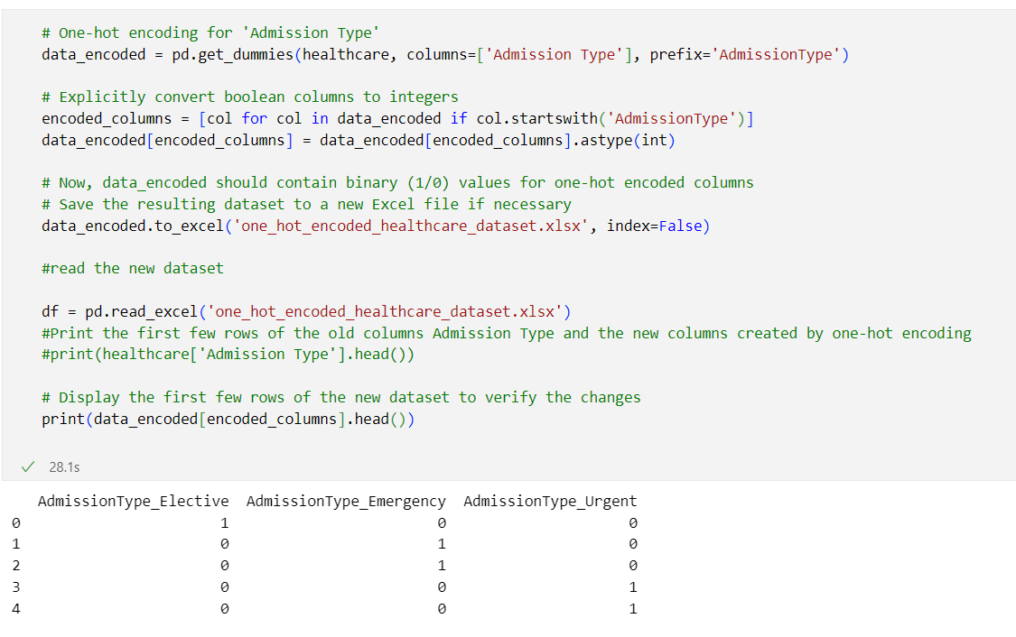
Data Transformation
One-hot Encoding for Admission Type

Slide 21
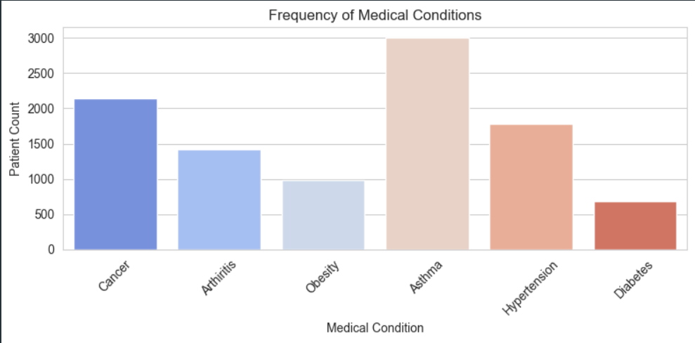
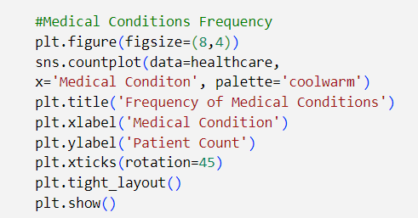
Visual Exploration

Slide 22
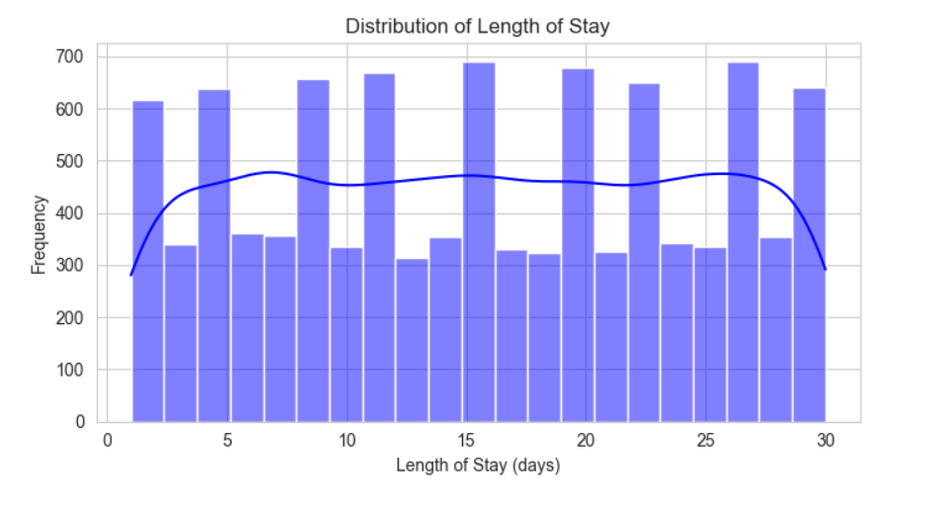
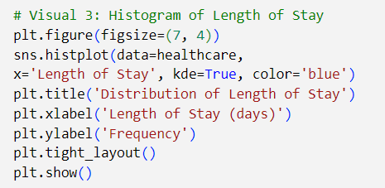
Visual Exploration

Slide 23
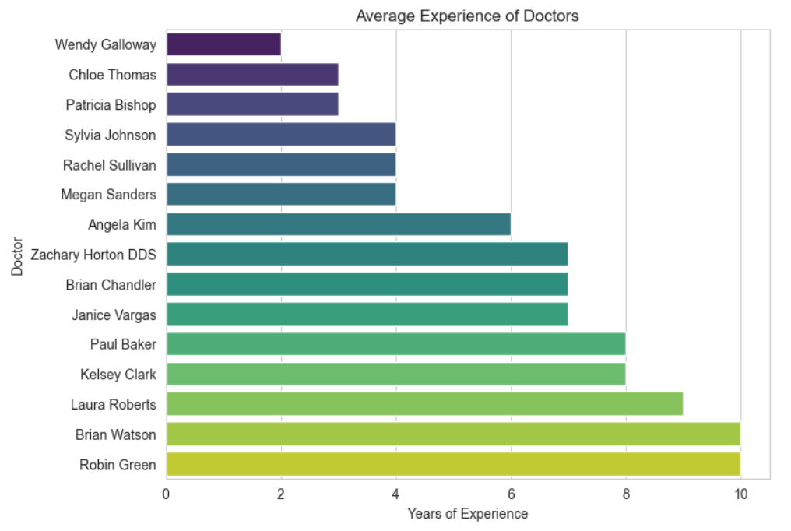
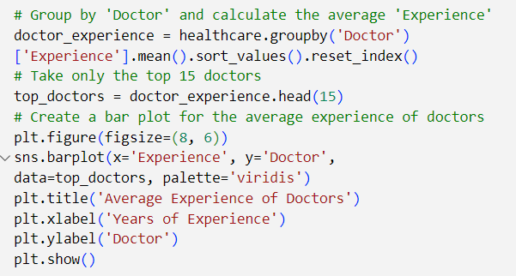
Visual Exploration

Slide 24

DATA ANALYSIS AND VISUALIZATIONS

Slide 25
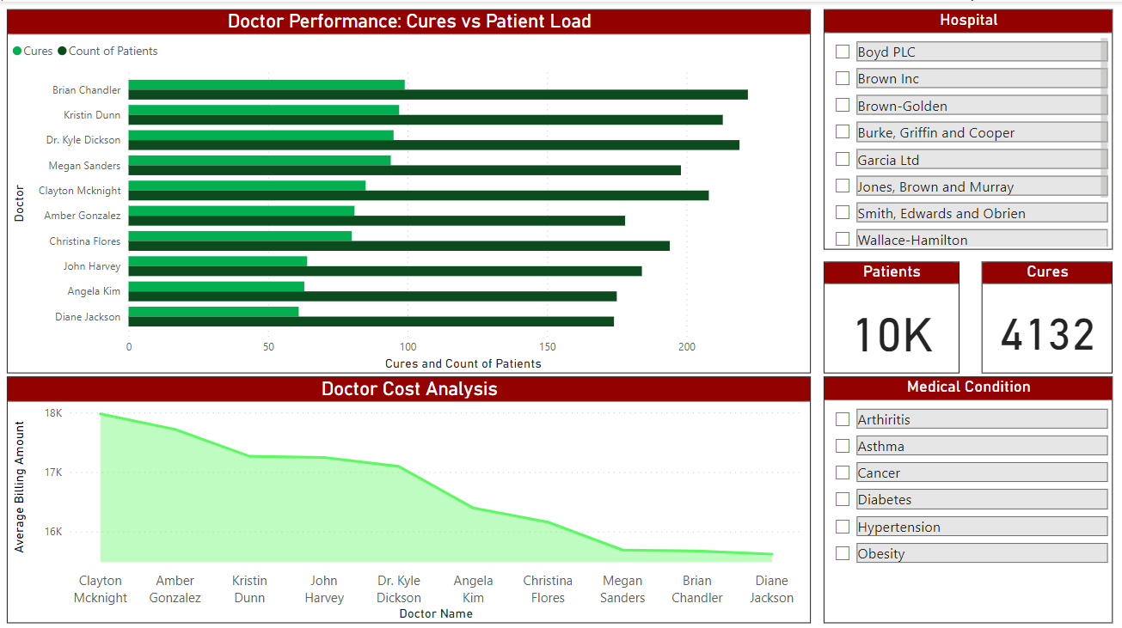

Data Analysis & Visualizations
Identification of top-performing doctors by analyzing recovery ratios
Analytical view into Cost of treatment per doctor
Notes:
Here are the two points, phrased effectively for presentation:
Optimizing Patient Outcomes: The dashboard enables identification of top-performing doctors by analyzing recovery ratios, which measures successful patient outcomes against total cases treated. This insight is pivotal for recognizing and replicating effective treatment approaches across the healthcare system.
Financial Efficiency in Patient Care: It provides an analytical view into the cost-efficiency of care per physician, revealing the economic impact of treatment methods. This helps in strategizing cost-effective healthcare while maintaining high-quality patient care standards.

Slide 26
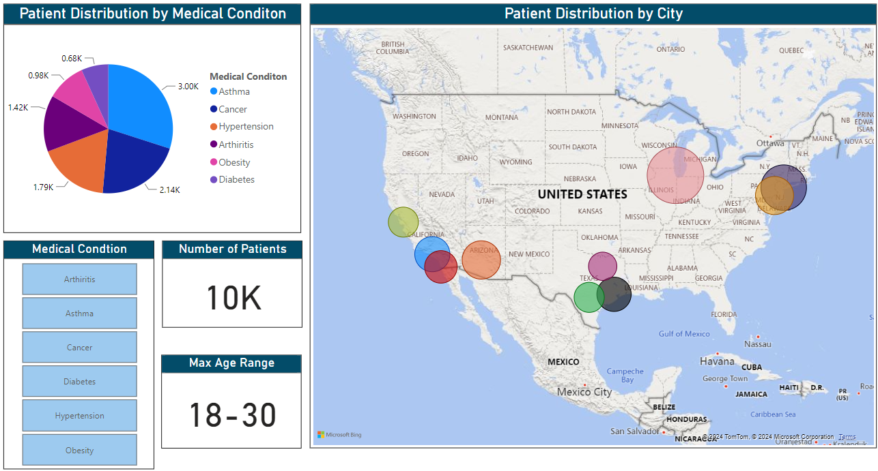
Data Analysis & Visualizations
Displaying patient load per city
Visual breakdown of patient distribution by medical condition
Identifying the maximum age range for patients per city and medical condition
Notes:
From this dashboard, we can articulate the following points:
Prevalence of Conditions: The pie chart offers a visual breakdown of patient distribution by medical condition, which can highlight the most prevalent health issues within the patient population. This information is crucial for healthcare providers to allocate resources and plan preventative care initiatives effectively.
Geographic Health Trends: The map illustrates patient distribution across different cities and hospitals, providing insight into regional health trends and the potential need for specialized services in certain areas. It also indicates the patient load on hospitals in various locations, which can inform resource distribution and staffing requirements.
Demographic Focus: By presenting the maximum age range for patients, the dashboard allows for a demographic analysis of the patient base, which can be used to tailor healthcare programs and outreach to specific age groups that are most affected by particular medical conditions.

Slide 27
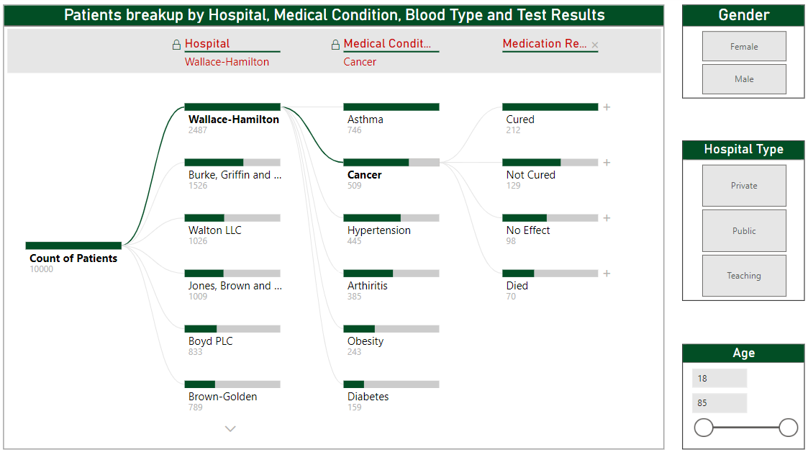
Data Analysis & Visualizations
Aggregating critical data points providing a comprehensive profile of patient demographics and medical history.
Notes:
For the dashboard displayed, focusing on patient demographics, medical conditions, and outcomes by hospital, here are three concise points:
Integrated Patient Profiles: The dashboard aggregates critical data points such as medical condition prevalence, blood types, and treatment outcomes, segmented by hospital, providing a comprehensive profile of patient demographics and medical history.
Outcome-Driven Resource Allocation: With visual filters for medical conditions and corresponding treatment results, the dashboard enables healthcare administrators to identify trends in treatment effectiveness and potential areas for resource reallocation or further medical training.
Targeted Treatment Strategies: Leveraging detailed breakdowns by blood type and gender, the dashboard empowers medical staff to develop targeted treatment strategies, enhancing personalized care and potentially improving patient outcomes.

Slide 28
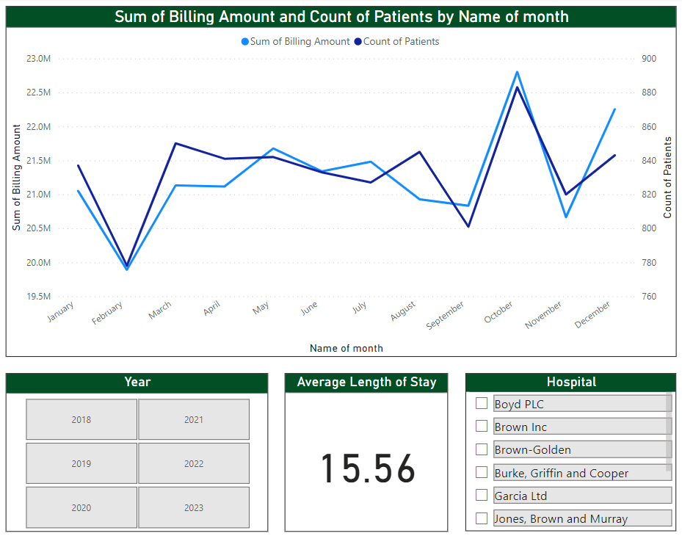
Data Analysis & Visualizations
Relationship between billing amounts and patient volumes over time
Highlights potential periods of high and low hospital utilization
Notes:
Based on the dashboard shown, here are three insights that could be drawn:
Billing and Volume Correlation: The line graph demonstrates the relationship between billing amounts and patient volumes over time, offering insights into operational trends, such as whether increased patient numbers correspond to increased billing.
Utilization Trends: By viewing patient count alongside billing data across months, the dashboard highlights potential periods of high and low hospital utilization, which can inform staffing and resource planning.
Efficiency Metrics: The "Average Length of Stay" metric provides a snapshot of hospital efficiency. A lower number might indicate effective patient throughput and resource utilization, while a higher number could suggest areas for process improvement.

Slide 29
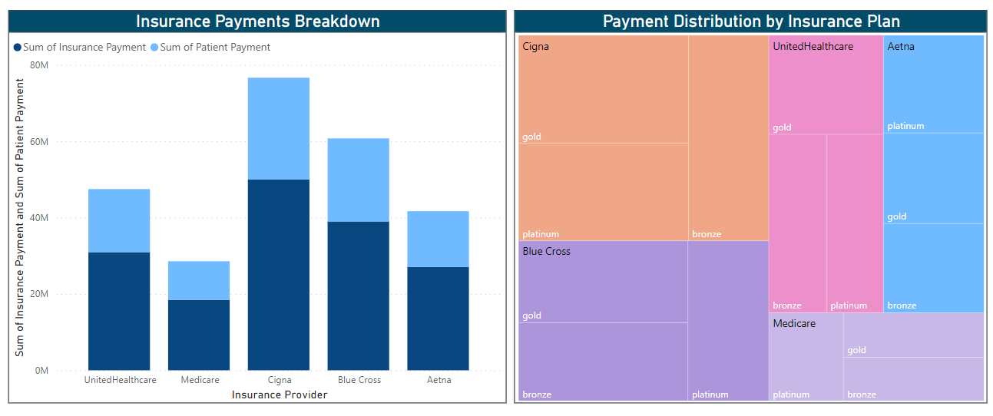
Data Analysis & Visualizations
Illustrates the comparative financial contributions made by patients and their insurance providers
Offers insights into which plans contribute most within the insurance provider
Notes:
Based on the visualizations in this dashboard, here are three succinct insights:
Payment Contributions: The bar chart illustrates the comparative financial contributions made by patients and their insurance providers, showcasing which entities bear the greater cost burden.
Insurance Plan Comparison: The treemap highlights the distribution of payments across different insurance plans within each provider, offering insights into which plans contribute most to the revenue and may hint at the popularity or coverage levels of different plans.
Provider Payment Patterns: The combined analysis of both visuals could inform strategies for negotiating with insurance providers, based on their payment patterns and the distribution across various insurance plans.

Slide 30

PREDICTIVE MODELLING

Slide 31
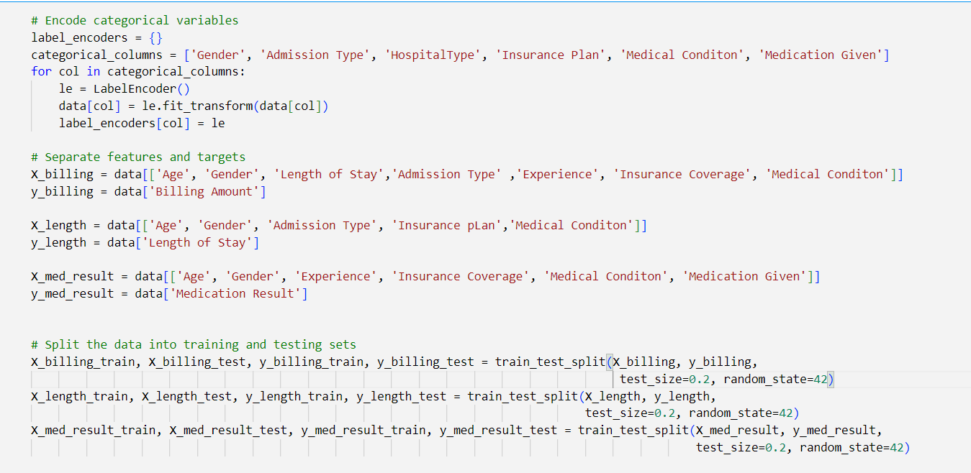
Predictive Modelling
Regression models trained on 10,000 patient records to predict key operational metrics:
Billing Amount
Length of Stay

Slide 32

Predictive Modelling

Slide 33
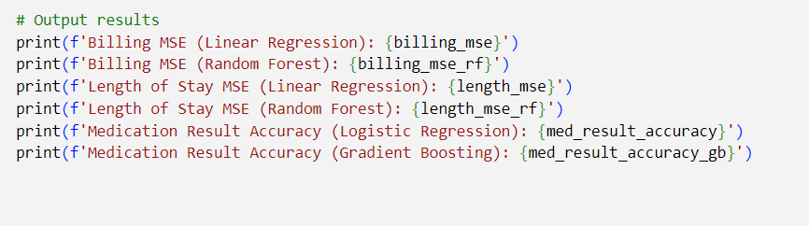
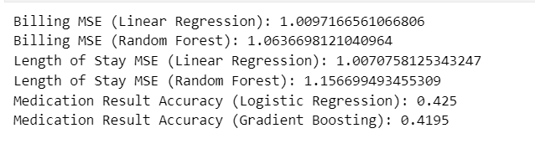
Predictive Modelling

Slide 34

BUSINESS IMPLICATIONS

Slide 35



Business Implications
City-Wise
Medical Conditions
Doctor Reputation
Estimate Expenses
Enables administrators to identify top-performing doctors and optimize workload distribution
Helps patients select doctors based on recovery rates and treatment outcomes
STAKEHOLDERS:
Healthcare Administrators
Patients
Enables patients to estimate billing costs based on condition and insurance coverage
Gives hospital management revenue insights segmented by condition and demographics
STAKEHOLDERS:
Patients
Hospital Management
Identifies geographic hotspots for specific medical conditions
Empowers policymakers to design targeted preventative care initiatives
Supports hospital infrastructure and capacity planning by condition type
STAKEHOLDERS:
Clinicians and Healthcare Providers
Government agencies and policymakers

Slide 36



Business Implications
Relationship Between Medical Attributes
Resource
Planning
Insurance Provider Analysis
Reveals correlations between demographics and medical conditions to guide targeted preventative care strategies
Helps clinicians identify trends and educate patients on risk factors
STAKEHOLDERS:
Patients
Doctors/Medical Staffs
Patient volume trends reveal seasonal patterns for proactive resource planning
Seasonal variations inform staffing, financial planning, and operational efficiency
STAKEHOLDERS:
Insurance Providers
Operations Managers
Provides insurance providers expense visibility by location and condition
Directly informs the design of competitive and targeted healthcare plans
STAKEHOLDERS:
Insurance Providers
Patients

Slide 37

THANK YOU

