Slide 1

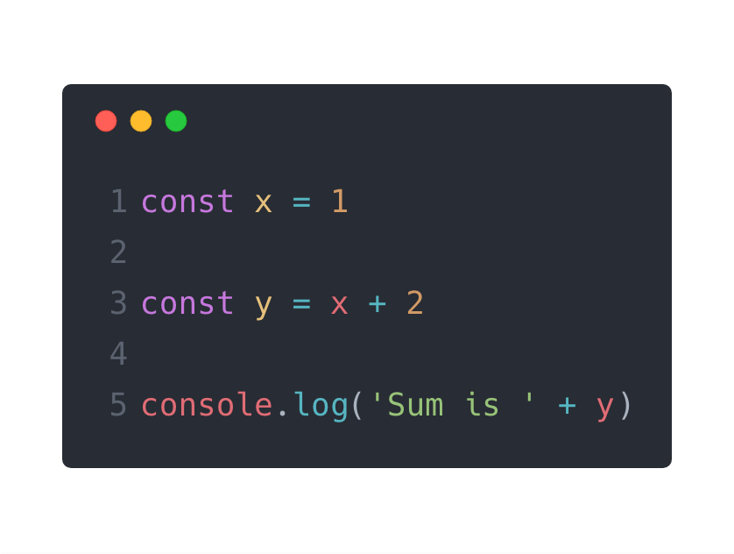
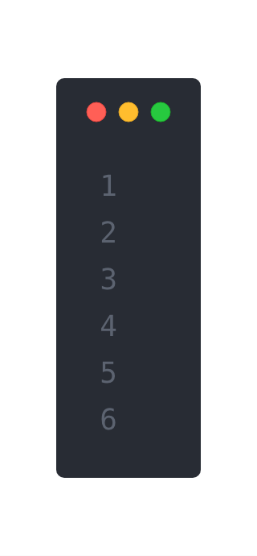

The V8 JavaScript Engine
Asynchronous Node.js
Call Stack
Node APIs
log('Sum is 3')
main()
Sum is 3
Event Loop
Callback Queue

Slide 2
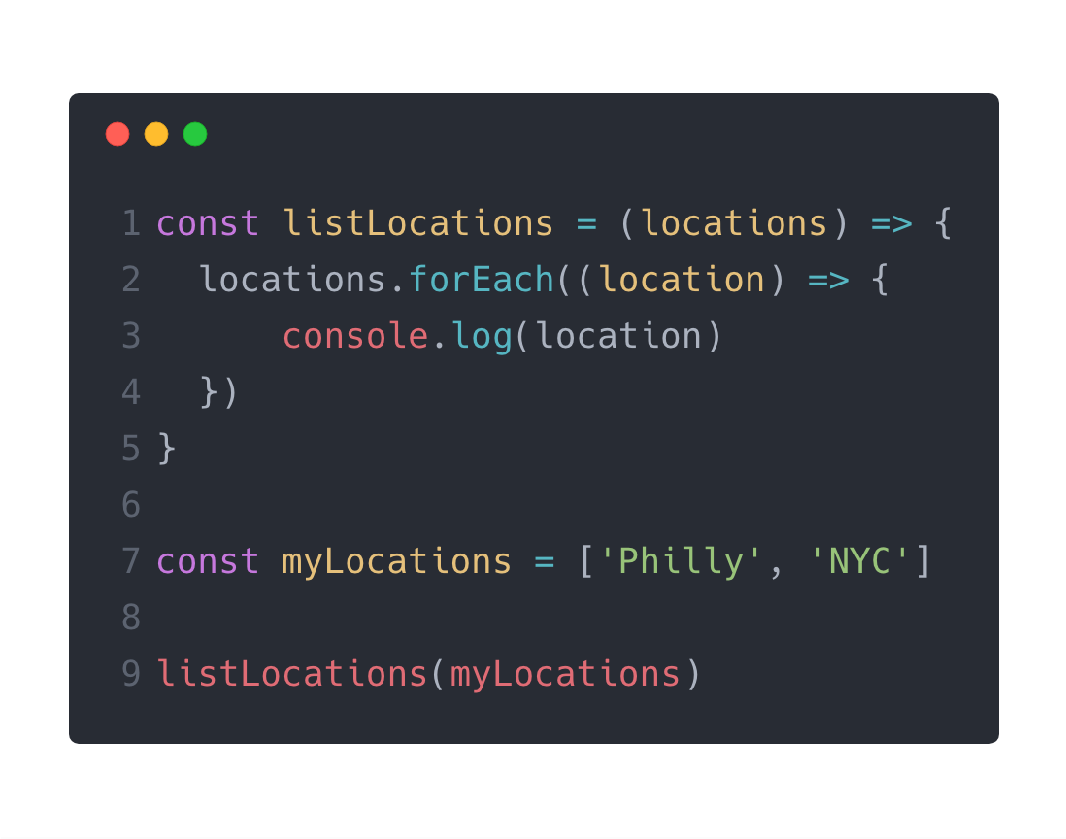
The V8 JavaScript Engine
Asynchronous Node.js
Call Stack
Node APIs
console.log('NYC')
console.log('Philly')
anonymous('NYC')
anonymous('Philly')
forEach(...)
listLocations([...])
main()
Philly
Event Loop
NYC
Callback Queue

Slide 3
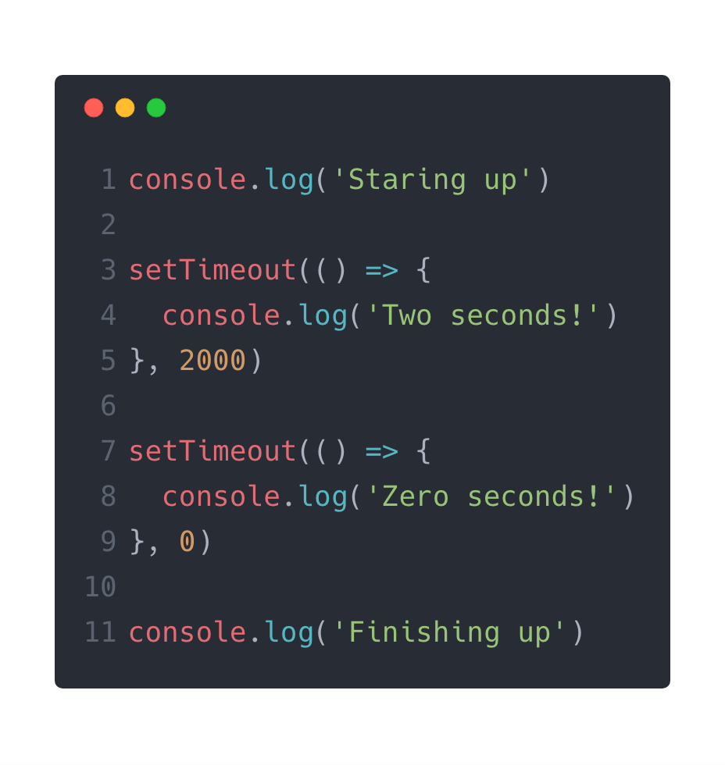
The V8 JavaScript Engine
Asynchronous Node.js
Call Stack
Node APIs
setTimeout (2 sec)
setTimeout (0 sec)
console.log('Two...')
setTimeout(..., 2000)
setTimeout(..., 0)
console.log('Zero...')
console.log('Fin...')
console.log('Sta...')
main()
Starting up
Event Loop
Finishing up
Zero seconds!
Callback Queue
Two seconds!
Callback (0 sec)
Callback (2 sec)

