Slide 1
Lilac

Slide 2
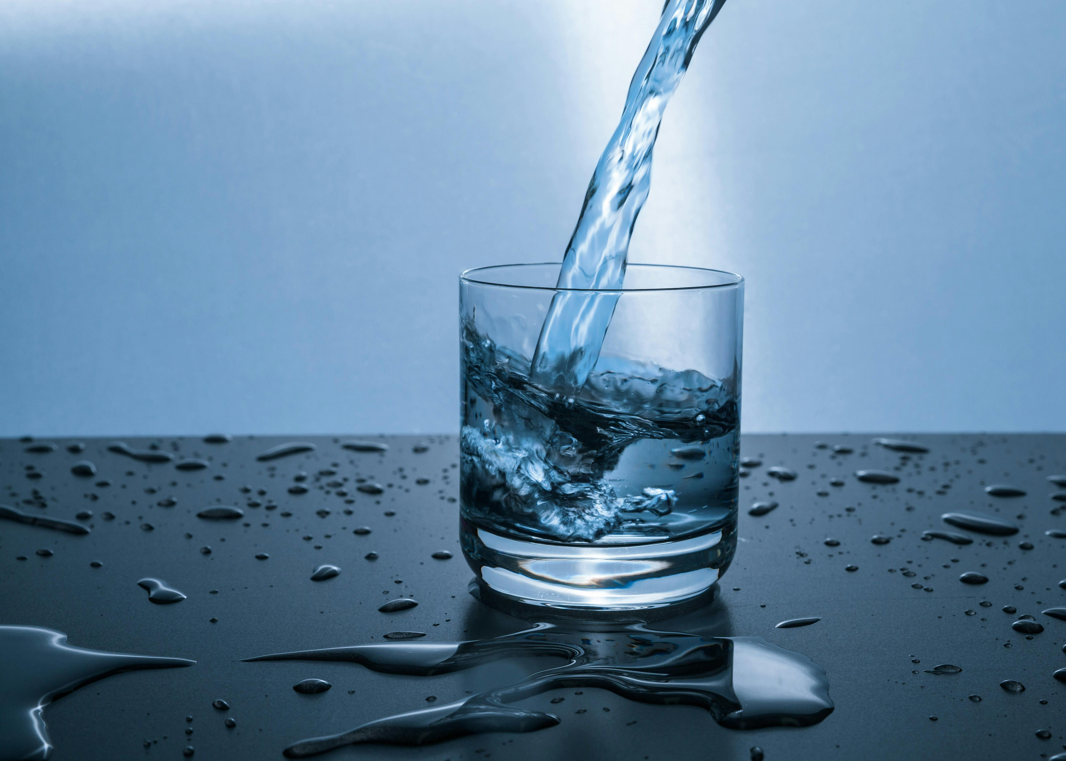
Question: What is the chemical symbol for water?
Answer: H2O

Slide 3
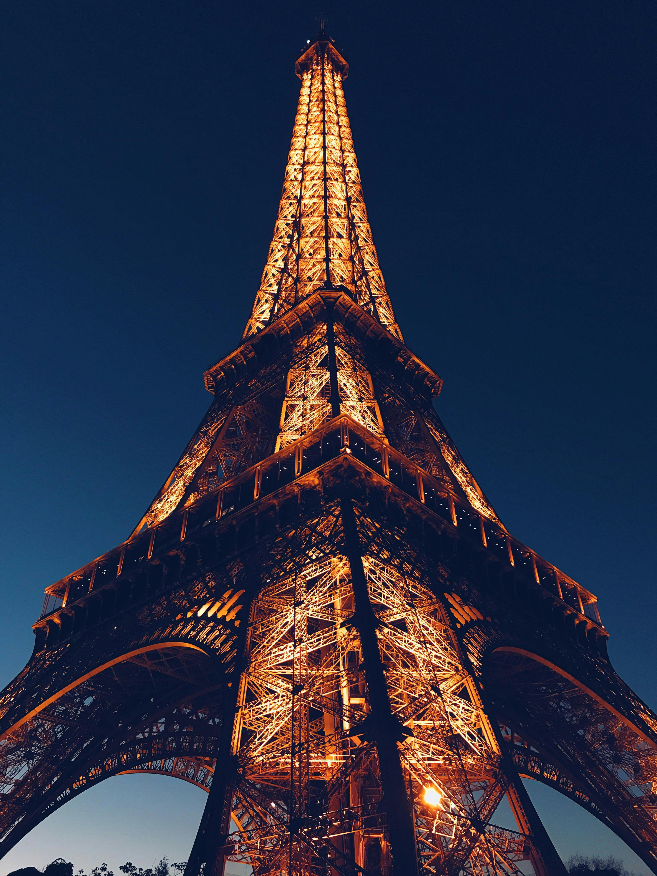
Question: What is the capital of France?
Answer: Paris

Slide 4
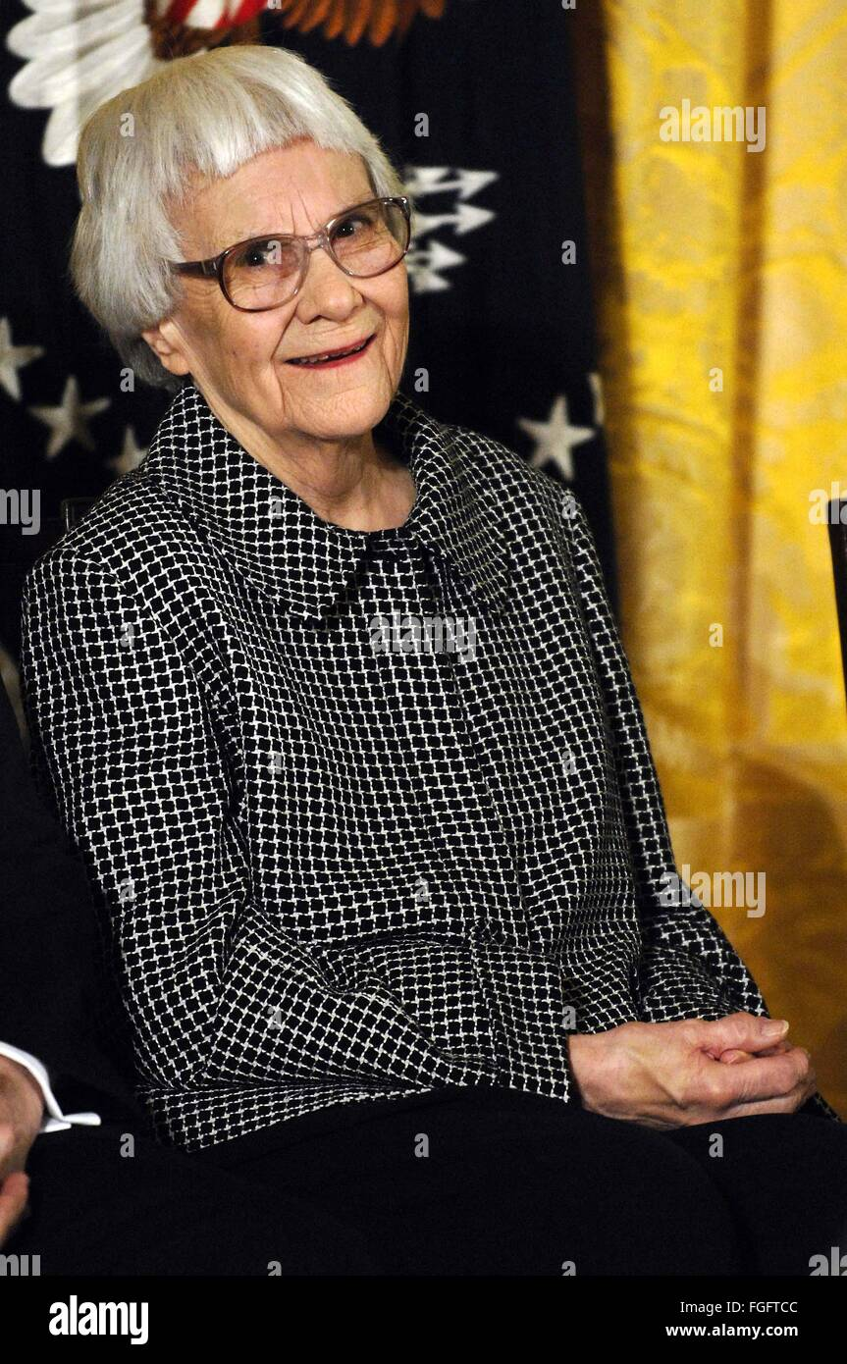
Question: Who wrote 'To Kill a Mockingbird'?
Answer: Harper Lee

