Slide 1
MINOR PROJECT
Music player Web App
Submitted by:
Rohan Gupta 0901CS201101
Soumya Dantre 0901CS201125

Slide 2
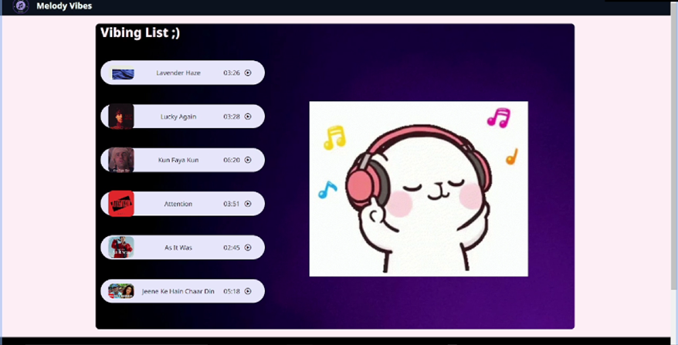
MUSIC PLAYER APP
In this we can play our favorite songs in
an interactive way .
This web app is built using html ,css ,javascript.

Slide 3

Features
In this Music player, user can add their reviews about any song they wanted to.
There is an interactive play and pause button which shows up animation on interaction.

Slide 4
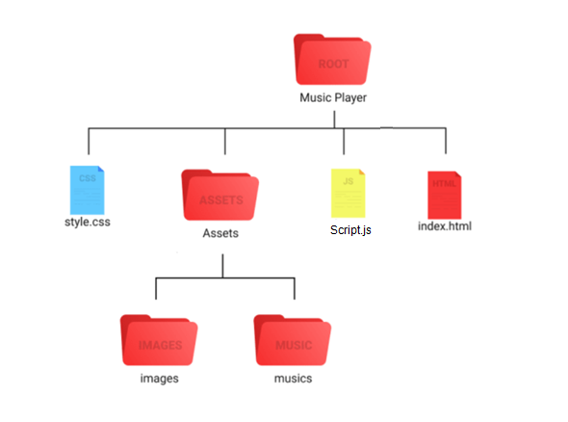
HIERARCHY

Slide 5

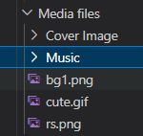
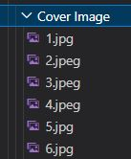
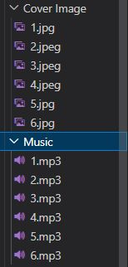
index.html contains our Html code.The HTML layout defines the element structure that would be shown on the page.
style.css contains styling for our web page.Using CSS we can style the different portions to make it more visually appealing.
script.js contains all the logic. The logic of the player is defined in the JavaScript file.
There are several functions that work together to handle all the functions of the player.

Slide 6

Video

Slide 7
THANK YOU

