Slide 1
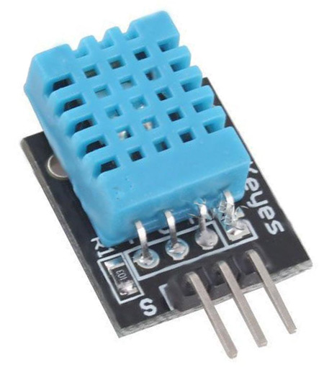
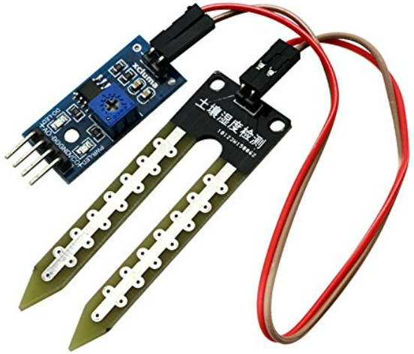
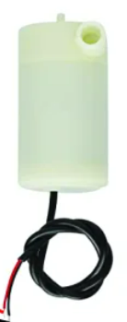
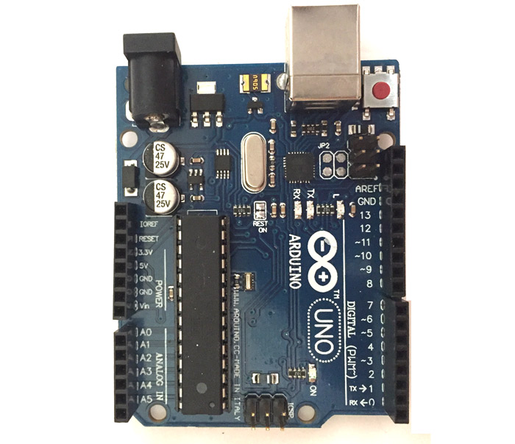
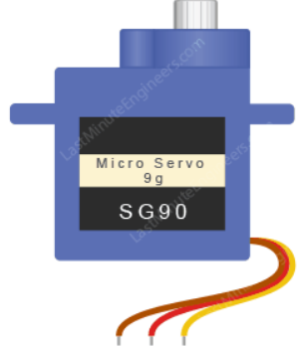
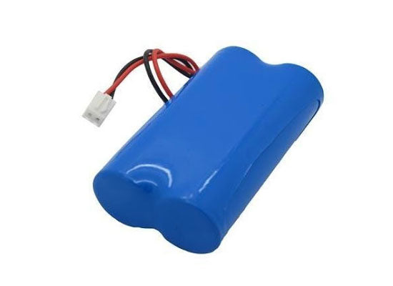
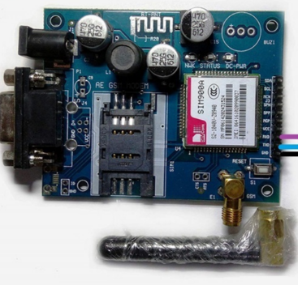
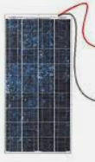

DHT11 sensor
Arduino UNO R3

Slide 2
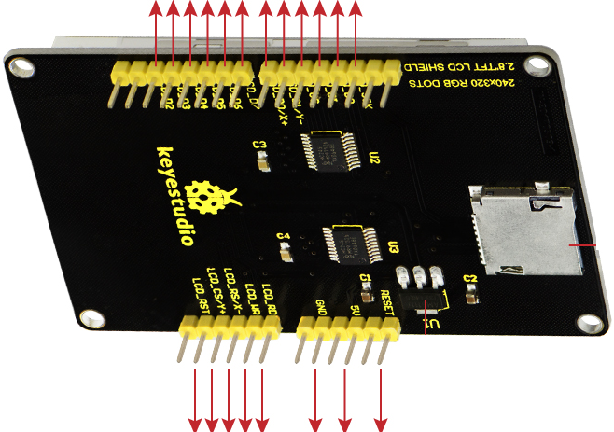
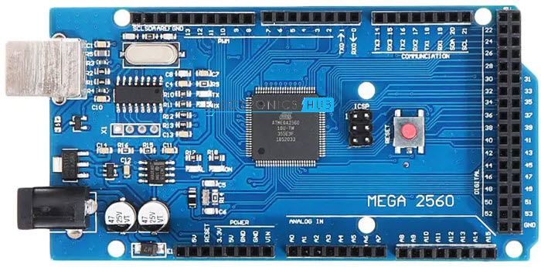
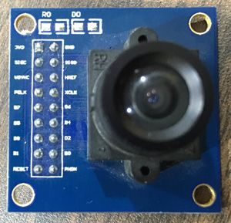
Arduino Mega 2560
680
1K
TFT 3.3 inch LCD Display with shield
OV7670 camera module
10k
10k

Slide 3
Arduino Mega 2560
Mobile application development
PIR sensor
OV7670 cam module
Arduino UNO R3
Smart Baby Bassinet
Sound Detector Sensor
TFT 3.3inch LCD display
Online Doctor consulting System
Temperature & Humidity sensor
Piezoelectric sensor

