Slide 1
Burger Grills-India’s best Burger Restaurant
An online website that sells burgers. It suggests users to not only customise their burgers by adding or removing ingredients but also create their own burgers by adding ingredients in stock.

Slide 2
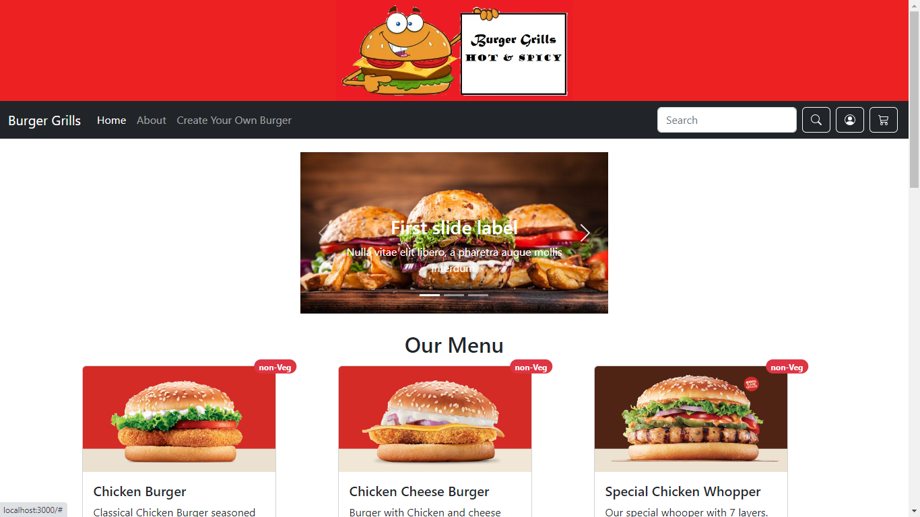
Home Page

Slide 3
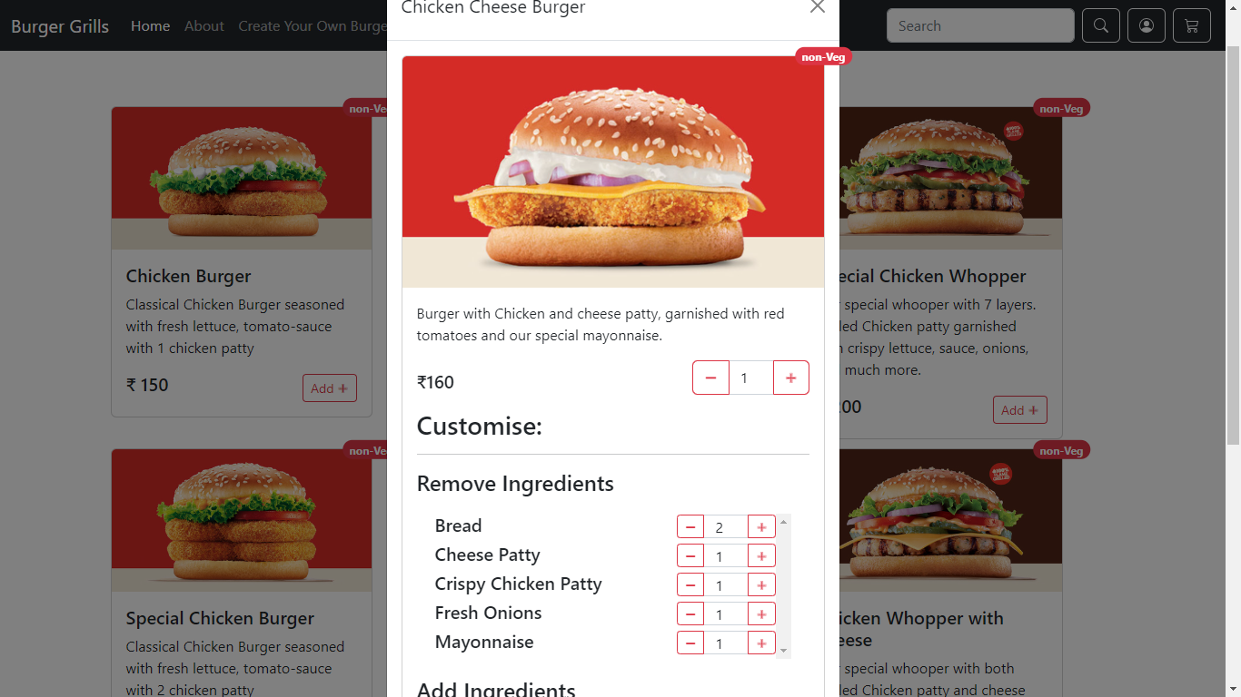
Modal for customising a burger

Slide 4
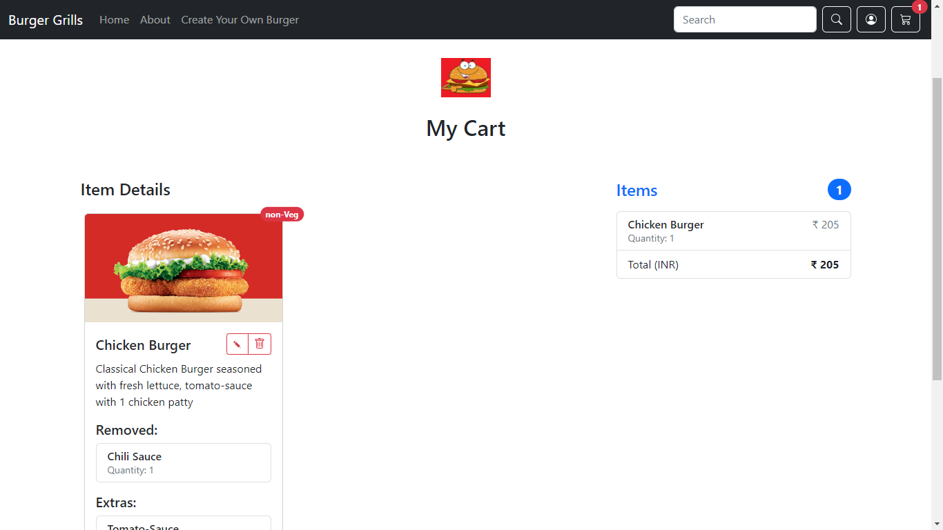

Slide 5
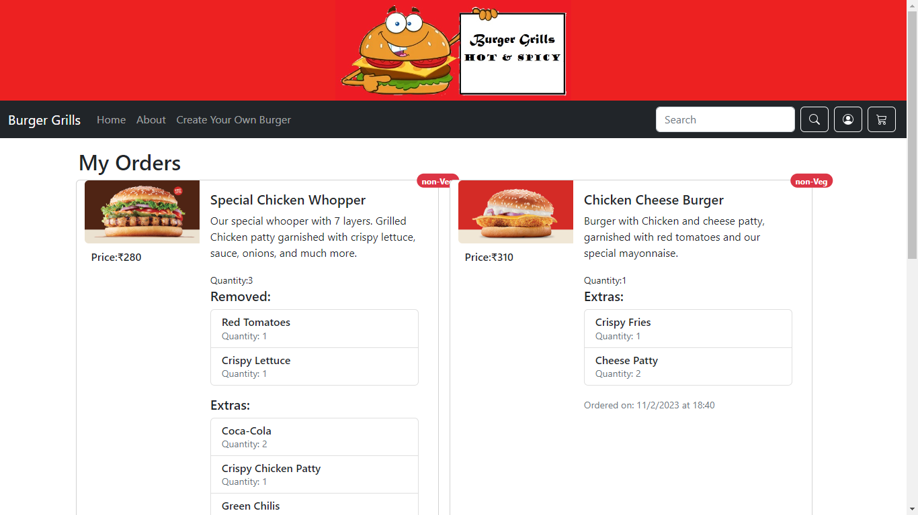

Slide 6
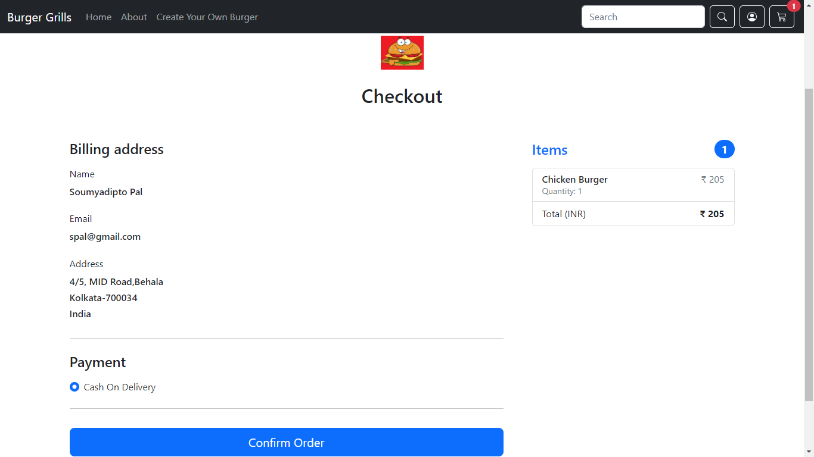

Slide 7
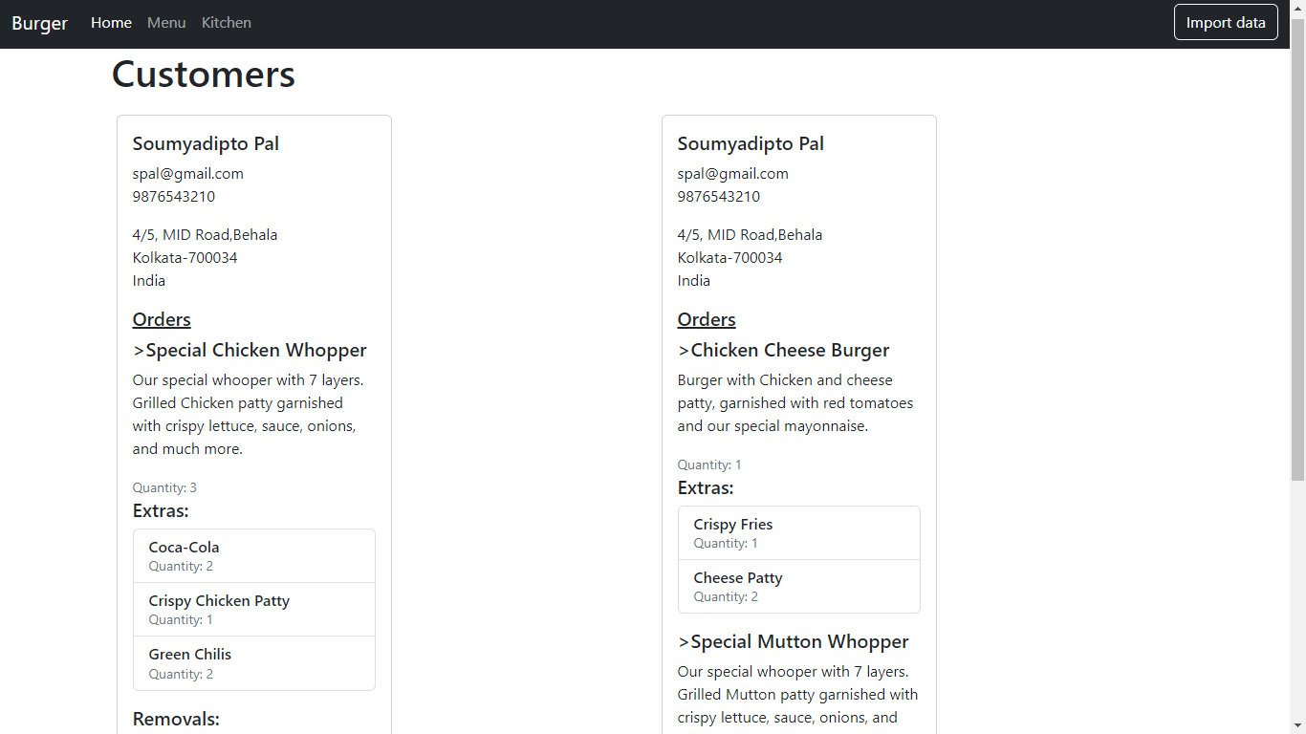
Home page of My admin

Slide 8
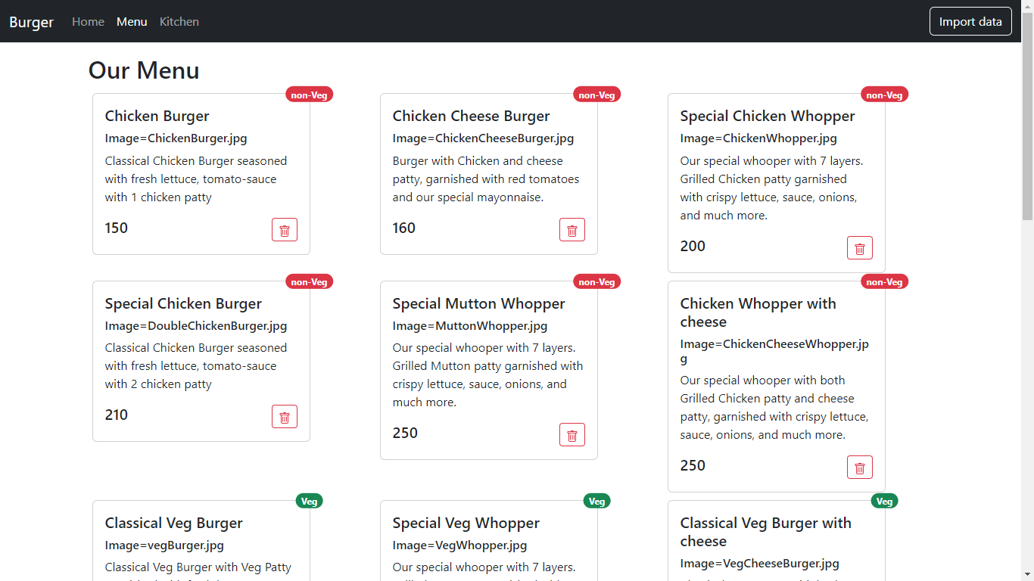

Slide 9
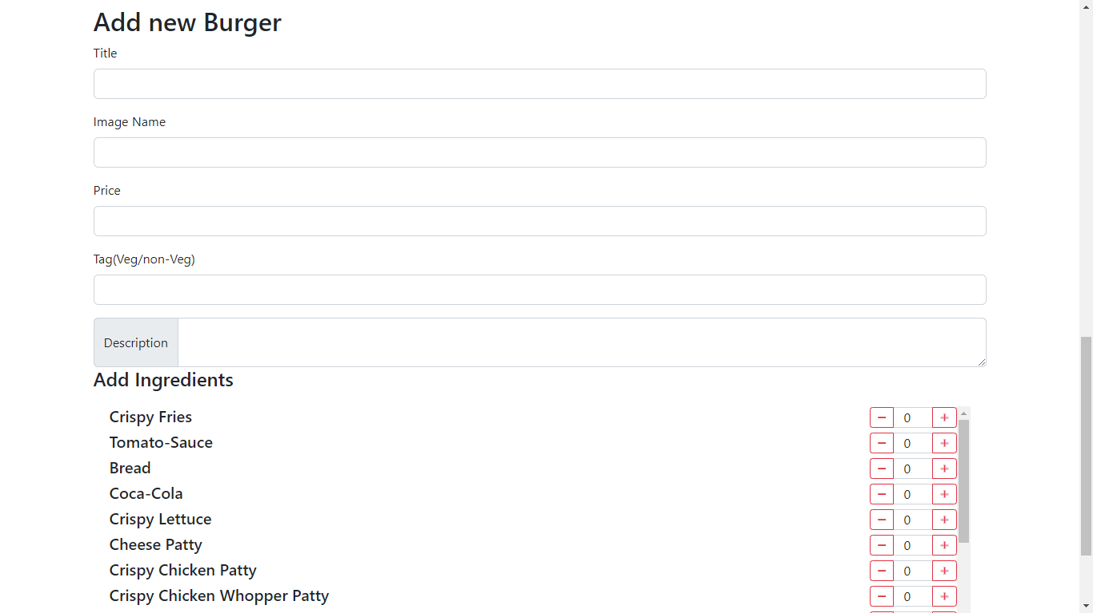

Slide 10
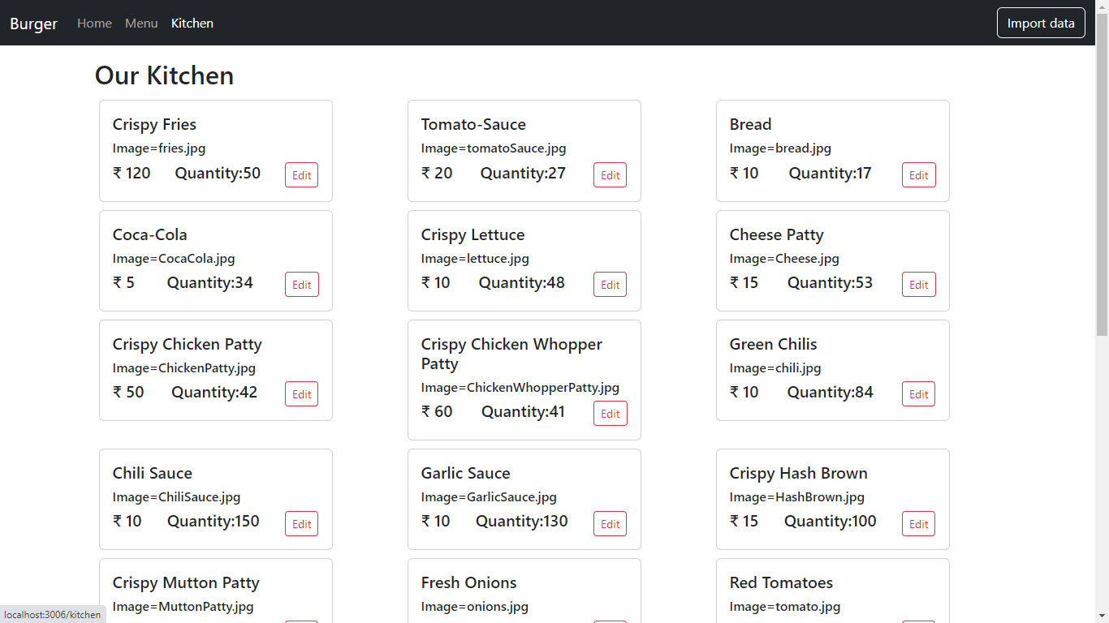

Slide 11
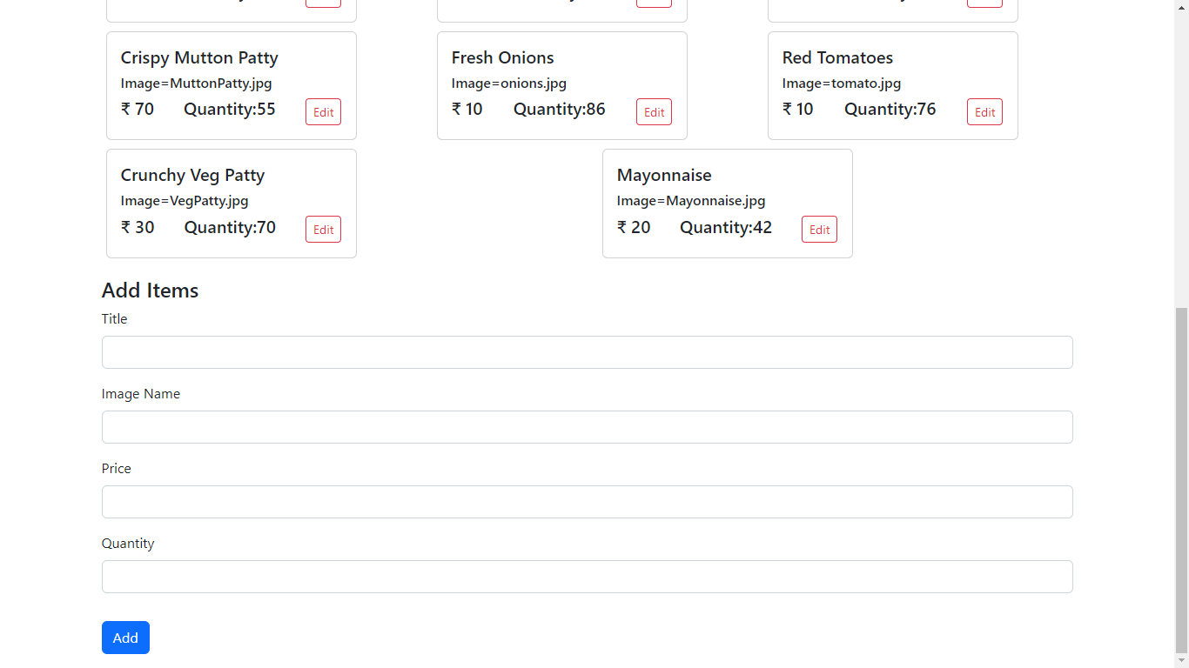

Slide 12
Thank
You!

